Slide 1
The Dark Menace: Characterizing Network-based Attacks in the Cloud
Rui Miao Rahul Potharaju
Minlan Yu Navendu Jain
(authors are unavailable to attend;
talk presented by John Heidemann, USC/ISI)

Slide 2
Cloud, Big… and Cloud Attacks, Bad
The market for cloud computing is growing
Reached $40 billion in 2014; 23%-27% growth YoY
Notes:
The cloud computing market is growing at a fast pace – it reached $40 billion last year and is growing at a rate of about 25% per year.
At the same time, it is becoming attractive for attackers as it hosts thousands of applications and services.
On one hand, attackers can launch inbound attacks to disrupt services and steal user data. For instance, in 2013, attackers hacked Apple, Facebook and Microsoft’s internal networks impacting more than 50 different services.
On the other hand, cloud offers renting of a large set of resources at a low cost – attackers can exploit this setup or they can compromise VMs to launch attacks against external sites. For example, in 2011, an attack on the Sony Playstation network compromised more than 100 million customer accounts. It was carried out by a malicious service hosted on Amazon EC2.
The bottom line is that as cloud computing continues to grow, this problem is going to become more challenging and we need a solid understanding of these attacks to defend against them.

Slide 3
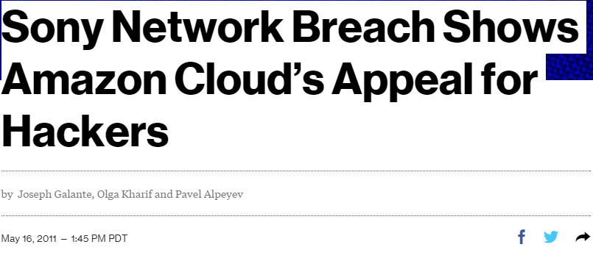
Cloud, Big… and Cloud Attacks, Bad
The market for cloud computing is growing
Reached $40 billion in 2014; 23%-27% growth YoY
Cloud becoming an attractive target for attacks
inbound :
from Internet
into cloud
In 2013, an attack caused 50+ services to go offline
outbound:
from cloud to Internet
In 2011, 100+ million customer accounts compromised
Notes:
Cloud computing market becomes very huge right now and has reached $40 billion last year, with a rapid growth of 30% every year.
However, the cloud platform is also becoming an attractive target and source of attacks.
Specifically, there are inbound attacks to disrupt hosted services and steal user data. For instance, in 2013, hackers accessed Apple, Facebook and Microsoft’s internal network and stolen company data. This attack caused Azure down worldwide and more than 50 different services are affected.
In the meanwhile, there are outbound attacks to abuse cloud computing resources or compromise VMs to launch attacks against external sites. For example, in 2011, an attack on the Sony Playstation network compromising more than 100 million customer accounts. This attack was turn out to be carried out by a malicious service hosted on Amazon EC2.

Slide 4
Yet, There are no Systematic Studies
Q1: How many attacks in and out?
What attack types are prevalent?
Q2: What do attacks look like?
What is the peak rate? How long do they last?
Q3: Who attacks and is attacked?
What are the sources and targets? Do they spoof IPs?
Notes:
Unfortunately, there have only been a few reports of individual attacks on enterprise and cloud networks, but no systematic measurement studies of attacks in the cloud. Specifically, we want to answer three fundamental questions:
Q1: What kind of attacks are prevalent in the cloud?
Q2: How often do attacks happen? How many services are affected? What attack size and duration of those attacks?
Q3: Where are those hackers? And What resources do they compromise or want to disrupt?
Answering these key questions will help guide cloud operators and researchers to effective mechanisms for
Evaluate effectiveness of existing ddos mitigation approaches,
attack detection and mitigation,
(c) ensuring security certification and compliance e.g., FISMA.

Slide 5
Yet, There are no Systematic Studies
Q1: How many attacks in and out?
What attack types are prevalent?
Q2: What do attacks look like?
What is the peak rate? How long do they last?
Q3: Who attacks and is attacked?
What are the sources and targets? Do they spoof IPs?
Implications: Guide cloud operators and researchers to
1. Analyze current DDoS mitigation approaches
2. Design new detection and mitigation solutions
3. Ensure compliance (ex: U.S. FISMA requirements)
Notes:
Unfortunately, there have only been a few reports of individual attacks on enterprise and cloud networks, but no systematic measurement studies of attacks in the cloud. Specifically, we want to answer three fundamental questions:
Q1: What kind of attacks are prevalent in the cloud?
Q2: How often do attacks happen? How many services are affected? What attack size and duration of those attacks?
Q3: Where are those hackers? And What resources do they compromise or want to disrupt?
Answering these key questions will help guide cloud operators and researchers to effective mechanisms for
Evaluate effectiveness of existing ddos mitigation approaches,
attack detection and mitigation,
(c) ensuring security certification and compliance e.g., FISMA.

Slide 6
Contribution: Characterize Attacks in the Cloud
First study of cloud attacks: inbound and outbound
Major cloud provider: 10,000+ services, 10+ data centers
Collect three-month NetFlow data at edge routers
Classification of cloud attacks: 9 types
Network-level: a variety of DDoS attacks, port scan
Application-level: SQL injection and spam
Guidelines for detection and mitigation
Notes:
To answer those questions and fill up the gap in having systematic measurement study, we present the first large-scale characterization
of inbound attacks towards the cloud and outbound attacks from the cloud.
We study the attacks by looking into the traffic on a major cloud provider. This cloud provider comprises 10+ geographically distributed
data centers across the world and hosts 10,000+ services (including web services, mobile application services, database and storage services, and data analytics).
We collect NetFlow data at edge routers of each data center over 3 month period.
We investigate nine types of attacks ranging from network-level attacks such as DDoS to application-level attacks such as SQL injection and spam.
By characterizing the diversity of cloud attacks, we aim to motivate the research community towards developing future security solutions for cloud systems.

Slide 7
Contribution: Characterize Attacks in the Cloud
First study of cloud attacks: inbound and outbound
Major cloud provider: 10,000+ services, 10+ data centers
Collected three-month NetFlow data at edge routers
Classification of cloud attacks: 9 types
From DDoS to application-level SQL injection and spam
Analyzed attack scale, complexity and distribution
Guidelines for detection and mitigation
Handle attack diversity and intensity (across VIPs, time)
Enable application-defined security policies
Notes:
To answer those questions and fill up the gap in having systematic measurement study, we present the first large-scale characterization
of inbound attacks towards the cloud and outbound attacks from the cloud.
We study the attacks by looking into the traffic on a major cloud provider. This cloud provider comprises 10+ geographically distributed
data centers across the world and hosts 10,000+ services (including web services, mobile application services, database and storage services, and data analytics).
We collect NetFlow data at edge routers of each data center over 3 month period.
We investigate nine types of attacks ranging from network-level attacks such as DDoS to application-level attacks such as SQL injection and spam.
By characterizing the diversity of cloud attacks, we aim to motivate the research community towards developing future security solutions for cloud systems.

Slide 8
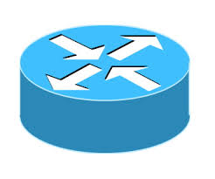
Cloud Operation
Traffic
Cloud traffic enters
Is Routed and filtered
Meets services
each runs on a VIP Virtual IP Address
Data Center
Edge routers
Security appliance
Datacenter
networks
VIP1
VIP2
NetFlix
One Drive
VM
VM
VM
VM
Notes:
Here is how we collect NetFlow data.
Flow of data center traffic:
This diagram shows a typical data center network.
Incoming traffic to different services first traverses the edge routers and then the commercial security appliances
These security appliances analyze inbound traffic to protect against a variety of well-known attacks.
Each service is assigned a public virtual IP (VIP). The traffic to the VIP is load balanced across a group of virtual machines hosting the service;
We collect NetFlow data from Edge routers.
The dataset is 200TB over three months (May, Nov, and Dec 2013). We collected NetFlow records from data center edge routers before the traffic is filtered by the security appliances. Thus, the attacks we detect are likely mitigated before they reach VMs hosting services in the cloud.
Due to sampling in the NetFlow data used and the fact that NetFlow lacks application-level information, we do not
aim at identifying all the attacks in the cloud. Instead, our goal is to understand the characteristics of attacks using low overhead
network-level information typically collected in many data center networks.
NetFlow data is aggregated over one-minute windows.

Slide 9
Measuring Cloud Attacks
Traffic
Major cloud provider
10k+ services, 10+ data centers
Capture NetFlow at edge routers
200 TB over three months
Upstream of DDoS appliance
Sampled at 1 in 4096
Cannot capture all the attacks
Good for studying attack characteristics
Aggregated
in 1-minute window by VIPs
Data Center
Edge routers
Netflow
Security appliance
Datacenter
networks
VIP1
VIP2
NetFlix
One Drive
VM
VM
VM
VM
VIP : Virtual IP for a service
Notes:
Here is how we collect NetFlow data.
Flow of data center traffic:
This diagram shows a typical data center network.
Incoming traffic to different services first traverses the edge routers and then the commercial security appliances
These security appliances analyze inbound traffic to protect against a variety of well-known attacks.
Each service is assigned a public virtual IP (VIP). The traffic to the VIP is load balanced across a group of virtual machines hosting the service;
We collect NetFlow data from Edge routers.
The dataset is 200TB over three months (May, Nov, and Dec 2013). We collected NetFlow records from data center edge routers before the traffic is filtered by the security appliances. Thus, the attacks we detect are likely mitigated before they reach VMs hosting services in the cloud.
Due to sampling in the NetFlow data used and the fact that NetFlow lacks application-level information, we do not
aim at identifying all the attacks in the cloud. Instead, our goal is to understand the characteristics of attacks using low overhead
network-level information typically collected in many data center networks.
NetFlow data is aggregated over one-minute windows.

Slide 10
Attack Categories and Detection
TCP SYN flood | Send many packets to a server
UDP flood
ICMP flood
DNS reflection | DNS responses by spoofed requests
Spam | Launch email spam to SMTP servers
Brute-force | Scan passwords or admin control
SQL injection | Send queries to exploit vulnerabilities
Port scan | Scan for open ports
Malicious web (TDS) | Communicate with malicious webs

Slide 11
Attack Categories and Detection
volume-based: packets/second with sequential change-point detection
TCP SYN flood | Send many packets to a server
UDP flood
ICMP flood
DNS reflection | DNS responses by spoofed requests
Spam | Launch email spam to SMTP servers
Brute-force | Scan passwords or admin control
SQL injection | Send queries to exploit vulnerabilities
Port scan | Scan for open ports
Malicious web (TDS) | Communicate with malicious webs
Notes:
Accordingly, we use those 4 methods to identify 9 types of attacks.

Slide 12
Attack Categories and Detection
volume-based: packets/second with sequential change-point detection
TCP SYN flood | Send many packets to a server
UDP flood
ICMP flood
DNS reflection | DNS responses by spoofed requests
Spam | Launch email spam to SMTP servers
Brute-force | Scan passwords or admin control
SQL injection | Send queries to exploit vulnerabilities
Port scan | Scan for open ports
Malicious web (TDS) | Communicate with malicious webs
spread:
abnormal fan-in or fan-out (# conns or hosts)
Notes:
Accordingly, we use those 4 methods to identify 9 types of attacks.

Slide 13
Attack Categories and Detection
volume-based: packets/second with sequential change-point detection
TCP SYN flood | Send many packets to a server
UDP flood
ICMP flood
DNS reflection | DNS responses by spoofed requests
Spam | Launch email spam to SMTP servers
Brute-force | Scan passwords or admin control
SQL injection | Send queries to exploit vulnerabilities
Port scan | Scan for open ports
Malicious web (TDS) | Communicate with malicious webs
spread:
abnormal fan-in or fan-out (# conns or hosts)
signatures: (TCP)
Notes:
Accordingly, we use those 4 methods to identify 9 types of attacks.

Slide 14
Attack Categories and Detection
volume-based: packets/second with sequential change-point detection
TCP SYN flood | Send many packets to a server
UDP flood
ICMP flood
DNS reflection | DNS responses by spoofed requests
Spam | Launch email spam to SMTP servers
Brute-force | Scan passwords or admin control
SQL injection | Send queries to exploit vulnerabilities
Port scan | Scan for open ports
Malicious web (TDS) | Communicate with malicious webs
spread:
abnormal fan-in or fan-out (# conns or hosts)
signatures: (TCP)
communications with known malicious hosts
Notes:
Accordingly, we use those 4 methods to identify 9 types of attacks.

Slide 15
Characterizing Cloud Attacks
Q1: How many attacks in and out?
Q2: What do attacks look like?
Q3: Who attacks and is attacked?
Notes:
Content

Slide 16
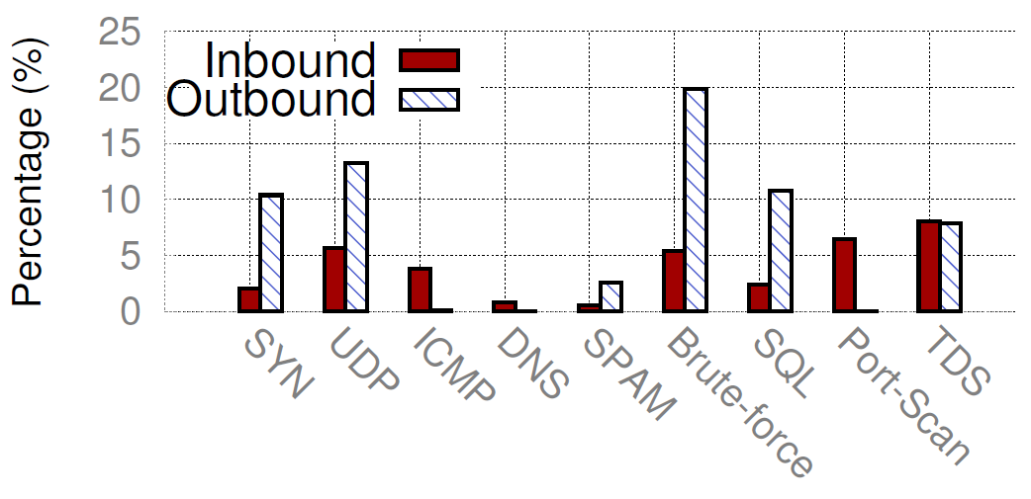
Attack Distribution
35% Inbound vs. 65% outbound
normalized by total number of attacks
More outbound floods than inbound:
Easier to abuse the cloud resources
Inbound are dominated by
flood, brute-force, and port scan
Outbound are dominated by
flood, brute-force, and SQL injection
Implication: High diversity → Need several detection methods
2x more outbound attacks → Improve security of out traffic
Notes:
Among total #attacks, 35.1% are inbound attacks and 64.9% are outbound attacks. Although many security mechanisms have been deployed to protect cloud hosted services against attacks (like security appliances, firewall, IDS in the cloud), this result shows there are more incidents that the cloud is actually attacking others.
This figure shows the distribution of different types of attacks. X-axis is the 9 types of attacks we detected, y-axis is percentage of total #attacks.
There are more outbound floods (e.g., SYN, DUP) than inbound.
This is likely because itis easier for attackers to leverage cloud resources to attack Internet users(using fake accounts, free trials or compromised machines)
It is harder to attack the cloud because the cloud operators have high level of security expertise and many attacks floods can be filtered by commercial security appliances.
If we look at what attack types are popular in the cloud. We find that inbound attacks are dominated by flood, brute-force, and port scan. For example, one brute-force attack we observed is that a service receive SSH traffic from up to 10K distinct hosts just from the sampled NetFlow data. Port scan can have over 100k TCP NULL packets per second.
We find that outbound attacks are dominated by flood, brute-force, and SQL injection. The cloud has rich resources for attackers to generate a large number of packets in floods and connections in brute-force and SQL injection.
Implication: We should have specific security mechanisms for those popular attacks.

Slide 17
Validation: How Complete Are We?
Inbound
method: compare us to security appliance DDoS alerts
we see most inbound attacks (79% of appliance-reports)
miss some attacks due to NetFlow sampling (1:4096)
Alerts may have some false positives (e.g., flash crowds)
Outbound
method: compare us to external complaints (incident reports)
we see most outbound attacks (84% of incident reports)
we miss application-level attacks (e.g., phishing, malware)
Notes:
To validate the attacks we detected are real attacks, we correlate our results with attack detection solutions deployed in the cloud.
The commercial hardware security appliance deployed in the cloud will automatically generate alerts if it detects an on-going attack.
For inbound attacks, we compare our results with alerts over a week.
We found 78.5% of the alerts also in our detected attacks.
We manually verified some of the alerts we missed. The services did not have significant traffic changes and thus they are likely false positives. Another reason is for us to miss attacks is the low sampling rate in netflow data.
The cloud security team may receive a complaint from an ISP when they notice malicious traffic originating from the cloud provider. Given such a complaint, the security team checks the logs of security appliances, investigates the corresponding tenant profile and payment information, and generates an incident report.
We found 83.7% of the reports also in our detected attacks. Since Netflow does not contain payload information, we miss those application-level attacks like phishing and malware hosting in the cloud.

Slide 18
Characterizing Cloud Attacks
Q1: How many attacks in and out?
9 diverse attack types: From DDoS to SQL injection, spam
Inbound vs. outbound: 2x more outbound attacks
Q2: What do attacks look like?
Q3: Who attacks and is attacked?
Notes:
Content

Slide 19
Characterizing Cloud Attacks
Q1: How many attacks in and out?
9 diverse attack types: From DDoS to SQL injection, spam
Inbound vs. outbound: 2x more outbound attacks
Q2: What do attacks look like?
Q3: Who attacks and is attacked?
Notes:
Content

Slide 20
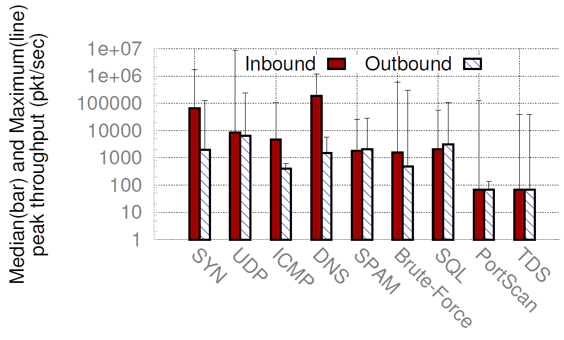
Attack throughput
Attacks consume lots of cloud resources
median aggregate attack traffic is 1% of mean cloud traffic
attackers are disproportionally heavy (1% tfc but ~0.1% VIPs)
High variation in throughput across time and VIPs
Inbound floods have 13-238 times higher peak than outbound
Inbound brute-force:
Peak vs. median = 361 times
Implication: Attack defenses need to dynamically adapt resources (over time and VIPs) to be cost-effective
Notes:
Besides the affected services, we now look at the scale of each individual attack.
The total attack throughput in the median is about 1% of the total cloud traffic. These attacks can have a significant
impact on both the cloud infrastructure (firewalls, load balancers) and services hosted in the cloud if we do not filter them at the network edge.
The figure shows the attack throughput distribution. X-axis is 9 types of attacks. Y-axis is median and maximum attack throughput.
First, there is inbound and outbound difference. For example, inbound floods have 13-238 times higher peak throughput than outbound. That is because cloud has high capacity and difficult to be affected by small floods.
(case study) We found one inbound TCP SYN flood that caused a CPU spike at the software load balancer (SLB) appliance and resulted in a restart of that appliance.
Second, there is peak and median difference. For example, peak inbound brute-force attack is 361 times larger than median.
Therefore, it may become too expensive to over-provision hardware security appliances for individual VIPs based on their maximum attack volumes
Implication: Security solutions need dynamic resource allocation over time and multiplexing across VIPs

Slide 21
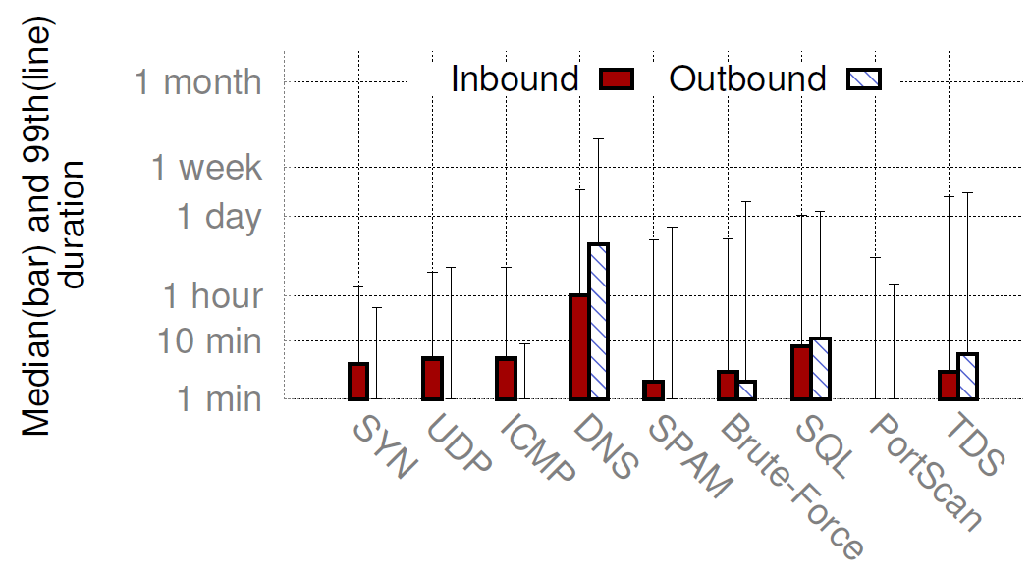
Attack duration
Attacks often have short duration ( < 10 min)
Hard to detect
Quickly move to a different target
A few attacks can last hours or even days
DNS reflection has long duration
Hard to detect: from many DNS resolvers having a low query rate
Often with short duration
Implication: Need fast (order of 10s-100s of seconds) and accurate detection to defend against most attacks
Notes:
In addition to the size of attacks, we still want to know how long do attacks last, as shown in the figure.
X-axis is 9 types attacks. Y-axis is median and tail of attack duration.
Attacks have less than 10 minute duration in the median. That is because from the hacker’s perspective:
Shorter attacks are harder to be detected by cloud operators;
an attacker may attack one target for a short time. If not successful, the attacker quickly moves to another target.
However, some attacks can last hours or even days. For example, DNS reflection attacks last longer than others in both inbound and outbound directions.
These attacks can sustain for a long time because they leverage many DNS resolvers simultaneously and each resolver receives relatively low query rate. Thus, it is hard to detect these attacks.
As a result, it is important to detect short duration attacks in a timely fashion and also accurately detect those slow rate attacks.

Slide 22
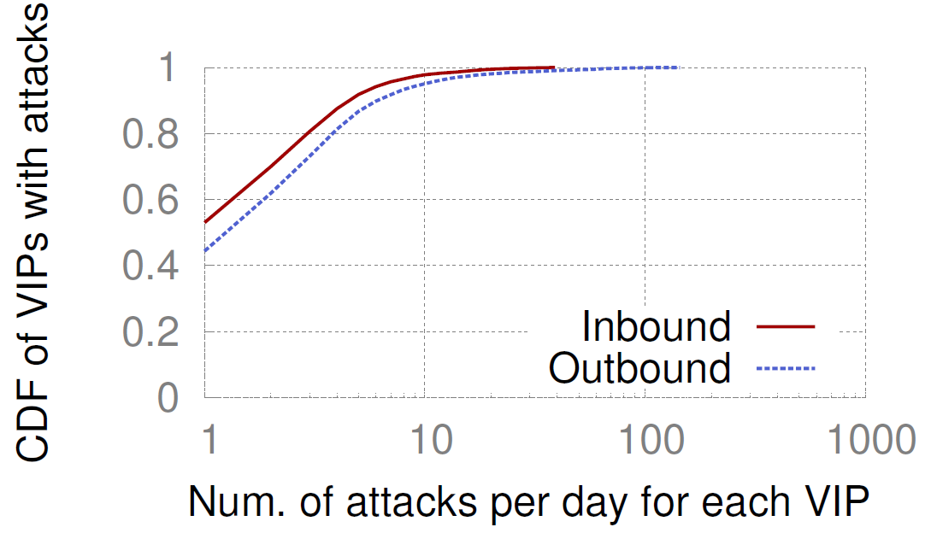
Attack frequency per VIP
Only a small fraction of VIPs involved
Inbound: 8 out of 10,000 VIPs per day
Outbound: 11 out of 10,000 VIPs per day
Occasional attacks vs. frequent attacks
A few VIPs experience 30-150 attacks in a day (usually SYN floods)
Mostly one attack in a day
*VIP : Virtual IP
Implication: Need to focus on the VIPs at the tail for attack detection and mitigation
Notes:
Only a small fraction of VIPs are under or generating attacks.
To understand how often attacks can happen, we show the attack frequency figure only for those attack involved VIPs.
X-axis is #attack in a day, y-axis is the CDF of attack involved VIPs.
Most of those VIPs experience occasionally one or a few attacks in a day. We find those attacks are more TDS, port scan, and brute-force attacks, since those attacks scan a wide range of services for vulnerabilities.
However, a few VIPs experience 30-150 attacks in a day. Those frequent attacks are more TCP SYN flood. These TCP SYN flood attacks
often target several popular services over media applications, HTTP, and HTTPS.
Understanding
-the VIPs under frequent attacks is important for operators to extract
the right attack signatures (e.g., popular attack sources) to protect
these VIPs from future attacks.

Slide 23
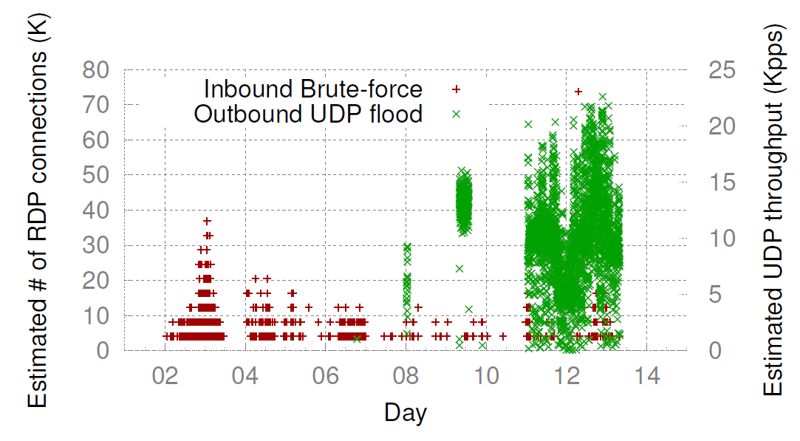
Attacks on the same VIP
Multi-vector attacks: exploit the vulnerabilities
6.1% of inbound attacks and 0.83% of outbound attacks
Compromised VIPs for outbound attacks
Inbound brute-force attack from 85 sources over one week
Outbound UDP flood against ~500 Internet sites
Implication: Need joint analysis of inbound and outbound traffic to identify causality in attacks; find compromised VMs
Notes:
In particular one VIP, we are interested in how attacks can happen.
First, we observe Multi-vector attacks that multiple types of attacks attacking the same VIP or coming from the same VIP at the same time.
This is likely because a single malicious program tries to launch multiple types of attacks to exploit the vulnerabilities of targets or to exhaust target resources in different ways.
We also combine both inbound and outbound attacks on the same VIP. This figure shows one attack incident over 2 weeks in x-axis. The left Y-axis is #RDP connection (note: RDP is remote desktop protocol from Microsoft). First, we observe inbound brute-force attacks from 85 sources over one week. The brute-force attacks had a peak of estimated around 70 K connections per minute but each connection has only a few packets sampled. This machine is believed to be compromised and controlled by the hacker to launch outbound attacks.
The right y-axis is #UDP packets per second, after being compromised, this machine generates outbound UDP attack against around 500 external sites, with a peak volume at 23 Kpps.
Implication: We should jointly analyzing the inbound and outbound traffic to identify the attack patterns of compromised VIPs, and then blocking their outbound traffic.

Slide 24
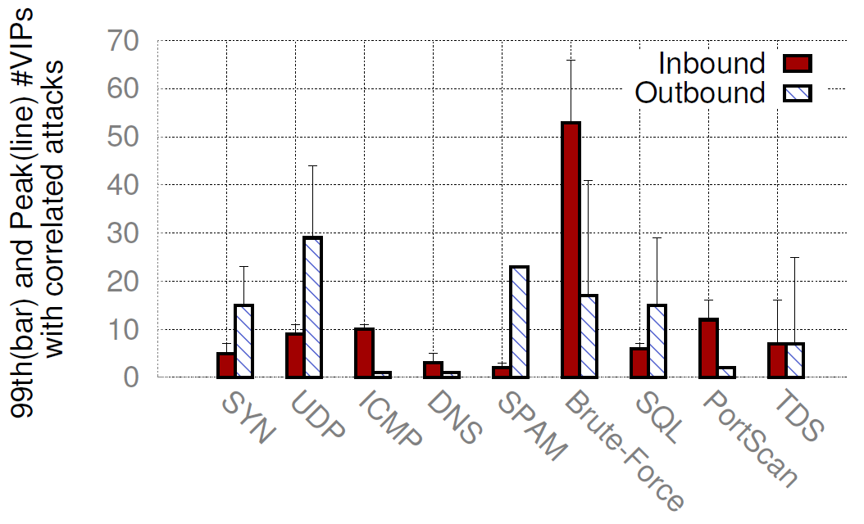
Attacks on multiple VIPs
Most attacks have only a few targets
1 VIP in the median, <10 VIPs in the 99th percentile
A few cases with 20-60 VIPs simultaneously
Brute-force on 60+ VIPs:
Two sources scan 8 IP subnets (500 VIPs) over 5 data centers
Implication: Need to correlate traffic across VIPs to coordinate attack detection and mitigation
Notes:
We then study how attacks can happen over many VIPs.
The figure show the distribution of how many VIPs are affected at the same time by one attack. X-axis is nine types of attacks we studied. Y-axis is the 99th percentile and peak #VIPs affected at the same time.
Figure shows that most types of attacks are targeted by fewer than 10 VIPs even in the 99th percentile
However, there are cases 20-60 VIPs are affected simultaneously. For example, We studied one incident of inbound brute-force attack.
There are two Internet hosts from small cloud providers that start attacking 66 VIPs at the same time, and move to other VIPs. During a single day, these two Internet hosts attack more than 500 VIPs. These VIPs are located in five data centers in the cloud, and they belong to 8 IP subnets with different sizes (/17 to /21).
Implication: To prevent such attacks, we need to correlate the traffic to different VIPs and coordinate their attack detection and mitigation.

Slide 25
Characterizing Cloud Attacks
Q1: How many attacks in and out?
9 diverse attack types: From DDoS to SQL injection, spam
Inbound vs. outbound: 2x more outbound attacks
Q2: What do attacks look like?
Peak rate: 100pps-9Mpps; out 13x-238x higher than in
Duration: Most attacks have short duration (<10 mins)
Frequency: Most VIPs see 1 attack/day; a long tail exists
Q3: Who attacks and is attacked?
Notes:
Content

Slide 26
Characterizing Cloud Attacks
Q1: How many attacks in and out?
9 diverse attack types: From DDoS to SQL injection, spam
Inbound vs. outbound: 2x more outbound attacks
Q2: What do attacks look like?
Peak rate: 100pps-9Mpps; out 13x-238x higher than in
Duration: Most attacks have short duration (<10 mins)
Frequency: Most VIPs see 1 attack/day; a long tail exists
Q3: Who attacks and is attacked?
Notes:
Content

Slide 27
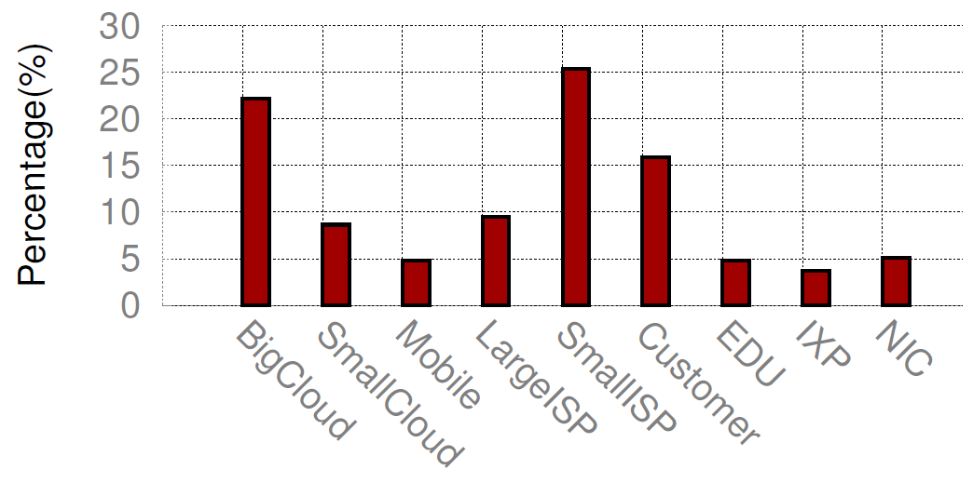
Origins of inbound attacks
Big cloud, Small ISPs and Customer Net dominate
Less security expertise and weak defenses;
relatively easy to be compromised by attackers
Percentage of attacks
Mostly high-volume UDP floods, SQL injection, TDS attacks due to large availability of resources
Implications: (1) Better cloud security can help everyone;
(2) Need to help those with less security expertise
Notes:
To geolocation attacks, we map the IP addresses of inbound attack sources and outbound attack targets to AS numbers using Quova. We use CAIDA AS taxonomy repository to identify AS types. We count the number of attack incidents of different types for each AS class if any of its IP is involved in the attack.
We found big cloud (Google, Amazon, Microsoft), small ISP, and Customer networks are the major contributors of inbound attacks.
Our cloud receives more UDP floods, SQL injection and TDS attacks from those Big cloud, this is probably due
to the availability of a large set of resources in big clouds to generate a high traffic volume and a large number of connections.
Small ISP and Customer networks also generate ~20% inbound attacks. This is probably because these local or regional ISPs have relatively less security expertise and weak defense systems, and thus they are more likely to be compromised and leveraged by attackers.
Implication: We should prevent resource abuse in the cloud and improve security support in local or regional ISPs

Slide 28
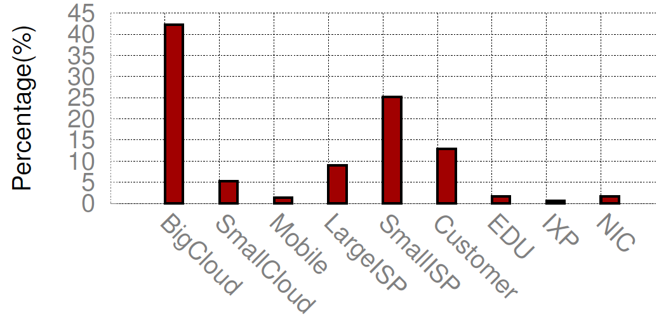
Targets of outbound attacks
Attacks target many ASes
Top 10 ASes are targets of 8.9% of the attacks
Specific attacks target hosts in one AS, usually (80%)
Mostly SQL injection and TDS attacks
Mostly brute-force and spam
Percentage of attacks
Implication: Important to coordinate measures across the cloud and these networks to protect against these attacks
Notes:
Different with ISP networks where prior work has shown that a small number of ASes are involved in a significant fraction of attacks, we show that cloud-related
attack incidents are widely spread across many ASes. For example, Top 10 ASes are targets of only 8.9% of the attacks. This mean the hackers abuse cloud resources for a board range of purpose.
Unlike Internet floods which often target a single host, we find that cloud outbound attacks target many hosts.
We also find 80% outbound attack target hosts in a single AS.
Similarly, we found big cloud (Google, Amazon, Microsoft), small ISP, and Customer networks are popular targets of outbound attacks.
Implication: Important to coordinate security measures across the cloud infrastructure and these networks to protect against these attacks.

Slide 29
More in the paper
Are source IPs spoofed?
What is the inter-arrival time of attacks?
What services are targeted by attacks?
How prevalent are attacks from mobile networks?
What is the geo-distribution of attacks?
Notes:
We observe that 67.1% of the TCP SYN floods have spoofed IPs.
Inter-arrival time
We investigate the major types of cloud services under inbound attacks. Mainly from HTTP and RDP services.
We found attacks from mobile networks. It is hard to blacklist sine they are behind proxy.
Geolocation distribution of source of inbound and target of outbound attacks

Slide 30
Conclusion
Cloud attacks are prevalent, both in and out
Key findings:
attacks are diverse: type, scale and distribution
outbound attacks dominate: many compromised cloud VMs
existing DDoS defenses are limited: many short attacks
Implications:
using correlation can improve detection
need programmable, scale-out, and flexible solutions to detect diverse attacks
questions? {rmiao, minlanyu}@usc.edu, {rapoth,navendu}@microsoft.com
Notes:
Pick better sentences from abstract, introduction and conclusion

Slide 31
Backup Slides

Slide 32
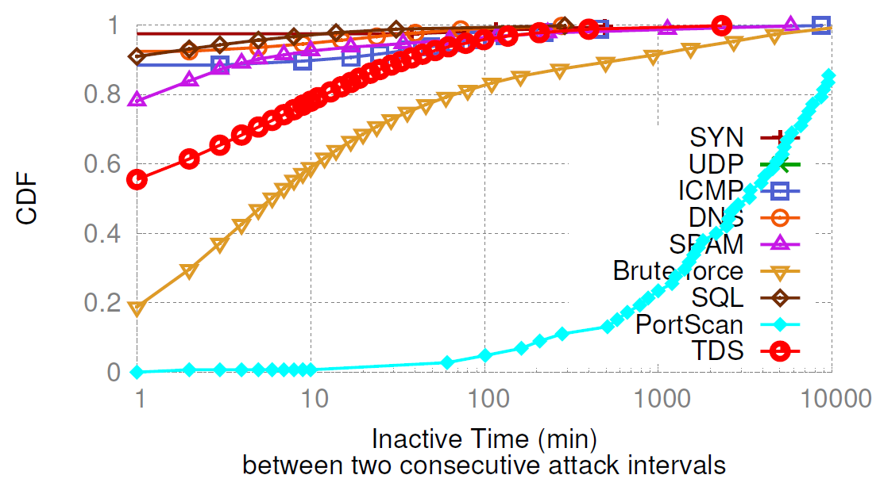
Identify the attack incidents
Cannot detect an attack over its entire duration
Due to low sampling rate in NetFlow
Separate attack incidents using inactive heuristic
Aggregate NetFlow by VIP in 1-minute window
Measure inactive time between two attack minutes
Pick ``knee point’’ using linear regression:
No statistically significant difference in the #incidents

