Slide 1
GRASS: Trimming Stragglers in Approximation Analytics
Ganesh Ananthanarayanan, Michael Hung, Xiaoqi Ren, Ion Stoica, Adam Wierman, Minlan Yu

Slide 2
Next Generation of Analytics
Timely results, even if approximate
Data deluge makes this necessary

Slide 3
Approximation Dimensions
Deadline: Maximize accuracy within deadline
“Pick the best ad to display within 2s”
Error: Minimize time to get desired accuracy
“#cars sold to the nearest thousand”
Optimal Scheduler
Improve accuracy by 48%
Speedup by 40%
*w.r.t. state-of-the-art schedulers (production workloads from Facebook and Bing)

Slide 4
Scheduling Challenge
Prioritize tasks
Subset of tasks to complete
#tasks » #slots (multi-waved jobs)
(NP-Hard but many known heuristics…)
Straggler tasks
Slowest task can be 8x slower than median task
Speculation: Spawn a duplicate, earliest wins
Google[OSDI’04], FB[OSDI’08], Microsoft[OSDI’10]

Slide 5
Challenge: dynamically prioritize between speculative & unscheduled tasks
to meet deadline/error bound

Slide 6
Opportunity Cost
Speculative copies consume extra resources
Slot 1
T1
Is speculation worth the payoff?
Slot 2
T2
Slot 3
T1
T3
time
0
5
9
10
Notes:
ST: deadline matters for prioritization

Slide 7
Roadmap
Two natural scheduling designs
GRASS: Combining the two designs
Evaluation of GRASS

Slide 8
Greedy Scheduling (GS)
Greedily improve accuracy, i.e., earliest finishing task
Straggler
Accuracy = 7/9
Slot 1
T1
T1
Deadline = 6
Slot 2
T2
T3
T4
T5
T6
T7
time
0
1
6
(at time =1 )
Task ID | T1 | T2 | T3 | T4 | T5 | T6 | T7 | T8 | T9
Time remaining | 5 | --- | --- | --- | --- | --- | --- | --- | ---
New copy | 2 | --- | 1 | 1 | 1 | 1 | 1 | 1 | 3

Slide 9
Resource Aware Scheduling (RAS)
Speculate only if it saves time and resources
Straggler
Accuracy = 8/9
Slot 1
T1
T4
T6
T7
T1
Deadline = 6
Slot 2
T2
T1
T3
T5
T8
time
0
1
3
6
One copy for 5s (vs.) Two copies for 2s
(at time =1 )
Task ID | T1 | T2 | T3 | T4 | T5 | T6 | T7 | T8 | T9
Time remaining | 5 | --- | --- | --- | --- | --- | --- | --- | ---
New copy | 2 | --- | 1 | 1 | 1 | 1 | 1 | 1 | 3

Slide 10
GS vs. RAS
Slot 1
Accuracy = 3/9
Accuracy = 7/9
T1
T1
GS
Deadline = 6
Deadline = 3
Slot 2
T2
T3
T4
T5
T6
T7
time
0
1
3
6
Neither GS nor RAS is uniformly better
Accuracy = 2/9
Accuracy = 8/9
Slot 1
T1
T4
T6
T7
RAS
Deadline = 6
Slot 2
T2
T1
Deadline = 3
T3
T5
T8
time
0
1
3
6

Slide 11
Intuition:
Use RAS early in the job (be “conservative”), switch to GS towards the end (be “aggressive”)
Notes:
“time remaining”

Slide 12
Theoretical Scheduling Model
Multi-waved scheduling of tasks
Constant wave-width
Agnostic to fairness policies
Heavy-tailed (Pareto) distribution of task durations
Speculation: GS, RAS, Switching, Optimal
Theorem:
Using RAS when >2 waves of tasks remain, and GS when ≤2 waves of tasks remain
is “near-optimal”

Slide 13
How to estimate two remaining waves?
Wave boundaries are not strict
Non-uniform task durations
Wave-width is not constant
Start with RAS and switch to GS close to the deadline/error-bound

Slide 14
Learning the switching point
Switch
RAS[4s]+GS[2s]
RAS
RAS
RAS
GS
GS
RAS[5s]+GS[1s]
RAS[6s]
4
5
6
Deadline
GS-only and RAS-only job samples
“Exploration vs. Exploitation”
Multi-armed bandit solution, ɛ = 0.1

Slide 15
GRASS (= GS + RAS) Scheduler
Opportunity Cost in speculation for stragglers
GS → Greedy Scheduling
RAS → Resource Aware Scheduling
Switch RAS→GS close to deadline/error-bound
Learn switching point empirically from job samples
Provably near-optimal in theoretical model

Slide 16
Implementation
Hadoop 0.20.2 and Spark 0.7.3
Modified Fair Scheduler
Job bins with GS-only and RAS-only samples
Task Estimators
Remaining time is extrapolated from data-to-process
progress reports at 5% intervals
New copy’s time is sampled from completed tasks

Slide 17
How well does GRASS perform?
Workload from Facebook and Bing traces
Hadoop and Dryad production jobs
Added deadlines and error bounds
Baselines: LATE & Mantri
200 node EC2 deployment (m2.2xlarge instances)

Slide 18
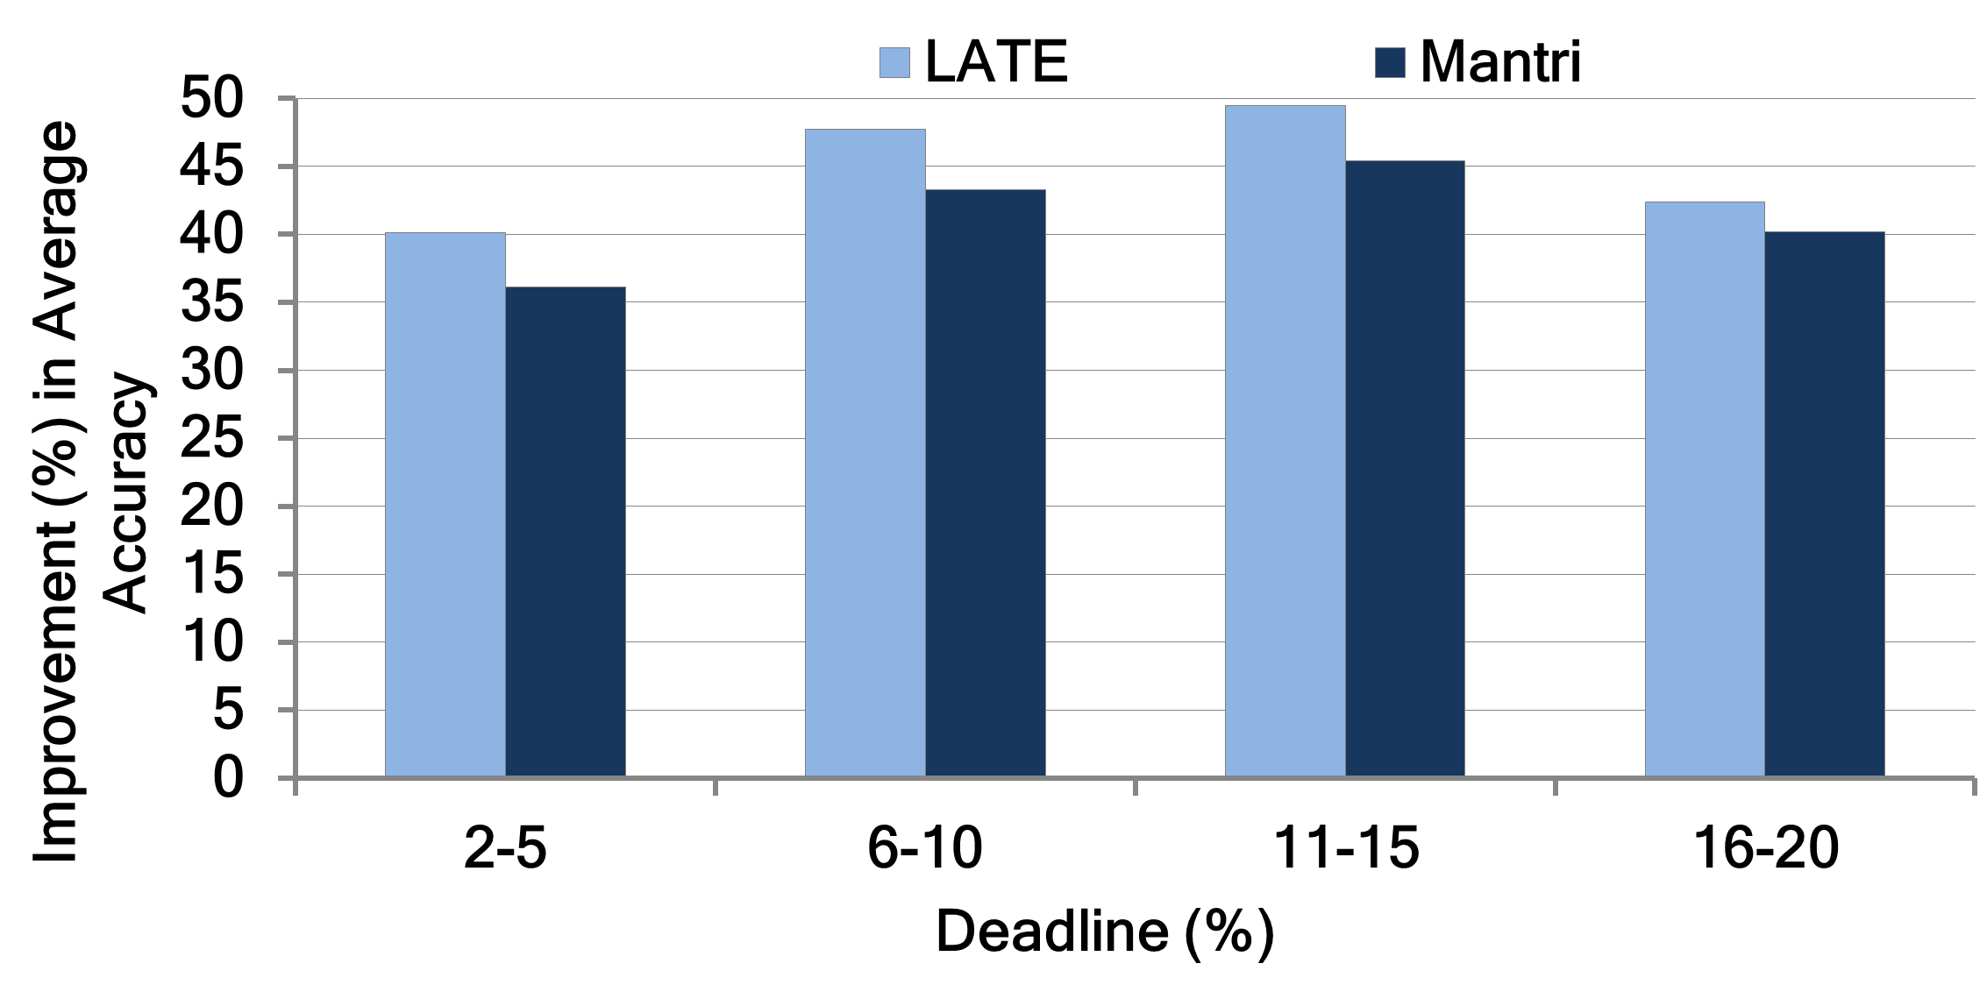
Accuracy of deadline-bound jobs improve by 47%
Gains hold across deadlines (lenient and stringent )

Slide 19
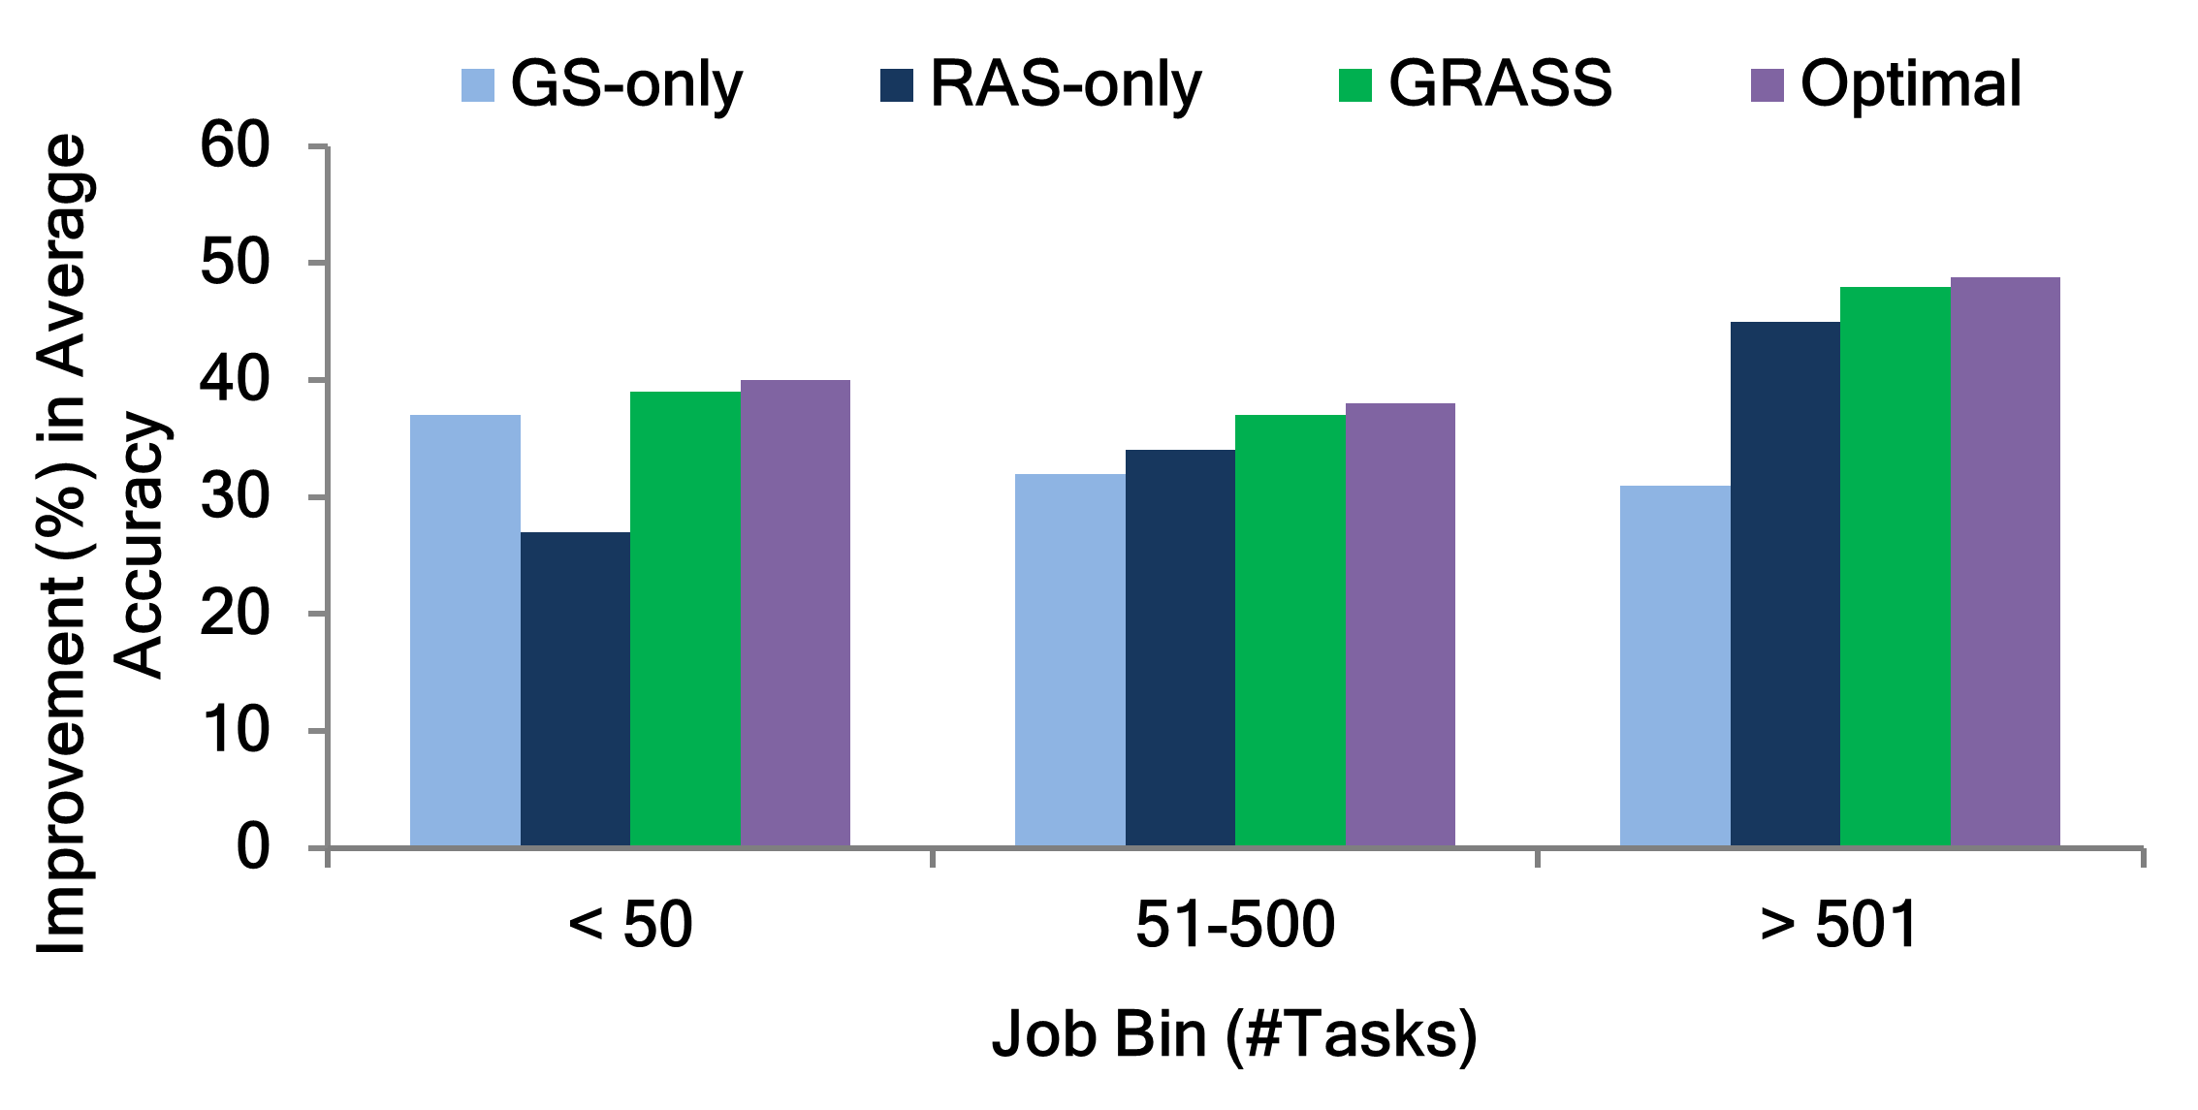
GRASS is 22% better than statically picking GS or RAS
… and is near-optimal

Slide 20
Error-bound Jobs
Overall speedup of 38% (optimal is 40%)
Gains hold across all error bounds
Exact jobs (0% error-bound) speed up by 34%
Unified Straggler Mitigation

Slide 21
Conclusion
Next gen. of analytics: Approximate but timely results
Challenge: Dynamic and unpredictable stragglers
GRASS – Conservative speculation early in the job; aggressive towards its end
Evaluation with Hadoop & Spark
Accuracy of deadline-bound jobs improve by 47%
Error-bound jobs speed up by 38%

