Slide 1
Direct Telemetry Access
Jonatan Langlet
Queen Mary University of London
Ran Ben Basat
University College London
Gabriele Oliaro
Carnegie Mellon University
Michael Mitzenmacher
Harvard University
Minlan Yu
Harvard University
Gianni Antichi
Politecnico di Milano
Queen Mary University of London
Notes:
So yes, let’s talk about the last two years of my life. Network telemetry

Slide 2
Network Telemetry
Monitoring
Insight
Collection
Aggr.
INT
Marple
CountSketch
CM Sketch
PacketScope
OmniMon
AROMA
TurboFlow
Sonata
HyperLogLog
PINT
Univmon
NetSeer
Paths
Latencies
Losses
Queue depths
Packet counters
Notes:
Here we break telemetry into 2 parts:
* Monitoring, where data is generated and exported
* and centralized collection of this data
* This is an active field, and there are tons of papers on cool new monitoring techniques
And to get a holistic view we need diverse telemetry such as
* flow paths..
* packet latencies..
* losses
* queue depths
* and various packet counters
* To achieve a network-wide view, we centrally collect telemetry reports...
* ..and the collector-server aggregates the data
* ..which is used to get an insight into the network state
* Our work focuses on this arrow here. How should we get the measurements into central collection?

Slide 3
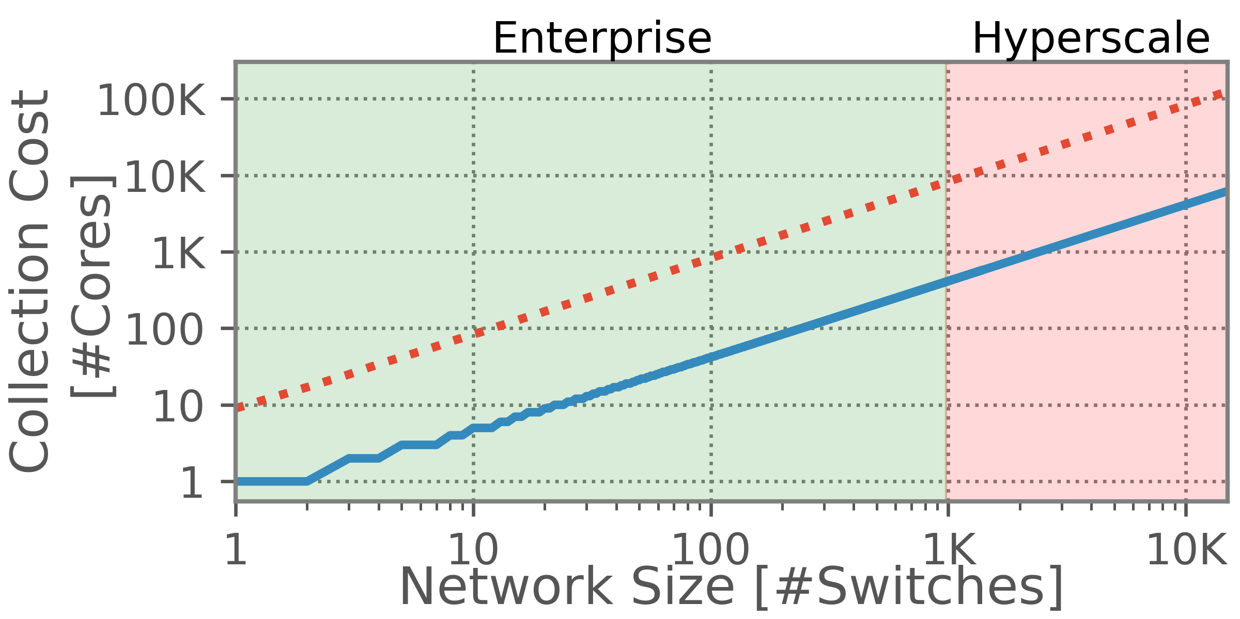
Collection is the Bottleneck
Miss important info
“wtf is confluo!?!” → “a stateof-the-art from NSDI”
Sampled INT
NetSeer
Wasteful
Khandelwal, Anurag, et al., “Confluo: Distributed Monitoring and Diagnosis Stack for High-speed Networks”, NSDI’19
Zhou, Yu, et al., “Flow Event Telemetry on Programmable Data Plane”, SIGCOMM’20
Notes:
In this figure, we highlight the amount of processing required just to receive measurements as the network grows.
Behind this figure is a state-of-the-art collector from NSDI 2019,
and we plot two very different monitoring-systems being collected
* first we have the red line, which is INT, kind of the poster-child for fine-grained telemetry.
It is incredibly powerful, and can generate telemetry reports for every single packet in a network.
This is of course super costly, and here we sample less than a percent of traffic.
* On the opposite end we have NetSeer from SIGCOMM 2020.
This system greatly reduces the load by only reporting detected packet loss events. We lose insight, but reduce the collection-load accordingly.
*However, this is still costly. For example, look at the costs at a thousand switches. We burn thousands of cores, just for data aggregation!
*This is such a waste, these cores could do valuable work, say running VMs, or doing actual analysis!

Slide 4
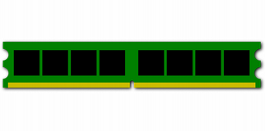
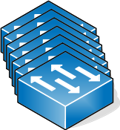
So why not RDMA?
But if we want to save CPU...
O(100Mops)
DMA
RDMA
This work
Telemetry Data
But RDMA requires explicit addressing!
But new usecase: telemetry. Issue..e.
Notes:
So we want to save the CPU while inserting a high rate of data into server memory.
So why not use RDMA? This is what it is designed for.
*RDMA is cool, it allows network cards to process memory operations directly, without involving the underlying CPU. It does this by directly making calls to the server DRAM, resulting in high-performance operations and freed-up CPU cycles.
* It is so fast, that a single network card can process more than a hundred million WRITE-operations per second. It is used in basically every high-performance computing cluster.
* So question is can we get this to work for telemetry?
Here, we do not have a typical RDMA scenario where servers make remote memory operations, but we have switches that want to populate data structures.
* And this is what our work is doing, CPU-bypassing telemetry-ingestion.
* Can’t be that tricky, right? Just implement RDMA support and you’re done?
Well we were hoping so too when we started this project!
There are several issues here, but let me highlight one of them

Slide 5
RDMA requires explicit addressing!
Notes:
It’s that RDMA requires explicit addressing!
When we generate a WRITE request in RDMA, we also need to state at which exact address we want to write the payload.
We can’t really do fancy if-statements, or chaining in hash-tables
And this gets tricky...

Slide 6
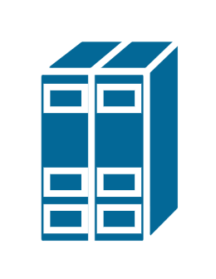
Thought Example – A list
a
0
[1] = b
b
1
?
2
[2] = d
3
[2] = e
…
Notes:
Let’s take a very simple example: we want to populate a list with telemetry information.
Just some data that we want the CPU to iterate over. Say, real-time packet losses.
* Let’s assume that the first switch knows that index 0 contains some data, and it therefore knows that it should write into index 1
* So it writes a report to memory
* But what happens if two other switches want to write at pretty much the same time? One would write first, and then immediately it is overwritten by the other switch.
* What should be at memory 2? Switches need to somehow synchronize this.

Slide 7
Solution 1 – Dedicated buffers?
0
1
[0] = b
2
Where are new losses?
3
…
0
[0] = d
1
2
3
…
0
[0] = e
1
2
3
…
Notes:
So, obvious solution, we could just allocate dedicated lists for each switch.
* Then this is not a problem, switches just track their own head-pointers, so there would never be any race-conditions here.
But there are a few issues with this approach.
* First,it is inefficient. There will be load-imbalances in the structures, since switches fire reports at wildly different rates depending on what is going on. Some buffers could stand almost idle, while others might quickly saturate
* And, we want the control-plane to quickly react to events, and this approach requires iterating over all allocated buffers to find which ones are reporting issues. And some hyperscalers can contain thousands of switches, and this adds unnecessary delays to reacticity

Slide 8
Solution 2 - Coordination?
My turn?
a
0
[1] = b
b
1
Which index?
?
2
[2] = d
3
[2] = e
…
Let’s re-sync!
Switch co-ordination imposes complexities, overheads, slowdown
“we considered this, problem is need switches to ‘talk’, then write. Telemetry is continuos, can not stop and discuss. We want something that does not ‘stop’”
Notes:
So why don’t we just coordinate a shared list between switches?
We could do that.
* and switches take turns…
* process shared index-pointers…
* and stay in sync
But this is an issue, since telemetry is a constant stream of information.
*There is no “stopping” of data until it is our turn to report. It needs to fire somewhere when it is generated. And in-ASIC buffers are small, and switch-local CPUs are easily overwhelmed.
*Additionally, this imposes overheads and complexities for inter-switch communication, which is not good given the limited resources available.

Slide 9
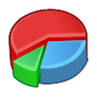
Solution 3 - Locking?
We still have to sync memory pointers
a
0
b
1
RDMA for telemetry is tricky...
?
2
My turn?
3
Lock
…
My turn?
Don’t demonstrate again. Same thingie ‘stop’
Add sol3: divide
Notes:
So why not just locking? Make the operations atomic.
* A lock could be attached to each memory buffer
* And switches check this lock and conditionally claim ownership
* Again, same set of problems as before. We can not simply “pause” the stream of telemetry.
And, locking prevents simultaneous in-flight reports, significantly reducing performance.
* And we still have to synchronize memory pointers.
* Finally, all of these solutions share another big problem: the RDMA protocol is complex. And adding support to every switch is a waste of resources just for this.
* So yeah, what I want to say is that RDMA for telemetry is tricky...

Slide 10
A step back..
Low overhead at switches
We need a lightweight protocol
1
+
Coordination-free updates
… where switches blindly push telemetry reports
2
+
Not relying on CPU for data ingestion
… without an in-line CPU
3
+
Queryable for analysis
… while still being organized and aggregated
4
=
We want memory-layout aware RDMA verbs
Notes:
So we can not just use RDMA as-is. Let’s take a step back..
* We want low overheads at switches. Their resources are limited, and they have more important things to do than just exporting telemetry.
* We want coordination-free updates, keeping complexities low and performance high
* We do not want to rely on the CPU for data ingestion. This is the current performance-bottleneck even after years of optimizations.
* And let’s not forget what we are doing. Of course we want the data queryable for analysis! A random block of garbled report is not exactly useful. Then any collection-benefits would be lost as soon as we have to query the information.
* So we we need a lightweight protocol,
* where switches blindly push telemetry reports,
* without an in-line CPU
* while still being organized and aggregated
* In a nutshell, we want memory-layout aware RDMA verbs!

Slide 11
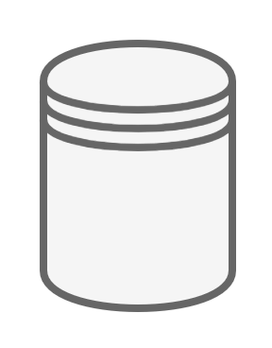
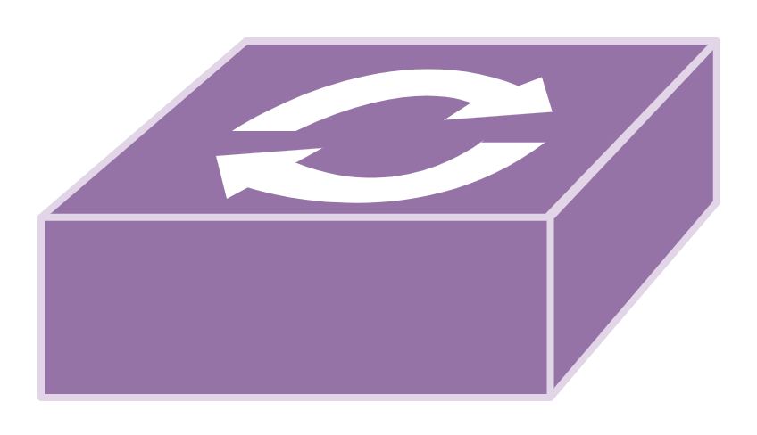
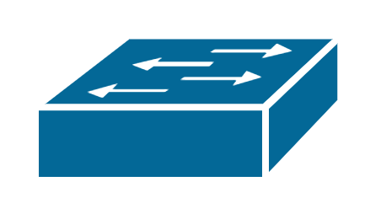
Direct Telemetry Access
I know about ‘R’!
Telemetry data structures
4
Expand RDMA
with collection primitives
Collector(s)
mem[A]=r
this means that…
3
Low overhead at switches
1
RDMA
Translates DTA into RDMA
Translator (ToR)
Coordination-free updates
2
2
I report ‘R’
No CPU for data ingestion
DTA
3
1
Switches send telemetry reports w/ new protocol ‘DTA’
Queryable for analysis
Telemetry switches
4
Notes:
Let’s introduce our actual solution, Direct Telemetry Access, or DTA
* Switches generate telemetry reports with new headers: DTA headers
* These packets are sent towards a collector, just as usual. But instead of reaching the collector, they get intercepted by the last-hop towards that server. By the top-of-rack switch that we call the Translator
* The Translator translates DTA into RDMA, acting as the sole manager of populating the telemetry-storing data structures.
* So in comes DTA, and out goes RDMA packets
* These are handled by the NIC, so the collector no longer has to care about data ingestion or aggregation. It just hosts the data structures, and performs data analysis.
* So, a switch reports some measurements
* the translator figures out how best to aggregate this information together with all previous telemetry reports
* it generates RDMA operations to write this into the collector’s memory
* and the collector magically knows about the new measurements!
* And this design manages to fulfil all our requirements.
* First, we designed the DTA protocol to be very lightweight, containing just the essentials to state the type of data being reported. It is almost as lightweight as just generating UDP.
* Second, switches don’t need any collaboration! They just fire-and-forget a report, and the translator handles aggregation.
* Third, we entirely bypass the CPU, by supporting legacy RDMA
* And finally, DTA achieves efficient queryable aggregation by the translator having sole-ownership over the data structures.
* And, thanks to this, we can expand on RDMA with new telemetry collection primitives! All through legacy RDMA

Slide 12
DTA enables telemetry primitives
Name
Function
Supported Systems
Key-Write
Key/Value
Storage
INT-MD, PINT, PacketScope,
Marple, Sonata
DTA Primitives
Postcarding
Aggregating
K/V Storage
INT-XD, INT-MX,
Trajectory Sampling
Append
Chronologic
Lists
dShark, Marple, PacketScope,
INT, NetSeer, Sonata
Key-Increment
Counter
Storage
Marple,
TurboFlow
Together achieves broad support
Postcarding? Check with Ran b4
Re-think key-write example. Does not sound exciting and new
Notes:
We designed four new telemetry primitives for RDMA using this technique
* First we have Key-Write, built for generic key/value storage. As such, it has a wide support for key-based queries.
* then there’s Postcarding, which is for aggregated key/value storage. This one is a bit more complex, and does report aggregation before populating an underlying key-value store. It is not as generic as Key-Write, but much faster. It is very efficient at say path-tracing in some INT configurations.
* Then there’s Append. This one is solving the previous list-creating example and has lots of uses. It can also easily do batching in the translator, leading to incredible performance.
* And finally we have Key-Increment, which stores network-wide counters. We can couple this with systems such as modern Netflow variants, or sketches, to do things like flow size estimation. Again, very generic.
* Together, they achieve a broad support of monitoring techniques.
And this is not a difinitive list, and we welcome new suggestions

Slide 13
Generic
I translate!
RDMA
DTA
INT
Marple
CountSketch
CM Sketch
PacketScope
NetSeer
AROMA
TurboFlow
Sonata
HyperLogLog
PINT
Notes:
Wrapping up.
DTA is generic. It is not designed with a specific system in mind, but allows broad support of different monitoring systems
This is achieved through translation at the top-of-rack switch.

Slide 14
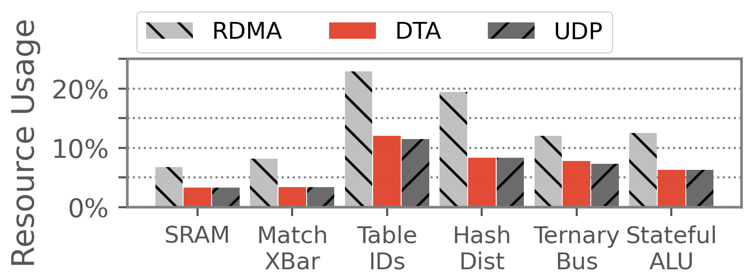
Generic, Lightweight
I translate!
RDMA
DTA
INT
Marple
CountSketch
CM Sketch
PacketScope
NetSeer
AROMA
TurboFlow
Sonata
HyperLogLog
PINT
Fig: Resource costs at reporters
Notes:
And DTA is lightweight! Recall how switching resources are very valuable. Well, turns out that DTA is almost as lightweight to generate as traditional UDP. So for most of the switches in the network, DTA is basically free

Slide 15
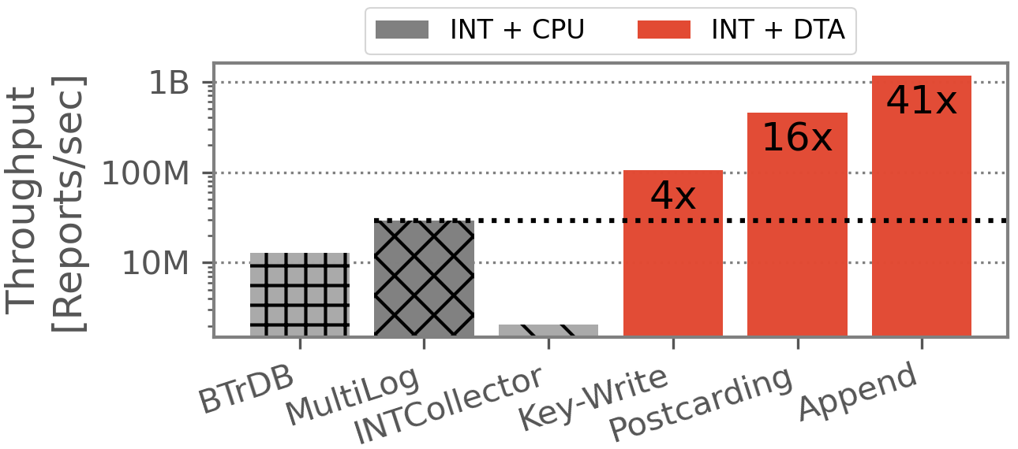
Generic, Lightweight, and Fast
I translate!
RDMA
Fig: 16-core performance (vs 0-core DTA)
DTA
INT
Marple
CountSketch
CM Sketch
PacketScope
NetSeer
AROMA
TurboFlow
Sonata
HyperLogLog
PINT
Fig: Resource costs at reporters
Notes:
And it is ridiculously fast! DTA achieves an order-of-magnitude performance improvement compared to CPU-based collectors.
And this is while simultaneously freeing up the CPU cores for other work at the collectors
We have now freed up additional cores per-collector to do say analysis with.

Slide 16
Direct Telemetry Access
https://github.com/jonlanglet/DTA
Open sourced
Code
Guides
Thanks
jonatan@langlet.io
End with drawbacks. E.g., contention with user traffic. Future directions, such as expanding RDMA at the NIC-level
Notes:
Last slide
We have released DTA as open-source, together with some guides on how to set up the system to build upon or integrate with new monitoring systems
Thanks! That’s all from me

Slide 17
Backup slides

Slide 18
Example: Key/Value Storage
Memory
I will write into the K/V storage
RDMA
Flow ‘A’ path is…
h₁(A)
h₁(B)
Flow ‘B’ path is…
h₂(B)
h₂(A)
DTA
‘A’
‘B’
CRC
CRC
Probabilistic storage
Checksumming
10M flows @ 30GB storage: >99.9% availability!
What is availability?
Notes:
Let’s collect network-paths through DTA
* First, a switch reports a network path for a flow
* this report reaches the translator, that will populate a key/value store of flow paths
* the flow identifier is stated in the DTA header
* * this is hashed into two memory locations
And we now have the path stored and queryable with redundancies in the key/value store
* Then another path is reported for another flow
* again, we know the flow ID
* * and hash it into two memory locations where we store the path
* and look at that, a hash collision. Indeed, this is probabilistic storage
* However, through checksumming and consensus voting, we can with high-certanity detect collisions at query-time
* Our experiments show that just 30GB of storage is enough to allow a greater than 99.9% query success rate when storing 10 million flow-paths. This means that we can retrieve 999 out of a thousand flow paths.
So it is probabilistic, but still highly reliable

Slide 19
What is network telemetry?
Remotely reading network measurements
Allows deep network insight
Troubleshooting
SLA compliance
Network reactivity

Slide 20
Modern network control loop
Continuously measure
Collecting for analysis
Adapting the network
Push changes
(2) Collect
(1) Measure
(3) Adapt
Flow paths
Latencies
(4) Reconfigure
Notes:
“Fiddling with the network knobs”
[end] So what exactly is the collection problem then?

Slide 21
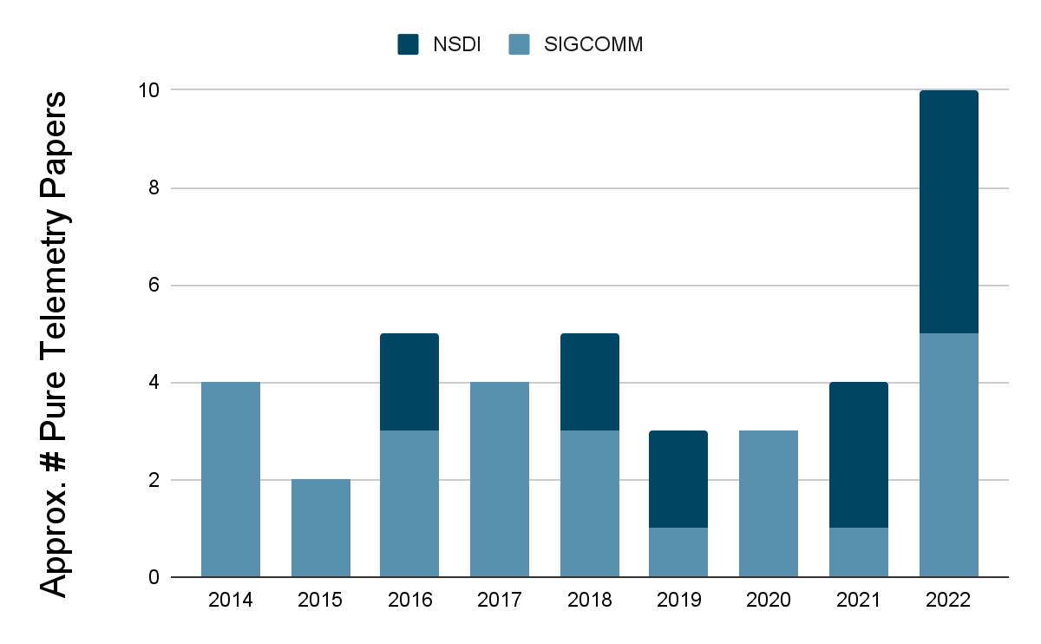
Tons of measuring works...
Cut :(
Programmable switches accelerated telemetry research
Tons of monitoring papers!
In-network pre-processing
Exporting new metrics
Notes:
[Start] Well, we are now in the epoch of programmable switches!

Slide 22
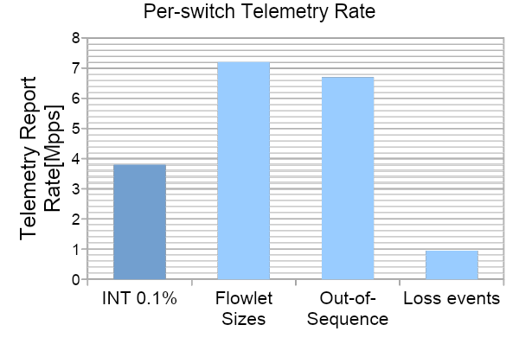
Telemetry is Intense
Cut for time?
INT
Flowlet Sizes
Out-of-Sequence
Paths
Packet losses
Narayana, Srinivas, et al., “Language-Directed Hardware Design for Network Performance Monitoring”, SIGCOMM’17
Zhou, Yu, et al., “Flow Event Telemetry on Programmable Data Plane”, SIGCOMM’20

Slide 23
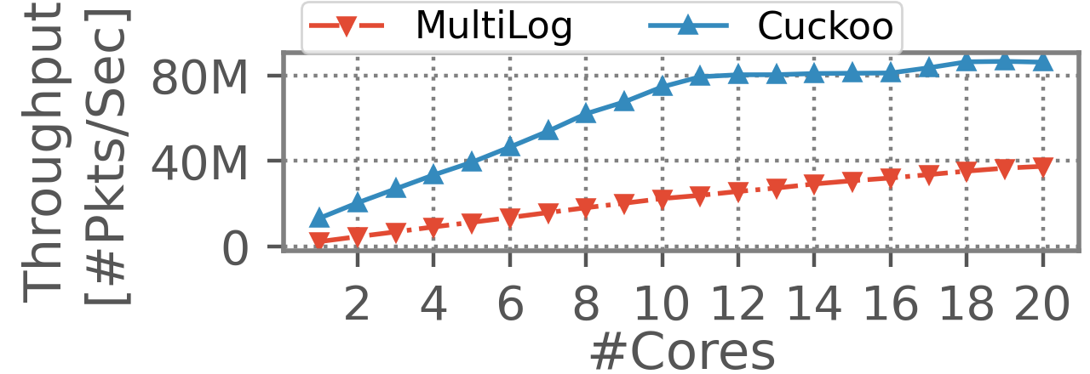
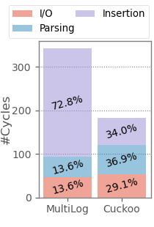
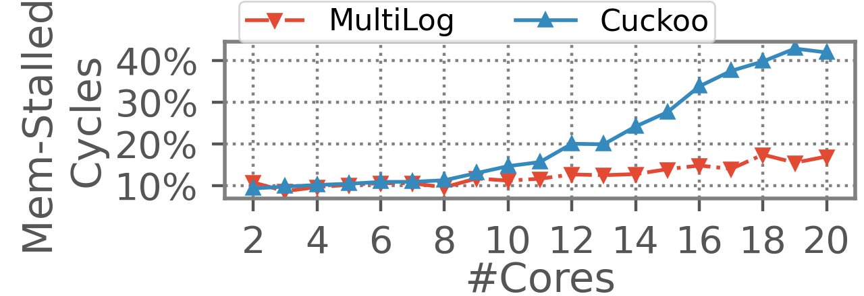
Software Solutions are not Enough
Cut for time? (important motivation)
Simple DPDK hash table
Full-fledged collector
Too slow for fine-grained telemetry
Khandelwal, Anurag, et al., “Confluo: Distributed Monitoring and Diagnosis Stack for High-speed Networks”, NSDI’19

Slide 24
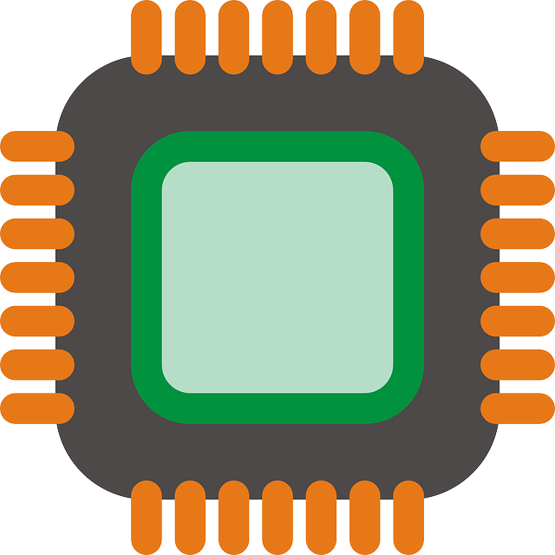
What do we want to build?
Collector
Analysis
A new telemetry ingestion flow
Data-plane speeds
Easily queryable for analysis
Four design goals
Low CPU costs
Few memory accesses
Broad compatibility with telemetry systems
Uses minimal hardware resources
Querying
Reports
Sonata
NetSeer
PacketScope
TurboFlow
PINT
INT
Marple

Slide 25
But RDMA is Limited…
Read
Fast
Explicit addressing
Write
Fast
Explicit addressing
Fetch and Add
Slower
Explicit addressing
Compare and Swap
Slower
Explicit addressing

Slide 26
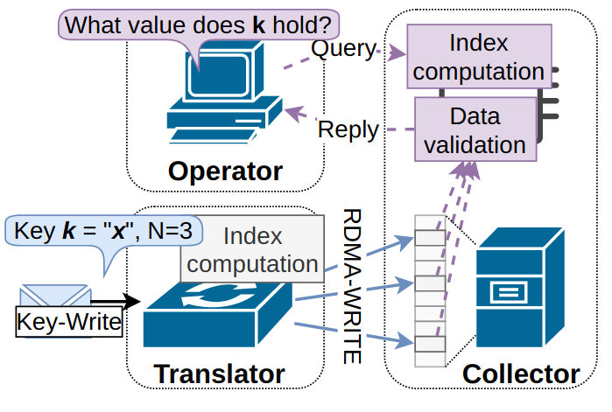
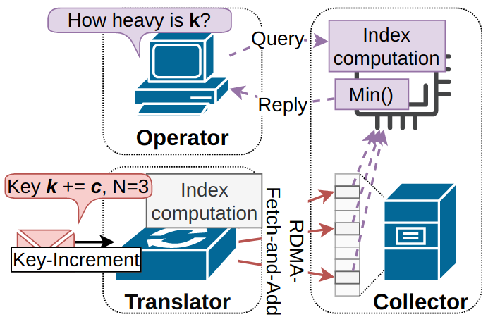
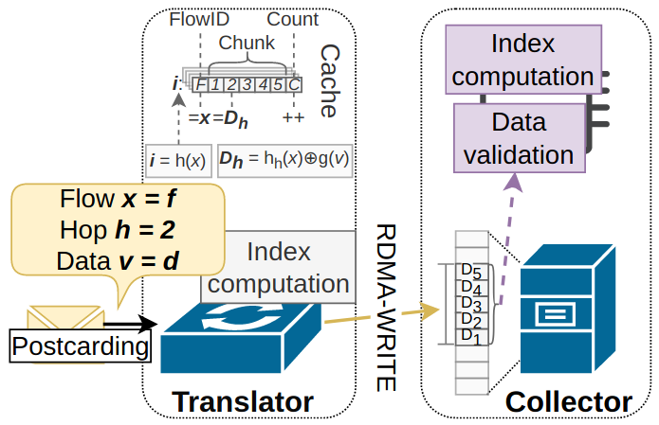
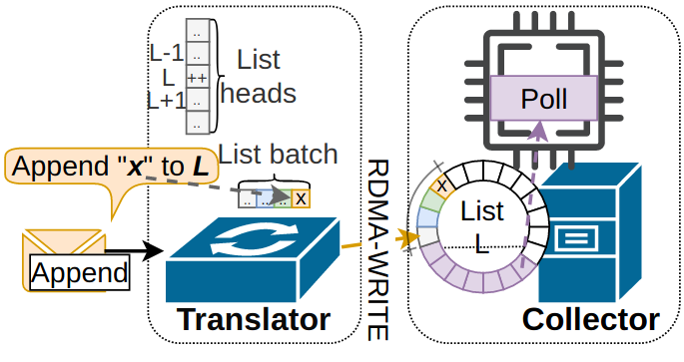
We support multiple verbs
Key/Value storage
Counter storage
Fig: Key-Write
Fig: Key-Increment
Too crowded! Use small version of our table instead
INT Postcard
Aggr.
Chronological events
Fig: Postcarding
Fig: Append

Slide 27
This work in one slide
Telemetry generates tons of data!
Overloads collector CPU
Reduced insight
We redesign telemetry collection
Bypassing the CPU
Increased insight
Reports
O(1Mpps)
Per switch & metric
RDMA
Add spoken: “of course I’m gonna show it’s not as simple as just ‘use RDMa and it works’”
Take it already here
Introduce RDMA here
“we use RDMA with is HPC tech to bypass CPU” “okay to repeat some”
End “but why do we need to redesign it?”
Notes:
[End] But why is this a problem now? What has changed?

Slide 28
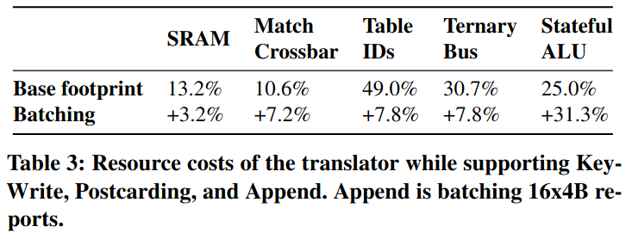
Resource costs @ Translator (in Tofino 1)

Slide 29
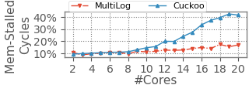
Memory can also bottleneck
Demonstrate with Cuckoo
Simple hash-based key-value store
(not fully-fledged collector)
DTA does not have memory bottleneck
Very low memory loads
Fig: CPU-based collector performance, CPU/Mem bound
Fig: #mem instructions per-report for DTA vs CPU

Slide 30
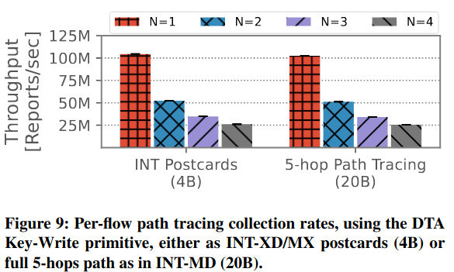
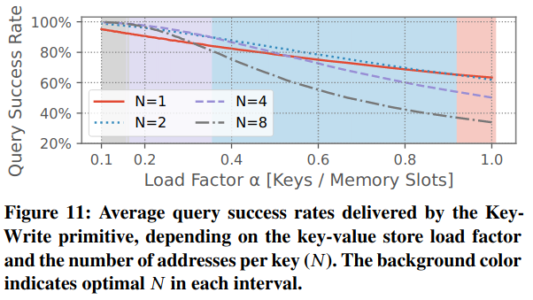
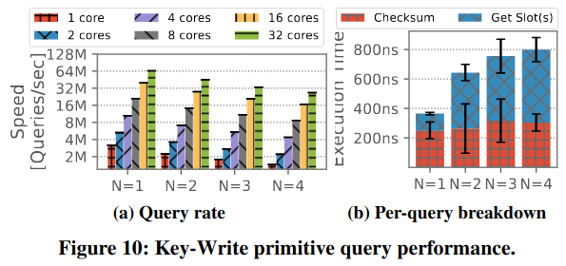
Key-Write

Slide 31
Key-Increment

Slide 32
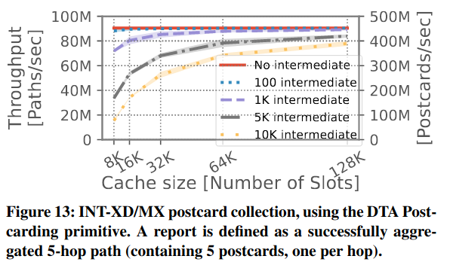
Postcarding

Slide 33
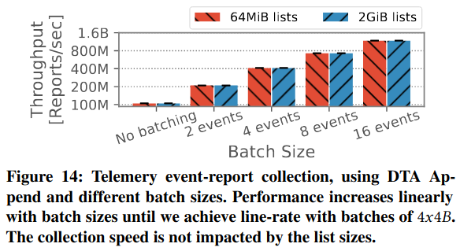
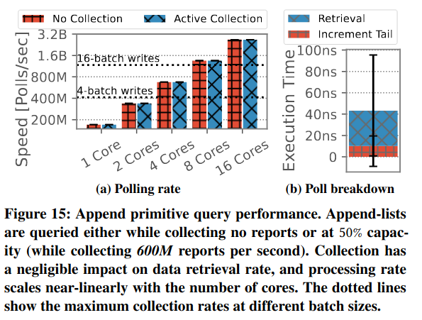
Append

Slide 34
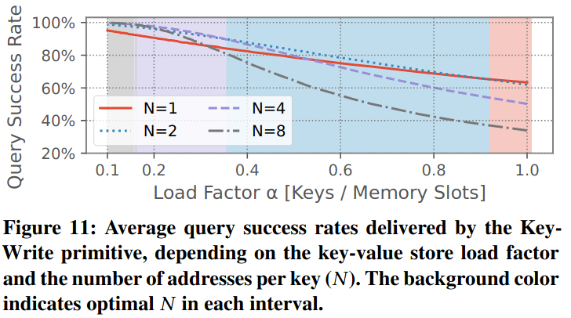
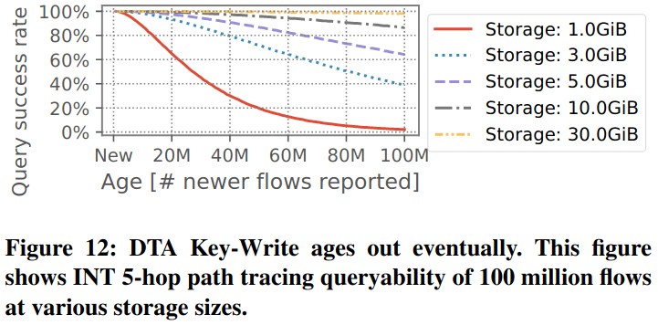
Storage is transient, but robust

Slide 35
Tofino implementation

