Slide 1



Teal:
Traffic Engineering Accelerated with Learning
Zhiying Xu¹ Francis Yan² Rachee Singh³ Justin Chiu³ Alexander Rush³ Minlan Yu¹
¹ ² ³
Notes:
Hi, I'm Zhiying from Harvard University.
Today I‘m going to talk about Teal,
a learning-based algorithm that accelerates traffic engineering in wide area networks
This is joint work with Francis from Microsoft Research,
Rachee, Justin, and Sasha from Cornell,
as well as my PhD advisor Minlan.

Slide 2
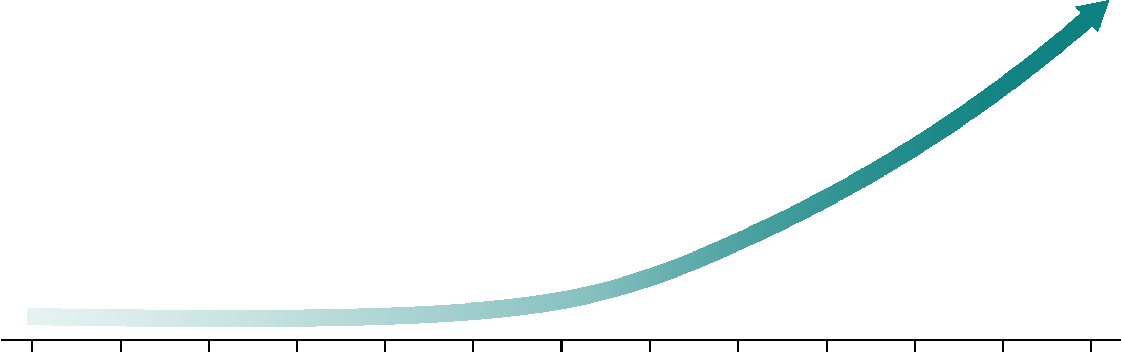
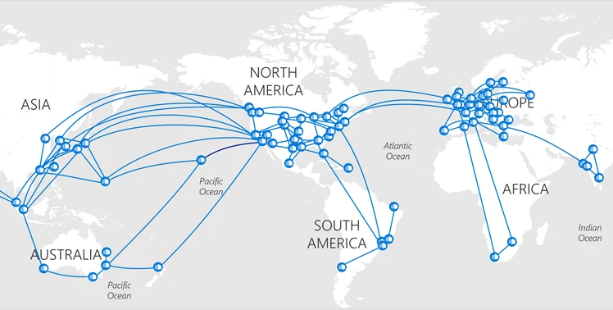
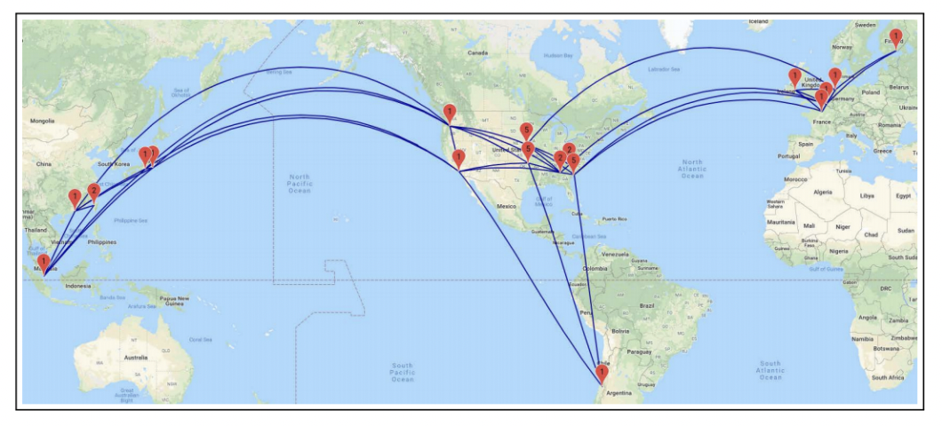
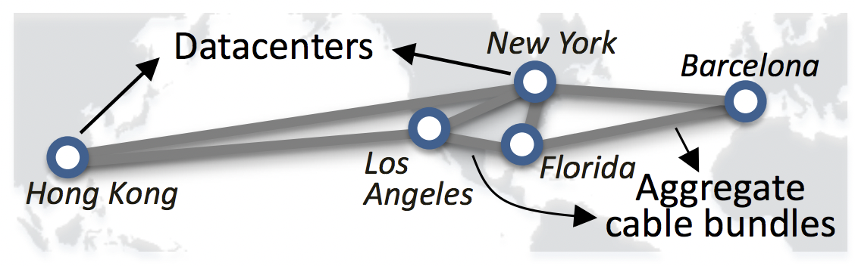
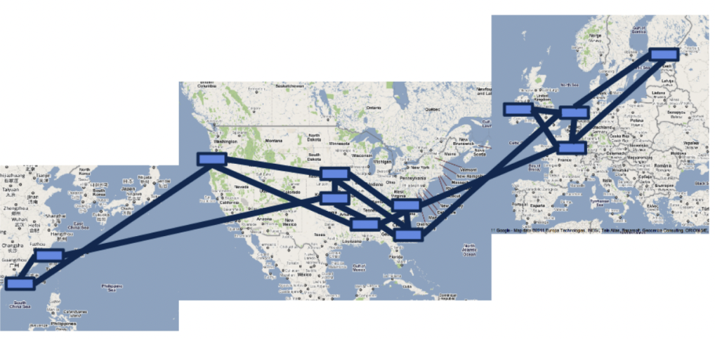
Inter-datacenter wide area network (WAN)
Connects datacenters worldwide
Increasingly large with more datacenters deployed
Microsoft, projected WAN:
~1000s of sites,
~1000s of links
Microsoft, Azure WAN:
~100s of sites, ~100s of links
Google, B4 and After:
33 sites, 38 links
???
Microsoft, SWAN:
5 sites, 7 links
Google, B4:
12 sites, 17 links
2011
2012
2018
2019
???
Notes:
First, what is a wide area network??
(click) The inter-datacenter wide area network is the network that connects datacenters worldwide.
(click) It becomes increasingly large with more datacenters
(click, click) from a few sites (click) to tens of sites or (click) hundreds of sites.
(click) And a future wide area network is projected to have thousands of sites
----------00:45-----------

Slide 3

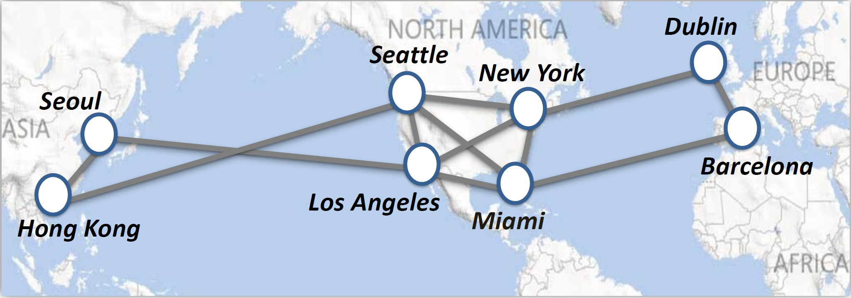


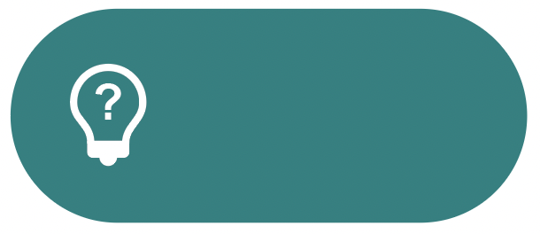



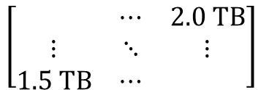
Traffic Engineering (TE) on WANs
WAN topology
with link capacities
Traffic allocations
on predefined paths
every 5 mins
Seattle
TE
Controller
New York
Traffic demands
for the next 5 mins
scales poorly
with large WANs
Los Angeles
Miami
Seattle
Miami
Seattle
$$\left[\begin{matrix} & ⋯ & 2.0 TB \\ ⋮ & ⋱ & ⋮ \\ 1.5 TB & ⋯ & \end{matrix}\right]$$
Miami
Notes:
on these wide area works, traffic engineering systems has been implemented
for every 5 minutes, the TE controller
(click) takes in WAN topology with link capacity,
as well as traffic demands for the next 5 minutes, such as 2 TB from Seattle to Miami.
(click) The TE controller outputs traffic allocation on the predefined paths
For example, there could be four paths from Seattle to Miami
and the TE controller will decide how much traffic is on each of these 4 paths
(click) However, the TE controller scales poorly, as the wide area network grows larger.
Let me show an example
----------01:25-----------

Slide 4
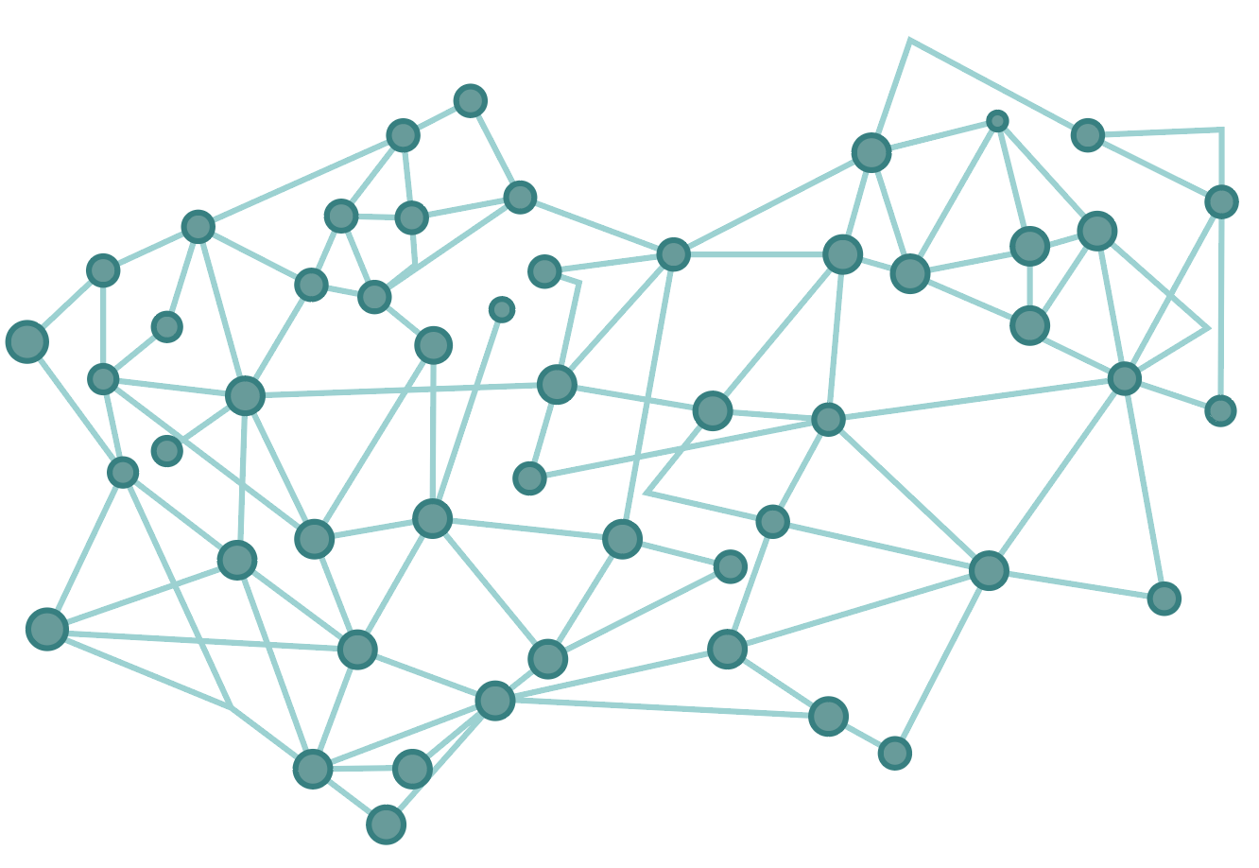


TE algorithms scale poorly with large WANs
Parallelism
Sequential
LP solvers
Computation time
Too slow
Satisfied demand
Optimal
Decomposition
Limited parallelism
Still slow
Suboptimal
10 minutes
5.5 hours
95% of demand
satisfied
(optimal)
1.5k nodes
& 8k edges
75% of demand
satisfied
POP
Notes:
(click) for example, we have a network with 1.5k nodes and 8k edges
(click) As TE is essentially a linear programming problem, LP solvers are widely used, such as Gurobi.
(click) Due to the sequential nature of the LP solver, (click) it is very slow to compute the optimal solution.
(click) In our example, it takes 5.5 hours to output the optimal solution with 95% of demand satisfied (click)
(click) To make TE faster, recent approaches, such as POP from SOSP '21,
decomposes the TE problem into a few subproblems and concurrently solves them with LP solvers
(click) But this limit parallelism is still too slow with 10-minute computation time
(click) Meanwhile, because of the decomposition, it is suboptimal with only 75% of demand satisfied
----------02:20-----------

Slide 5
Key insight: neural network inference unlocks massive parallelism
 | Parallelism | Computation time | Satisfied demand
LP solvers | Sequential | Too slow | Optimal
Decomposition | Limited parallelism | Still slow | Suboptimal
Highly parallelizable
Neural network inference
Fast
Near-optimal
largely consists of
matrix multiplications
leverages thousands
of GPU threads
exploits regularities in
abundant training data
Notes:
(click) We can see the root cause of scalability problem is actually sequential nature or limited parallelism.
(click) To tackle this, our key insight is that neural network inference unlocks massive parallelism.
(click) neural network inference is highly parallelizable because it largely consists of parallelizable matrix multiplication
(click) By leveraging thousands of GPU threads, the neural network inference can be quite fast
(click) And it can also achieve near-optimal solution through exploiting the regularities in our abundant training data
----------03:00-----------

Slide 6
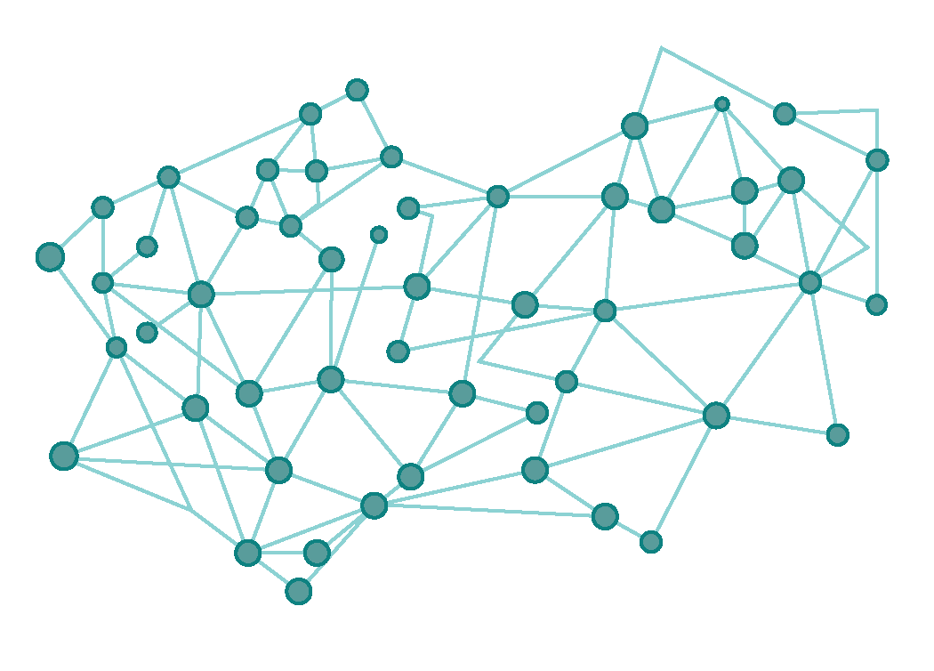

How to model TE with neural networks?
TE controller
traffic allocations
GNN (graph neural network) is a natural fit
  message passing between local neighboring nodes
  Missing a global view for traffic flows
FlowGNN: extracts flow features
  GNN nodes:
  GNN edges: capacity and demand constraints
capacity
constraints
demand
constraints
✘
    "edge nodes" for WAN links
    "path nodes" for traversing flows
path
nodes
edge
nodes
Notes:
However, using neural network inference for TE is challenging
(click) First, for the input, how to model the TE problem with neural networks?
(click) Graph neural network, or GNN, is a nature fit for such graph-structured problem
It does message passing between local neighboring nodes to learn graph features.
(click) However, it misses a global view for traffic flows.
Suppose there is a traffic from a source to a destination far away,
we cannot capture the feature for this traffic flow through local nodes.
(click) To solve this problem, we design flowGNN to extract flow features,
which are compact vectors capturing a learned representation of flows.
Let's look at this example
(click) We create two types of GNN nodes. One type is edge nodes for edges.
(click) As there are traffic flows from one source to another destination,
we also create path nodes for the paths that these flows traverse
(click) the message passing between GNN nodes captures capacity and demand constraints
(click) if an edge is on a path, we will create message passing between corresponding edge node and path node.
Edge nodes send capacity usage information to paths nodes while path nodes send back flow allocation information
In this way, we mimic the capacity constraints for flows.
(click) There is also another message passing among path nodes from the same source and destination,
in order to mimic the demand to be allocated on all these paths.
----------04:35-----------

Slide 7



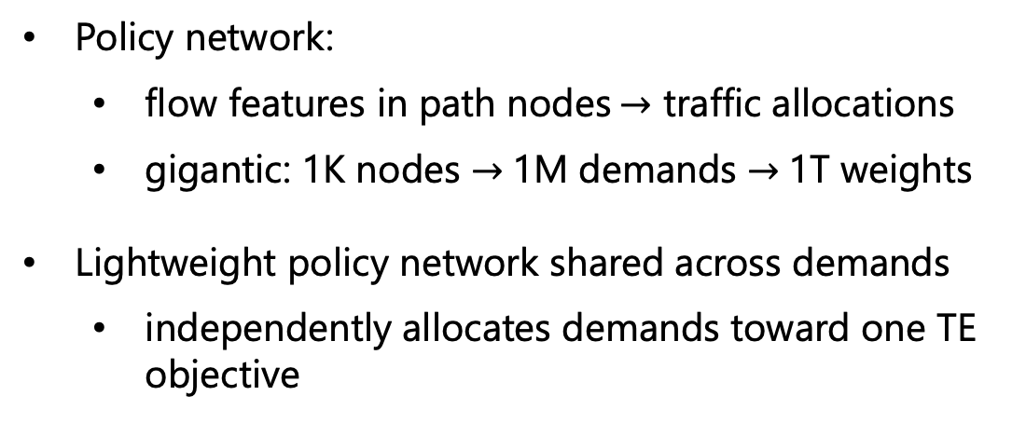
How to address millions of traffic allocations?
TE controller
traffic allocations
flow
features
policy
network
flow
allocations
Policy network:
  flow features in path nodes$→$ traffic allocations
  gigantic: 1K nodes $→$1M demands $→$1T weights
Lightweight policy network shared across demands
  independently allocates demands toward one TE objective
$$d_{1→2}$$
?
✘
$$d_{1→3}$$
?
millions of demands
…
…
…
each demand
as an RL agent
cooperative
optimization
$$d_{N−1→N}$$
?
  multi-agent reinforcement learning (RL)
Notes:
Now that GNN has learnt flow features for TE, our next challenge is on the TE controller:
(click) in a large network, How to address millions of traffic allocations?
(click) Usually, a policy network will map the flow features learnt in path nodes to traffic allocations
(click) However, in such a large network, the policy network for all the demands is gigantic
a graph with one thousand nodes, can have one million demand pairs from each source to each destination, further resulting in one trillion weights in policy network, which is too many to learn
(click) instead, we use a Lightweight policy network shared across demands
This policy network independently allocates demands toward one TE objective
(click) To learn this policy network, we use multi-agent reinforcement learning,
(click) which treat each demand as an individual RL agent
and these RL agent work cooperatively to optimize a global TE objective
----------05:35-----------

Slide 8
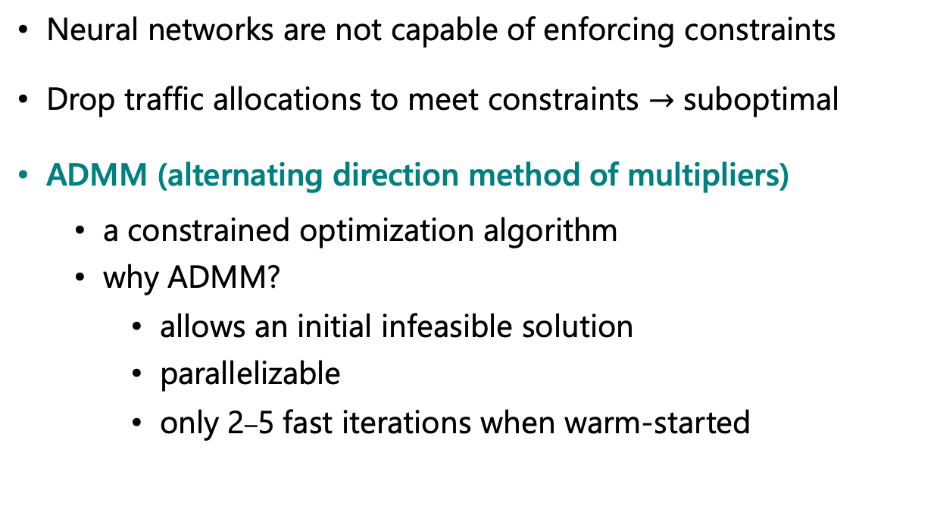
How to enforce capacity constraints?
TE controller
traffic allocations
Neural networks are not capable of enforcing constraints
Drop traffic allocations to meet constraints $→$ suboptimal
ADMM (alternating direction method of multipliers)
  a constrained optimization algorithm
  why ADMM?
    allows an initial infeasible solution
    parallelizable
    only 2–5 fast iterations when warm-started
✘
feasible allocations
optimal
drop
traffic
ADMM
neural network output
Notes:
Our final challenge is in the output: (click) How to enforce capacity constraints on the traffic allocation
(click) the previous neural networks are not capable of enforcing constraint. As the right figure shows, it can only output a coarse traffic allocations outside the green area for constrained satisfying allocations
(click) One naïve solution is to drop traffic allocations to meet constraints, but the solution is suboptimal-- we will end up in a point satisfying constraints but far from the optimal
(click) Therefore, we leverage ADMM,
(click) a constrained optimization algorithm that iteratively fine-tunes the traffic allocations from the upstream neural networks in order to satisfy more constraints.
(click) But why admm?
First, ADMM allows an initial infeasible solution
We could start from an initial point that violates constraints, just like an output from the neural networks
(click) Second, ADMM is highly parallelizable
(click) finally, when warmed-started with a neural network output, only 2-5 fast iterations are enough to significantly improve the solution quality.
----------06:45-----------

Slide 9
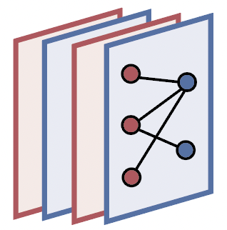


Teal summary
FlowGNN:
extracts flow features
Multi-agent RL:
maps flow features
to initial allocations
ADMM:
fine-tunes allocations
to satisfy constraints
traffic
allocations
Notes:
Here is a summary of Teal
Teal is composed of 3 parts to tackle the three previous challenges
(click) flowGNN, the first part, extracts flow features to model TE problem
(click) Multi-agent RL, the second part, maps flow features to traffic allocations
(click) ADMM, the third part, fine-tunes traffic allocations for capacity constraints

Slide 10
Experimental setup
Network traffic collected on Microsoft’s WAN (SWAN)
  over a 20-day period in 2022
Transform real traffic data to larger topologies
  UsCarrier (158 nodes), KDL (754 nodes), ASN (1739 nodes)
Baselines:
  LP-all: allocates all demands using LP solver (Gurobi)
  LP-top: allocates top 10% demands using LP solver and pins remaining ones on shortest paths
  POP [SOSP ‘21]: state-of-the-art decomposition-based TE scheme
TE schemes maximize total flow
  normalized into satisfied demand (%)
Notes:
Our evaluation setup is as follows.
We used network traffic from Microsoft production WAN.
(click) This real traffic data are transformed into other topologies of various sizes
(click) As for baselines, we denote LP-all as solutions from the LP solver
(click) Since LP solver can be slow, another baseline, LP-top, allocates top 10% of demands with LP solver, and pins the remaining demands onto the shortest paths
(click) We adopt a state-of-the-art decomposition-based TE schemes, POP from SOSP’21.
We have also compared with other baselines such as NCFlow from NSDI '21 but the results are omitted in this talk due to time limit.
(click) As for the metric, our objective here is to maximize total flow and we normalized our results into satisfied demands.
----------08:10-----------

Slide 11
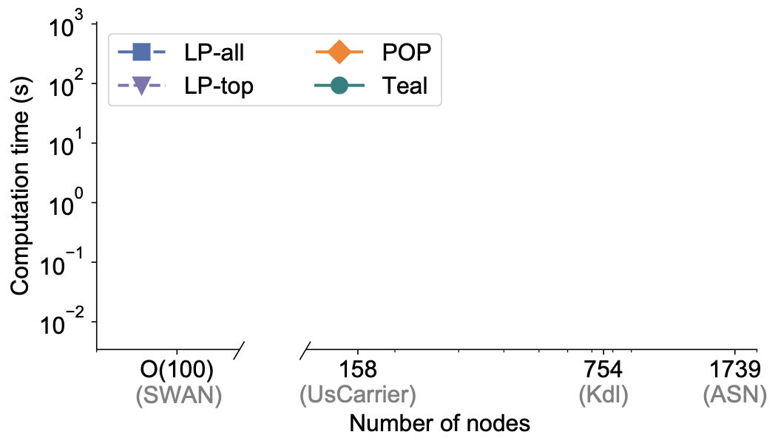
Teal significantly accelerates TE optimization
Teal allocates traffic within 1 second
LP-all: 616× slower in Kdl
LP-top: 197× slower in ASN
POP: 625× slower in ASN
Notes:
Our evaluation shows that Teal significantly accelerates TE
In this figure, x axis is number of nodes, and y axis is computation time
(click) Teal allocates traffic within 1 s in larger networks
(click) LP-all is not scalable on the largest network, ASN, and is over 600 times slower in Kdl
(click) LP-top is almost 200 times slower in ASN
(click) while POP is over 600 times slower in ASN
----------08:45-----------

Slide 12
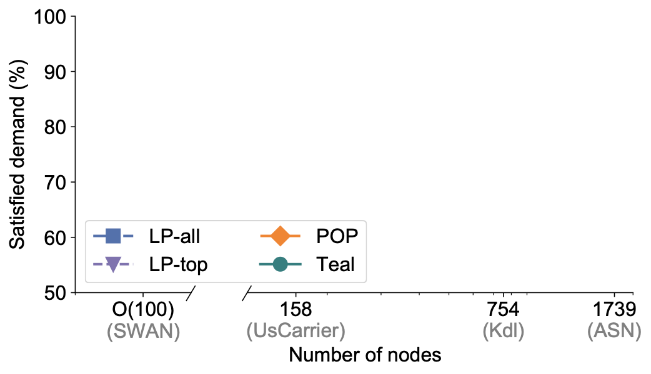
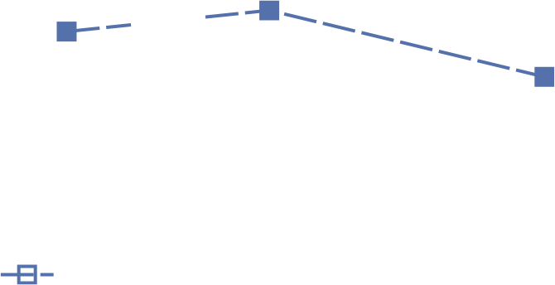
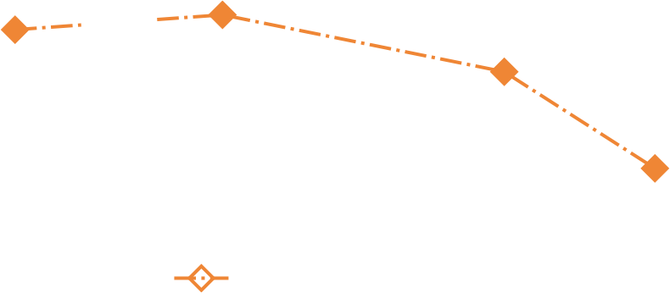
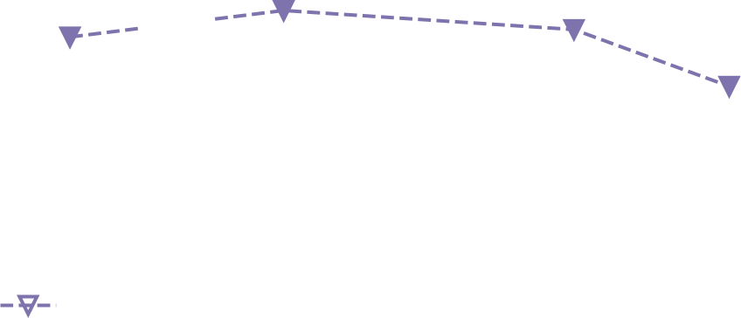
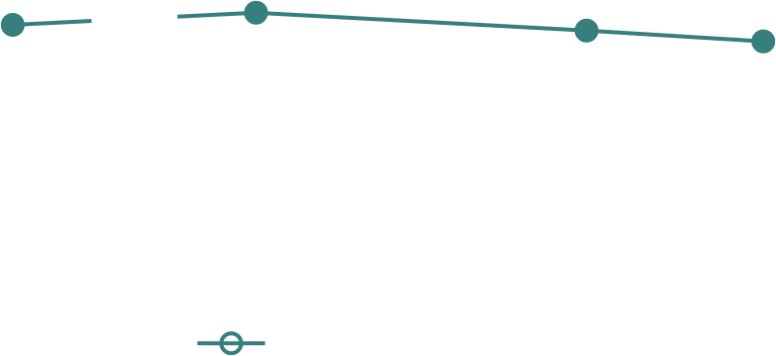
Teal generates near-optimal traffic allocations
Teal satisfies ~90% of demand
LP-all: 3% less in Kdl
LP-top: 6% less in ASN
POP: 14.5% less in ASN
Notes:
Apart from being fast, Teal generates near-optimal traffic allocations
In the figure below, x axis is still number of nodes and y axis is now percentage of satisfied demand
(click) Teal satisfied around 90% of demand in larger networks
(click) LP-all, an optimal scheme satisfies 3% less demand than Teal on kdl.
The gap is because while LP-all is spending time computing the next traffic allocation,
the TE system is forced to reuse the previously computed allocation,
leading to suboptimal results in practice.
(click) LP-top satisfied 6% of demand less
(click) while POP satisfied 14.5% less
----------09:30-----------

Slide 13
Teal: Traffic Engineering Accelerated with Learning
Teal substantially accelerates large-scale TE with deep learning
while achieving near-optimal traffic allocations
key insight: neural network inference unlocks massive parallelism
New paradigm for applying ML: accelerating networking optimization problems
Notes:
In conclusion, Teal substantially accelerates large-scale TE with deep learning
while achieving near-optimal traffic allocation.
our key insight is that neural network inference unlocks massive parallelism
(click) With the encouraging results in our work,
we believe that Teal has opened the door to a new paradigm for applying ML in networking,
which is accelerating network problems in addition to its conventional uses.
Thank you!

