Slide 1



Optimus: Accelerating Large-Scale Multi-Modal LLM Training by Bubble Exploitation
Weiqi Feng, Yangrui Chen, Shaoyu Wang, Yanghua Peng,
Haibin Lin, Minlan Yu

Slide 2
The rise of Multimodal LLMs
GPT-4o (OpenAI): Processes text, images, and more for versatile applications like visual question answering.
Gemini 2.5 Pro (Google): Excels in processing text, images, audio, video, and code with a 1-million-token context window.
LLaVa: Open-source model excelling in image captioning and visual reasoning.

Slide 3
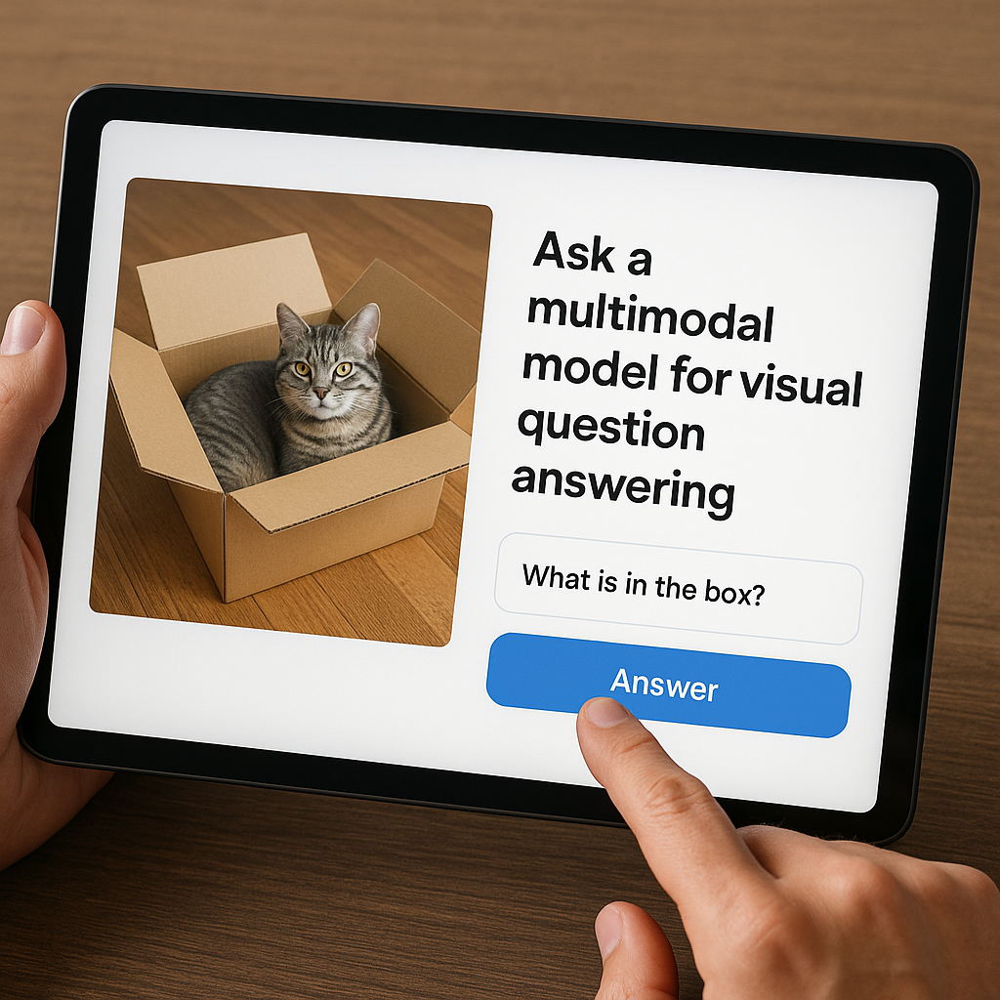
The rise of Multimodal LLMs
GPT-4o (OpenAI): Processes text, images, and more for versatile applications like visual question answering.
Gemini 2.5 Pro (Google): Excels in processing text, images, audio, video, and code with a 1-million-token context window.
LLaVa: Open-source model excelling in image captioning and visual reasoning.

Slide 4


Background: Multimodal LLM (MLLM) architecture
Aligned Features
LLM backbone
Image
Encoder 1
Audio
Encoder 2
…
Output
Other modality
Encoder n
Text
What does this …

Slide 5
Background: Unique Characteristics of MLLMs
Dominant Model Size of LLM Backbone: The LLM backbone dominates with significantly more parameters (e.g., Flamingo’s 70B of 80B total parameters [1]) compared to encoders.
Dependency Between Encoders and LLM Backbone: Encoders generate features before the LLM backbone’s forward pass, while gradients are computed by the backbone before encoders in the backward pass
[1] Alayrac, Jean-Baptiste, Jeff Donahue, Pauline Luc, Antoine Miech, Iain Barr, Yana Hasson, Karel Lenc et al. "Flamingo: a visual language model for few-shot learning." Advances in neural information processing systems 35 (2022): 23716-23736.

Slide 6
Inefficiencies of 3D Parallel Training Systems for MLLMs
3D parallel training systems like Megatron-LM [1], designed for symmetric transformer models, require placing encoders in the first pipeline stage for MLLM training, resulting in pipeline imbalances.
LLM
PP Stage 1
PP Stage 2
PP Stage 3
PP Stage 4
Encoder
GPU 1
GPU 2
GPU 3
GPU 4
DP=1
PP=4
TP=2
GPU 5
GPU 6
GPU 7
GPU 8
[1] Narayanan, Deepak, Mohammad Shoeybi, Jared Casper, Patrick LeGresley, Mostofa Patwary, Vijay Korthikanti, Dmitri Vainbrand et al. "Efficient large-scale language model training on gpu clusters using megatron-lm." In Proceedings of the international conference for high performance computing, networking, storage and analysis, pp. 1-15. 2021.

Slide 7
Talk Outline
Direction: scheduling encoder computation in LLM bubbles
Optimus: making bubble exploitation works in practice
Evaluation: performance of Optimus at scale

Slide 8
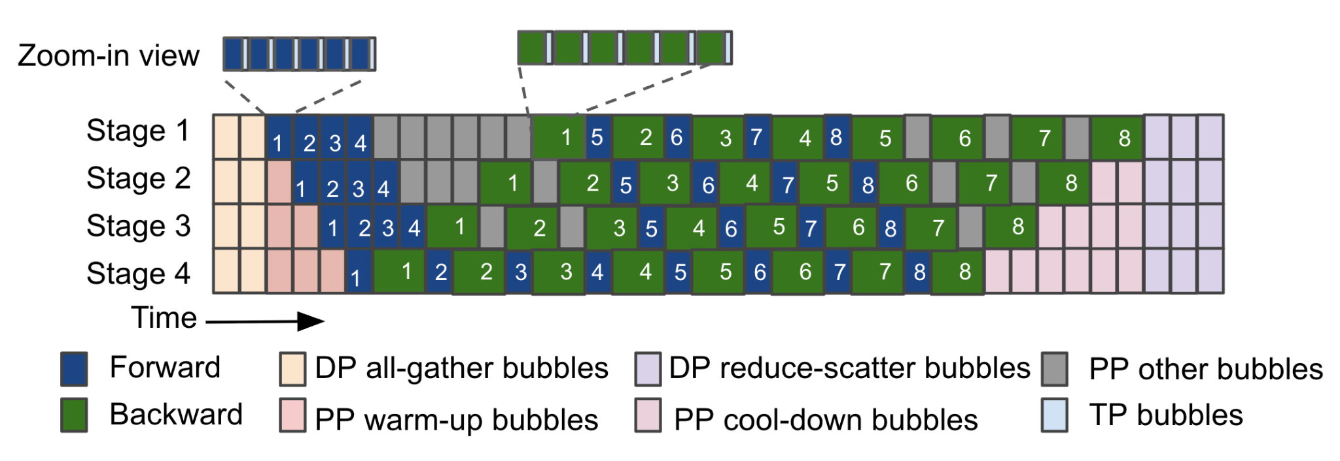
Significant GPU Idle Time (bubbles) in MLLM Training
We noted that over 48% of GPU cycles were idle (bubbles) during internal large-scale MLLM training tasks, with these bubbles attributed to three main causes:
Communication in Data Parallelism (DP)
Dependency in Pipeline Parallelism (PP)
Communication in Tensor Parallelism (TP)

Slide 9
Most Bubbles Occur during LLM Computation
We noted that over 48% of GPU cycles were idle (bubbles) during internal large-scale MLLM training tasks, with these bubbles attributed to three main causes:
Communication in Data Parallelism (DP)
Dependency in Pipeline Parallelism (PP)
Communication in Tensor Parallelism (TP)
Majority of bubbles (around 90%) occur during the LLM forward pass and backward pass

Slide 10
Most Bubbles Occur during LLM Computation
We noted that over 48% of GPU cycles were idle (bubbles) during internal large-scale MLLM training tasks, with these bubbles attributed to three main causes:
Communication in Data Parallelism (DP)
Dependency in Pipeline Parallelism (PP)
Communication in Tensor Parallelism (TP)
Direction: scheduling encoder computation in LLM bubbles
Majority of bubbles (around 90%) occur during the LLM forward pass and backward pass

Slide 11
Talk Outline
Direction: scheduling encoder computation in LLM bubbles
Optimus: making bubble exploitation works in practice
Evaluation: performance of Optimus at scale

Slide 12
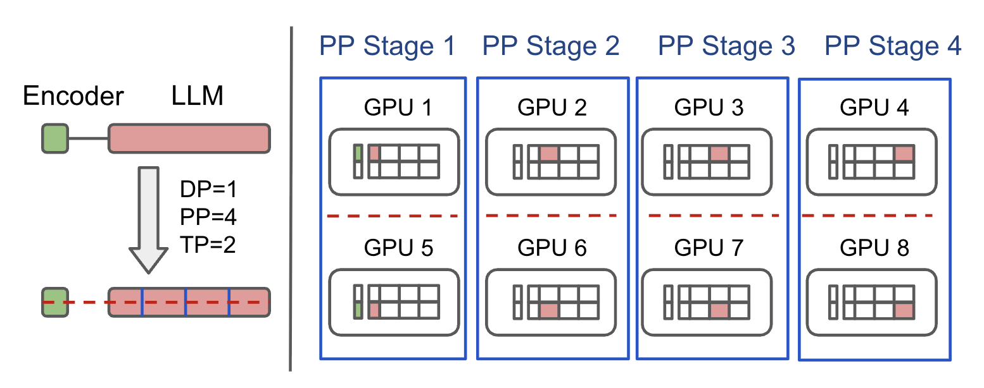
Challenge 1: Limited GPUs have both encoder and LLM model states
The current 3D parallelism strategy distributes the MLLM across multiple GPUs as a single pipeline, resulting in only GPUs in one pipeline stage holding both encoder and LLM model states.

Slide 13
Challenge 1: Limited GPUs have both encoder and LLM model states
However, holding both encoder and LLM states on GPUs is a necessary condition for scheduling encoder computation within LLM bubbles.
Optimus approach: Colocate encoders and LLM with separate parallelism

Slide 14
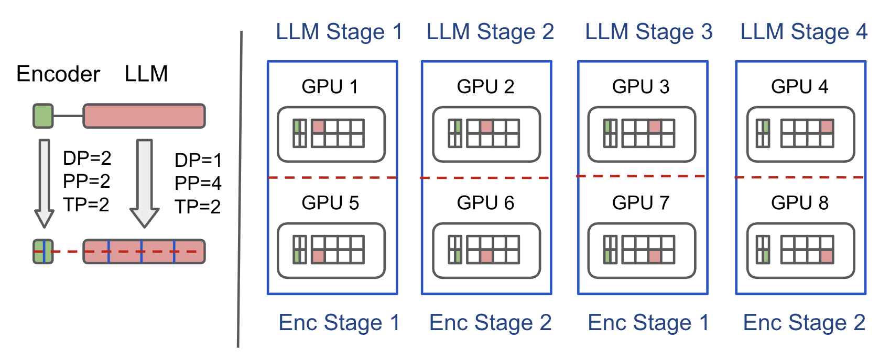
Colocate encoders and LLM with separate parallelism
Assign separate 3D parallel plans to encoders and LLMs across all GPUs

Slide 15
Colocate encoders and LLM with separate parallelism
Benefit 1: All GPUs have both encoder and LLM states
Benefit 2: Encoder can select parallelism plans to optimize its computational efficiency

Slide 16

Challenge 2: Complex Dependencies in MLLM training
Synchronous training introduces iteration dependencies
Dependencies exist within encoder and LLM pipelines
Encoder-LLM dependencies enforce microbatch-level constraints
Before
Encoder
LLM
Encoder Forward
LLM Forward
Before
LLM Backward
Encoder Backward

Slide 17
Challenge 2: Complex Dependencies in MLLM training
Synchronous training introduces iteration dependencies
Dependencies exist within encoder and LLM pipelines
Encoder-LLM dependencies enforce microbatch-level constraints
Optimus approach: Dual-stage dependency management
Before
Encoder
LLM
Encoder Forward
LLM Forward
Before
LLM Backward
Encoder Backward

Slide 18
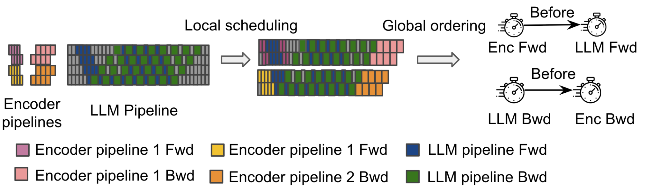
Dual-stage Dependency Management
Use two stages to handle complex dependencies
Local scheduling: Each encoder pipeline schedules its computation within available LLM bubbles.
Global ordering: Ensures microbatch-level dependencies between encoders and LLM by comparing microbatch timestamps.

Slide 19
Dual-stage Dependency Management
Use two stages to handle complex dependencies
Local scheduling: Each encoder pipeline schedules its computation within available LLM bubbles.
Global ordering: Ensures microbatch-level dependencies between encoders and LLM by comparing microbatch timestamps.
Please checkout the paper for the detailed bubble scheduling algorithm

Slide 20
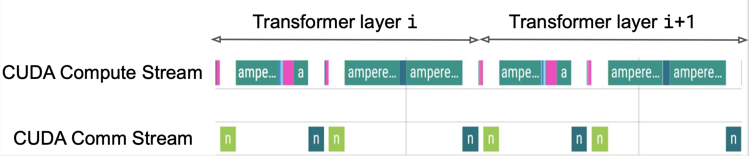
Challenge 3: Sub-millisecond LLM bubbles
LLM bubbles differ greatly in duration, from sub-millisecond tensor parallelism communication bubbles (e.g., ~300µs for two GPT-175B transformer layers) to hundreds of milliseconds for data parallelism communication.
Optimus approach: Schedule encoder computation at kernel level

Slide 21
Schedule Encoder Computation at Kernel Level
Decomposing encoder layers into kernels optimizes sub-millisecond bubble utilization and schedules encoder communication kernels during LLM computation to prevent TP communication bandwidth conflicts.
Encoder kernels
schedule
LLM compute
LLM bubble
Encoder computation kernel
Encoder communication kernel

Slide 22
Talk Outline
Direction: scheduling encoder computation in LLM bubbles
Optimus: making bubble exploitation works in practice
Evaluation: performance of Optimus at scale

Slide 23
Evaluation Overview
Models:
We build MLLM models with different image encoder sizes (ViT-22B, ViT-11B, ViT-5B) and LLM backbones (LLAMA-70B, GPT-175B).
Metrics: Iteration time and Model Flops Utilization (MFU)
Testbed:
We performed experiments on a production training cluster with thousands of NVIDIA Hopper GPUs, each featuring 80GB of memory and 989 TFLOPS of computing performance.

Slide 24
Evaluation Overview
Baselines:
Megatron-LM
We place multimodal encoders in the first pipeline stage to adapt to MLLM training.
Megatron-LM balanced
We use a dynamic programming algorithm to assign different layers of submodules to pipeline stages and achieve approximately the same computation amount.
Pytorch FSDP
Alpa (OSDI 22)
a compiler system for distributed DL training that automatically generates parallel execution plans covering 3D parallelisms

Slide 25
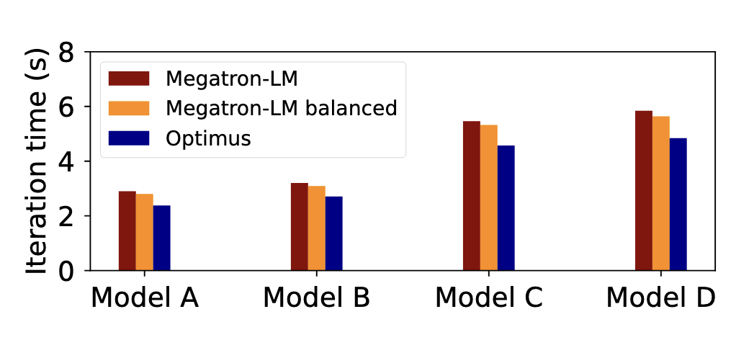
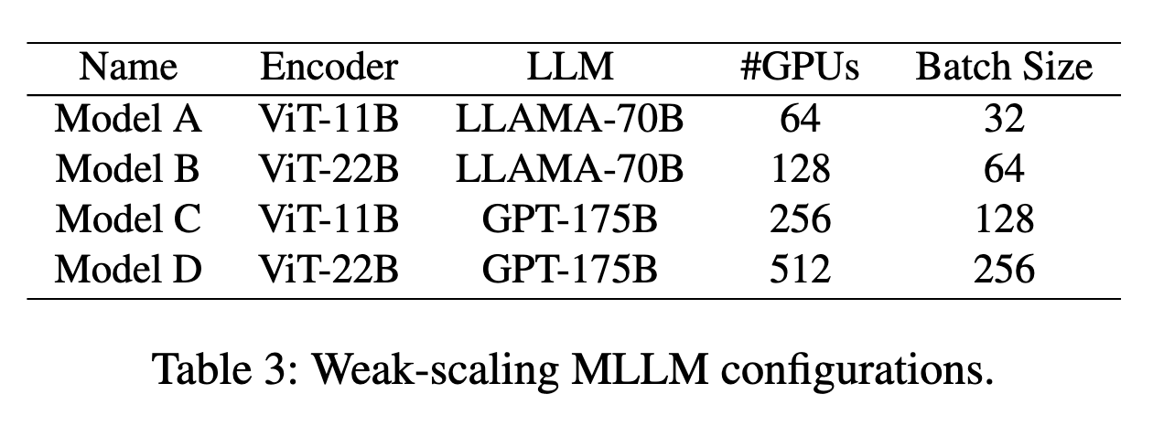
Weak Scaling Experiment
To study large-scale model training, we scale model size and GPU count, evaluating weak-scaling performance of Optimus and baselines using Table 3 configurations.
Optimus achieves a speedup of up to 1.22× compared to Megatron-LM and 1.18× compared to the Megatron-LM balanced.
* Alpa and FSDP are not shown in the figure because of OOM

Slide 26
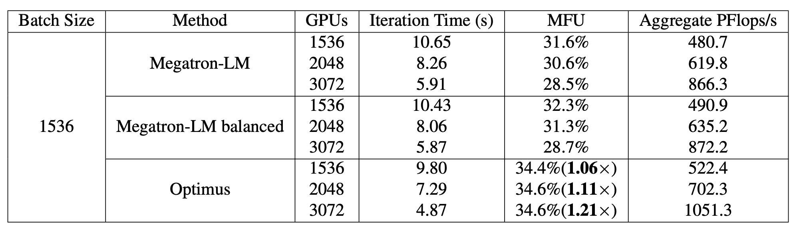
Strong Scaling Experiment
We evaluate strong-scaling performance of Optimus and Megatron baselines with ViT-22B+GPT-175B, increasing GPUs (1536, 2048, 3172) at a constant batch size of 1536.

Slide 27
Strong Scaling Experiment
We evaluate strong-scaling performance of Optimus and Megatron baselines with ViT-22B+GPT-175B, increasing GPUs (1536, 2048, 3172) at a constant batch size of 1536.
Optimus reduces iteration time by up to 21.3% compared to Megatron-LM, and by up to 20.5% compared to the Megatron-LM balanced.

Slide 28
More results in the paper
Explore the paper for details on:
Optimus performance with multi-encoder MLLMs
Optimus GPU memory usage
Optimus bubble scheduling efficiency and algorithm runtime

Slide 29

Optimus Summary
Optimus is a distributed MLLM training system that schedules encoder computation in LLM bubbles to reduce end-to-end training time.
Experiments show that Optimus speeds up MLLM training by 20.5%–21.3% on ViT-22B and GPT-175B across 3072 GPUs, outperforming existing systems by an average of 20.3%.

Slide 30
Thank You!

