Slide 1
Tradeoffs in CDN Designs for Throughput Oriented Traffic
Minlan Yu
University of Southern California
Joint work with Wenjie Jiang, Haoyuan Li, and Ion Stoica

Slide 2
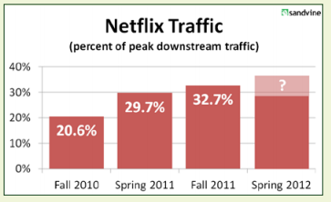
Throughput-Oriented Traffic
Throughput-oriented traffic is growing in Internet
  Cisco report predicts that 90% of the consumer traffic will be video by 2013 (E.g., NetFlix, Youtube)
  Software, game, movie downloads
  Most are delivered by content distribution networks
Revisit CDN design choices for throughput-oriented traffic
Notes:
Throughput-oriented traffic is growing …
Cisco…
Sandvine report…. [figure]
Video streaming, software, games, video downloads

Slide 3


Where is the throughput bottleneck?
Client:
Computer/access link too slow
Network:
Congestions at peering and upstream links
Server:
Not enough resource (CPU, power, bw)
Notes:
Clients have no choice other than upgrading
the connection. CDNs often have strong incentives
to buy more bandwidths to eliminate throughput bottlenecks.
Therefore, the most challenging problem is to avoid
throughput bottlenecks inside the network.

Slide 4
Understanding Throughput Bottleneck
Network bottlenecks are common
  NetFlix sees reduced video rates due to low ISP capacity
  Akamai reported bottlenecks at peering links
Degraded video performance caused by network congestion
Notes:
For the figure: viewers with the same CDN server have different performance experiences.
Viewers with different CDNs all experience same congestion
When there are
more than 14K concurrent viewers, there is a clear degradation
of the delivery performance caused by network congestion.
Ignore it: For the web traffic in Coral CDN
5.77% of connections have client bottleneck
6.20% of connections have network bottleneck
72.23% of connections have server bottleneck

Slide 5
Nature of Bottleneck is Changing
More throughput-oriented applications
  Video traffic lasts longer and has higher volume
More elephants step on each other in the future
  Decreases the benefits of statistical multiplexing
  Introduces more challenges in bandwidth provisioning

Slide 6
Improving Network Throughput
ISP-CDNs: multiple paths and better path selections
  ISPs move up in the revenue chain to deliver content
    ISP-CDNs such as AT&T and Verizon
  Control both servers and the network
  Better traffic engineering for CDN traffic
Existing CDNs: Deploy servers at more locations and setting up more peering points
Question 1: What’s the throughput benefit of more paths over more peering points?
Peering points
… …

Slide 7
Improving CDN Throughput
Highly distributed approach (e.g., Akamai)
  Many server locations, more high-throughput paths
  Higher management, replication, bandwidth cost
More centralized approach (e.g., Limelight)
  A few large data centers with more peering points
  Lower cost due to economy of scale
More centralized
Highly distributed
Question 2: How to compare more centralized vs. more distributed CDNs on throughput and cost?
… …
Notes:
Jiasi: Phrases to explain management, replication, bw cost
We are not modeling real CDNs but only comparing the two methods..
In terms of bandwidth cost, Akamai traditionally has hosted
servers at many ISPs for “free”. However, as ISPs start to
provide their own CDN services, it is very hard for other
CDNs to place servers for free any more. Even Akamai
today can only place servers for free for a few small ISPs
without many clients, but has to pay those large ISPs for
placing the servers. In addition, Akamai is deploying more
capacity in large data centers, and thus incurring the peering
bandwidth cost as other CDNs. According to the SEC
fillings [23], Akamai’s bandwidth costs are higher than Limelight’s
(of course, Akamai carries significantly more traffic,
but still it shows that Akamai doesn’t get the bandwidth for
free).

Slide 8
Modeling CDN Design Choices
CDNs: Increase peering points at the edge
ISPs: Improve path selection at the core

Slide 9
Increase Peering Points
Modeling peering points (PPs)
  Increase #PPs to study throughput effect
  Pick PP locations from synthetic and real topologies
Peering point selection
  Maximize aggregate throughput
  By assigning client locations to PPs
  … and splitting traffic to different PPs
Notes:
Fix #PPs, select different #servers and PPs per server to study operation cost

Slide 10
Improve Path Selection
Today: No cooperation (1path)
  ISPs: Shortest path routing (e.g., OSPF)
  CDNs: Select peering points to maximize throughput
Better contracts between ISPs and CDNs (n paths)
  ISPs: Expose multiple shortest paths to CDNs (e.g.,MPLS)
  CDNs: Select peering points and paths

Slide 11
Improving Path Selection
ISP-CDNs: Optimal throughput (mcf)
  Joint traffic engineering and server selection
  Reduced to multi-commodity flow problem
Optimization formulation
  Objectives: Max total throughput
  Subject to: Client demands & Link capacity constraints
  Variables: Peering point selection, traffic splitting on each paths (Flow_{path, pp, client})

Slide 12
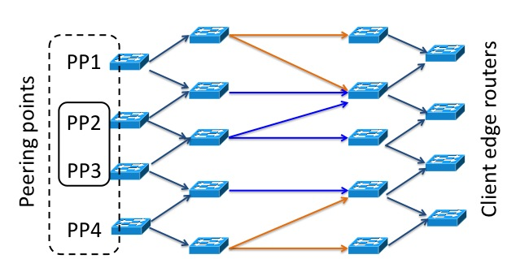
An Example
Min-cut size
  improving path selection only approximates the min-cut size
  increasing #peering points essentially increases min-cut size
Capacity =2
Capacity =1
Capacity =2
With PP2 and PP3, the maximum throughput of multiple paths is 4 (min-cut size 4)
Increase to 4 PPs, the min-cut size now is 8

Slide 13
Question 1:
What’s the benefit of path selection over peering point selection?

Slide 14
Quantify the Benefits under Various Scenarios
Network
  Topologies: power-law, random, hierarchy, different link density, router-level ISP topo, AS-level Internet topo
  Link capacity distribution: uniform, exp., pareto, higher inter-AS bandwidth
CDN peering points
  Map Akamai and Limelight server IP addresses to ASes (collected from PlanetLab measurement at Nov. 2010)
  Randomly pick peering points for synthetic topologies
Client demands
  Session-level traces from Conviva collected between Dec. 2011 and April. 2012
Notes:
Jiasi:
It’s challenging to quantify the benefits of different CDN designs such as path selection or peering point selection, because
These designs may change over time, and are also highly related to business decisions. Instead of studying a point of design by measuring some existing CDNs, we perform an extensive evaluation to understand the eﬀect of more paths and more peering points in a variety of settings.
-

Slide 15
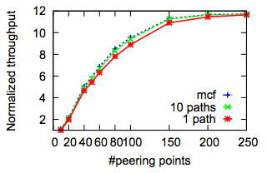
Multipath is better than Multiple Locations
  Power law graph (500 nodes, 997 links)
  Uniform link capacity distribution
  200 clients at random locations
Multiple paths have little improvement
over increasing peering points
Notes:
10% at 100 loc, 20% at 10 loc

Slide 16
Effect of Network Topology
  Increasing peering points are better than multipath in most topologies
  Except star-like topology with uniform link capacity
The throughput from 1path to mcf increases by 110% - 584%
The throughput from 10 PPs to 20 PPs increases by 337%
Notes:
With a uniform distribution of
link capacity, the throughput from 1path to mcf increases by
110.3%-584.0%, which is comparable to double PPs from 10
to 20 (337.0%).
Jiasi: This is because even with more PPs, the
traffic still have to traverse through the same set of internal
routers (i.e., the min-cut size remains almost the same).

Slide 17
Path selection not useful under Flash Crowd
  Conviva traces during normal and flash crowd periods
  Path selection has little benefits under normal traffic
  Path selection is worse than only peering point selection
Thpt (Path + peering point selection)
Thpt (Peering point selection)
Notes:
Jiasi: mcf/1path
Throughput of both path and peering point selection over …
As expected,
when the path selection interval is the same with PP selection, mcf only has 0.7% improvement in acceptance ratio
than 1path case. Worse still, during the ﬂash crowd event,
when the path selection interval increases, the acceptance
ratio drops signiﬁcantly. For example, with 10 minute interval, the ratio drops by 50% from 1path’s ratio; with 1 hour
interval, the ratio is only 8% of that of 1path case

Slide 18
  More peering points always better than more paths with long-tail Distribution of Contents
  Long-tail content distribution trace from Conviva
  With fewer replications, the throughput benefit of multipath increases
    Without replication the content delivery is closer to the single-source traffic

Slide 19
Takeaway 1:
CDNs only need to control the edge of the Internet to improve the throughput.
ISP-CDNs don’t get significant benefits from controlling the network over CDNs

Slide 20
Question 2:
How to compare throughput and cost between more centralized vs more dist. CDNs?

Slide 21
Throughput Comparison of CDNs
  Assume a fixed aggregate peering bandwidth per CDN
  A more distributed CDN achieves better throughput than more centralized one
Distributed
Centralized
Notes:
For example, to get 150 total peering points, the more distributed CDN has 80, server locations with 2-3 PPs each, while the more centralized CDN has 15 server locations with >10 PPs each
when there are around 150 peering points with a total of about 78 Tbps peering bandwidth,
the more distributed solution (“2-3”) reaches 8.0 Tbps, while the more centralized solution (“>10”) reaches 6.2 Tbps.

Slide 22
CDN Operation Cost
Management cost
  At each location: electricity, cooling, equip maintenance, and human resources
Content replication cost
  Storage cost to replicate popular content
  Bandwidth cost to redirect traffic for rare content
Bandwidth cost
  CDNs often pay ISPs for the bandwidth they use at the peering points based on mutually-agreed billing model
Notes:
Increase the throughput causes more CDN operation cost, there are three types…

Slide 23
Different Cost Functions
Cost as a function of bandwidth at a location
  Different functions: polynomial, linear, log, exp
  Model how fast the unit cost drops with throughput
  In practice: a linear combination of different functions
Notes:
Jiasi: we formulate all these types of cost as a function ob bw at a location. Different types of cost differ only at how fast….
We formulate different functions to model the speed.
Polynomial func for bandwidth cost: f(bw) = bw^a (a<0)
Log func for electricity cost: f(bw) = c*log(bw+a) (c<0)
Exp func for magt and human cost: f(bw) = c * e^{a*bw}
(a<0)

Slide 24
Polynomial Cost
Dist. CDN is more expensive than Centralized one
  Limelight has larger throughput at each location and thus better scalability gains
  Same observation holds across various operational cost functions and their combinations
Distributed
Centralized

Slide 25
Takeaway 2:
More distributed CDNs achieve higher throughput than more centralized CDNs, but…
… are more expensive for same throughput

Slide 26
Conclusion
A simple model to quantify CDN design choices
  Increasing the number of peering points
  Improving path selection
  More distributed vs more centralized design
Optimizations at the edge is enough for CDNs
  Multipath has little benefit over increasing # locations and choosing different peering links
  There’s a tradeoff of throughput and cost among CDNs

Slide 27
Thanks!
Questions?

