Slide 1
Xatu: Boosting Existing DDoS Detection Systems Using Auxiliary Signals
Zhiying Xu
Joint work with Sivaramakrishnan Ramanathan¹, Alexander Rush², Jelena Mirkovic³, Minlan Yu⁴
¹USC/Meta, ²Cornell Tech, ³USC/ISI, ⁴Harvard University

Slide 2
Distributed denial-of-service (DDoS)
overwhelm the target with a flood of traffic
a significant threat to the Internet
server
client
attackers

Slide 3
Commercial DDoS Defense
Incoming traffic
(e.g. sampled NetFlow)
➀
Clean
traffic
➃
commercial attack detection appliance
(Cdet)
commercial scrubbing center
(CSrub)
Network provider
➁
Anomalous traffic
signature
➂
Anomalous traffic
signature

Slide 4
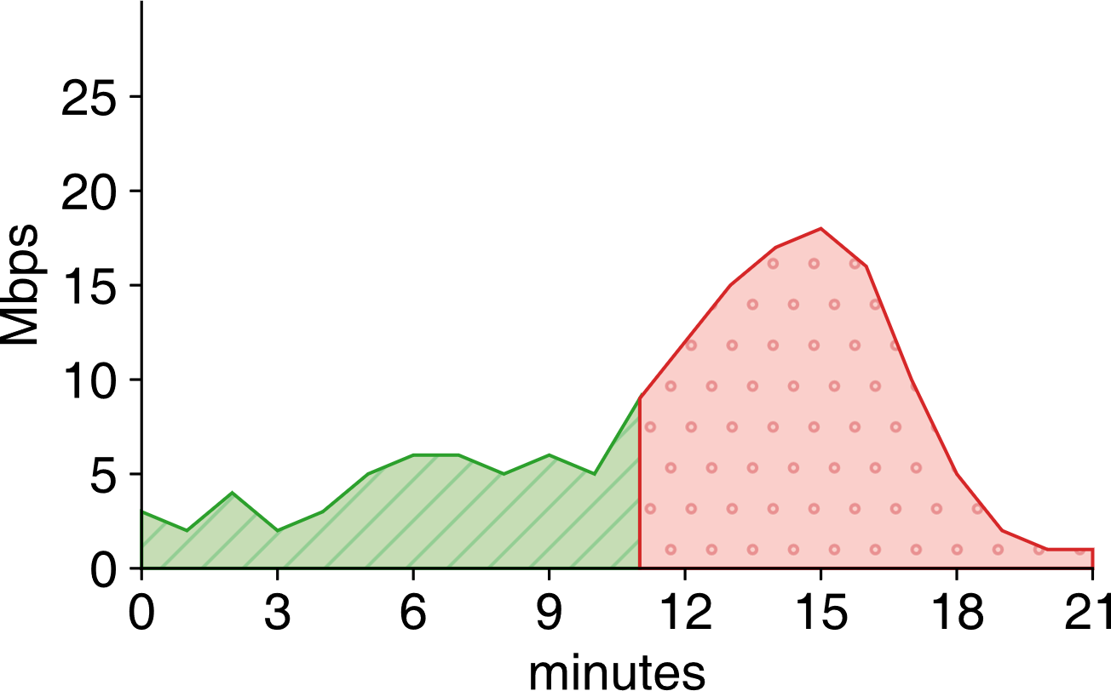
Early attack detection problem
Effectiveness
$$\frac{\text{anomalous} \text{traffic} \text{sent} \text{to} \text{CScrub} \text{(}\text{B}\text{)}}{\text{anomalous} \text{traffic}\text{ (}\text{A}\text{)}}$$
early
detection
detection
Scrubbing overhead
anomaly starts
$$\frac{\text{extraneous} \text{traffic} \text{sent} \text{to} \text{CScrub} \text{(}\text{C}\text{)}}{\text{anomalous} \text{traffic}\text{ (}\text{A}\text{)}}$$
B
C
A
Problem: maximize effectiveness while keeping overhead small

Slide 5
State of the art is not …
Threshold
Effectiveness, overhead

Slide 6
Xatu uses auxiliary signals for early detection
Key motivation: auxiliary signals are early attack indicator
attack preparation:
infect and coordinate bots
bootstrap scanning
develop and test attack software
…
attack history:
attack the target repeatedly
attack related targets in the same organization
…

Slide 7
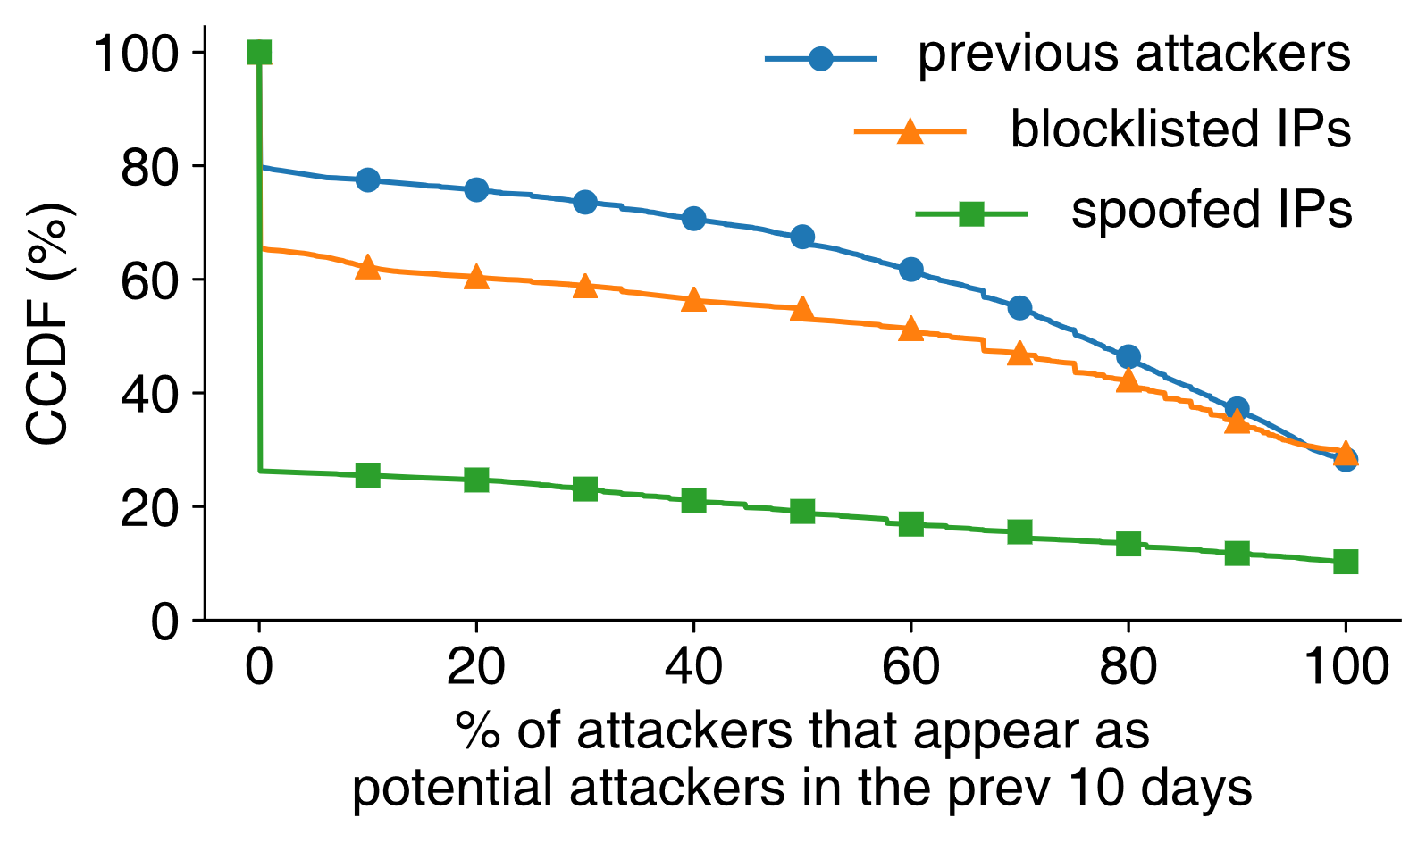
Auxiliary signals: attack preparation
Blocklisted sources (A1) Sources of previous attacks (A2) Spoofed sources (A3)
Potential attack sources are active up to 10 days before the attacks
Their activity increases closer to the attacks

Slide 8
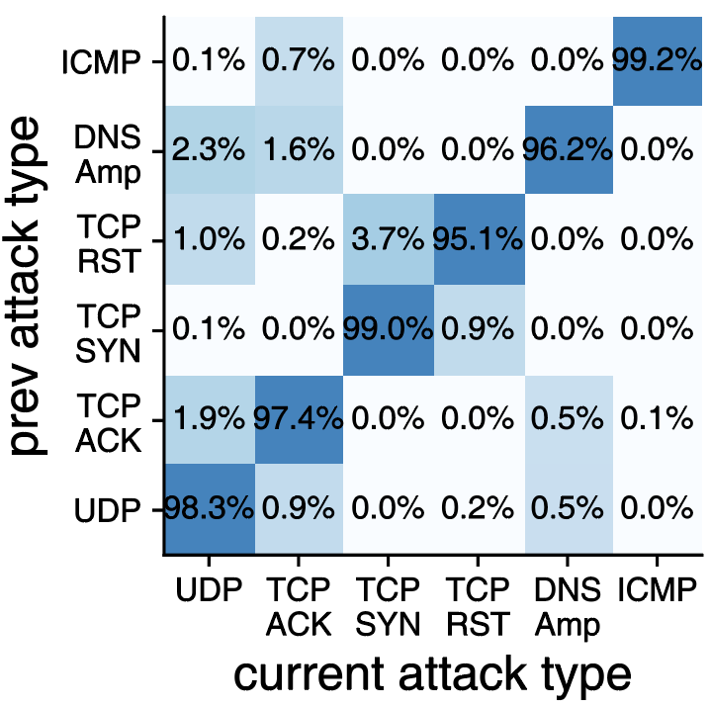
Auxiliary signals: attack history
Previous attacks to the same customer (A4)
Attackers may launch the same type of attack again if the first attack is successful
Attackers may launch various types of attacks over time to explore vulnerabilities

Slide 9
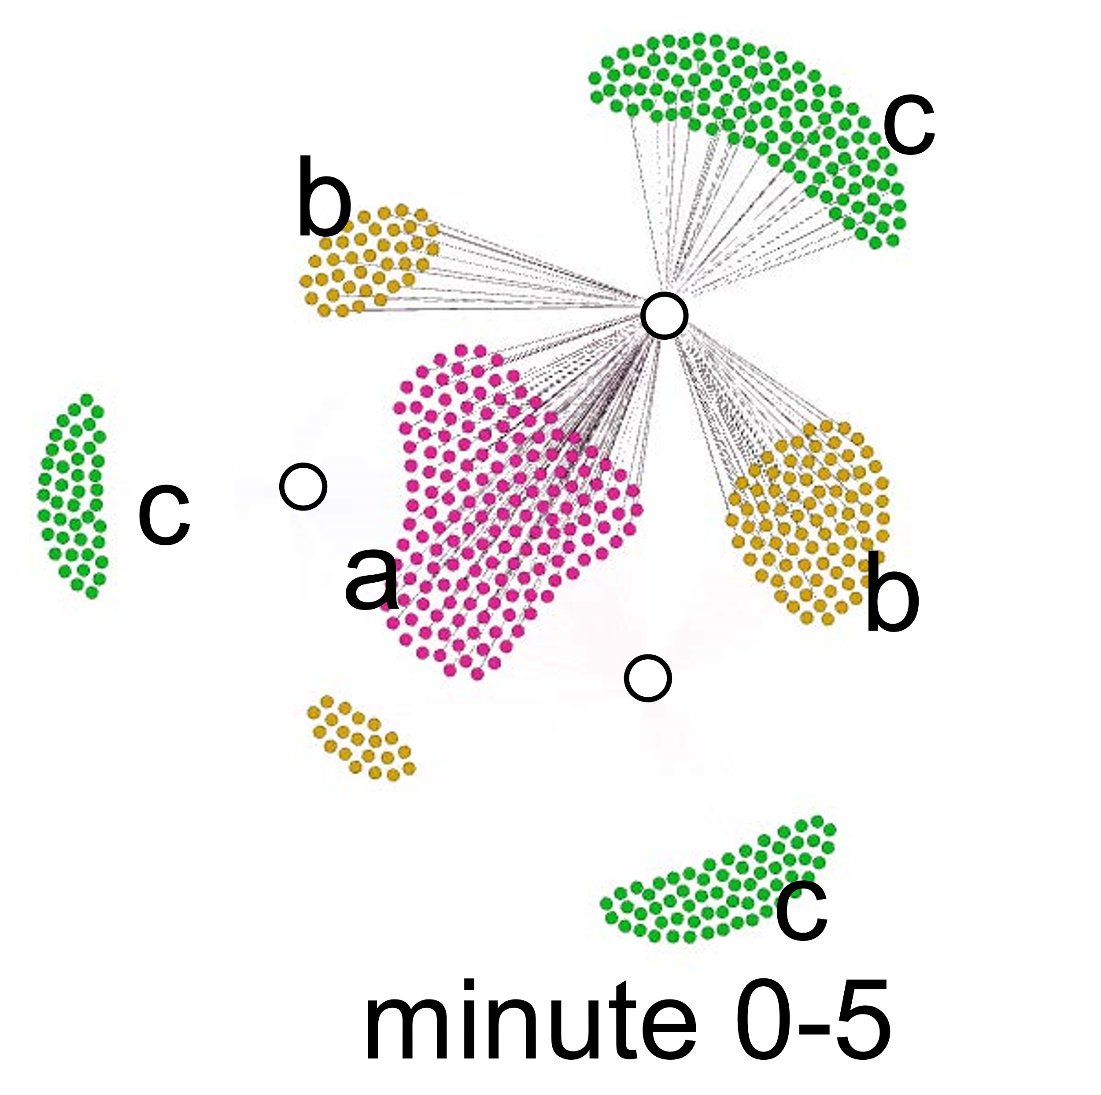
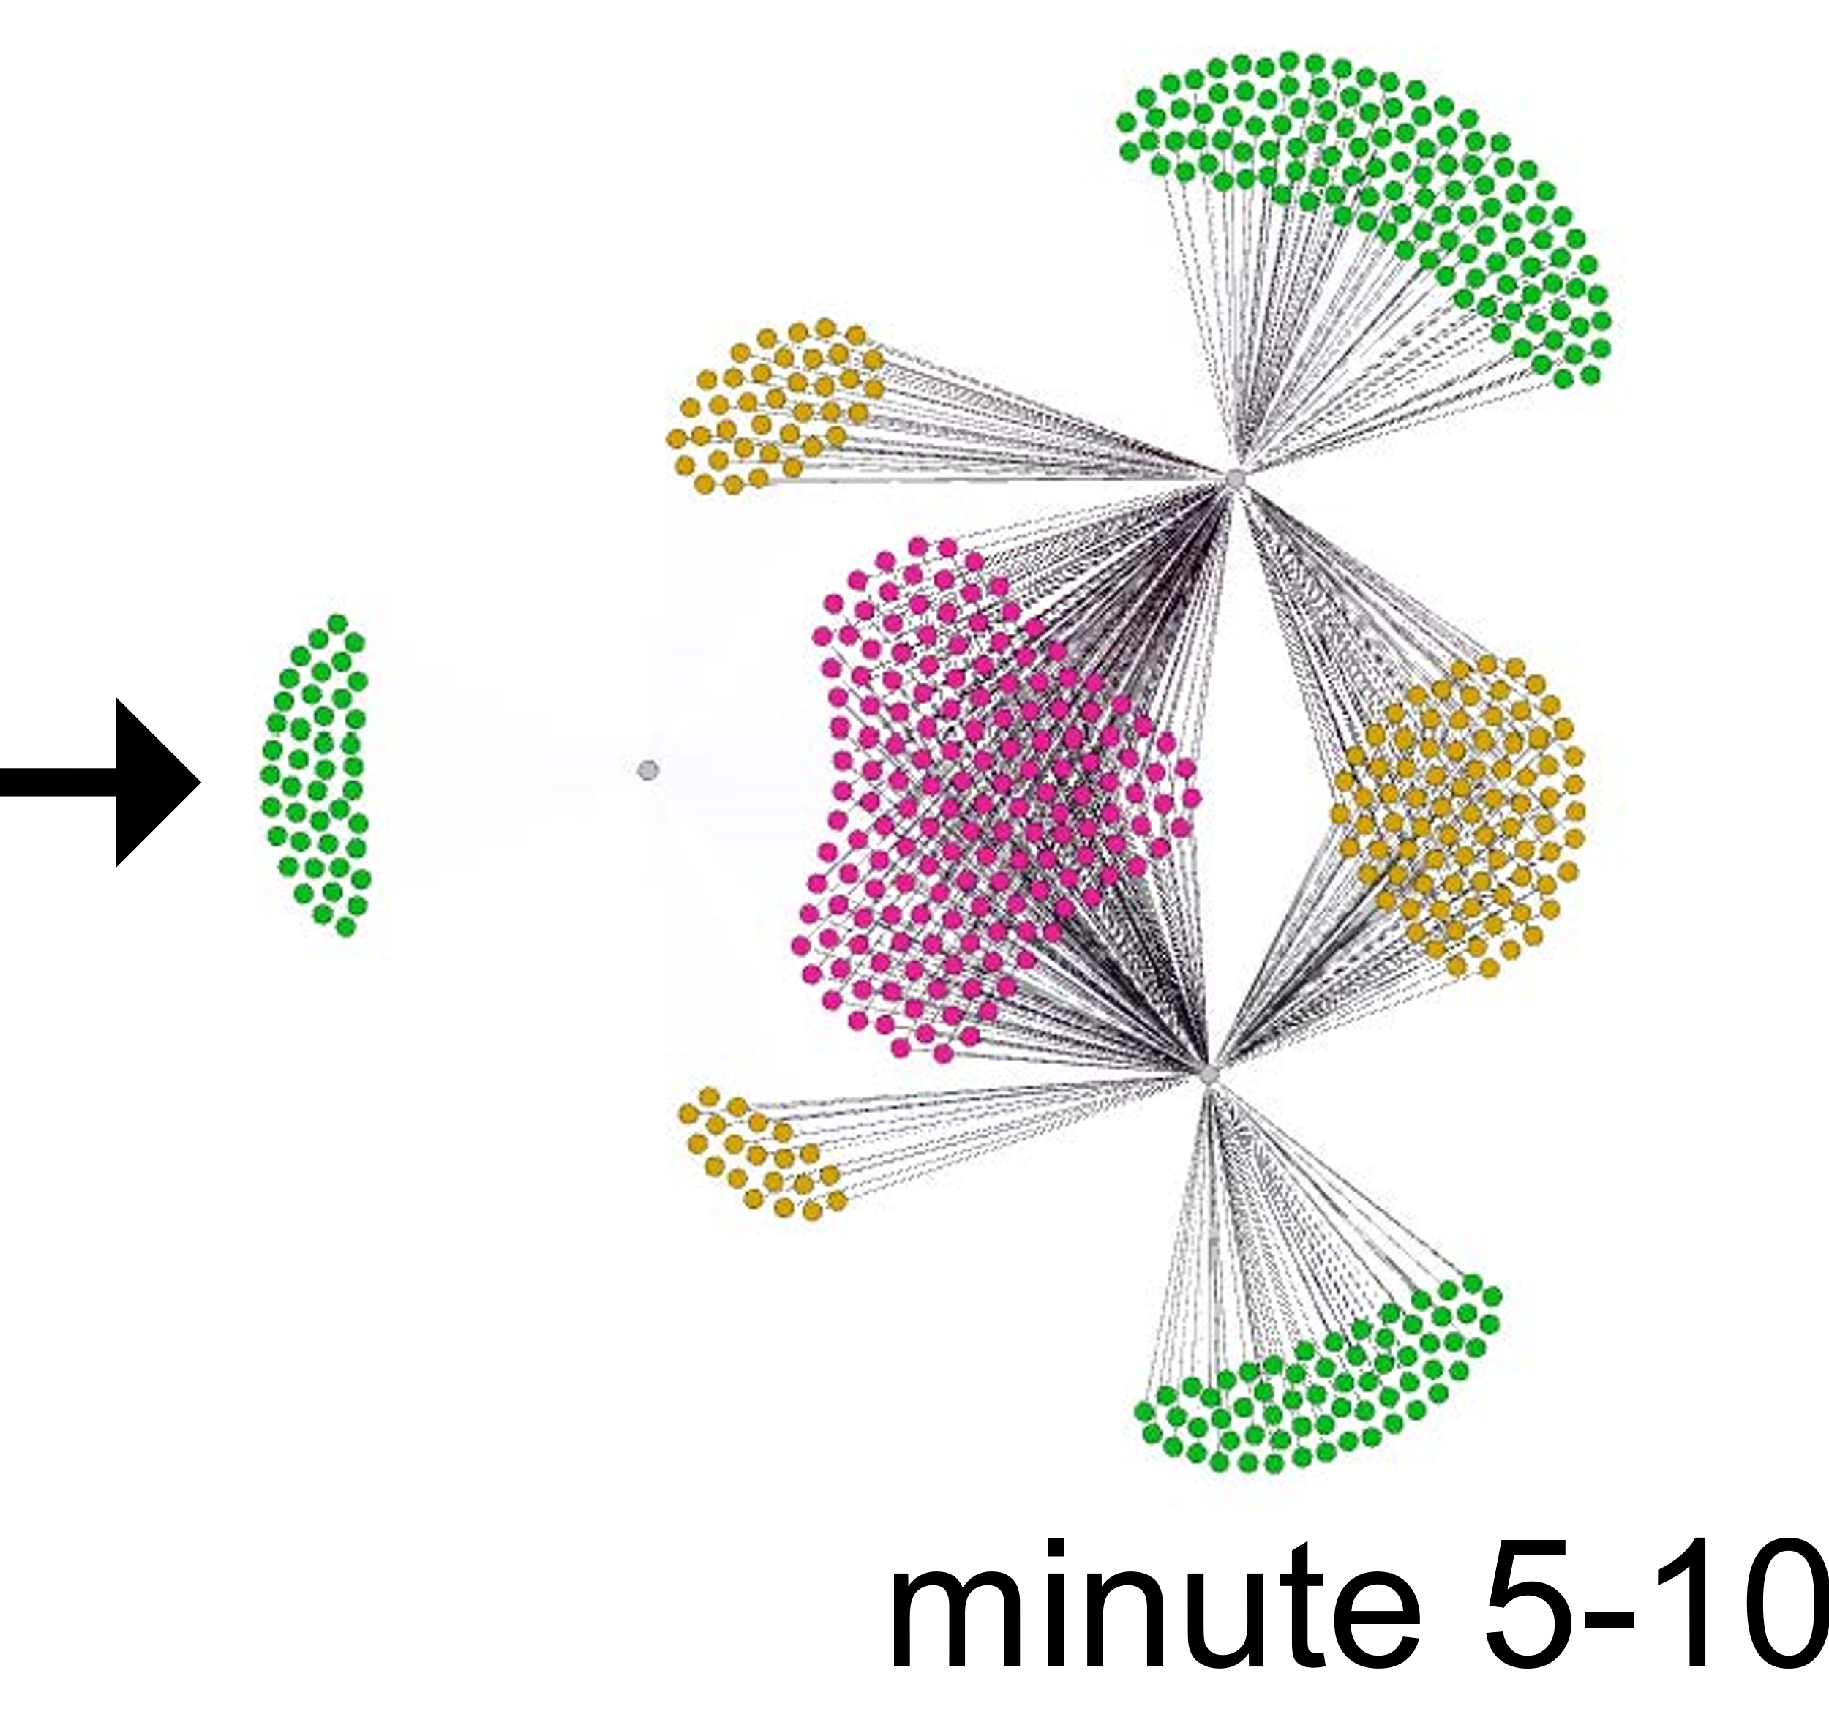
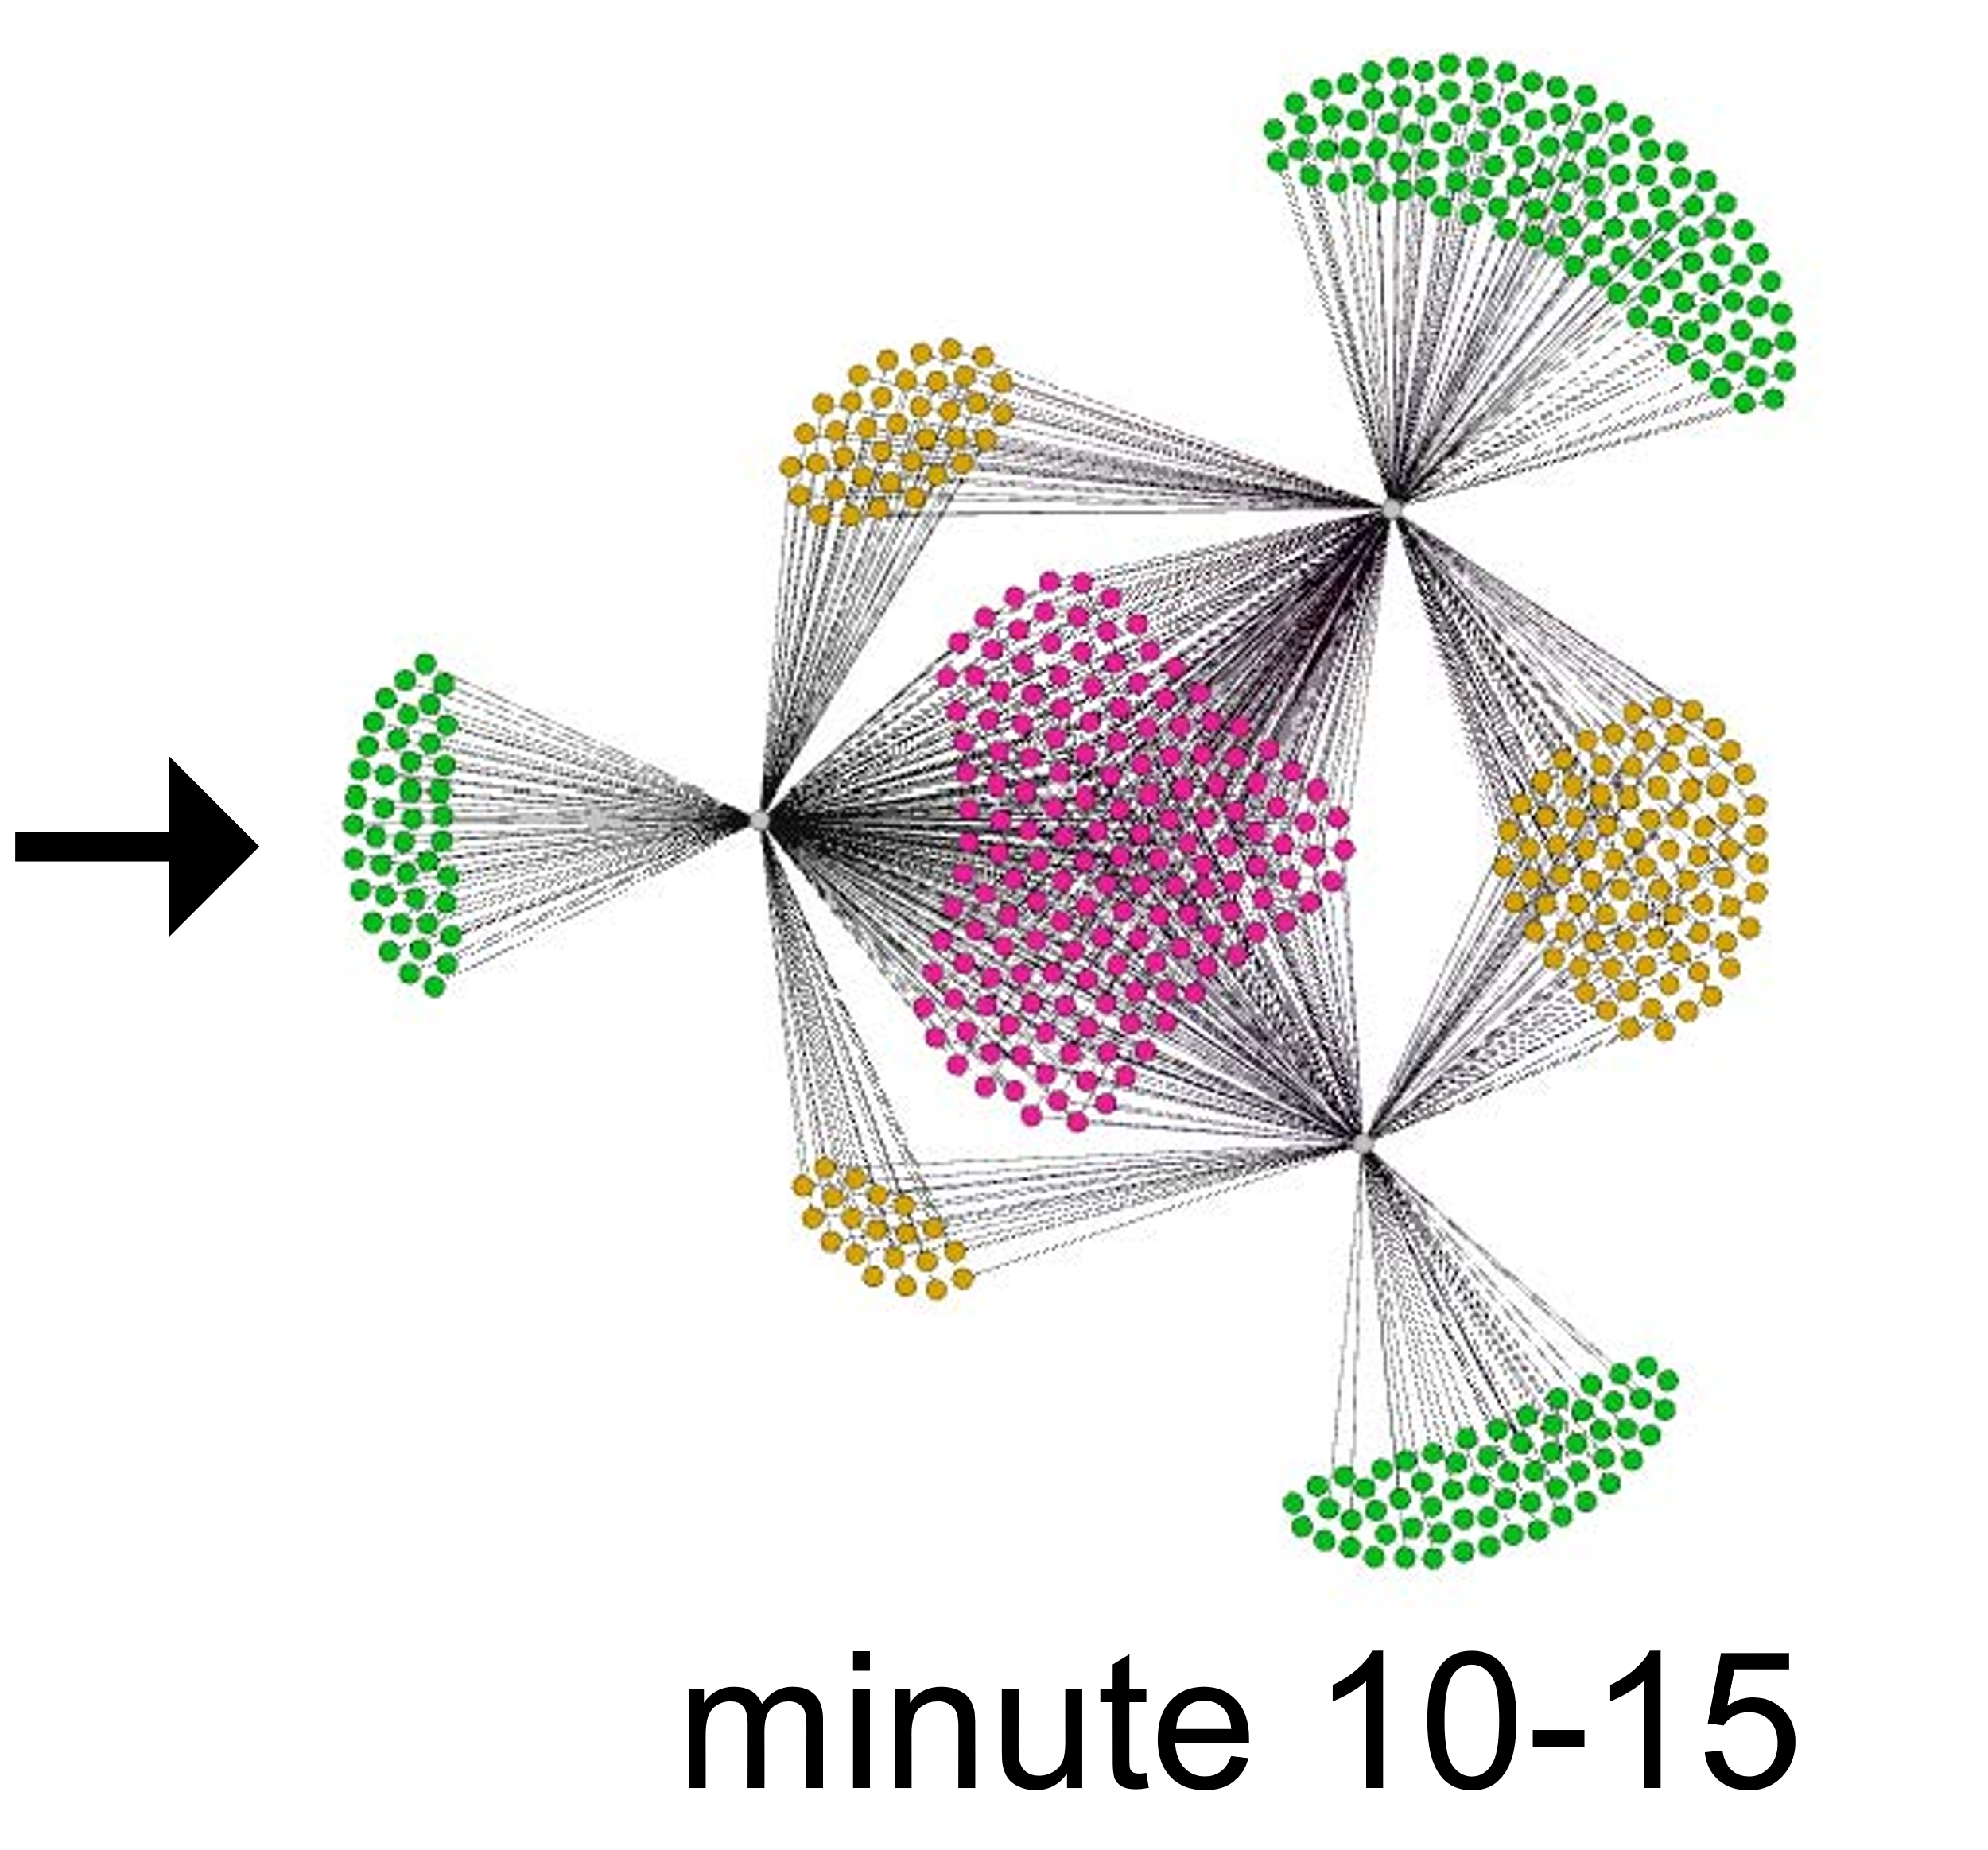
Auxiliary Signals: attack history
Correlated attacks across customers (A5)
The same set of attackers may attack different customers over time to leverage the same bots

Slide 10
Challenges of using auxiliary signals
Auxiliary signals are weak and incomplete
present even when no attack is imminent
not accurately measured or comprehensively observed
✘
deterministic approaches?
Machine learning
boost weak signals, and detect their correlation
identify sophisticated temporal patterns

Slide 11
Xatu overview
1. Multi-timescale LSTM model
derive both long-term and short-term benefits from diverse auxiliary signals
2. Survival analysis
enable early detection to improve effectiveness, while keeping the overhead low
survival analysis
multi-timescale LSTM model
instantaneous attack probability
traffic features
(volumetric + auxiliary)

Slide 12
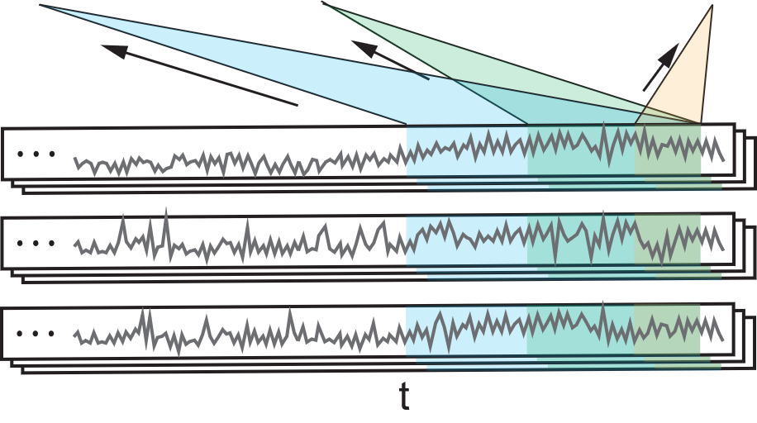
Multi-timescale LSTM for auxiliary signals processing
instantaneous attack probability
Smaller timescale: Detailed feature trends for accurate prediction
Larger timescale: overview of long-term feature trends
multi-timescale LSTM model
volumetric features (V)
attack preparation features (A1, A2, A3)
attack history features (A4, A5)

Slide 13
Xatu overview
1. Multi-timescale LSTM model
derive both long-term and short-term benefits from diverse auxiliary signals
2. Survival analysis
enable early detection to improve effectiveness, while keeping the overhead low
weight update
survival analysis
multi-timescale LSTM model
instantaneous attack probability
traffic features
(volumetric + auxiliary)

Slide 14
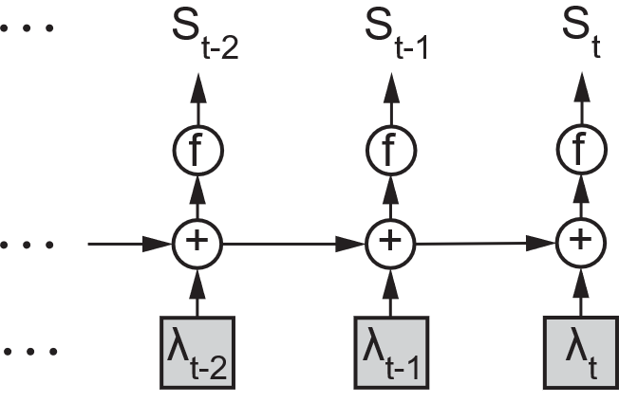
Survival analysis for boosted detection
cumulative non-attack probability
Attacks: max Pr(detection before ground-truth)
Non-attacks: max Pr(no detection over time)
survival analysis
cumulate
instantaneous attack probability

Slide 15
Training and evaluating Xatu with real traffic data
NetFlow dataset from a large ISP
spanning 100 days and 18.5 TB of sampled NetFlow data
50 days for training, 20 days for validation, 30 days for testing
DDoS detection from the state-of-the-at NetScout
6 prevalent attack types – UDP, TCP ACK, TCP SYN, TCP RST, DNS Amp, ICMP
Metric
effectiveness: the portion of anomalous traffic sent to CSrub
scrubbing overhead: the ratio of extraneous traffic sent to CSrub
mitigation time: the time taken to detect an attack

Slide 16
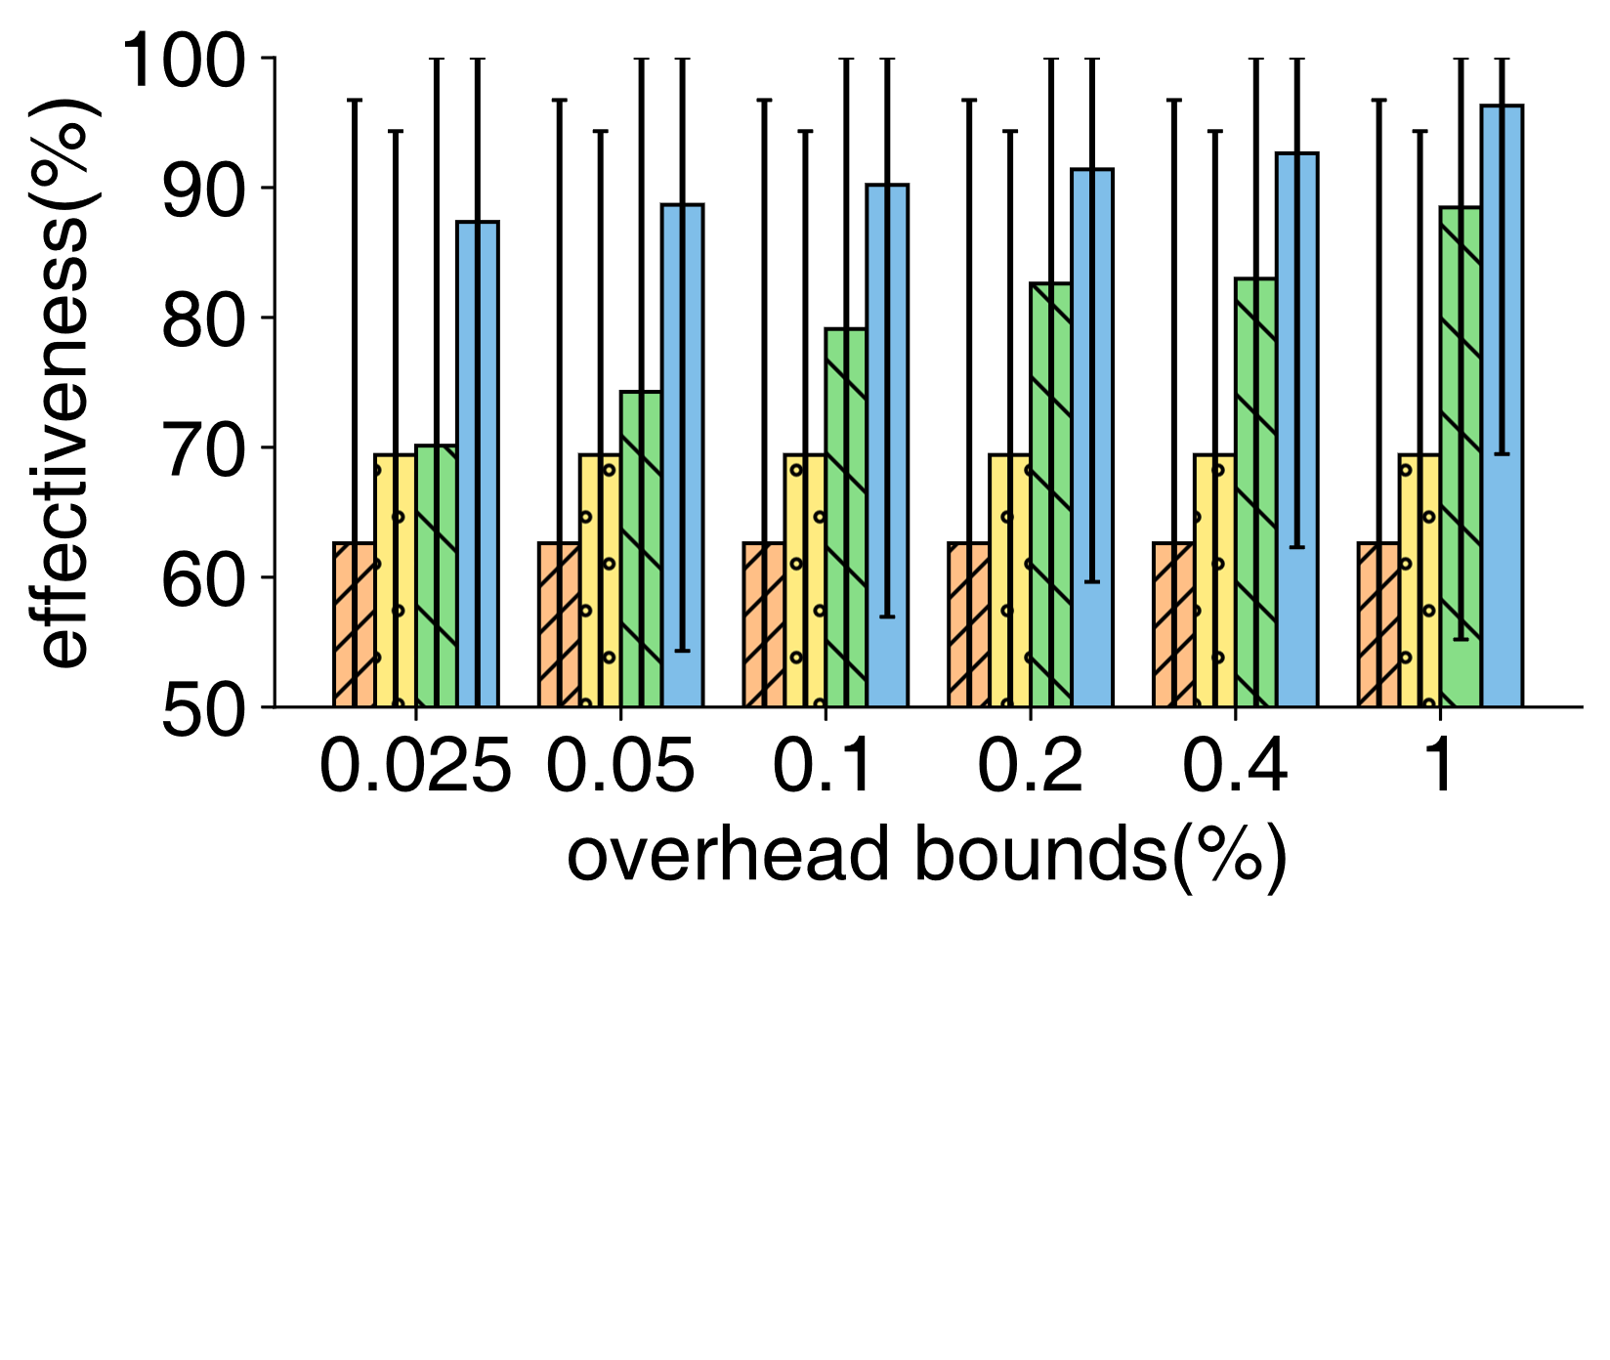
Comparing Xatu with the state of the art
Xatu with

Slide 17
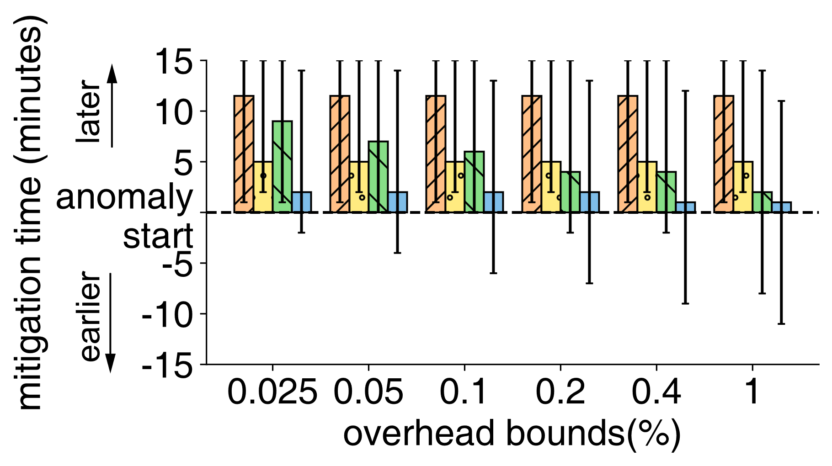
Comparing Xatu with the state of the art

Slide 18
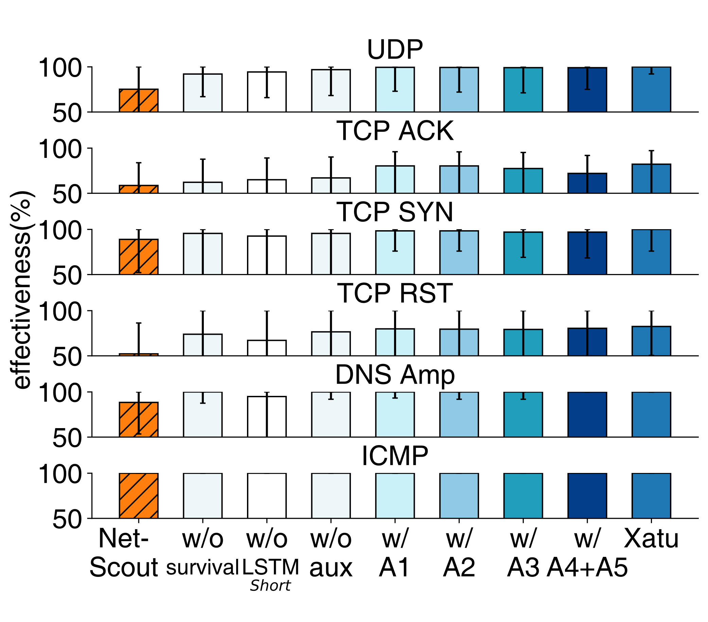
Breakdown of Xatu’s Contribution

Slide 19
Xatu: Boosting Existing DDoS Detection Systems Using Auxiliary Signals
Zhiying Xu<zhiyingxu@g.harvard.edu>

