Slide 1
Re-evaluating Measurement Algorithms in Software
Omid Alipourfard, Masoud Moshref, Minlan Yu
{alipourf, moshrefj, minlanyu}@usc.edu
Notes:
Thanks TY.
Good afternoon,
My name is Omid and today I'll answer this question that which measurement algorithm
works best in the software switch context. This is a joint work with Masoud Moshref, and
Minlan Yu, my advisor, from USC.

Slide 2
Software Switches are Popular
Data centers: “Use the cloud to manage the cloud”
Load balancer and Firewall on VMs
ISPs: AT&T replaces hardware routers with NFV
Allow customers to run network functions on commodity servers
Notes:
Software switches are popular today.
[Click]
In data-centers and clouds, people are using the commodity servers available to
perform network functions such as load-balancers and firewalls, this is also known as
using the cloud to manage the cloud.
[Click]
On the other end of the spectrum, Internet service providers such as AT&T are
planning to replace their hardware boxes at the edge of their network with
commodity servers that run network functions. This would allow them to update
their software more rapidly and also to sell their infrastructure at the edge of
the network as a service.

Slide 3
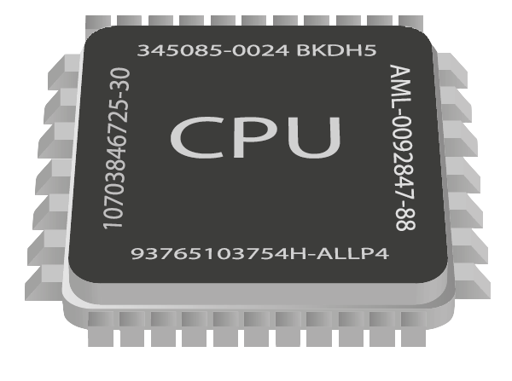
Network Function Virtualization
Typical X86 server
NAT
IDS
DPI
Firewall
Notes:
Using commodity servers to perform network functions in data-centers, ISPs, and
honestly anywhere with a network, is known as network function virtualization.
[Click]
People use these servers to run functions such as network address translation,
firewall, and intrusion detection systems.

Slide 4
Measurement is Critical for NFVs
Make decisions based on measurement input
Firewall, load balancing, intrusion detection systems (IDS)
We also need measurement for managing NFVs
Profiling NFV usage, resource scheduling..
“If you can’t measure it, you can’t manage it”
Notes:
When it comes to network functions, measurement plays a critical role.
It either is an input to other network functions, like a firewall.
[Click]
Or in the case of NFV, you would use measurement for profiling and
resource scheduling of your commodity servers.
[Click]
Measurement is, of course, so important that there is a saying which goes like
this:
"If you can't measure it you can't manage it."

Slide 5
What is the best algorithm for measurement in software?
Notes:
For these commodity servers, there is very little research on how to do network
measurement. By the end of the talk, we will answer this question:
"What measurement algorithm works best for software in network?"

Slide 6
New Design Concerns in Software
Domain
Constraint
Objective
Hardware switches
Limited Memory Size
Fit in the Memory
Software switches
Working-set (Cache size)
Maximizing Throughput
It’s time to reevaluate measurement algorithms in software context!
Notes:
If you look at older research on network measurement, you can see that there
is a large body of works on how to perform measurement effectively on hardware
switches.
So hardware switches have limited memory, and it is only natural that
most of those works focus on the efficient use of that limited space. If the
measurement data-structure grows larger than the memory size of the switch,
people normally sacrifice accuracy to lower the memory size requirement.
[Click]
On the other hand, when it comes to software switches, people have plenty of
memory space available (think tens of GBs); so memory is not an issue.
Software switches have cache-hierarchy, so what ends up being important is the
working set of the measurement task; if you can fit the . People would naturally want to trade
accuracy to maximize throughput. So we have the knob of choosing the algorithm
for measurement.
[Click] [Pause]
Now you have these two very different concerns for hardware and software switches,
as such, we think that now is the time to reevaluate algorithms in this context. This is
especially true, given that modern servers have large caches, with very
efficient caching mechanisms.

Slide 7
Previous Works on Measurement Algorithms
Measurement task
Heavy-hitters detection
Super-spreaders detection
Flow-size distribution
Change detection
Entropy estimation
Quantiles
Notes:
To re-evaluate measurement algorithms we looked at measurement tasks that are
important for the NFV, for example, change detection is important for
scheduling, heavy-hitter detection is important for firewalls. We surveyed the
papers for the measurement algorithms in the past 10 years or so, and

Slide 8
Measurement Algorithms
Measurement task | Sketch | Heap/tree
Heavy-hitters detection
Super-spreaders detection
Flow-size distribution
Change detection
Entropy estimation
Quantiles
Popular measurement algorithms in the hardware switch and database domain
Notes:
We found that there are two major class of algorithms, Sketch based algorithms
and Heap based algorithms.
[Click]
Most of these algorithms are popular in the domain
of hardware and database research.

Slide 9
Measurement Tasks
Measurement task | Sketch | Heap/tree
Heavy-hitters detection | NSDI’ 13, JoA’ 05 | ICDT’ 05, ANCS’ 11
Super-spreaders detection | NSDI’ 13, PODS’ 05
Flow-size distribution | SIGMETRICS’ 04
Change detection | TON’ 07 | CONEXT’ 13
Entropy estimation | COLT’ 11
Quantiles | Hot ICE’ 11 | SIGMOD’ 99, 01, 13
Notes:
You can see the list of the papers that we looked at and the year that they were
published. Note that there is still continuous research going on and it is
still unclear which algorithm works best.

Slide 10
Measurement Tasks
Measurement task | Sketch | Heap/tree
Heavy-hitters detection | NSDI’ 13, JoA’ 05 | ICDT’ 05, ANCS’ 11
Super-spreaders detection | NSDI’ 13, PODS’ 05
Flow-size distribution | SIGMETRICS’ 04
Change detection | TON’ 07 | CONEXT’ 13
Entropy estimation | COLT’ 11
Quantiles | Hot ICE’ 11 | SIGMOD’ 99, 01, 13
Notes:
Let me give you a quick overview of these algorithms for an example measurement
task: heavy-hitter detection.

Slide 11
Algorithms for Heavy-hitter Detection
Heavy hitters: Detect the most popular flows in the traffic.
Different memory-computation tradeoffs:
Simple hash table: For every packet, hash the header, update a counter
Sketches: For every packet, hash the header several times, update relevant counters.
Heap: Keep a heap of counters, remove smallest counter when there is no space for new packets.
Different trade offs for algorithms: which one is the best?
Precision
Memory
Processing
Precision
Memory
Processing
Notes:
Heavy-hitter detection is for finding the most popular flows in the traffic.
You can use the output of heavy-hitter detection, for example, as an input to
load-balancer or for DDoS detection.
[Click]
Now! there are many ways to support heavy-hitter detection and they have different
memory and processing requirements.
The simplest way to detect heavy-hitters is to keep a hash-table of all the
flow counters. Basically, for every incoming packet,
hash the header, and increment the count of the associated entry.
It is possible to reduce the memory footprint, if we use a sketch.
[Click]
For a count-min sketch, we hash the header multiple times with different hash
functions, and then increment the count of the associated counters. You can
think of it as several hash tables.
Finally, we can even squeeze the memory more by spending more processing to
increase the accuracy.
[Click]
And these are usually the tree/heap based algorithms. In this case, you would
keep a heap of counters and update the heap based on the incoming packet. If
the packet does not fit in the heap, you replace the smallest entry of the heap
with your new packet.
[Click]
So each of the algorithms make different trade-offs to do the same task. We did
a few experiment to figure out which one works best and why.

Slide 12
Evaluating the algorithms
Compare different measurement algorithms
Hash, sketch, heap
Metrics
Performance: network throughput, per-packet delay
Precision: % of selected heavy-hitters that are correct.
Evaluation setting
CAIDA traces
Click modular router modified with DPDK
Notes:
The metrics that we looked at are: performance and precision. We define
performance based on the throughput and per packet delay of the software
switch. Precision is the percentage of selected heavy-hitters that are correct.
For the evaluation, we replayed a traffic trace from CAIDA, and implemented
these three algorithms on top of a modifed version of Click router that uses
DPDK.
[Click]
So I am going to show you something awesome.

Slide 13
Simple Hash Table Works the Best
Throughput
Simple hash table has 34% higher throughput over sketches, and 108% over heap.
Precision
Simple hash table is only 4% less accurate for sizes greater than 200KB.
The accuracy difference is less than 1% when the size is greater than 10MB.
Notes:
!!!! This is the interesting, In our experiment, the throughput of the hash table was best.
[Click]
It had 34% higher throughput than sketch and 108% better performance than heap!
[Click]
Note that even though we get this high throughput it doesn't affect the
precision much: in this case, we only suffered 4% precision for the sizes
greater than 200KB, and less than 1% accuracy for sizes of 10MB and greater.
Let's look at why we have higher throughput.

Slide 14
Hash has the lowest average per packet delay
O(log(N)) memory accesses
3 hashes + 6 mem. accesses
1 hash + 2 mem. accesses
Notes:
In this graph, we are looking at the per-packet average latency. On the X axis
we see the size of the data-structure in KB. The Y axis shows the average delay
per packet in nano-seconds. Both axes are in log scale. As we see from the
graph, the green line which is the hash table has the lowest average delay per
packet.
[Click]
This is because hash table has a single hash function and two memory
Accesses
[Click]
sketch has 3 hash functions with 6 accesses
[Click]
and heap in the worst case has O(log(N)) accesses.
[Click]
With different memory size there is a slight difference in delay, and this
difference becomes clearer with tail latency.

Slide 15
Tail Latency Jump from L3 to Memory
Notes:
This is similar to the last graph, but the Y axis shows the 95th percentile delay.
[Click]
If you look at this portion of the graph, you can see a sudden jump in all of
the three algorithms. This jump is because of the large size of the
data-structure. Because of its size the data-structure does not fit in the
caching hierarchy effectively anymore, and so part of it is kept in the memory.
As you can see, the hash table, which is the green line, works best even in the
tail latency case.

Slide 16
Simple hash table works well for heavy-hitter detection.
What about the other tasks?
Observation
All measurement tasks maintain a table of entries (e.g., counters).
@10 Gbps, 67 ns to process each packet on average (worst case).
Notes:
Based on the last experiment, we can say that hash table works very well for
heavy-hitter detection.
[Click]
But, what about other measurement tasks?
[Click]
Rather than starting more tasks, we observed that all these tasks need to
maintain a table of entries. Based on this observation, we built a model to
understand entry accesses in the table. This allows us to generalize our model
to other measurement tasks. I won’t go into the detail of our model, but it is
based on the probability of finding the packet in L3 vs. Memory.
[Click]
Let me remind you that at 10Gbps in the worst case we only have 67 ns per
packet.

Slide 17
Memory access is too slow
16 ns
L3
Memory
100 ns
Notes:
In modern servers, CPUs typically have several levels of cache: L1, L2, L3 and
memory. L1 and L2 are quiet small and have an access times of a few nanoseconds.
[Click]
L3, on the other hand, has an access time of 16 ns.
[Click]
And the memory has an access time of 100 ns. Remember that we only had 67 ns
per packet, this means that we cannot access memory on every packet.
The good thing is that most network traffics have a long tail distribution and
therefore most items are available from L3 and lower level caches.

Slide 18
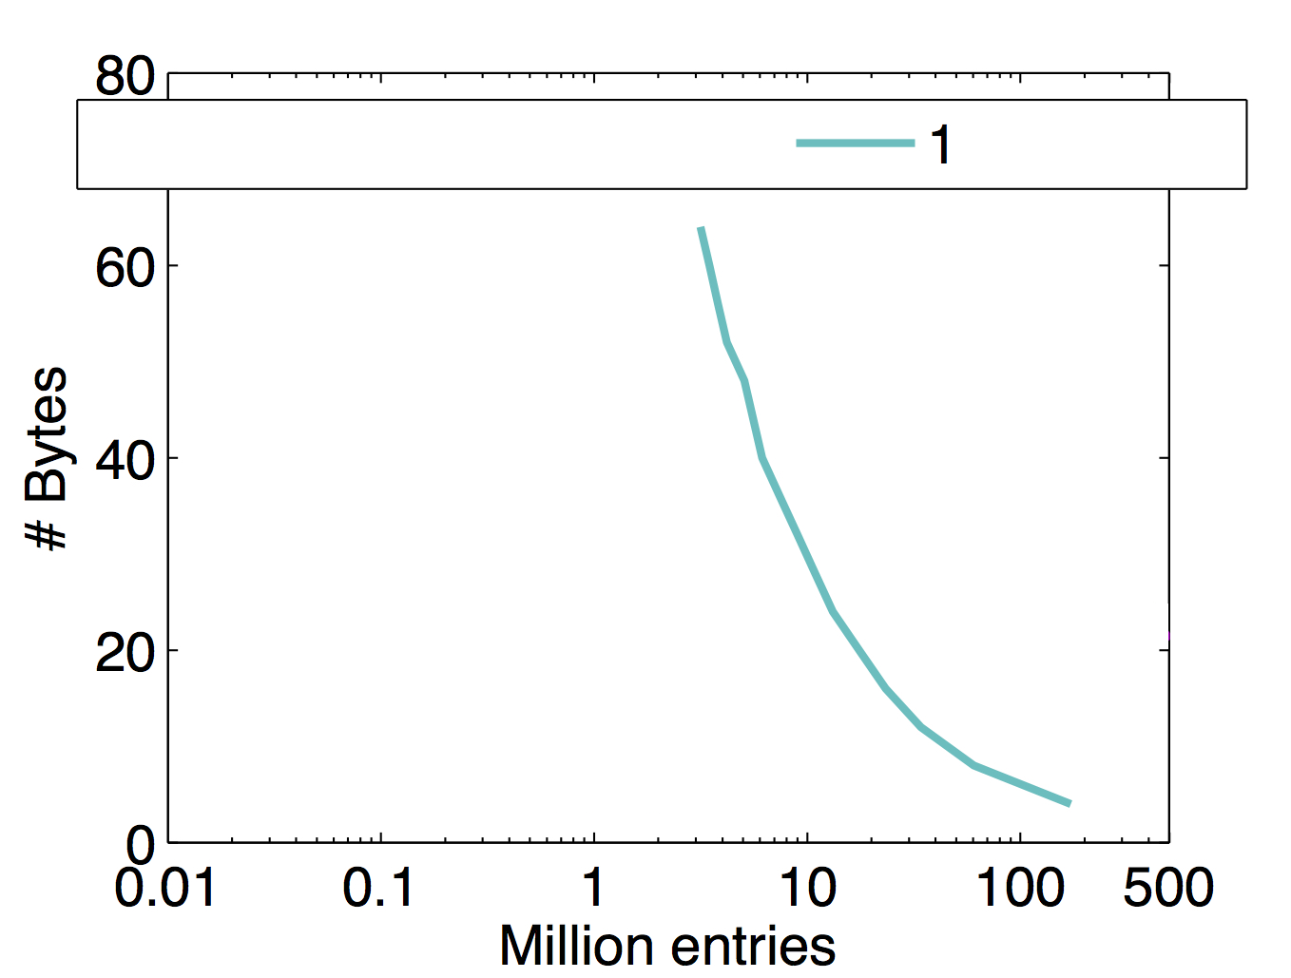
Plenty of memory for measurement
#entries that can be used for line-rate packet processing
~5 Mil NetFlow Entries
~15 Mil Hash Entries with Distinct counters
~200 Mil Hash Entries
Notes:
I will show you the result for a traffic that has the same skew as our CAIDA
trace, but our results remain true for other distributions, too.
Remember that measurement tasks require to keep a table of entries. So,
Table size equals entries times the number of bytes per entry. There are
different tasks, some need to maintain a single counter per entry, some need to
maintain a group of bits, and some need to keep all the five tuples.
[Click]
In the graph that we see here, the X axis shows the number of entries and the Y
axis shows the number of bytes.
[Click]
Based on our model, for our traffic distribution, we can keep 200 million 4 byte
entries while processing packets at line rate. This can be useful, for example,
for heavy-hitter detection.
[Click]
If we also want to keep distinct counter per each flow, that is, beside keeping
just the number of packets for that flow, count the packets for subflows, we can
can keep 15 million entries. This can be used for super-spreaders detection.
[Click]
It is also possible to keep a full NetFlow table with 5 million entries.

Slide 19
Enough memory to hold everything!
5 Mil NetFlow Entries
15 Mil Hash Entries with Distinct counters
200 Mil Hash Entries
Average Flow size of 1KB → 1.25 Mfps @ 10Gbps
More than enough space to hold everything!
Notes:
So, what do these numbers mean?
[Click]
To give you a sense of what these numbers mean, we consider the number of flows
that we can see on a 10Gbps link. Assuming an average flow size of 1KB, we can
have 1.25 Million flows per second.
[Click]
This means that we can fit enough entries to have line rate packet processing
and also support most measurement tasks!
---
Separate the consequence and the concern.

Slide 20
Effects of Skew and Multicore
Different skews of traffic
Simple hash table result is consistently the best
Sharing data across multiple cores
Because of cache contention, performance drops
Notes:
As I said in a few slides back, we also tested the three algorithms with
different skews, and simple hash table consistently perform ed the best.
[Click]
We also tested sharing the data-structure of each algorithms across multiple
cores, and as older papers have suggested, because of cache contention, the
performance drops. We saw that the packet latency was almost twice as bad, even
without using locks.

Slide 21
Future Work
Where simple hash table fails?
Solution to the failed cases
Improving the model
Notes:
To wrap up the talk, I wanna point out the future directions that we plan to
look into:
We want to understand the generality of our conclusion:
m1) We showed you were simple hash table works, we will do more measurement to
show you where it fails. Maybe uniform traffic.
m2) Once we understand where fails, we can suggest solutions to make it work
Better
3) Finally, the model that we used in the paper is far from perfect. We do not
consider the caching strategy of the CPU. There might be opportunities here,
for example, rearrange the data-structure if there is contention.

Slide 22
Conclusion
NFV is the new trend in data-centers and ISPs
Measurement is a key component for NFV
Simple hash table works best
For many tasks, the working set fits in the cache
Especially when the traffic is skewed
We expect this to be true in the future with newer servers
Larger cache, better efficient cache
Notes:
To conclude, we saw that software switches are becoming a popular solutions in
NFV in places such as data-centers and ISPs.
[Click]
We need measurement in most of the NFV solutions.
[Click]
Our experiment shows that simple hash table is very effective. This is because
the working set of the network traffic fits in the cache of the modern servers.
This is because the normal traffic is mostly skewed.
[Click]
We hope to have even better performance with newer servers as they have larger
and more efficient caches.
Thank you, that's all.

