Slide 1
Nadeen Gebara*, Alberto Lerner^{Ɫ}, Mingran Yang^{ꙙ}, Minlan Yu○, Paolo Costa^{ꬸ},
Manya Ghobadi^{ꙙ}
Challenging the Stateless Quo of Programmable Switches
Imperial College London* University of Fribourg^{Ɫ} MIT^{ꙙ} Harvard University ○ Microsoft Research ^{ꬸ}
Notes:
Hello everyone, I would like to talk with you today about the revolutionary programmable switches.
Not only have these switches allowed line-rate programmable packet protocol programs, but they even went a step further and enabled a new class of in-network applications
However, in-network applications are fundamentally different from packet-protocol programs these switches were originally designed for and supporting them can be both challenging and restrictive.
Rather than accepting these restrictions, we see an exciting opportunity to rethink the current architecture of these switches with in-network applications in mind such that their requirements are better supported.
Let’s start by taking a look at the current architecture of programmable switches and how they support programmable packet protocols.

Slide 2
Protocol Independent Switch Architecture (PISA) Pipeline
Match Table Configuration
Control plane
Data plane
_{Parser}
_{Deparser}
Stage₁
Stage₂
Stage_{N-1}
Stage_{N}
Match-Action Units
Notes:
The switch pipeline comprises of multiple match-action unit stages. When programmers write their programs usually as match action primitives, the program is compiled as match table configurations within the stages.

Slide 3
Protocol Independent Switch Architecture (PISA) Pipeline
Data plane
Packet Header
Vector
Packet
_{Parser}
_{Deparser}
Stage₁
Stage₂
Stage_{N-1}
Stage_{N}
Payload Bus
Notes:
When the switch is programmed, and a packet arrives, the packets associated with the program are extracted by a parser and placed in the packet header vector which serves as a register for holding the packet headers fed into match-action stages.

Slide 4
Protocol Independent Switch Architecture (PISA) Pipeline
Data plane
State
State
State
S
E
L
E
C
T
O
R
S
E
L
E
C
T
O
R
S
E
L
E
C
T
O
R
_{Parser}
Match Tables
Action Unit
Match Tables
Match Tables
Action Unit
Action Unit
_{Deparser}
Match-Action Unit Stage₁
Stage₁
Stage₂
Stage_{N-1}
Stage_{N}
Match-Action Unit Stage₁
Match-Action Unit Stage₁
Notes:
A stage selects the header fields for which match-action rules were configured and can perform simple actions associated with packet-protocols on these headers such as header updates

Slide 5
Protocol Independent Switch Architecture (PISA) Pipeline
Data plane
State
Feed-forward Transfer
S
E
L
E
C
T
O
R
_{Parser}
Match Tables
Action Unit
_{Deparser}
Match-Action Unit Stage₁
Simple Operations
Stage_{N-1}
Stage_{N}
Notes:
Additionally stages can retain some state that must be kept past the life-time of a packet of a switch such as packet counters and statistics.
The header is then fed onto successive stages that are similarly configured to perform header match-action operations.

Slide 6
Protocol Independent Switch Architecture (PISA) Pipeline
Shared-nothing Stages
Data plane
State
Feed-forward Transfer
S
E
L
E
C
T
O
R
_{Parser}
Match Tables
Action Unit
_{Deparser}
Match-Action Unit Stage₁
Stage_{N-1}
Stage_{N}
Notes:
It’s worth nothing that these stages are completely independent and the match tables, action units, and state within stages are completely independent and can’t be read or written by other stages.
The only way to communicate across stages is by using metadata fields in the packet header in the forward direction

Slide 7
PISA Switch
Ingress
Scheduler
Egress
Pipeline₁
_{Parser}
_{Deparser}
Pipeline_{N}
Pipeline_{N}
Stage₁
Stage₂
Stage_{N-1}
Stage_{N}
Independent pipelines
Notes:
And to support even higher line-rates switches usually have many of these pipelines that attached to groups of ports and operate in parallel.
Similar to MAUs within a stage, these pipelines are also independent and everything within a pipeline can’t be direct accessible by other pipelines

Slide 8
PISA Enabled a Wave of In-network Applications
Notes:
In addition to supporting packet protocols, such a programmable architecture also enabled in-network applications.

Slide 9
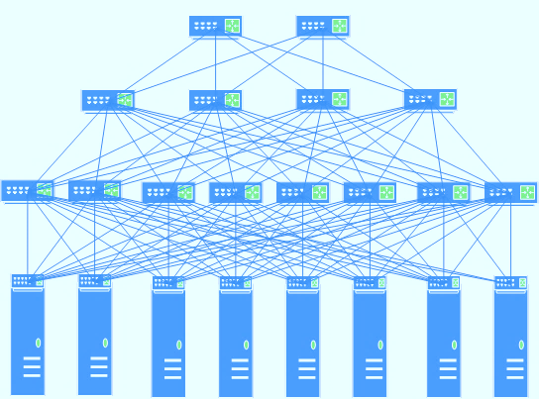
Motivation for In-network Applications
Cache Hit
Lower Service Latency [SOSP’17]
RESPONSE
Higher Application Throughput and Lower Network Load
[SOSP’17, HotNets’17, HotNets’19]
REQUEST
Programmable Switches Running In-network Applications
Notes:
So what exactly do I mean by in-network applications ? Rather than only running programs on endhosts and using switches for routing tasks. In-network applications also offload some operations to programmable switches. The ability to run parts of programs in the network itself actually proves beneficial for many reason.
For example: netcache latency
Distributed training ml

Slide 10
Motivation for In-network Applications
Lower Service Latency
[NSDI’16, SOSP’17, SIGMOD’20]
Higher Application Throughput and Lower Network Load
[SOSP’17, HotNets’17, HotNets’19]
Simpler Distributed System Co-ordination [OSDI’16, NSDI’18, OSDI’20]
Improved Telemetry
[SOSR’17, SIGCOMM’20]
Programmable Switches Running In-network Applications
Notes:
Vantage point serialization nopaxos and eris
And telemetry too

Slide 11
In-network Applications vs. Packet Protocols
Defining Features
 | In-Network Applications | Packet-protocol Programs
Natural Abstraction | Data-structure operations | Match-action rules
Central Unit | State | Packet headers
Notes:
Even though they were implemented on programmable switches, they are still quite different from packet-protocols
While packet-protocols are naturally best described using match-action rules; in-network applications often involve data structure operations.
They focus more on stateful associated with applications that resides on the switch, and update the state rather than focusing on packet-headers as in the case of packet-protocols.

Slide 12
Is PISA the Right Architecture for In-network Applications?
Notes:
Let’s take a look how these differences impact supporting stateful data structure operations typical of in-network applications on PISA

Slide 13
In-network Applications on PISA
State
Data plane
Application State
S
E
L
E
C
T
O
R
Packet
_{Parser}
Match Tables
Action Unit
_{Deparser}
Match-Action Unit Stage₁
Stage₁
Stage₂
Stage_{N-1}
Stage_{N}
Notes:
First of all, primary thing usually extracted from packet arriving onto packet header vector is some variable associated with the application or state rather than a protocol header.

Slide 14
1. Limited Support for Complex Operations Within a Stage
State
Data plane
S
E
L
E
C
T
O
R
_{Parser}
Match Tables
Action Unit
_{Deparser}
Match-Action Unit Stage₁
Stage₁
Stage₂
Stage_{N-1}
Stage_{N}
Notes:
In some cases applications might require more complex operations that are not supported because they are not common to packet-protocols and result in high area overhead like fp ops. These no way around.
In other cases when state is kept on data structure and application’s operation requires multiple stateful accesses, the application is constrained by the stateful memory accesses and operations within a stage.

Slide 15
1. Limited Support for Complex Operations Within a Stage
Application data structure distributed across stages and constrained by number of stages
S
E
L
E
C
T
O
R
S
E
L
E
C
T
O
R
S
E
L
E
C
T
O
R
S
E
L
E
C
T
O
R
_{Parser}
_{Deparser}
Stage₁
Stage₂
Stage₃
Stage_{N}
Notes:
This forces distributing the data structure cross stages in order to do multiple stateful accesses.

Slide 16
2. Shared-nothing Stage Architecture
Packet Header Vector used to transfer state and unroll operation across stages
S
E
L
E
C
T
O
R
S
E
L
E
C
T
O
R
S
E
L
E
C
T
O
R
S
E
L
E
C
T
O
R
_{Parser}
_{Deparser}
Stage₁
Stage₂
Stage₃
Stage_{N}
Notes:
Now combining the first limitation with the fact that the pipeline has a shared-nothing stage architecture, operations must be unrolled across stages with the phv used as the means in order to propagate state from stage to stage

Slide 17
2. Shared-nothing Stage Architecture
S
E
L
E
C
T
O
R
S
E
L
E
C
T
O
R
S
E
L
E
C
T
O
R
S
E
L
E
C
T
O
R
_{Parser}
_{Deparser}
Stage₁
Stage₂
Stage₃
Stage_{N}
Notes:
Size of application state now depends on number of stages and phv size

Slide 18
3. Feed-forward State Transfer
S
E
L
E
C
T
O
R
S
E
L
E
C
T
O
R
S
E
L
E
C
T
O
R
S
E
L
E
C
T
O
R
_{Parser}
_{Deparser}
Stage₁
Stage₂
Stage₃
Stage_{N}
Notes:
Since packet vector is used for state transfer, this is restricted to forward direction and in situations where updates depend on global state of data-structure, backward updates are needed.

Slide 19
3. Feed-forward State Transfer
Backward state updates can only be completed through recirculation
S
E
L
E
C
T
O
R
S
E
L
E
C
T
O
R
S
E
L
E
C
T
O
R
S
E
L
E
C
T
O
R
_{Parser}
_{Deparser}
Stage₁
Stage₂
Stage₃
Stage_{N}
Notes:
These can only be supported through recirculation which is problematic for both correctness and performance reasons

Slide 20
4. Programming with Fixed Memory Access Patterns
Programmer must consider physical mapping
A
B
S
E
L
E
C
T
O
R
S
E
L
E
C
T
O
R
S
E
L
E
C
T
O
R
S
E
L
E
C
T
O
R
_{Parser}
_{Deparser}
Stage₁
Stage₂
Stage₃
Stage_{N}
Notes:
Even in simpler cases with no such operations, writing programs is not fexible since programmer must be aware of the fact that state is partitioned across stages. For example, compiler maps state onto available memory. If programmer accesses variable A before B, and A and B are mapped onto different stages. Then, throughput the program must do that.
For example, if you keep track of size of queue and the size is in stage 1 stored as A, then size update must always be updated or read before accessing queue entries.

Slide 21
5. No State-sharing Across Pipelines
Must traverse scheduler again for routing
Ingress
Scheduler
Egress
Pipeline₁
_{Parser}
_{Deparser}
Packet
Stage₁
Stage₂
Stage_{N-1}
Stage_{N}
Pipeline_{N}
Pipeline_{N}
Notes:
The next limitation for in-network applications is the fact that pipelines are independent. And since ports are statically assigned to pipelines, packets must now be forced to traverse a single pipeline and potentially routed back to the appropriate port if the destination port was not assigned to the pipeline housing the application’s state.

Slide 22
Rethinking Programmable Switches for In-network Applications?
Notes:
There are different ways to go about resolving these limitations faced by in-network applications on programmable switches. Some of which have already been proposed:

Slide 23
Potential Approaches
More intuitive programming languages [P4All, HotNets’20]
- Applications still constrained by the architecture itself
Supporting more complex operations within a stage [Domino, SIGCOMM ‘16]
Area overhead
Applications still constrained by other pipeline limitations
Making state accessible from multiple stages/pipelines [dRMT, SIGCOMM’17]
Complex Interconnect
Hard to support
Mixing MAU stages and other configurable stages in a pipeline [Taurus ; FlowBlaze, NSDI‘19]
Increased packet cut-through latency
Complex pipelines
Notes:
For example, improving the programming language can definitely help provide a friendlier development experience such as relaxing need for writing in match-action abstractions as proposed or even forcing fixed access patterns. But this won’t solve the inherent limitations of the pipelined architecture.
Lack of support for complex operations can be done using more powerful match action units in stages, but this is comes at a high overhead if we support all potential operations that could be required by any application, and there is usually a limit on how complex operations can be to sustain a high throughout. Further, this doesn’t solve the fact that state is only accessible from a single stage.
This can be solved by disaggregating memory and making it accessible from many action units, or interconnecting all stages. But at the expense of interconnection complexity and is really hard to support considering any memory access pattern for any application.
Other works have also considered relaxing the emphasis on only MAU stages to support more applications. Though this allows supporting more applications, it can increase cut-through latency and results in complex pipelines.

Slide 24
Proposed Approach
PISA Pipeline
Packet-protocol Programs
Match-action abstraction
Packet headers centric
S
E
L
E
C
T
O
R
_{Parser}
Match Tables
Action Unit
_{Deparser}
Stage₁
Stage_{N-1}
Stage_{N}
Notes:
Inspired by the specialized nature of the PISA pipeline and how well it is tailored for needs of packet-protocols, we proposed complementing it with a pipeline tailored for the needs of stateful applications.

Slide 25
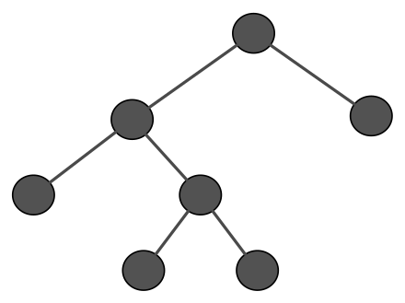
Proposed Approach
PISA Pipeline
Packet-protocol Programs
Match-action abstraction
Packet headers centric
S
E
L
E
C
T
O
R
_{Parser}
Match Tables
Action Unit
_{Deparser}
Stage₁
Stage_{N-1}
Stage_{N}
Stateful Pipeline
Data Structure Instance Block 1
In-network Applications
Data structure abstraction
State centric
Stateful Queue
Stateful Queue
Data-structure specific instances can be designed optimally unlike a generic pipeline
More natural abstraction and flexible data structure operations
Support for parallel execution
Simpler shared state management and synchronization
App Bus
Packet Reorder
Data Structure Instance Block 4
Notes:
.
Specifically, one that makes use of specialized data structure instance blocks and keeps an application’s state.
By focusing on optimizing data structures and their operations we hope to have the following advantages:
More natural abstraction for programming
Multiple data structure instances can be executed in parallel
State management and accesses is simpler when optimized for a specific data structure with well-understood memory access requirements compared to supporting any application in a generic pipeline.

Slide 26
Proposed Approach
PISA Pipeline
Data plane
Slack time
S
E
L
E
C
T
O
R
Time for headers to traverse PISA pipeline
_{Parser}
Match Tables
Action Unit
_{Deparser}
Stage₁
Stage_{N-1}
Stage_{N}
Stateful Pipeline
Data Structure Instance Block 1
Stateful Queue
Stateful Queue
App Bus
Packet Reorder
Data Structure Instance Block 4
Notes:
We expect to be able to support complex operation since the slack time, or the latency of the PISA pipeline, is in the order of 800ns. Therefore, provided stateful operations are completed and their results are provided back to the original pipeline with the aid of a packet re-order unit within the slack time, then the stateful pipeline does not hinder the original pipeline.

Slide 27
Summary
In-network applications are fundamentally different from packet-protocols
Supporting in-network applications on PISA is both challenging and limited
An exciting opportunity to rethink the architecture of switches for in-network applications
Research Agenda
Data structure instance blocks
Performance-cost trade-offs
State mapping and synchronization
Software & compiler support
Notes:
In conclusion, supporting in-network applications is challenging on programmable switches since they are stateful and require more complex data structure ops compared to packet-protocols. And we believe this presents the community an exciting opportunity moving forward to further challenge the current constraints of programmable switches.
And moving forward we believe hope to be able to address the following questions in greater detail such as blue boxes.

Slide 28
Integration options
System-in-Package (SiP)
2.5D & 3D Chip stacking solutions (already used by some FPGAs
Notes:
Stateful externs must complete within single pipeline stage
Operations therefore at granularity of stage

Slide 29
There are two dimensions
Pipelining
Parallelism
More stateful operations within slack time

Slide 30
Design Choices
A. Pure Logic-based approach
B. Generic parallel cores with custom data structure instance blocks and synchronization
C. Custom processor cores

Slide 31
A. Pure Logic-based approach
Notes:
e.g. update/replace minimum list value;

Slide 32
B. Generic parallel cores with custom data structure instance blocks and synchronization
Core Scheduler
Each core executes data structure operations of packet to completion

Slide 33
C. Custom cores
Similar in theory to previous idea, but more flexible register files and forwarding logic in cores
Cores execute multiple packets simultaneously
(State loaded into core’s register file and kept in register per-stage)
(Synchronization still needed across cores/ special synch instructions)
Compounded operations

Slide 34
Questions
Build on FPGA to start prototyping blocks
Consider multiple blocks and data-structure specific ISA cores with memory mappings
How are you going to fit on the same-die ? {intel technology)
Throughput and pipelining
Programmability if not FPGA
How is this different from externs {externs are limited to within the stage}

Slide 35
My questions
Programmable Parser ~ 40 Gbps
Application bus might become bottleneck ?
Each parser connected to one queue
Order of scheduling and slack ?
More on deparser

Slide 36
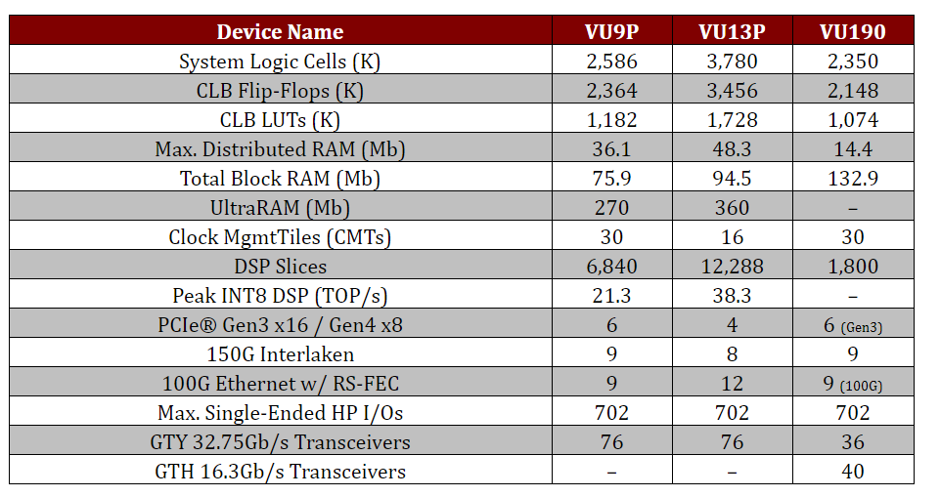
FPGA specs
Notes:
Stratix V FPGAs feature up to 66 full-duplex transceiver channels, with transceivers at data rates from 14.1 Gbps to 28.05 Gbps. Providing up to over 930 Gbps
0.5 GB on chip RAMXilinx ultraram: https://www.xilinx.com/support/documentation/white_papers/wp477-ultraram.pdf

