Slide 1



Your network doesn’t end at the NIC
A case for unifying the inter-host and intra-host networks in (AI) datacenters
Raj Joshi†, Saksham Agarwal‡, ChonLam Lao†, Minlan Yu†
†Harvard University, ‡UIUC

Slide 2




Network layer Ethernet/IP stack started/ended at NIC
10.1.1.1
20.1.1.1
Host A
Host B
Notes:
Traditionally, the network layer of Ethernet/IP stack has always begun and ended at the NIC
The network layer first assigns addresses to the NIC interfaces
Then provides the routing of packets from between the NICs

Slide 3




Network layer of Ethernet/IP stack ends at the NIC
Data transfers
App/OS buffers
Run completely different network protocols
App/OS buffers
Memory
Bus
Memory
Bus
10.1.1.1
20.1.1.1
PCIe
PCIe
Host A
Host B
Worked well for ~2 decades for traditional datacenter workloads
Notes:
Within the host, the network is simple
The NIC connects to the CPU I/O over PCIe and then to the DRAM via the memory bus.
The network protocols of the memory bus, PCIe interconnect, Ethernet/IP network work independently of each other.
But together they enable data transfers between the app/OS buffers residing on the DRAM.
This has worked well for traditional server/client …

Slide 4
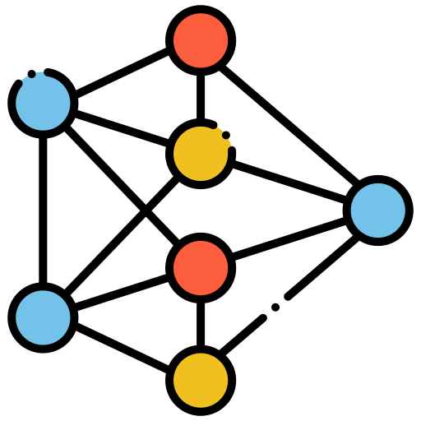
Two paradigm shifts driven by modern workloads such as LLMs
Notes:
However, there have been 2 main shifts from the status quo driven by modern …

Slide 5
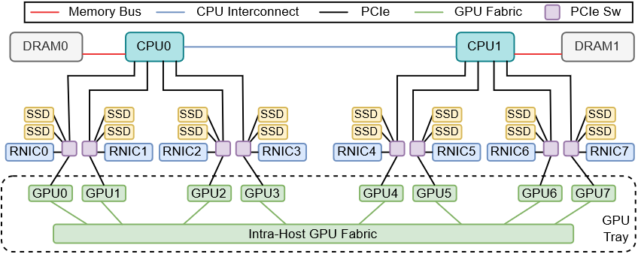
Multi-GPU servers: large, complex intra-host networks
Notes:
First is that, today we have multiple GPU servers with large and complex intra-host networks
These servers have up to 8 GPUs connected via intra-host GPU fabric
GPUs are also connected to multiple RDMA NICs, SSDs, and DRAM via a large PCIe fabric consisting of multiple PCIe switches

Slide 6

Data transfers in today’s ML workloads
Traditional Workloads
LLM Workloads
Data transfers are between App/OS buffers (on the DRAM)
More peer-to-peer transfers between intra-host devices (performance reasons)
Notes:
Second paradigm shift is that, unlike traditional workloads ... where data transfers are between
today’s LLM workloads involve more P2P data transfers between intra-host devices

Slide 7
Workloads: P2P transfers between intra-host devices
GPU ↔ GPU
Notes:
GPUs directly communicate with each other over the intra-host GPU fabric

Slide 8
Workloads: P2P transfers between intra-host devices
GPU ↔ CPU Memory
Notes:
GPUs directly communicate with the CPU memory

Slide 9
Workloads: P2P transfers between intra-host devices
GPU ↔ SSDs (GPUDirect Storage)
Notes:
They also communicate with directly with local SSDs

Slide 10
Workloads: P2P transfers between intra-host devices
GPU ↔ RNIC ↔ remote GPUs/memory/SSDs
Notes:
They communicate with the RNICs to in order to directly reach remote GPUs/memory/SSDs

Slide 11

Protocols for the intra- and inter-host networks have not evolved in response to these paradigm shifts!
The Problem
Notes:
The problem is that

Slide 12

To understand WHY this is a problem
Example: Collective Communication in distributed LLM Training
Typically involves 100s to 1000s of GPUs
Notes:
To understand WHY this is a problem, let’s take an example of distributed LLM training

Slide 13
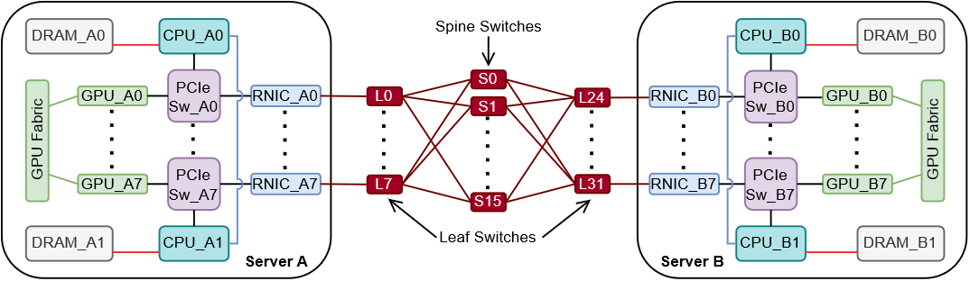
Single step in Collective Communication
GPU_A0 (server A) sends data to GPU_B0 (server B) via GPUDirect RDMA
Inter-host network:
RDMA over Ethernet
Notes:
The figure here shows a single step in collective comm, where GPU_A0 in server A sends data to GPU_B0 in server B

Slide 14
Single step in Collective Communication
GPU_A0 (server A) sends data to GPU_B0 (server B) via GPUDirect RDMA
Both GPUs register a memory buffer with nearest RNICs
Inter-host network:
RDMA over Ethernet
Notes:
The way it works is as following:
Both GPUs register a memory buffer with their nearest RNICs

Slide 15
Single step in Collective Communication
GPU_A0 (server A) sends data to GPU_B0 (server B) via GPUDirect RDMA
RNIC_A0 reads data from GPU_A0, sends RDMA Write pkts. RNIC_B0 writes to GPU_B0.
PCIe
Cmpl
PCIe
Write
RDMA Write
PCIe
Read
Inter-host network:
RDMA over Ethernet
Notes:
Then RNIC_A0 reads data from GPU_A0 …

Slide 16


Single step in Collective Communication
GPU_A0 (server A) sends data to GPU_B0 (server B) via GPUDirect RDMA
Consider a case where RNIC_B0 fails!
PCIe
Cmpl
PCIe
Write
RDMA Write
PCIe
Read
Inter-host network:
RDMA over Ethernet

Slide 17



Single step in Collective Communication
GPU_A0 (server A) sends data to GPU_B0 (server B) via GPUDirect RDMA
If RNIC_B0 fails, then GPU_B0 becomes unavailable!
Training stalls immediately!
PCIe
Cmpl
PCIe
Write
RDMA pkts
~11 mins of total downtime.
~5 mins wasted GPU compute.
PCIe
Read
Impact even greater at larger scales.
      (more details in the paper)
Inter-host network:
RDMA over Ethernet

Slide 18
Single step in Collective Communication
GPU_A0 (server A) sends data to GPU_B0 (server B) via GPUDirect RDMA
Core issue: loss of connectivity to GPU_B0, despite alternative paths.
PCIe
Cmpl
PCIe
Write
RDMA Write
PCIe
Read
But today’s intra- and inter-host network protocols do NOT support using the alternative path!
Inter-host network:
RDMA over Ethernet
2 reasons
Notes:
The core issue here is the loss of connectivity to GPU_B0, despite having alt paths
e.g. the blue path that shows that we can reach GPU_B0 through RNIC_B7 and GPU_B7

Slide 19



Intra- and Inter-host networks operate independently
Inter-host network ends at the RNIC and has no visibility beyond it!
  Writing to GPU_B0 $≈$ Writing to RNIC_B0. Unaware of the blue path via RNIC_B7.
RDMA Write
Inter-host network:
RDMA over Ethernet
End-to-End Routing Problem
Notes:
The 1st reason is that the intra and inter-host networks operate independently
As a result, the inter-host network ends at the RNIC and has no visibility beyond it.
From the inter-host network’s perspective, writing to GPU_B0 is basically abt writing to RNIC_B0.
We call this end-to-end routing problem

Slide 20
Intra-host: rudimentary point-to-point protocols
Limited support for forwarding across heterogenous interconnects
  e.g. for blue path to work, PCIe Writes need to be forwarded by GPU_B7 over GPU fabric
RDMA Write
??
Inter-host network:
RDMA over Ethernet
Intra-host Forwarding Problem
Notes:
The 2nd reason is that the intra-host network runs rudimentary point-to-point protocols
With limited support for forwarding across heterogenous interconnects
e.g. for the blue path to work, PCIe writes need to be forwarded to

Slide 21


To better support device-to-device communication
We need to re-architect the AI datacenter network to treat intra-host devices as the ultimate network endpoints.
Paradigm: the intra-host and inter-host networks operate together as a single, unified network.
Notes:
To solve these problems and to better support device-to-device communication
to this end, we envision a paradigm where …

Slide 22




Blueprint for realizing this vision
Global Addressing Scheme
Unified Routing Scheme
Forwarding Mechanism
Uniquely identifies intra-host devices across the datacenter
Routes across the intra- and inter-host networks
Bridges different intra-host interconnects
Notes:
We outline a blueprint for realizing this vision, which comprises of
… Iet’s take a quick look into these through our LLM training example

Slide 23
Global Addressing Scheme
Each intra-host device has unique DeviceID: ServerID + LocalDeviceID
  GPU_B0 DeviceID: 11.17.3.2:22
LocalDeviceID
22
ServerID:
11.17.3.2
Notes:
For each server we first assign a ServerID. e.g. server B is assigned 11.17.3.2. This can something like an IP address.
Within each server, each device is assigned a DeviceID e.g. GPU_B0 is assigned 22

Slide 24


Unified Routing Scheme
Centralized Routing Controller
intra-host routes
and costs
Local Routing Agent
Local Routing Agent
22
ServerID:
11.17.3.2
Notes:
Now, for unified routing, a local routing agent reports intra-host routes and costs to a centralized routing controller

Slide 25
Unified Routing Scheme
Centralized Routing Controller
11.17.3.2:22 | via RNIC_A0
11.17.3.2:22 | ECMP(spine)
11.17.3.2:22 | fwd(L24)
11.17.3.2:22 | fwd(port_GPU_B0)
22
ServerID:
11.17.3.2
End-to-End datapath: GPU_A0 to GPU_B0
Notes:
Which then installs the rules across the intra- and inter-host networks thereby establishing an end-to-end datapath between..
Note that the routing rules are also installed on intra-host devices including the GPUs and the PCIe switches
And all switching devices including Ethernet switches match on the globally unique device ID of GPU_B0

Slide 26
Unified Routing Scheme
Centralized Routing Controller
11.17.3.2:22 | via RNIC_A0
11.17.3.2:22 | ECMP(spine)
11.17.3.2:22 | fwd(L24)
11.17.3.2:22 | fwd(port_GPU_B0)
22
ServerID:
11.17.3.2
Notes:
Now, when RNIC_B0 fails, the local routing agent informs the same to the centralized routing controller, which then updates the routing rules

Slide 27
Unified Routing Scheme
Centralized Routing Controller
11.17.3.2:22 | via RNIC_A0
11.17.3.2:22 | ECMP(spine)
11.17.3.2:22 | fwd(L31)
11.17.3.2:22 | fwd(port_GPU_B7)
22
ServerID:
11.17.3.2
Notes:
to use the alternative path via RNIC_B7 and GPU_B7

Slide 28
Unified Routing Scheme
Centralized Routing Controller
11.17.3.2:22 | via RNIC_A0
11.17.3.2:22 | ECMP(spine)
11.17.3.2:22 | fwd(L31)
11.17.3.2:22 | fwd(port_GPU_B7)
Q. How does GPU_B7 forward data from its PCIe interface to its GPU fabric interface?
Forwarding Mechanism
22
Bridges PCIe and GPU Fabric interconnects
(more details in the paper)
??
ServerID:
11.17.3.2
Notes:
But one question still remains: how does …
That’s where our blueprint’s forwarding mechanism comes into picture that bridges PCIe and …

Slide 29


Unified Routing Scheme
Centralized Routing Controller
11.17.3.2:22 | via RNIC_A0
11.17.3.2:22 | ECMP(spine)
11.17.3.2:22 | fwd(L31)
11.17.3.2:22 | fwd(port_GPU_B7)
Distributed LLM Training Scenario
22
Network-layer can re-route around failures!
Allowing current iteration to complete.
Reducing downtime and GPU compute wastage
ServerID:
11.17.3.2
Notes:
What this means for our distributed LLM training scenario is

Slide 30





Supporting emerging device-to-device communication
Security and Isolation
Firewall and ACLs, QoS
Foundation
for a rich
future
research
agenda!
End-to-End Semantics
Reliability and Congestion Control
Foundational Datagram Service
Addressing, routing, and forwarding
Proposed
Blueprint
First step!
Notes:
Now zooming out, in the grand scheme of supporting …, our proposed blueprint provides a framework for a foundational datagram service that provides addressing, routing and forwarding.
But it is truly just the first step!
More importantly, it lays the foundation for a rich research agenda, with exciting questions from designing new end-to-end semantics for reliability and congestion control to ensuring robust security and isolation.

Slide 31




Supporting emerging device-to-device communication
New Industry Standards
Help shape the future of device-to-device communication
Notes:
With new industry standards like UALink and UltraEthernet already emerging, now is the perfect time for us, the research community, to help shape the future of device-to-device communication.

Slide 32

Thank you!
Credits: This presentation template was adapted from Slidesgo, including icons by Flaticon.
Flaticon icons by: Freepik, Muhammad_Usman, Paul J., IconMarketPK, Awicon, Pixel perfect, Eucalyp, andinur, Uniconlabs, Nikita Golubev, Konkapp, Iconjam, Flat Icons, Uniconlabs, RaftelDesign, wanicon, Design Circle, Iconjam, Smashicons, Iconjam, Uniconlabs, pojok d, ultimatearm.

Slide 33
Supporting emerging device-to-device communication
Security and Isolation
Firewall and ACLs, QoS
Foundation
for a rich
future
research
agenda!
End-to-End Semantics
Reliability and Congestion Control
Foundational Datagram Service
Addressing, routing, and forwarding
Proposed
Blueprint
First step!
Notes:
Now zooming out, in the grand scheme of supporting …, our proposed blueprint provides a framework for a foundational datagram service that provides addressing, routing and forwarding.
But it is truly just the first step!
More importantly, it lays the foundation for a rich research agenda, with exciting questions from designing new end-to-end semantics for reliability and congestion control to ensuring robust security and isolation.

Slide 34
Why not do it at the application-layer?
Context: LLM Training RNIC failure & forwarding via transit GPU_B7
Requires a staging buffer on the transit GPU (extra data copy!)
  Consumes valuable memory on the transit GPU
  Requires complex mechanisms to avoid interfering with GPU’s local workloads
Huge control overhead in doing a “chunked” pipelined transfer
  Send a chunk to GPU_B7 via RNIC_B7 → pipelined memcpy to GPU_B0
  Do this for every chunk
[Potential] Reconfiguration overhead
  GPU_B7 to register transit buffer with RNIC_B7
  Establish RDMA connection between RNIC_A0 and RNIC_B7

Slide 35
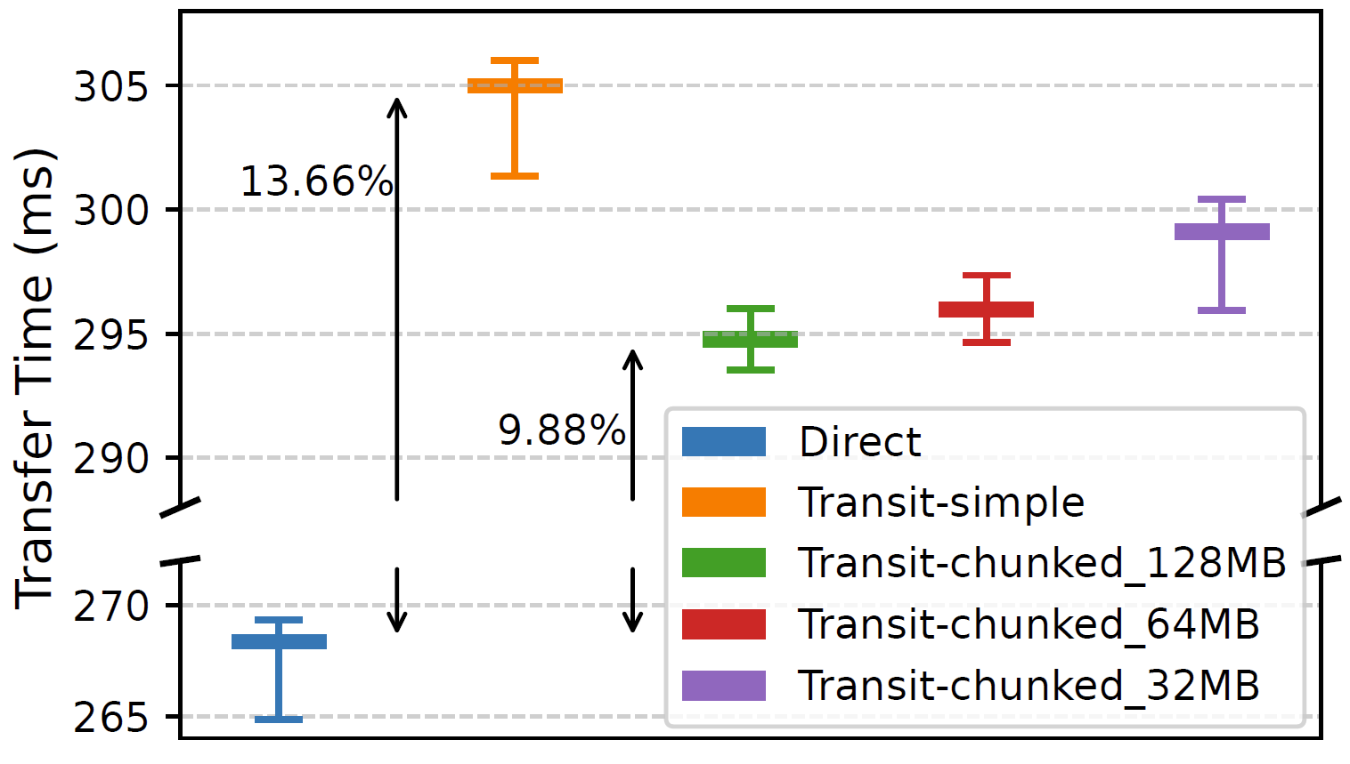
Why not do it at the application-layer?
Transfer time for 6.4GB KV cache from GPU0 to DRAM0 directly (PCIe) vs. app-driven transit via GPU1.
(whiskers: min, 25th, 50th,75th, and 99th percentiles.)

Slide 36
Feasibility on existing network infrastructure
Inter-host Network
  Ethernet switches can parse and match on the global device ID
  e.g. src/dest serverIDs as IPv4/6 addresses and the local device ID as IP options
Intra-host Network
  PCIe switches and CPU I/O complex already support routing based on physical memory addresses. Just need to make them runtime programmable.
  PCIe to GPU fabric forwarding: additional hardware support
    Upcoming industry specs like UALink can help standardize this.

Slide 37
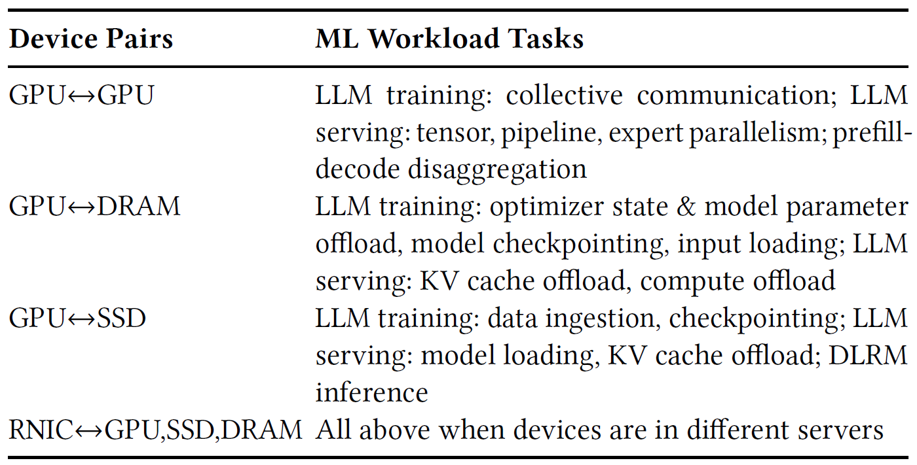
ML workloads driving device-to-device communication

Slide 38
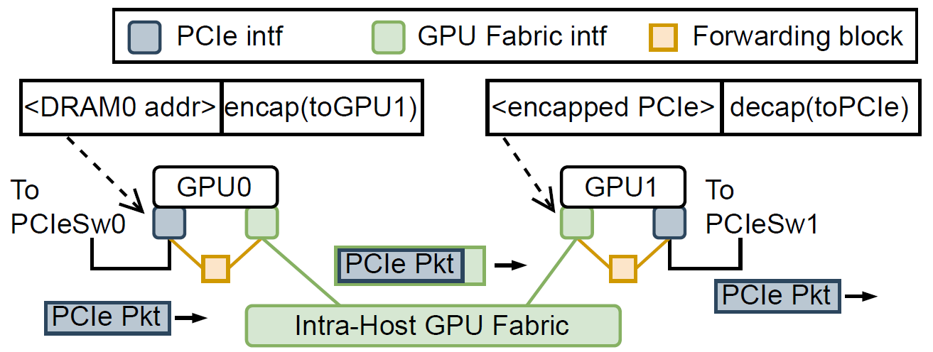
Forwarding Mechanism
GPU0 writing to DRAM0 indirectly via GPU1

Slide 39
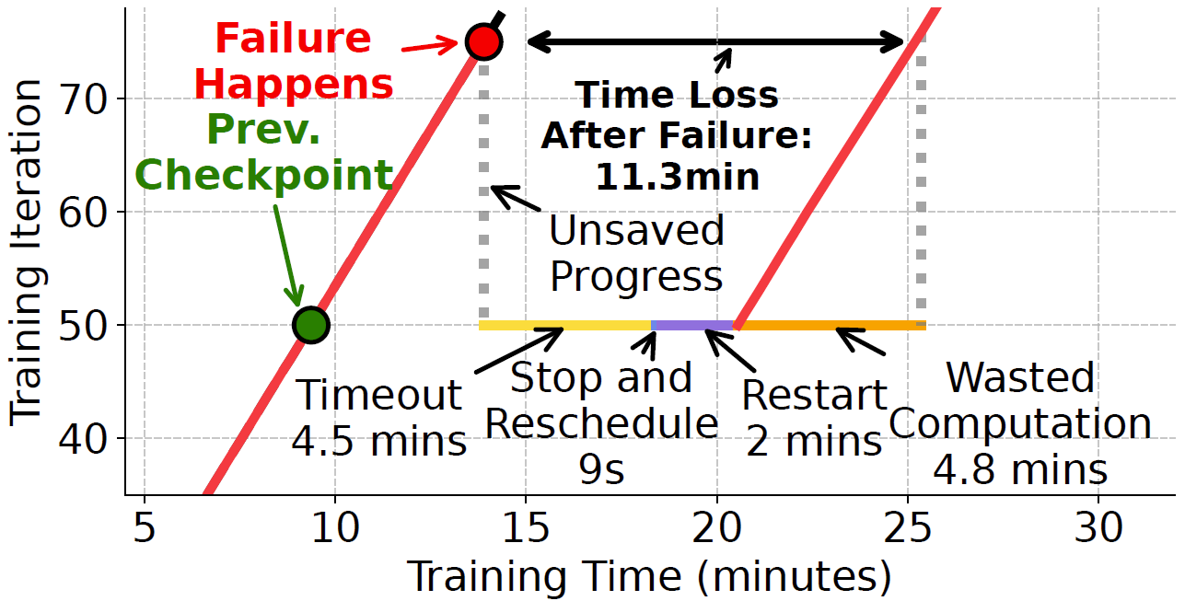
Training with RNIC Failure
Setup
  GPT2-20B on 4-machines
  32×A100 GPU cluster
  Megatron-LM: TP=2, PP=4, DP=4

