Slide 1



Optimal Oblivious Routing for Structured Networks
Sucha Supittayapornpong, Pooria Namyar, Mingyang Zhang,
Minlan Yu, Ramesh Govindan
IEEE INFOCOM 2022
Notes:
Hello, My name is Sucha Supittayapornpong at Vidyasirimedhi Institute of Science and Technology.
The paper I will be presenting is titled optimal oblivious routing for structured networks.
It is joint work with Pooria Namyar, Mingyang Zhang, Minlan Yu, and Ramesh Govindan.

Slide 2
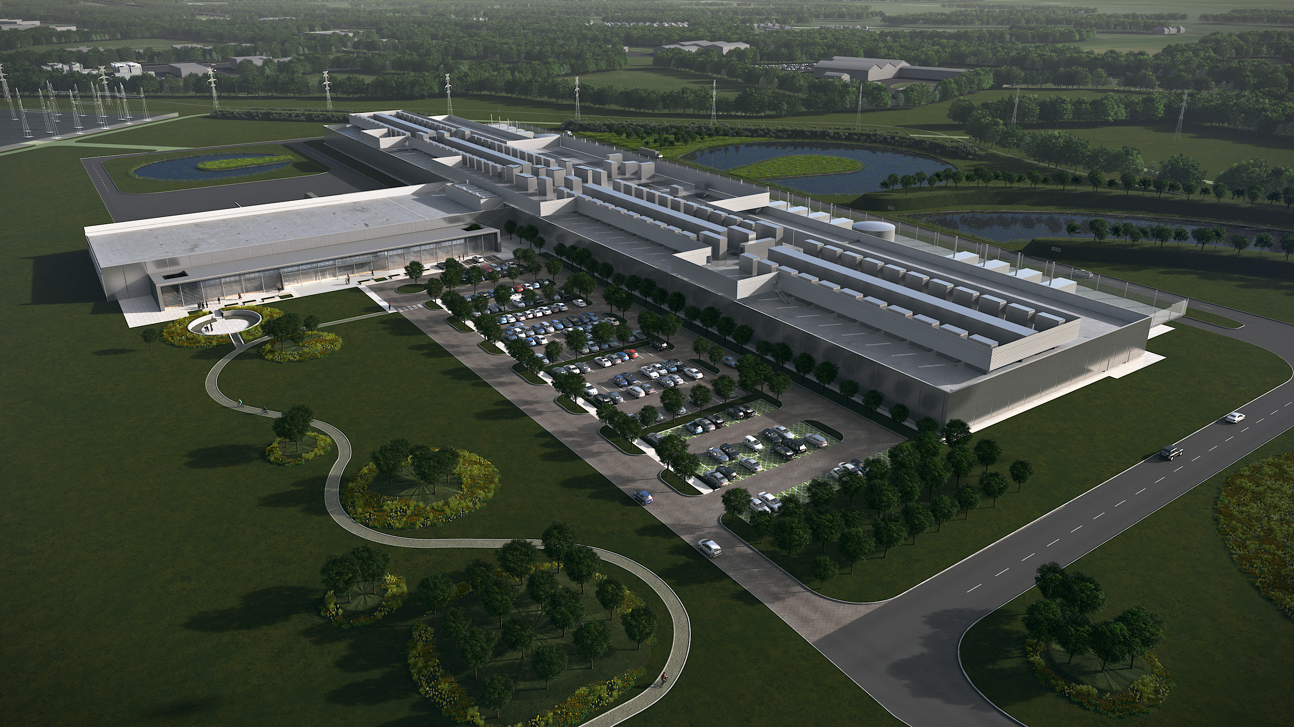

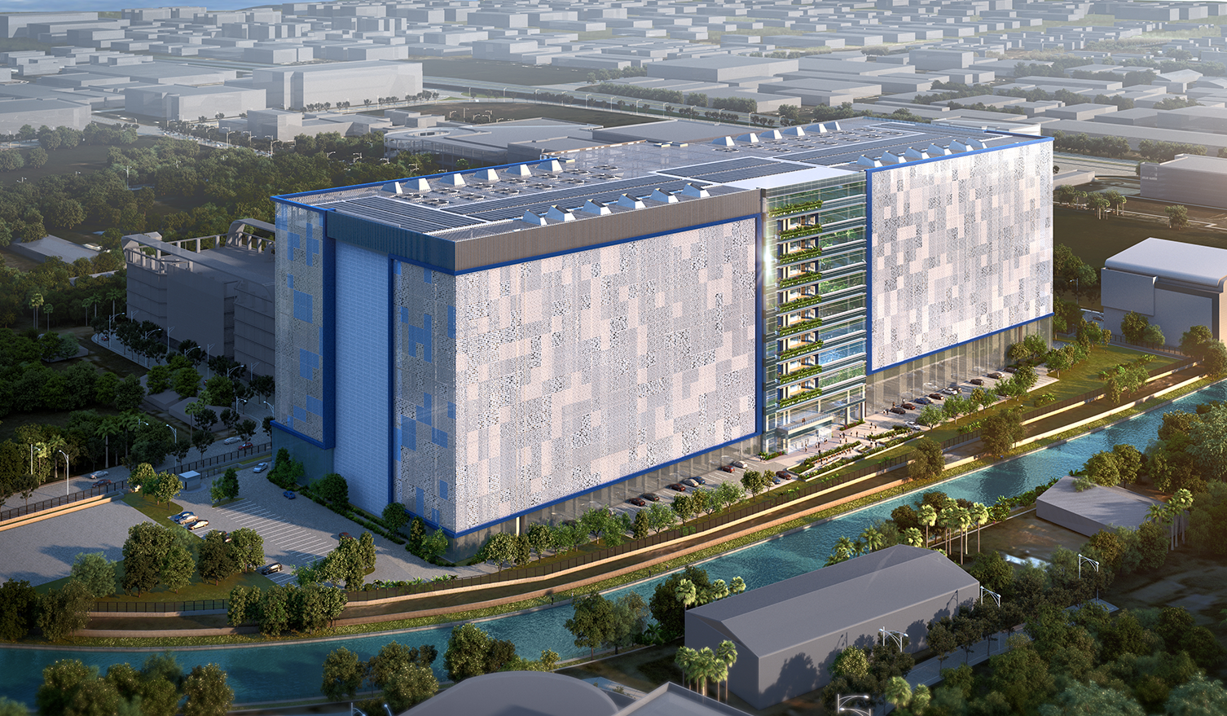
Datacenter Networks
Notes:
In this work, we consider routing in datacenter networks.
So, let me give the background of datacenter topology and routing in datacenter networks.

Slide 3
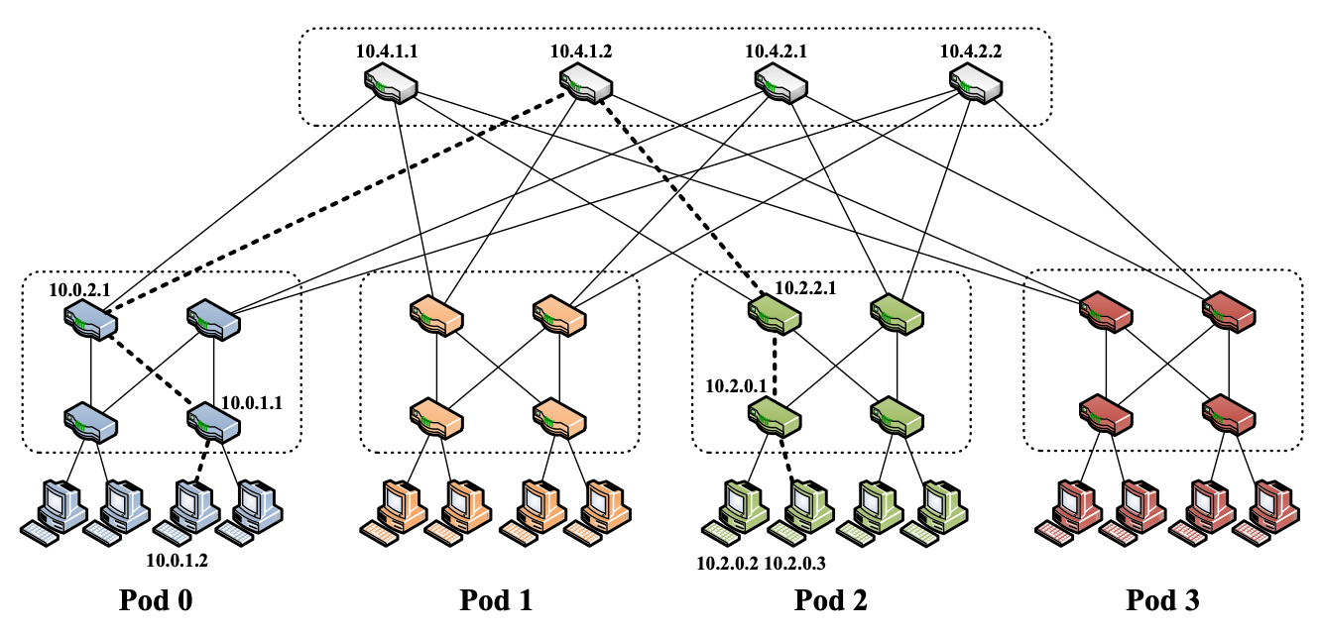
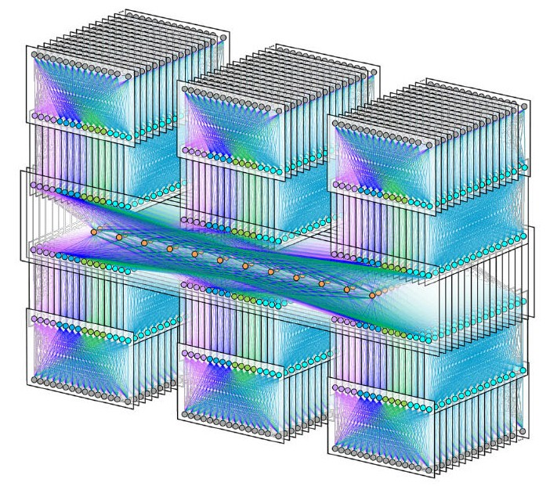
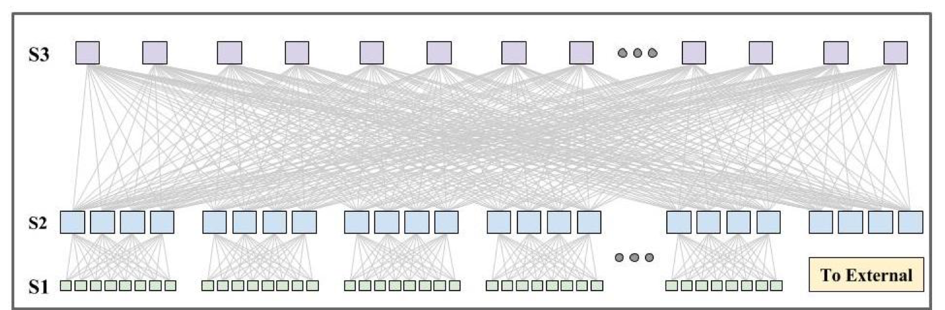
Datacenter network topology
Folded-Clos Family
FatTree (2008)
Facebook F16 (2019)
Google’s Watchtower (2015)
Notes:
Most datacenter network topologies that are deployed in production nowadays belong to the folded-clos family, such as FatTree, Google’s Watchtower, and Facebook F16.
However, recent research about datacenter network topologies is moving away from this folded-Clos family.

Slide 4
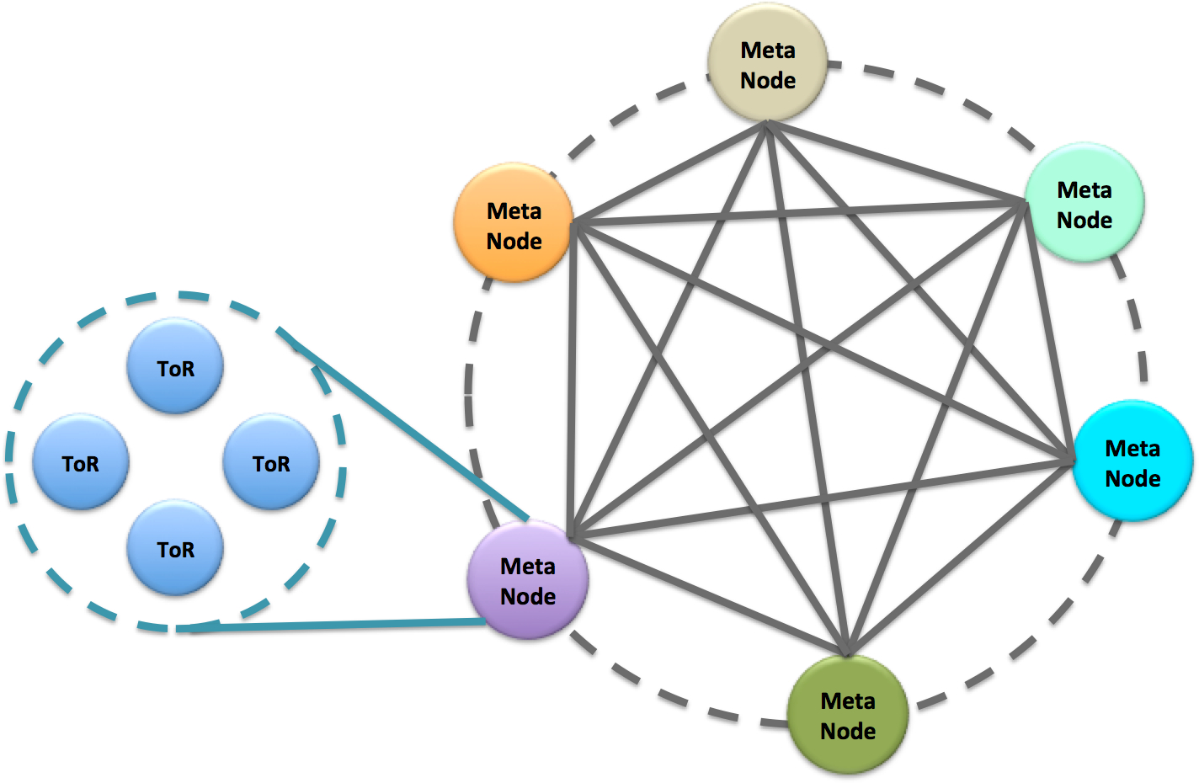
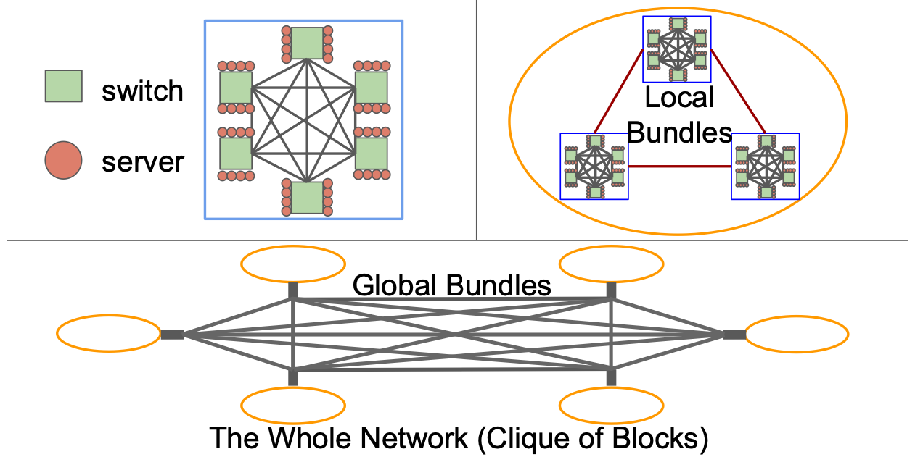
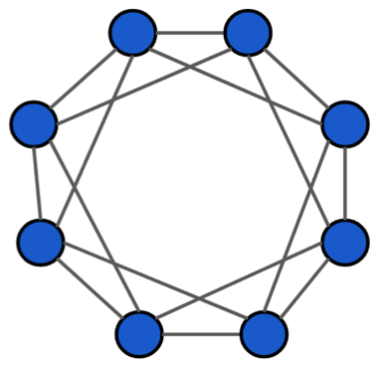
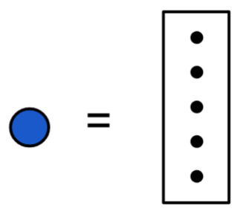
Recent proposals for datacenter networks
Xpander (2016)
FatClique (2019)
DRing (2020)
High throughput, Low cost, Low manageability
Structured networks
Notes:
There are many proposals for datacenter network topologies such as Xpander, FatClqiue, (the most recently) DRing. These new topologies aim to achieve high throughput, low cost, and low manageability.
In particular, the insight from the FatClique paper in 2019 suggests that low manageability can be achieved by having a structure in the topology.
This can be seen in FatClique and Dring which have repeated structures.

Slide 5
Recent proposals for datacenter networks
Xpander (2016)
FatClique (2019)
DRing (2020)
k-shortest paths
k-shortest paths
k-shortest union
These routing approaches cannot achieve designed capacity.
Notes:
When we look at routing approaches for these topologies, Xpander and FatClique use k-shortest paths while DRing uses k-shortest union.
However, these routing approaches cannot achieve the designed capacity of those topologies.

Slide 6
Existing routings for datacenter networks
VLB
Clique
ECMP
Folded-Clos family
WCMP
Recent proposals
Our work designs optimal routings for recent and future proposals.
Notes:
Let’s look at existing routing approaches that can achieve the designed capacity of some topologies.
Valiant load balancing or VLB achieves the designed capacity of Clique topologies and works reasonably well with the Folded-Clos family.
Equal-cost multipath (ECMP) and Weighted-cost multipath (WCMP) achieve the designed capacity of the Folded-Clos family.
However, those recent topologies including FatClique and Dring have no optimal routing for them.
Our work will fill this gap.
We will design optimal routing for the structrued networks including the recent proposals and other topologies in the future.

Slide 7

Oblivious routing is preferred
Oblivious routing
  Fix routes
  Simple system
  Simple hardware
Dynamic routing
  Routes change
  Complex system
  Special hardware
VLB, ECMP, and WCMP approaches are oblivious routing.
Notes:
Before we design the routing for structured network.
Let’s look at two types of routing approaches: Oblivious routing and Dynamic routing.
Oblivious routing has a fixed set of routes, where the routes are designed to be robust to traffic variation. Because of these fixed routes, the network system and hardware are quite simple.
Alternative, in dynamic routing, routes change over time to cope with traffic variation. This dynamic leads to a complex network system and may require special hardware.
In fact, if we look at practical routing nowadays, all of them are oblivious routing.

Slide 8
Oblivious routing for structured networks
Oblivious routing
  Fix routes
  Simple system
  Simple hardware
FatClique (2019)
DRing (2020)
Notes:
Therefore, in this work, we focus on designing optimal oblivious routing for structured networks.

Slide 9
Network model
Datacenter network is represented by a logical network.
  Each node is a switch (router) attached to servers.
  Each edge is a logical link with normalized capacity.
Notes:
To design optimal oblivious routing, we can formulate it as a robust optimization problem.
First, we model a physical network (on the left) by a logical network (on the right) where each node is a switch attached to servers and each edge is a logical link with normalized capacity.
For example, two 100 Gbps physical links with a combined capacity of 200 Gbps are normalized to a logical link with a 2-unit capacity.

Slide 10
Robust traffic set
Traffic in datacenter networks is unpredictable.
We consider all possible traffic patterns.
Source traffic at most
the number of servers
Absorb traffic at most
the number of servers
Notes:
Since traffic in a datacenter network can be unpredictable, we consider a set of all possible traffic patterns as shown here.
The first constraint in the set states that a switch can source traffic at most the number of servers attached to it.
The second constraint states that a switch can absorb traffic at most the number of servers attached to it
The last one says that traffic between servers attached to same swtich is forward internally.

Slide 11
Oblivious routing as robust optimization
Max-min throughput
Conservation constraint
Capacity constraint
for all traffic patterns
Too many variables and constraints!!!
Unsolvable by off-the-shelf solvers
Notes:
The oblivious routing is formulated as a robust optimization problem as shown here.
The objective is to maximize the minimum throughput with additional marginal throughput.
The first constraint is the conservation constraint, basically, flow in = flow out at every node.
The second constraint is the robust link capacity constraint that makes sure no capacity violation occurs for every possible traffic pattern.
It is easy to see that for a large network, there are too many variables and constraints, and the problem is unsolvable by any off-the-shelf solvers.

Slide 12
Key idea
Network structure helps reduce
the numbers of variables and constraints.
Notes:
Here is the key idea to make the problem solvable!
We can use the network structure to help reduce the numbers of variables and constraints, so the problem is solvable by an off-the-shelf solver.
This key idea leads to the contributions of this work.

Slide 13
Contributions
Automorphism-invariant optimal solution exists
Algorithm targeting this solution
Polynomial-time construction of the algorithm
Automorphism-invariant solution
Set of optimal routing solutions
Notes:
We first prove that there exists a special optimal routing solution, called an automorphism-invariant optimal solution, in which a group of variables takes the same value.
Then, we design an algorithm that targets this optimal solution.
Since the algorithm relies on a new set of variables, we provide a polynomial-time construction of these variables.

Slide 14
Contributions
Automorphism-invariant optimal solution exists
Algorithm targeting this solution
Polynomial-time construction of the algorithm
Automorphism-invariant solution
Set of optimal routing solutions
Notes:
Let’s look at how we use network structure to find the automorphism-invariant optimal solution.

Slide 15
Network structure as graph automorphism
Automorphism preserves
  Adjacency
  Link capacity
  Number of servers
Notes:
We model the network structure by graph automorphism.
Graph automorphism is a mapping from a set of nodes in a graph to the same set of nodes in the same graph.
For example, in the left graph, node 0 is mapped to node 1, so after mapping node 0 becomes the second node in the right graph.
We extend this automorphism mapping to preserve adjacency, link capacity, and the number of servers.
For example, node 0 is still connected to node 4 and node 5 after the mapping. The link capacity is still the same, and the number of servers is still the same, which is two.

Slide 16
Existance of automorphism invariant optimal solution
Commodity (0, 1)
At the optimal, decision variables form groups
All decision variables in each group take the same value
Variables form a group, and
they take the same value at optimal
Notes:
We then use graph automorphism to prove the existence of the automorphism-invariant optimal solution.
The proof is the paper. Here, let’s talk about the implication of the result.
The implication is as follows. At the optimal, decision variables form groups, and all decision variables in a group take the same value.
For example, these green flow variables in commodity (0, 1) form a group, and they take the same value at optimal.
Similarly, the blue flow variables form a group and take the same value at optimal.

Slide 17
Existance of automorphism invariant optimal solution
Commodity (0, 1)
Commodity (2, 3)
Variables form a group, and
they take the same value at optimal
Notes:
The right figure shows groups of variables for commodity (2, 3).

Slide 18
Contributions
Automorphism-invariant optimal solution exists
Algorithm targeting this solution
Polynomial-time construction of the algorithm
Automorphism-invariant solution
Set of optimal routing solutions
Notes:
Using the previous implication, we design an algorithm that targets this automorphism-invariant solution.

Slide 19
Variables are represented by their representatives
Commodity (0, 1)
Represented by one variable
Represented by another variable
Notes:
First of all, since all variables in a group take the same value at optimal. We represent them by a single representative variable.
Therefore, we only need one variable for these two green variables.
Similarly, we only need one variable for the blue variables.

Slide 20
Formulation targeting the invariant solution
Representative throughput
Representative share
Number of variables is reduced significantly.
Notes:
As a result, we reformulate the optimization problem with representative variables.
This significantly reduces the number of variables, which in turn reduces the memory footprint and problem complexity.

Slide 21
Example: Representative throughput variables
4 representatives for 12 variables
Notes:
For example, this toy example only needs 4 representative throughput variables instead of 12 variables.

Slide 22
Further simplication: conservation constraint
Only representative commodities
Number of constraints is reduced significantly.
Notes:
We further simplify the formulation by considering only representative commodities for the conservation constraints.
This reduces the number of constraints significantly.

Slide 23
Further simplication: link capacity constraint
Only representative links
Traffic set increased
incrementally
Number of constraints is reduced significantly.
Notes:
Further, we reduce the robust link capacity constraints by considering only those representative links
And also, by considering traffic patterns incrementally.

Slide 24
Traffic patterns are considered incrementally
Find suboptimal routing
Find traffic patterns violating link capacity
Routing solution
Traffic patterns
Notes:
This is how we consider traffic patterns incrementally.
The algorithm uses a previous suboptimal solution to select traffic patterns that violate link capacity.
It then adds those traffic patterns to the optimization problem.
The process continues until no capacity violation occurs.
And, this is how we obtain the optimal routing solution.

Slide 25
Contributions
Automorphism-invariant optimal solution exists
Algorithm targeting this solution
Polynomial-time construction of the algorithm
Automorphism-invariant solution
Set of optimal routing solutions
Notes:
One point that I haven’t mentioned is how to determine the groups of variables. Which group does a variable belong to?

Slide 26
Represenative variable needs mapping
Polynomial-time algorithms are provided in the paper.
Notes:
We provide polynomial-time algorithms to construct the grouping in the papers.

Slide 27
Experiments
Optimal routing for partially deployed FatTree
Scalability of our approach for FatClique
Generality for future topologies
Notes:
Let’s look at experiments. We will show the application of our algorithm, its scalability, and its generality.

Slide 28
Experiment: Partially deployed FatTree
Our approach yields 12.5% - 87.5% throughput improvement.
Notes:
First, we find the optimal oblivious routing for partially deployed FatTree topology.
A datacenter network is usually deployed incrementally by increasing the number of aggregation blocks. The topology on the left has three aggregation blocks.
Each partially deployed FatTree needs routing. We compare our optimal routing to a heuristic one, which uses WCMP.
The x-axis is the number of aggregation blocks in a topology, where 32 blocks mean fully deployed FatTree.
The y-axis is the throughput for each partially deployed FatTree.
Our approach yields 12.5% to 87.5% throughput improvement.

Slide 29
Scalability: Variables and Constraints
> 10⁹ without our technique
~ 10³ with our technique
Our approach significantly reduces
the numbers of variables and constraints.
Notes:
Next, we look at the scalability of our algorithm in Deterministic FatClique.
First, we consider the number of variables and constraints in the optimization for different sizes of FatClique.
The x-axis is the number of switches which represents the size FatClique.
The y-axis is the variable count and constraint count.
The red plots show the number of variables and constraints for the robust optimization without our technique. The numbers are higher than 10 to the power 9.
With our technique, the numbers reduce significantly to around thousands.

Slide 30
Scalability: Traffic matrices
< 100
Our approach significantly reduces
the numbers of considered traffic patterns.
Notes:
For the number of traffic patterns, our approach reduces it significantly. For this result, the algorithm consider less than 100 traffic patterns to obtain the optimal routing.

Slide 31
General topology
Our approach applies to other topologies with different distributions of servers and link capacity.
Notes:
Lastly, our approach applies to other topologies with different distributions of servers and link capacity. The figure here shows the optimal routing solution for a toy topology with different distributions of servers and link capacity.

Slide 32
Conclusion
An automorphism-invariant optimal solution exists.
The solution method can be constructed in polynomial time.
Our approach is general and scales well.
Notes:
We conclude our work as follows.
We show that an automorphism-invariant solution for optimal oblivious routing exists.
We then use this insight to develop a solution method to obtain this optimal solution.
And, our approach is general and scales well.
This concludes this presentation.
Thank you for your attention.

Slide 33
Scalability: Computation time
< 16 hours
Our approach allows an off-the-shelf solver to find
an optimal routing solution.
Notes:
The computation time for the optimization is less than 16 hours.

