Slide 1
Enforcing Network-Wide Policies in the Presence of Dynamic Middlebox Actions using FlowTags
Seyed K. Fayazbakhsh*, Luis Chiang¶, Vyas Sekar*, Minlan Yu★, Jeffrey Mogul
*CMU, ¶Deutsche Telekom, ★USC, Google

Slide 2

Middleboxes complicate policy enforcement in SDN
Policy:
E.g., service chaining,
access control
Control Apps
Network OS
Dynamic and
traffic-dependent
modifications!
e.g., NATs, proxies
Data Plane

Slide 3

Modifications → Attribution is hard
Block the access of H₂ to certain websites.
NAT
Firewall
H₁
Internet
H₂
S₁
S₂

Slide 4
Dynamic actions → Policy violations
Web ACL
Block H₂ → xyz.com
Proxy
H₁
1. Get xyz.com
2. Response
Cached
response
Internet
S₁
S₂
3. Get xyz.com
H₂
4. Cached response

Slide 5
Our work: FlowTags
Some candidate (non-)solutions:
Placement, tunneling, consolidation, correlation
Address some symptoms but not root cause
→ OriginBinding and PathsFollowPolicy violations
FlowTags provides an architectural solution:
→ Enables policy enforcement and diagnosis
despite dynamic middlebox actions.

Slide 6
Outline
Motivation
High-level Idea
FlowTags Design
Evaluation

Slide 7
High-level idea
Middleboxes need to restore SDN tenets
  Possibly only option for correctness
  Minimal changes to middleboxes
Add missing contextual information as Tags
  NAT gives IP mappings,
  Proxy provides cache hit/miss info
FlowTags controller configures tagging logic

Slide 8

FlowTags architecture
Control Apps
e.g., steering, verification
Admin
Control Apps
New control apps
e.g., policy steering, verification
Policy
Network OS
Control plane
Existing APIs
e.g., OpenFlow
FlowTags
APIs
Data plane
FlowTags
Enhanced
Middleboxes
FlowTags
Tables
Mbox
Config
SDN
Switches
FlowTable

Slide 9
FlowTags in action
Config w.r.t original principals
Block: 10.1.1.2 → xyz.com
H₁ 10.1.1.1
<SrcIP,Cache Hit> | Tag
10.1.1.2, Hit | 2
Tag | OrigSrcIP
2 | 10.1.1.2
Proxy
Web ACL
DROP
xyz.com
2
S₁
S₂
Internet
Tag | Fwd
2 | S₂
Tag | Fwd
2 | ACL
xyz.com
H₂
10.1.1.2

Slide 10
Outline
Motivation
High-level Idea of FlowTags
FlowTags Design
Evaluation

Slide 11
Challenge 1: Tag Semantics
FlowTags-enhanced
SDN Controller
Control plane
Data plane
Add Tag
Decode Tag
H₁
10.1.1.1
Proxy
Web ACL
Internet
H₂
10.1.1.2
S₁
S₂
Tag | Forward
Tag | Forward

Slide 12
Challenge 2: New APIs, control apps
FlowTags-enhanced
SDN Controller
Control plane
Data plane
Add Tag
Decode Tag
H₁
10.1.1.1
Proxy
Web ACL
Internet
H₂
10.1.1.2
S₁
S₂
Tag | Forward
Tag | Forward

Slide 13
Challenge 3: Middlebox Extensions
FlowTags-enhanced
SDN Controller
Control plane
Data plane
Add Tag
Decode Tag
H₁
10.1.1.1
Proxy
Web ACL
Internet
H₂
10.1.1.2
S₁
S₂
Tag | Forward
Tag | Forward

Slide 14
Outline
Motivation
High-level Idea of FlowTags
FlowTags Design
  Tag semantics
  Controller and APIs
  Middlebox modification
Evaluation

Slide 15
Semantics: Dynamic Policy Graph (DPG)
Proxy
Web ACL: Block H₂ → xyz.com
H₁
Internet
H₂
S₁
S₂
{H₁}; Miss
{H₁}; Hit
{H₂}; <Allowed,Miss>
Internet
H₁
{H₁}; -
{H₂}; Hit
{H₂}; Miss
ACL
Proxy
{H₂}; -
H₂
{H₂}; Blocked
{H₂}; <Allowed,Hit>
Drop

Slide 16
Semantics: Dynamic Policy Graph (DPG)
Proxy
Web ACL: Block H₂ → xyz.com
H₁
Internet
H₂
S₁
S₂
{H₁}; Miss
{H₁}; Hit
{H₂}; <Allowed,Miss>
Internet
H₁
{H₁}; -
{H₂}; Hit
{H₂}; Miss
ACL
Proxy
{H₂}; -
H₂
{H₂}; Blocked
{H₂}; <Allowed,Hit>
Drop
Intuitively, need a Tag <per flow, per-edge> in DPG

Slide 17
Outline
Motivation
High-level Idea of FlowTags
FlowTags Design
  Tag semantics
  Controller and APIs
  Middlebox modification
Evaluation

Slide 18
FlowTags APIs
OpenFlow
FlowTags
FlowTags-enhanced
SDN Controller
Generate Tag
Consume Tag
H₁ 10.1.1.1
Tag | OrigSrcIP
<SrcIP,Cache Hit> | Tag
Tag | OrigSrcIP
2 | 10.1.1.2
<SrcIP,Cache Hit> | Tag
10.1.1.2, Hit | 2
Proxy
Web ACL
S₁
S₂
Internet
Tag | Fwd
Tag | Fwd
2 | S2
Tag | Fwd
Tag | Fwd
2 | ACL
H₂
10.1.1.2

Slide 19
FlowTags-enhanced controller
Policy DPG
Reactive
Physical
realization
Middlebox Event Handlers
Switch Event Handlers
Tag generate and consume
Flow expiry
Flow rules
S₁
S₂
S₃
S₄

Slide 20
Outline
Motivation
High-level Idea of FlowTags
FlowTags Design
  Tag semantics
  Controller and APIs
  Middlebox modification
Evaluation

Slide 21
Middlebox extension strategies to add FlowTags support
Strategy 1: Packet Rewriting
Middlebox
module
module
input traffic
output
traffic
module
module
module
module
Light-weight packet
rewriting shims
Pro: One shot
Con: Hard to get internal context

Slide 22
Middlebox extension strategies to add FlowTags support
Strategy 2: Module Modification
Middlebox
module
module
input traffic
output
traffic
module
module
module
module
Pro: More change is needed
Con: Suited for getting internal context

Slide 23
Middlebox extension strategies to add FlowTags support
Middlebox
Shim
module
module
input traffic
output
traffic
module
module
module
module
Tag generation
Tag consumption
Our Strategy:
Packet rewriting for Tag consumption
Module modification for Tag generation

Slide 24
Outline
Motivation
High-level Idea of FlowTags
FlowTags Design
Evaluation

Slide 25
Key evaluation questions
Feasibility of middlebox modification
FlowTags overhead
Number of Tag bits
New capabilities

Slide 26
FlowTags needs minimal middlebox modifications
Middlebox | Total LOC | Modified LOC
Squid | 216,000 | 75
Snort | 336,000 | 45
Balance | 2,000 | 60
iptables | 42,000 | 55
PRADS | 15,000 | 25

Slide 27
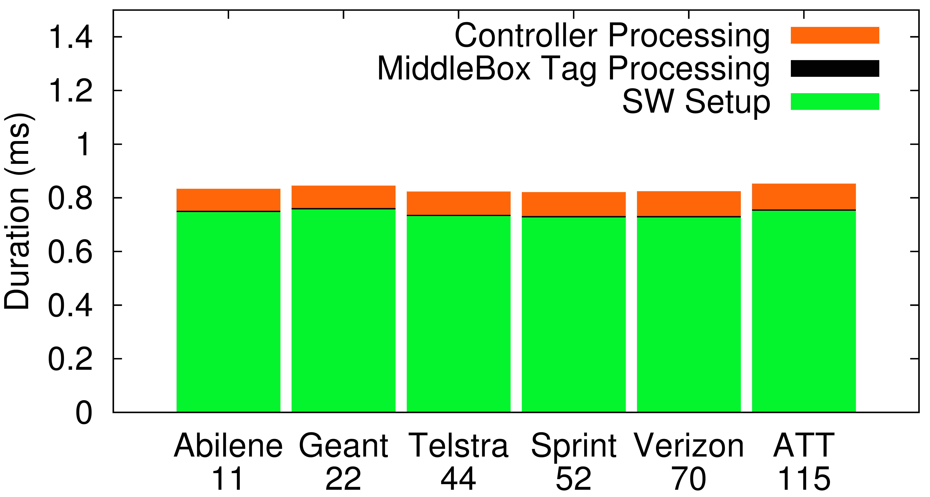
FlowTags adds low overhead
1.4
1.2
1
0.8
0.6
0.4
0.2
0
Controller Processing
Middlebox Tag Processing
Switch Setup
Breakdown of flow processing time (ms)
Abilene Geant Telstra Sprint Verizon AT&T
# PoPs:
11 22 44 52 70 115

Slide 28
Summary of other results
Adds < 1% overhead to middlebox processing
Tags can be encoded in ~ 15 bits
  E.g., IP-ID, IPv6 FlowLabel, EncapHeaders (NVP)
Can enable new capabilities
  Extended header space analysis
  Diagnosing network bottlenecks

Slide 29
Conclusions
Middleboxes complicate enforcement
  E.g., NAT/LB rewrite headers, proxy sends cached response
Root cause: Violation of the SDN tenets
  Origin Binding and Paths-Follow-Policy
FlowTags extends SDN with new middlebox APIs
  Restores tenets using new DPG abstraction
  No changes to switches and switch APIs
FlowTags is practical
  Minimal middlebox changes, low overhead
  An enabler for verification, testing, and diagnosis

