Slide 1
Scalable Distributed Massive MIMO Baseband Processing
Junzhi Gong (Harvard)
Anuj Kalia (Microsoft)
Minlan Yu (Harvard)
Notes:
Hello, everyone! Today I am going to talk about our project, about building a scalable distributed massive MIMO baseband processing system. This project was done with Anuj from Microsoft, and my advisor Minlan.

Slide 2
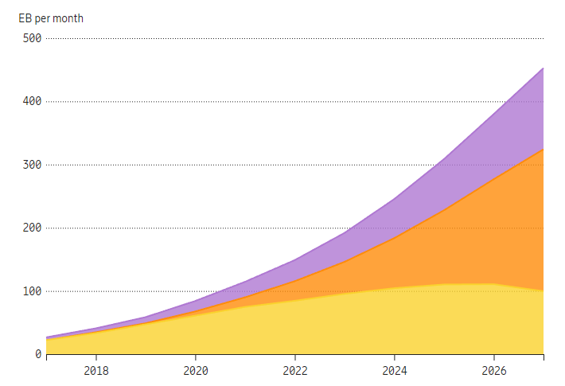
Increasing traffic rate in 5G
Increased demand on mobile traffic rate
Image credit to Ericsson
Notes:
Today we are moving to the 5G era. The mobile traffic demand is increasing by a lot in the last few years. Here is the figure of total 5G traffic rate. It shows the traffic rate increase in the last few years, and predicts the rate increase in the next few years.

Slide 3
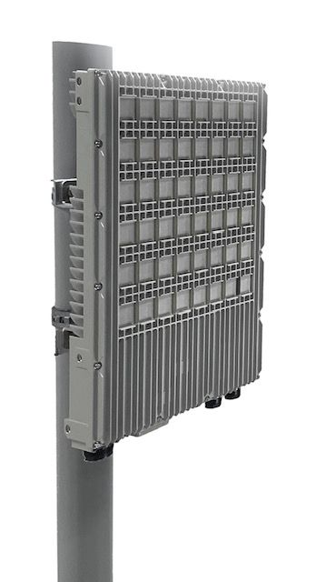
Key to higher data rate in 5G: massive MIMO
M antennas
Massive MIMO: with many antennas, many users can send/recv data at the same time, at the same frequency
Radio unit (RU)
Beamforming
Beamforming: focuses radio signals directly at the users, to eliminate interference
K users
M×K massive MIMO
Notes:
To satisfy the increasing traffic rate from 5G, one of the key new features of 5G for higher throughput is called massive MIMO.
Massive MIMO is the technique of using a lot of antennas at the cell tower to simultaneously serve many users at the same time at the same frequency, so it supports high throughput.
Here is the cell tower, and the key component here is the radio unit, which consists of an array of antennas. Let’s say the number of antennas is M.
And there are K user devices, and we call it M*K massive MIMO.
The large number of antennas are used to implement a technique called beamforming, which focuses the radio signals directly at the users.
Because of beamforming, there is little interference among the users even though they are sending/receiving data at the same frequency.
Therefore, the massive MIMO technique achieves higher throughput.

Slide 4
Computation and wired communication challenges of massive MIMO
Fronthaul traffic
M×K massive MIMO
Baseband unit (BBU)
Fronthaul packets (wireless signals)
User bits
Notes:
However, making massive MIMO scalable to more antennas and users is challenging, because of the high computation and wired communication cost from massive MIMO.
The RU sends the signals from users to a component called baseband unit over an ethernet link, which converts these fronthaul packets into user bits.
And the traffic to carry those radio signals is called fronthaul traffic.
Historically, the BBU has been implemented in specialized hardware like FPGA or DSP.
However, these days there is a movement to virtualize the RAN by running the BBU on commodity servers.

Slide 5
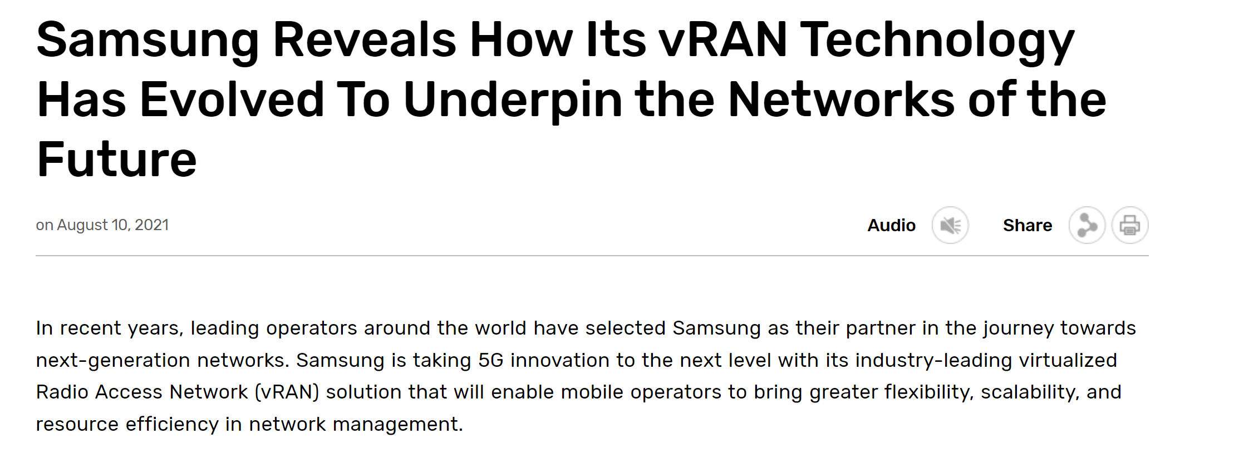
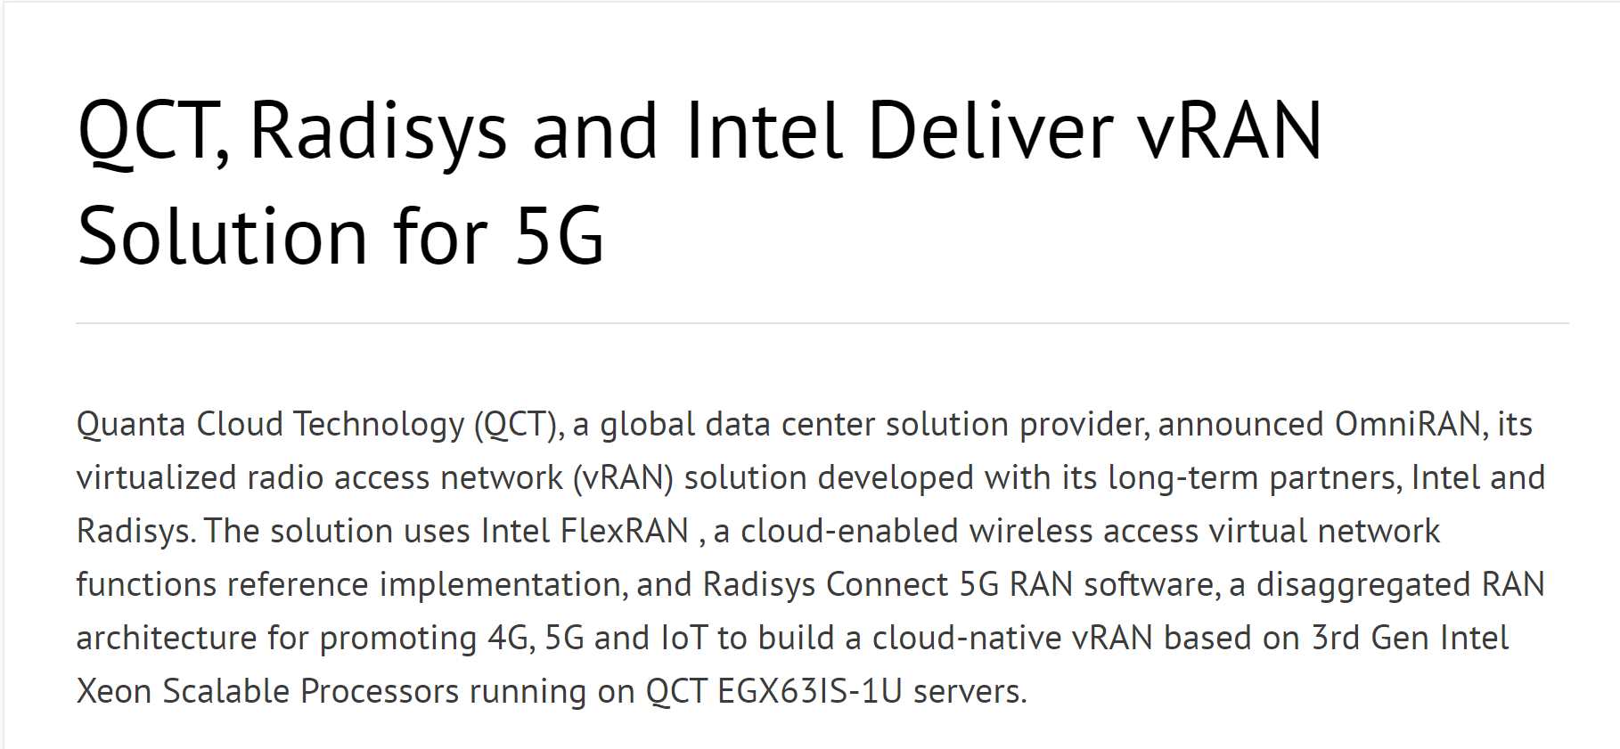
Computation and wired communication challenges of massive MIMO
Fronthaul traffic
RAN virtualization movement
Commodity server
M×K massive MIMO
Notes:
Like virtualizing network function, it can mitigate vendor lockin, has flexible deployment, and high-velocity development.
[Optional] We have seen this already happened for higher-layer 5G network stacks, like the 5G core networks, but now we are seeing this for lower layer stack, like the radio access network.
According to the news, many companies have already built and deployed their own 5G BBU software solutions.

Slide 6
Computation and wired communication challenges of massive MIMO
Agora [CoNEXT 20]:
Needs 28 cores (a full server) for 64x16 MIMO
Can’t scale to larger MIMO configurations (e.g., 128x32)
Single server is not enough
Large amount of computation with more antennas/users
Fronthaul traffic
Commodity server
M×K massive MIMO
High fronthaul bandwidth with more antennas
Notes:
This is great, but it presents a problem because of the very high amount of computation and high fronthaul bandwidth required by massive MIMO.
There are some recent work on designing efficient massive MIMO processing systems on commodity servers, like Agora.
The problem of Agora is that it is limited to one single server, so it cannot scale to increasing number of antennas and users.
Agora requires 28 cores to support 64 antennas and 16 users, where it almost requires a full server.
If we want to go to a higher configuration like 128 antennas or 32 users, we need to design a distributed system where we can use the computation resources from multiple servers.

Slide 7
Inter/intra-server communication limits scalability in prior massive MIMO systems
BigStation [SIGCOMM 10]
Agora [CoNEXT 20]
State-of-the-art distributed solution
State-of-the-art single-server solution
1
High inter-server communication
2
High intra-server communication
Server 1
Server 2
Core 1
Core 2
Core 3
Core 4
Server 3
Server 4
…
Core N
Core N+1
Notes:
To understand how our system improves the scalability of massive MIMO, let's take a look at the scalability bottlenecks in existing state-of-the art designs, in both the distributed and single server settings.
Existing state-of-the-art systems suffer from high communication overhead, which limits their scalability.
For example, the state-of-the-art distributed system design for massive MIMO is called BigStation. Its scalability is limited by the large amount of inter-server communication.
The single-server system Agora also suffers from inter-core communication overhead in its design, and that also limits scalability.

Slide 8
Hydra: minimize inter and intra-server communication for scalability
Reduce inter-server communication overhead
Exploit RU features to deliver fronthaul data directly to servers instead of shuffling the data among servers in prior designs
Delay shuffling until later in the pipeline when the data size is reduced
Reduce intra-server communication overhead
Subcarrier-to-core affinity to minimize inter-core data movement
Eliminate centralized task scheduling
Notes:
Now let’s talk about our solution, Hydra, a scalable distributed massive MIMO system.
In Hydra, we optimize both inter and intra server communication overhead.
In this talk, I will focus on the distributed aspects of the system, that optimizes the inter-server communication overhead.
For single-server scalability improvement, please refer to our paper for more details.
To reduce inter-server communication overhead, Hydra first exploits features of modern RUs to deliver fronthaul data directly to the servers, instead of shuffling the fronthaul data among the servers in prior designs.
Second, we observe the massive MIMO signal processing pipeline progressively reduces the amount of data, like converting from floating point wireless signals into user bits.
Therefore, to minimize the amount of data exchange, Hydra delays data shuffling until later in the pipeline.

Slide 9
Background: massive MIMO processing pipeline
Antenna-parallel
Subcarrier-parallel
User-parallel
From RU
FFT
Equalization
Demodulation
FEC decoding
To core network
To RU
IFFT
Precoding
Modulation
FEC encoding
From core network
9
Notes:
Before talking about our ideas, let’s look at the massive MIMO processing pipeline.
Prior work has shown that the MIMO processing pipeline has different types of parallelism at different stages, the antenna-parallel stage, subcarrier-parallel stage, and the user-parallel stage.
The antenna-parallel stage means antennas can be processed independently and in parallel.
This is similar in the later two stages.
For uplink processing, when the BBU receives the radio signals, the signals are processed first by FFT in the antenna parallel stage, and then processed by equalization and demodulation, which are in the subcarrier-parallel stage, and finally processed by forward error correction in the user-parallel stage.
The downlink processing is similar.

Slide 10
Data dependency between stages introduces communication overhead
Example: 120x30 MIMO, 1200 subcarriers
Antenna-parallel
Subcarrier-parallel
User-parallel
40 packets
…
1
Server 1
Antennas 1-40
Antenna set 1
Subcarrier set 1
User set 1
From RU
40 packets
…
Server 2
2
Antenna set 2
Subcarrier set 2
User set 2
Antennas 41-80
40 packets
…
Server 3
3
Antennas 81-120
Antenna set 3
Subcarrier set 3
User set 3
10
Notes:
To understand how Hydra optimizes inter-server communication overhead, let’s look at how the design of BigStation suffers from inter-server data communication overhead.
The first overhead comes from data dependency between adjacent stages of the pipeline.
Let’s take a hypothetical example where we have 120 antennas and 30 users, with 1200 subcarriers, on three servers.
Let’s first partition the workload for the antenna parallel stage. Since in this stage, data is antenna-parallel, we can simply partition 120 antennas into equal ranges, 40 antennas per server.
Here, the first server processes antenna 1 to 40, and the second server processes antenna 41 to 80, and the third one is 81 to 120.
We can do the same thing for later stages as well.

Slide 11
Data dependency between stages introduces communication overhead
Example: 120x30 MIMO, 1200 subcarriers
Antenna-parallel
Subcarrier-parallel
User-parallel
1
Server 1
Antenna set 1
Subcarrier set 1
User set 1
From RU
Server 2
2
Antenna set 2
Subcarrier set 2
User set 2
3
Server 3
Antenna set 3
Subcarrier set 3
User set 3
11
Notes:
Let’s focus on one packet at each server.

Slide 12
Data dependency between stages introduces communication overhead
Example: 120x30 MIMO, 1200 subcarriers
Antenna-parallel
Subcarrier-parallel
User-parallel
SC 1
SC 1200
1
~5 KB
SC 1-400
Server 1
Antenna set 1
Subcarrier set 1
User set 1
From RU
SC 1
SC 1200
SC 401-800
Server 2
2
~5 KB
Antenna set 2
Subcarrier set 2
User set 2
SC 1
SC 1200
Server 3
3
~5 KB
SC 801-1200
Antenna set 3
Subcarrier set 3
User set 3
12
Notes:
After the antenna-parallel stage processes each packet, the packets are ready to be fed to the next stage.
The challenging thing here is that the data rate that needs to be fed is very large, around 128 Gbps.
Note that packet holds the data for all 1200 subcarriers in the system, while each server in the subcarrier parallel stage processes different nonoverlapping sets of subcarriers.
It is not possible to simply forward the packets directly to the next stage on the same server.

Slide 13
Data dependency between stages introduces communication overhead
Example: 120x30 MIMO, 1200 subcarriers
Antenna-parallel
Subcarrier-parallel
User-parallel
SC 1
SC 1200
~5 KB
Server 1
Antenna set 1
Subcarrier set 1
User set 1
From RU
SC 1
SC 1200
Server 2
~5 KB
Antenna set 2
Subcarrier set 2
User set 2
SC 1
SC 1200
Server 3
~5 KB
Antenna set 3
Subcarrier set 3
User set 3
13
Notes:
To feed the data correctly, each server needs to partition the packet into three subcarrier sets.

Slide 14
Data dependency between stages introduces communication overhead
Example: 120x30 MIMO, 1200 subcarriers
Antenna-parallel
Subcarrier-parallel
User-parallel
SC 1
SC 1200
~5 KB
Server 1
Antenna set 1
Subcarrier set 1
User set 1
From RU
SC 1
SC 1200
Server 2
~5 KB
Antenna set 2
Subcarrier set 2
User set 2
SC 1
SC 1200
Server 3
~5 KB
Antenna set 3
Subcarrier set 3
User set 3
Scalability bottleneck: High rate (> 120 Gbps) of inter-server shuffling
14
Notes:
And then forward each partition of the subcarrier data to the corresponding server.
This requires shuffling all the data that we received from the radio between the servers, causing more than 120 Gbps of inter-server shuffling.

Slide 15
Idea #1: Exploit modern RU features to avoid data shuffling
SC 1
SC 1200
Server 1
~5 KB
Antenna
set 1,2,3
Antenna set 1
Subcarrier set 1
User set 1
Server 2
Antenna set 2
Subcarrier set 2
User set 2
RU
Server 3
Modern RU (O-RAN 7.2x) features
Support FFT
Antenna set 3
Subcarrier set 3
User set 3
15
Notes:
To address this overhead, Hydra exploits features of modern RUs to eliminate such data shuffling.
In almost all modern virtualized RAN deployments, the RUs support FFT, so we can offload the antenna parallel stage from the servers to the RU.

Slide 16
Idea #1: Exploit modern RU features to avoid data shuffling
SC 1
SC 1200
Still high overhead from duplication
Server 1
~5 KB
Antenna
set 1,2,3
Subcarrier set 1
User set 1
Server 2
Subcarrier set 2
User set 2
RU
Server 3
Modern RU (O-RAN 7.2x) features
Support FFT
Subcarrier set 3
User set 3
16
Notes:
Now the packet is processed in the RU.
However, to feed the packet to the next stage, we still need to forward this packet to all servers by duplication, because the packet still consists of data for all subcarriers.
Therefore, simply offloading FFT to the RU does not eliminate the data shuffling.

Slide 17
Idea #1: Exploit modern RU features to avoid data shuffling
SC 1
SC 1200
Server 1
~5 KB
Antenna
set 1,2,3
Subcarrier set 1
User set 1
Server 2
Subcarrier set 2
User set 2
RU
Server 3
Modern RU (O-RAN 7.2x) features
Support FFT
Configurable fronthaul packet segmentation
Originally designed for MTU tuning
Subcarrier set 3
User set 3
17
Notes:
The good news is that, modern RUs support another feature, which is configurable fronthaul packet segmentation.
This feature is originally for MTU size tuning, which allows the large fronthaul packets to be segmented so that they can go through networks with small MTU sizes.
Here we can use it in a new way for a scalable fronthaul packet delivery.
We can configure the RU to partition the packets based on different subcarrier set processed by different servers.

Slide 18
Idea #1: Exploit modern RU features to avoid data shuffling
SC 1
SC 1200
Server 1
1
2
3
~5 KB
Antenna
set 1,2,3
Subcarrier set 1
User set 1
Server 2
Subcarrier set 2
User set 2
RU
Server 3
Modern RU (O-RAN 7.2x) features
Support FFT
Configurable fronthaul packet segmentation
Originally designed for MTU tuning
Subcarrier set 3
User set 3
18
Notes:
And then forward each partition to each server without duplication.

Slide 19
Idea #1: Exploit modern RU features to avoid data shuffling
SC 1
SC 1200
Server 1
~5 KB
Antenna
set 1,2,3
Subcarrier set 1
User set 1
1
Server 2
Subcarrier set 2
User set 2
2
RU
Server 3
Modern RU (O-RAN 7.2x) features
Support FFT
Configurable fronthaul packet segmentation
Originally designed for MTU tuning
Subcarrier set 3
User set 3
3
Hydra eliminates fronthaul shuffling by leveraging modern RU features
19
Notes:
With this idea, we only need to forward the data once to all the servers, without any extra inter-server data shuffling.

Slide 20
Observation: the pipeline progressively reduces the data size
Shuffling here is more scalable!
Per-antenna FP samples
4 x
25%
128 Gbps
32 Gbps
24 Gbps
Per-user bits
120 antennas
30 users
8-byte FP signal
6-byte user bits
FFT
Equalization
Demodulation
FEC decoding
Transform from antenna domain to user domain
Converts wireless signals to user bits
Notes:
Let's switch to our second idea for reducing inter-server communication.
Hydra’s second idea comes from our observation, that the massive MIMO signal processing pipeline progressively reduces the data size, so if we delay the inter-server data shuffling as much as possible, we can make the system more scalable.
Let’s go back to our hypothetical example, with 120 antennas and 30 users.
After FFT, we have data for all 120 antennas fed to equalization. The rate is around 128 Gbps.
Then the equalization stage transforms the data from the antenna domain to the user domain, converting data from 120 antennas to only 30 users, causing a four times reduction.
This reduction works general because the number of users in massive MIMO is usually much smaller than the number of antennas.
The demodulation stage converts the 8-byte FP wireless signals into intermediate representation of user bits, which is around 6 bytes, resulting another 25% reduction.
Therefore, if we can delay the data shuffling until the user-parallel stage, it is more scalable.
Our system, Hydra decides to delay the shuffling at this point.

Slide 21
Intuitive parallelization can increase inter-server communication
Antenna
set 1,2,3
Subcarrier-parallel
User-parallel
Subcarrier-parallel
User-parallel
RU
Subcarrier-parallel
User-parallel
Matrix inversion for SC 800
Maximizing parallelism makes sense when CPUs are weak (e.g., BigStation)
Limits scalability due to high inter-server communication with large numbers of antennas and users
Notes:
This decision from Hydra is important, because inside the massive MIMO pipeline, there are a lot of sources of parallelism, and it can be intuitive to exploit the parallelism as much as possible. But that limits scalability because it introduces high communication overhead.
Now I will give you an example of how BigStation exploits the parallelism without optimizing the communication overhead.
Let’s look at the matrix inversion task for subcarrier 800, which is required by massive MIMO, and there are lots of large matrix inversion tasks in BigStation.
BigStation aggressively partitions the task across multiple servers, to reduce the processing latency.
This makes sense when the CPUs are weak, because otherwise the latency for the task is too long.
However, when we have more antennas or users, we have higher communication overhead across servers.

Slide 22
Idea #2: Affinitize subcarriers to a dedicated server
Antenna
set 1,2,3
Subcarrier-parallel
User-parallel
Subcarrier-parallel
User-parallel
RU
Subcarrier-parallel
User-parallel
Matrix inversion for SC 800
Shuffling only after the subcarrier-parallel stage: low overhead due to data size reduction
Notes:
In contrast, Hydra decides to affinitize all those tasks in subcarrier stage to a dedicated server, and delays the shuffling until the user parallel stage. This minimizes the inter-server communication overhead.

Slide 23
Evaluation setup
Hardware configurations
Four commodity servers
Each server has two 16-core CPUs, with AVX2 support
100 GbE NIC
Experiments were done with RU emulator
Three servers for Hydra
One server for RU emulator
Notes:
Let me introduce our evaluation setup.
We have 4 commodity servers, and each server has two 16-core CPU, with AVX.
Each server has a 100GbE NIC.
We use three servers to run Hydra, and one server for RU emulator.

Slide 24
Hydra is more scalable than existing systems
3 servers
2 servers
1 server
Hydra supports more challenging MIMO settings
Experiment on more servers
27 servers in CloudLab (18 for Hydra, 9 for RU emulator)
Hydra supports 256×32 MIMO (Uplink) with 18 servers
Notes:
Our experiments show that Hydra is more scalable than existing systems.
Let’s look at the end-to-end performance comparision between Hydra and the existing BigStation and Agora systems.
The x-axis shows different MIMO settings, and the y-axis is the minimum number of CPU cores required.
Our results show that Agora requires 28 cores for 64*16 MIMO and cannot support higher MIMO dimensions, since it is a single-server solution.
BigStation requires 44 cores for 64*16 MIMO, which already spans two servers. While Hydra requires only 19 cores.
Compared to BigStation, we see similar results for 128*16 MIMO. For even higher MIMO dimensions, like 128*32 and 150*32, BigStation cannot support them with three servers, while Hydra can support them with 53 cores and 71 cores respectively.
To evaluate Hydra's performance on more servers than our three-node cluster, we also ran experiments on a larger cluster with 27 10-core servers in CloudLab. We find that Hydra can support 256x32 MIMO in this setting.

Slide 25
Conclusion: Hydra’s massive MIMO processing is scalable
We show that inter- and intra-server communication is a key scalability limiter in prior massive MIMO designs
Hydra’s scalability comes from
Using features of modern RUs in novel ways
Efficient computation partitioning
Hydra supports 150×32 MIMO for the first time in software
Hydra’s scalability makes rapid development and deployment of 5G networks possible
Thank you!
Notes:
Thank you, and I'm now happy to take questions.

