Slide 1
Rearchitecting the TCP Stack for I/O-Offloaded Content Delivery
Taehyun Kim, Deondre Martin Ng, Junzhi Gong*, Youngjin Kwon, Minlan Yu*, KyoungSoo Park
KAIST & *Harvard University
Notes:
Hello, I'm Taehyun Kim, thank you for the introduction.
This talk is about a new TCP stack architecture for high performance content delivery.
This is collaboration between KAIST and Harvard University.

Slide 2
Increasing Demand for High-quality Video Streaming
COVID-19 pandemic (2020~) – “more” rapid increase in video traffic
Global Video Traffic
(Cisco whitepaper 2022)
Exabytes per month
2017 2022
CDN server performance is critical for cost-effective service
Notes:
The demand for higher quality online video streaming keeps on increasing.
Especially during the pandemic, we have seen an explosive increase in video traffic, and the global video traffic is expected to grow as well.
Serving higher quality to a broader population requires lots of resources, so it’s critical to have good CDN server performance for cost-effective operation.

Slide 3
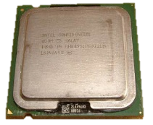
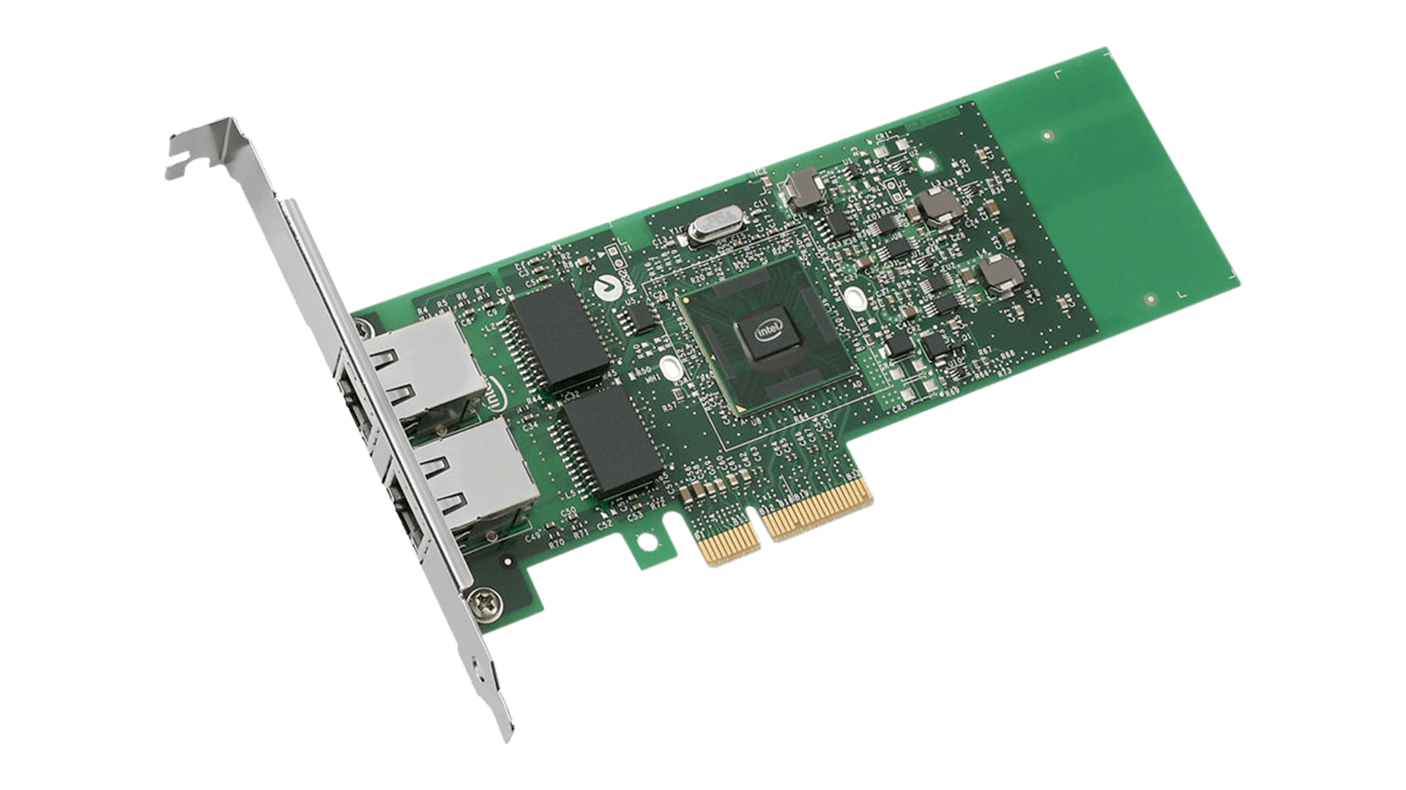
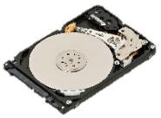
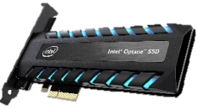
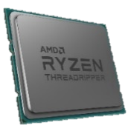
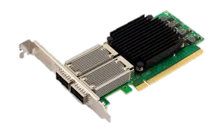
Computing Hardware Development Trend
+ Rapid performance improvement with IO devices
DISK
CPU
NIC
2005
Read()
Send()
Video to users
150-200 IOPS
2 cores
1GbE
~10⁴x
32x
400x
2022
Read()
Send()
Video to users
A few 10⁶ IOPS
64 cores
400GbE
- Demise of Moore’s law for CPU advancement (since 2006)
Notes:
A typical CDN server reads video chunks from disk and serve them to clients via NIC.
Then, which hardware component is a performance bottleneck in modern CDN servers?
About 20 years ago, IO devices such as disk and NIC used to be a typical bottleneck,
but Moore’s law for CPU has ended and there has been revolution in IO device capacity improvement.
For example, the disk bandwidth has grown by 10 thousand times while the NIC capacity has increased by 400 times.
In comparison, CPU improvement for the past two decades is much smaller by a few orders of magnitude.
If the trend persists, CPU is likely to become a performance bottleneck in the near future.

Slide 4
CPU Consumption for HTTP Video Streaming Server
Benchmark setting
- nginx (v.1.80.0) on Linux
- 300KB files on 4x Optane NVMe
- 100Gbps NIC
- Single core of Xeon Silver 4210
Typical server operations
Read an HTTP request
Read a file chunk for the request
Send the response
Result
Observation 1: CPU cycles are 100% utilized
Observation 2: data plane dominates CPU consumption
Data plane: 72%
Control plane: 28%
Disk IO
Memory
Management
open()
fstat()
Application
TCP control logic
Network IO
Why CPU bottleneck for IO-bound workload?
Notes:
To observe this, we did a simple experiment with an nginx HTTP video streaming server for delivering 300KB video chunks.
We use 4 NVMe disks with a 100Gbps NIC on Linux. This is a complete disk-bound workload.
We observe that over 70% of CPU cycles are spent on data plane operations such as file system operations, disk I/O, and network I/O. In contrast, we find that CPU consumption on the control logic is much smaller.
Why is CPU a bottleneck for IO-bound workload?

Slide 5
Root cause: “CPU-centric” OS Abstractions
Modern OS designed with “implicit” assumptions
CPU is fast but IO devices are slow
CPU is never bottleneck for IO-bound workloads
Artifact: CPU-centric IO operations
size_t read(fd, buf, size); // Disk→Memory
size_t write(fd, buf, size); // Memory→IO device
All content must be brought to ”main” memory first!
Memory (or CPU) becomes the bottleneck
Disk
CPU
Memory
Network Card
How to avoid CPU bottleneck for IO-bound workload?
Notes:
This traces back to the very old assumption in operating system design.
In old days, CPU is assumed to be fast while IO devices are slow,
so they assume CPU is rarely a bottleneck for IO-bound workload.
This results in the CPU-centric IO operations. That is, all data in IO devices must be brought to main memory first before running any operations on it.
Read() and write(), and even an optimized API like sendfile() brings the data into main memory first.
However, the old assumption no longer holds. IO devices are getting really fast which makes CPU relatively slow.
Then, the existing design creates a bottleneck in main memory. So, how do we avoid CPU bottleneck for IO bound workload?

Slide 6
Opportunity in the Solution Space
Modern PCIe devices support P2PDMA
Peer-to-peer DMA without CPU intervention
No main memory copy if the DMA devices have memory
Programmability in IO devices
SmartNICs & computational SSDs
Arm SOC, FPGA-based, or ASIC-based
Approach: SmartNIC as the hub for NVMe disk IOs
Disk
CPU
Memory
P2P DMA
Network Card
Key design issue: where to place TCP stack?
Notes:
In this work, we see an opportunity with peer to peer PCIe DMA.
Instead of reading the content into main memory, why not “NIC” reads it directly from disk via P2PDMA?
Then, we can avoid reading the data into main memory.
Fortunately, modern SmartNIC provides programmability, so we can pull it off.
Then, what happens to the TCP stack? TCP stack is currently run on CPU, but where should it run if NIC directly fetches the content on disk via P2PDMA?

Slide 7
Challenges in Operating TCP Stack
Option1: TCP stack on CPU side
No disk content available on CPU
Disk
TCP stack
Option2: TCP stack on SmartNIC
Performance limited by SmartNIC resources
Lighttpd with Linux TCP on Bluefield-2: 12Gbps
On Xeon Silver 4210: 59Gbps
?
CPU
Memory
P2P DMA
?
Network Card
Hybrid solution?
Separate IO-intensive Data Plane from TCP stack?
Notes:
The first option is to run the TCP stack on the CPU-side. But the problem is that you cannot create TCP data packets because you don’t have data in the main memory.
OK. The second option is to run the TCP stack on SmartNIC. But then the hardware capacity of the smartNIC is pretty weak.
For example, if you run Lighttpd on Bluefield-2 for video chunk delivery, it achieves only 4.9 times lower throughput than on CPU.
So, we choose the hybrid approach to use both CPU and SmartNIC. We separate IO-intensive data plane from the TCP stack.

Slide 8
IO-TCP: Split TCP Stack Architecture for Content Delivery
Separation of TCP control/data planes
TCP stack
Host IO-TCP Stack
SmartNIC IO-TCP Stack
Reliable data delivery
Congestion control
Flow control
Header generation
Read file from disk
Send packet
Low latency control logic
High throughput data operations
Notes:
IO-TCP, our TCP stack, presents a split TCP stack architecture that addresses the problem.
The key idea is that CPU runs control plane while we offload the dataplane to smartNIC.
The control plane refers to the operations that require low latency control decisions such as reliable data delivery, congestion control, flow control and header generation.
The data plane refers to the other operations that requires high throughput data operations such as disk I/O and data packet I/O. These operations are easily hardwarizable.

Slide 9
IO-TCP Overview
CPU
Control Plane:
CPU
Application
Host IO-TCP Stack
Client
NVMe SSDs
SmartNIC
Data Plane:
SmartNIC & Disk
P2PDMA
Data stream
SmartNIC IO-TCP Stack
Provides 4 offload APIs for SmartNIC execution (offload_open(), offload_fstat(), offload_close(), offload_write())
Application calls offload APIs for remote execution
Host sends a special command to SmartNIC for each API
SmartNIC stack performs corresponding IO operations
Notes:
Here is the overview of IO-TCP.
An application runs on the host stack. When it needs to do IO operations, it can choose to offload the execution of them to SmartNIC.
That is, for file I/O on SmartNIC, the application can call offload_open() and offload_write() to read and send the file content to a client.
For executing the offload operations, the host stack sends a special command to SmartNIC for each operation, and the SmartNIC stack
performs corresponding disk and network I/O operations.

Slide 10
IO-TCP based Web Server Workflow
CPU
Application
offload_open()
offload_write()
Control Plane:
CPU
Host IO-TCP Stack
OPEN
SEND
ACKs bypass NIC stack
SmartNIC IO-TCP Stack
File open/read
via P2P DMA
Data Plane:
SmartNIC & Disk
NVMe SSDs
HTTP
response
headers
HTTP
response
body
Request
ACK
Client
Notes:
Here is the overall operations of an IOTCP-based web server.
When the server receives a request, it opens the corresponding file using offload_open() so that the SmartNIC opens the file from NVMe directly without involving CPU.
When the file is opened, the host stack receives the metadata like the file size from smartNIC, so that the web server can send the response header to the client.
When the application calls offload_write() to send the response body. Then the host stack sends a SEND command packet to the smartNIC stack, and the smartNIC stack reads the file content using P2PDMA and sends it to the client.
When the client sends acknowledgements, they bypass the SmartNIC stack and get delivered to the host stack for executing control logic like congestion control, reliable data transfer, etc.

Slide 11
Key Operation for Offloading: SEND Command
Host IO-TCP Stack
SEND command
(virtual data packet)
Eth
IP
TCP
[‘file id’ ‘offset’ ‘length’]
SmartNIC IO-TCP Stack
Translate the payload of SEND command
Read file asynchronously from disk to the payload
Send out the packet
DISK
(real data packet)
Eth
IP
TCP
File
[‘file id’ ‘offset’ ‘length’]
SmartNIC HW
TSO
Checksum Offloading
TLS Offloading
Notes:
There are four internal commands sent from the host stack to the SmartNIC stack, but I’ll explain only one command, SEND, here.
When the host delivers a SEND command packet to the NIC, the command packet contains the protocol headers of a regular TCP data packet without actual file content in the payload. Instead, the packet payload contains the file id, offset, and length on the payload. So, this is a virtual data packet.
When smartNIC receives the SEND command packet, it translates the given file information, and reads the file content from disk.
And then, it sends out the data packet using scatter gather IO. This is a real data packet.
It also uses standard NIC offload features like TSO, Checksum offloading and TLS offloading.

Slide 12
IO-TCP Challenges
Challenges
How to calculate accurate packet RTT ?
How to deal with retransmission ?
More details in the paper
Notes:
In implementing IO-TCP, we need to address two challenges in making the TCP operations conform to the standard protocol.
The first challenge is how to calculate accurate packet RTT despite of the disk IO delay in the smartNIC stack.
For the time constraints, please refer to the paper for the details
and let me explain the the second challenge this time.

Slide 13
How to Handle Retransmission?
Re-reading the disk for retransmission could be slow!
Our approach
Keep the data on NIC memory until the data is confirmed to be delivered (ACK)
Problem: only Host receives all the ACKs (for control logic)
Solution: periodic notification of ACKnowledgeD(ACKD) sequence numbers (Host → NIC)
Required memory size <= window size (e.g., 375MB for 100Gbps NIC with 30ms of average RTT )
Host
IO-TCP Stack
Retransmission triggered
When unACKDed size > threshold
SEND
SEND
ACKD
SmartNIC
IO-TCP Stack
File
Keep the file
File
Long disk IO
Repeat disk IO?
Free ACKDed files
ACK
Client
Notes:
The second problem lies in how to handle packet retransmission.
We have CPU handle retransmission, but if we are not careful, it will be very inefficient.
Like this picture shows, SmartNIC could re-read the same content from a disk again just for retransmission.
Instead, we have smartNIC keep the content in memory until it is acked by the other endpoint.
So when the host receives acknowledgements, it periodically informs smartNIC about it, so the smartNIC can discard the content when it's really acked.

Slide 14
Implementation
Host stack: extended mTCP to support NIC offload
1,793 lines of code modification on mTCP
NIC stack: based on NVIDIA Bluefield2 SmartNIC
1,853 lines of C code
We implement TSO, scatter-gather IO, and TLS crypto offload
Easy to port existing apps
open(), fstat() and close() → offload_open(), offload_fstat() and offload_close()
write() → offload_write()
Porting Lighttpd server to IO-TCP: ~10 lines of code modification
Notes:
We implement the host stack by slightly modifying mTCP, a user-level TCP stack.
We implement the SmartNIC stack as a simple DPDK application.
We added only four offload APIs offload- open(), fstat(), close(), and write(), that implement the function in the SmartNIC stack.
This allows porting pretty easy. We needed only about 10 lines of code modification to port lighttpd to IO-TCP.

Slide 15
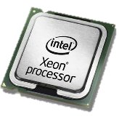
Experiment Setup
Server
Xeon Silver 4210 @ 2.2GHz, 10 cores
with 128GB DDR4
Client
2 Clients
NVIDIA Bluefield-2 (100Gbps x 2)
Max. 80Gbps
Intel Optane 900P NVMe (20Gbps x 4)
Baselines
Lighttpd on Linux TCP with sendfile() (Kernel version: 4.14)
Atlas: webserver on kernel-bypass TCP stack with raw disk access [1]
Buffer-cache-free design
FreeBSD 1.10 & Chelsio 100Gbps NIC
[1] “Disk|Crypt|Net: rethinking the stack for high-performance video streaming.” SIGCOMM, 2017.
Notes:
For our testbed, we use a server CPU, two Bluefield2 SmartNICs and four NVMe disks with 20Gbps each.
Since bluefield2 cannot fully saturate three Intel Optane NVMes due to its weak memory bandwidth, we use 2 NVMes per each SmartNIC for now and the maximum throughput is limited to 80Gbps.
We compare our system to two baselines, Linux TCP with sendfile() and Atlas.
Atlas is an academic webserver on kernel-bypass TCP stack with raw disk access in user level
Please note that it’s not an apples-to-apples comparison because the current version of Atlas can only serve hard-wired contents and it misbehaves with higher load.

Slide 16
IO-TCP Performance - Plaintext
500KB video file chunks (disk bound)
Lighttpd ported to IO-TCP
78.1
Max. throughput of 4 NVMes
78.8
56.8
IO-TCP
Atlas
LinuxTCP
20.3
12.0
IO-TCP achieves Full BW of 4 NVMe disks with a single CPU core
[1] “Disk|Crypt|Net: rethinking the stack for high-performance video streaming.” SIGCOMM, 2017.
Notes:
For plaintext 500KB files, Linux TCP cannot saturate 4 NVMe disks even with 10 CPU cores.
Atlas reaches the max performance with only 4 CPU cores.
Our system needs only one host CPU core to saturate 4NVMes.
Since our system offloads high throughput IO workload to smartNICs.
We can say that Atlas works well because the workload size fits the CPU cache size here.

Slide 17
IO-TCP Performance – TLS
500KB video file chunks (disk bound)
Lighttpd ported to IO-TCP
Cipher mode: AES-GCM 256
Max. throughput of 4 NVMes
77.4
IO-TCP
Atlas
LinuxTCP
44.2
37.4
12.5
6.4
IO-TCP still reaches the max throughput for TLS traffic
[1] “Disk|Crypt|Net: rethinking the stack for high-performance video streaming.” SIGCOMM, 2017.
Notes:
However, when it comes to TLS traffic which is pretty much standard these days, the benefit of Atlas goes away, because CPU becomes overloaded.
It's inevitable to see the performance degradation in the CPU-centric systems if the workload size exceeds the LLC.
In contrast, IO-TCP still reaches the max performance as it effectively leverages crypto hardware offloading.

Slide 18
Source of Performance Improvement
Separation of Control plane / Data plane
- No main memory read/write for IO
- No CPU cache eviction by DDIO
Shorter e2e RTT → Larger window size
Overall Throughput Improvement
Mitigated Cache & Memory contention for Control plane
Separation achieves 27% lower LLC miss rate
Faster control plane
IPC of the control path improves by 58%
Notes:
The IO-TCP throughput is actually higher than that of simply adding the processing power of host CPU and SmartNIC.
Then, why does IO-TCP perform better?
Separating the control and data paths reduces the cache contention of the control logic, and make the execution time of control path much faster.
Then, the faster control plane reduces the RTT and helps increase the send window size faster.
To demonstrate our analysis, we measured the LinuxTCP with extra delay to emulate the LLC misses. We find that even with 20 microseconds of a control path delay, the overall performance was significantly reduced.

Slide 19
IO-TCP Overhead Evaluation
Overhead factors
Host-NIC communication overhead
Performance limit of Arm-based subsystem on BF2
The fewer connections would be advantageous to CPU-only approach (Linux TCP)
300 KB files
10 KB files
Notes:
You might suspect there's overhead in our system as the host stack needs to communicate to SmartNIC stack for packet transmission.
That's true, so we did some experiments to magnify this overhead.
When the number of connections is small like 1 or 2, Linux TCP outperforms IO-TCP, but when the number of connections becomes 4, IO-TCP is still better.
On the right side, when you deal with a small content like 10KB files, the similar trend happens.
But as long as the number of connections is 4 or larger IO-TCP still performs better.

Slide 20
Summary
BIG Trend: IO device advancement outpaces the rate of CPU capacity growth
IO-TCP: a split TCP stack architecture for a content delivery system
CPU host stack carries out the control plane functionalities of a TCP stack
NIC stack serves as data plane of a TCP stack
IO-TCP achieves full bandwidth of 4 NVMe disks with a single CPU core
Current bottleneck lies in SmartNIC memory bandwidth
SmartNIC with higher memory BW will improve the throughput even more
Bluefield-3 will achieve 140Gbps per NIC
QUIC-based CDN can adopt our separated stack design as well
Notes:
In summary, we observe that CPU is becoming relatively more expensive while IO devices are getting faster.
IO-TCP presents a new TCP stack architecture for content delivery that allows harnessing IO device capacity more efficiently with little CPU cycle consumption.
Our prototype shows that one requires only a single CPU core to handle 80 Gbps disk bound workload.
Although the current bottleneck lies in SmartNIC memory bandwidth, SmartNICs with higher memory bandwidth will improve the throughput even more.
For example, Bluefield-3 will achieve about 140Gbps per NIC.
We emphasize that the SmartNIC logic can be easily hardwarizable, and can be made faster, and that our design is general enough to be applied to a related protocol like QUIC.

Slide 21
Thank you!
Notes:
Thank you for listening. I’ll be happy to answer any questions

Slide 22
IO-TCP Performance – Varying File Sizes

Slide 23
IO-TCP Performance – Varying Number of Connections

Slide 24
Linux TCP vs. IO-TCP
Lighttpd setup | Throughput (Gbps)
Linux TCP on Bluefield-2 only | 11.98
Linux TCP on Bluefiend-2 and 1 CPU core | 22.02
IO-TCP on Bluefield-2 and 1 CPU core | 44.13

Slide 25
TCP Fairness
Jain’s fairness index with varying number of connections
IO-TCP: 0.91~0.97
Linux TCP: 0.90~0.97

Slide 26
User-level TCP Stacks vs. IO-TCP
Throughput with 500KB file delivery
TAS: 9.0 Gbps
mTCP: 21.4 Gbps
F-Stack: 36.0 Gbps
Linux TCP: 56.8 Gbps
These stacks are not optimized for large-file content delivery
Optimized for small messages
Lacks of an implementation for sendfile() and a support for TSO

Slide 27
Asynchronous sendfile() on FreeBSD vs. IO-TCP

Slide 28
Retransmission Timer & RTT Measurement
Retransmission timer at the host stack
Problem: disk access delay is added
Up to a few ms when backlogged
Solution: SEND ECHO packets to the host
Short & fixed delay (~3us in our setup)
Negligible overhead: a SEND for 10s~100s MTUs
CPU
Application
offload_write()
Host IO-TCP Stack
SEND
SEND
ECHO
SmartNIC IO-TCP Stack
NVMe SSDs
Disk I/O delay
Short& Static delay
Client
Notes:
The first challenge is how to implement the retransmission timer and RTT measurement accurately. When SmartNIC handles SEND message from the host, it needs to read the data from disks, which can take up to a few milliseconds in the worst case. So, the timer could expire prematuraly if we ignore the disk delay.
To address the problem, SmartNIC notifies the host by an ECHO packet when the data packets are really sent out.
Then, the host stack can start the timer for the data packets.

Slide 29
Retransmission Timer & RTT Measurement
Retransmission timer at the host stack
Problem: disk access delay is added
Up to a few ms when backlogged
Solution: SEND ECHO packet to the host
Short and static delay (3us in our setup)
Negligible overhead: a SEND for 10s~100s MTU
RTT measurement with Timestamp option
Add the static delay(3us) and the I/O delay to the $TS_{val}$
CPU
Application
offload_write()
Host IO-TCP Stack
SEND
SEND
ECHO
SmartNIC IO-TCP Stack
NVMe SSDs
$$TS_{val}=TS_{val}^{′}+3us+I/O delay$$
Client
Notes:
The same problem happens to RTT measurement.
To remedy the problem, the smartNIC readjusts the timestamp option value by adding the IO deay and the internal packet transfer delay.

Slide 30
CPU as a Bottleneck for NVMe
With multiple NVMe disks, CPU can be a bottleneck
Intel Xeon Silver 4210 (2.20GHz)
6x Intel Optane 900P
Simple fio
A single CPU core cannot even support 2 disks for 4K BS

