Slide 1



THC: Accelerating Distributed Deep Learning Using Tensor Homomorphic Compression
Minghao Li, Ran Ben Basat, Shay Vargaftik, ChonLam Lao, Kevin Xu, Michael Mitzenmacher, Minlan Yu
Notes:
Hi everyone, I am Minghao Li from Harvard University. Today I am presenting our work THC: accelerating distributed deep learning using Tensor Homomorphic Compression. This work is done in collaboration with our colleagues at UCL and vmware by Broadcom.

Slide 2



Deep Neural Networks (DNNs) are prevalent
ChatGPT
GitHub Copilot
Midjourney image generator
Background
Compression Cost
Homomorphism
High Accuracy
Evaluation
Notes:
I think it's without a question that Deep neural networks (or DNNs) have become the essential components of many fascinating applications. ChatGPT, coding copilot, image generator, just to name a few.

Slide 3
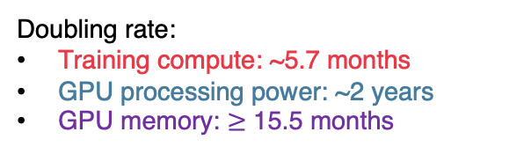
DNN training job size grows fast
5.7-month doubling
Doubling rate:
Training compute: ~5.7 months
GPU processing power: ~2 years
GPU memory: $≥$ 15.5 months
2-year doubling
More GPU workers.
More data transferred.
15.5-month doubling
Sources:
[1] Jaime Sevilla, Lennart Heim, Anson Ho, Tamay Besiroglu, Marius Hobbhahn, & Pablo Villalobos. (2022). Compute Trends Across Three Eras of Machine Learning. 2022 International Joint Conference on Neural Networks (IJCNN) (pp. 1-8)
[2] NVIDIA (https://resources.nvidia.com/l/en-us-gpu)
Background
Compression Cost
Homomorphism
High Accuracy
Evaluation
Notes:
In recent years, the computing demands of DNN models are increasing at a faster pace, with the training compute doubling about every 5.7 months.
(click) Meanwhile, GPU computation speed doubles every 2 years, and GPU memory size is seeing a mere 15-month doubling period. This growth rate difference calls for using more GPUs to training a huge model to ensure reasonable batch size and training time(click) Therefore, we are excepting to see more GPU workers participating in the training; and more data being transferred between the workers as the model size keeps increasing.
2013 K40 1.43 TFLOPS (double precision) 4.29 Tflops (single precision), 12 GB
2016 P100 9.3 TeraFLOPS, 16GB CoWoS HBM2 at 732 GB/s or 12GB CoWoS HBM2 at 549 GB/s
2017 May V100 112 TFLOPS, 16GB (Tesla V100 PCle) or 125 TFLOPS, 32GB (Tesla V100 SXM2)
2020 May A100 312 TFLOPS, 80GB
2022 H100 (PCIe) 756 teraFLOPS (TF32 Tensor Core), 51 teraFLOPS (FP32) 80GB
2024 H200 989 TFLOPS (TF32 Tensor Core), 67 TFLOPS (FP32) 141GB

Slide 4
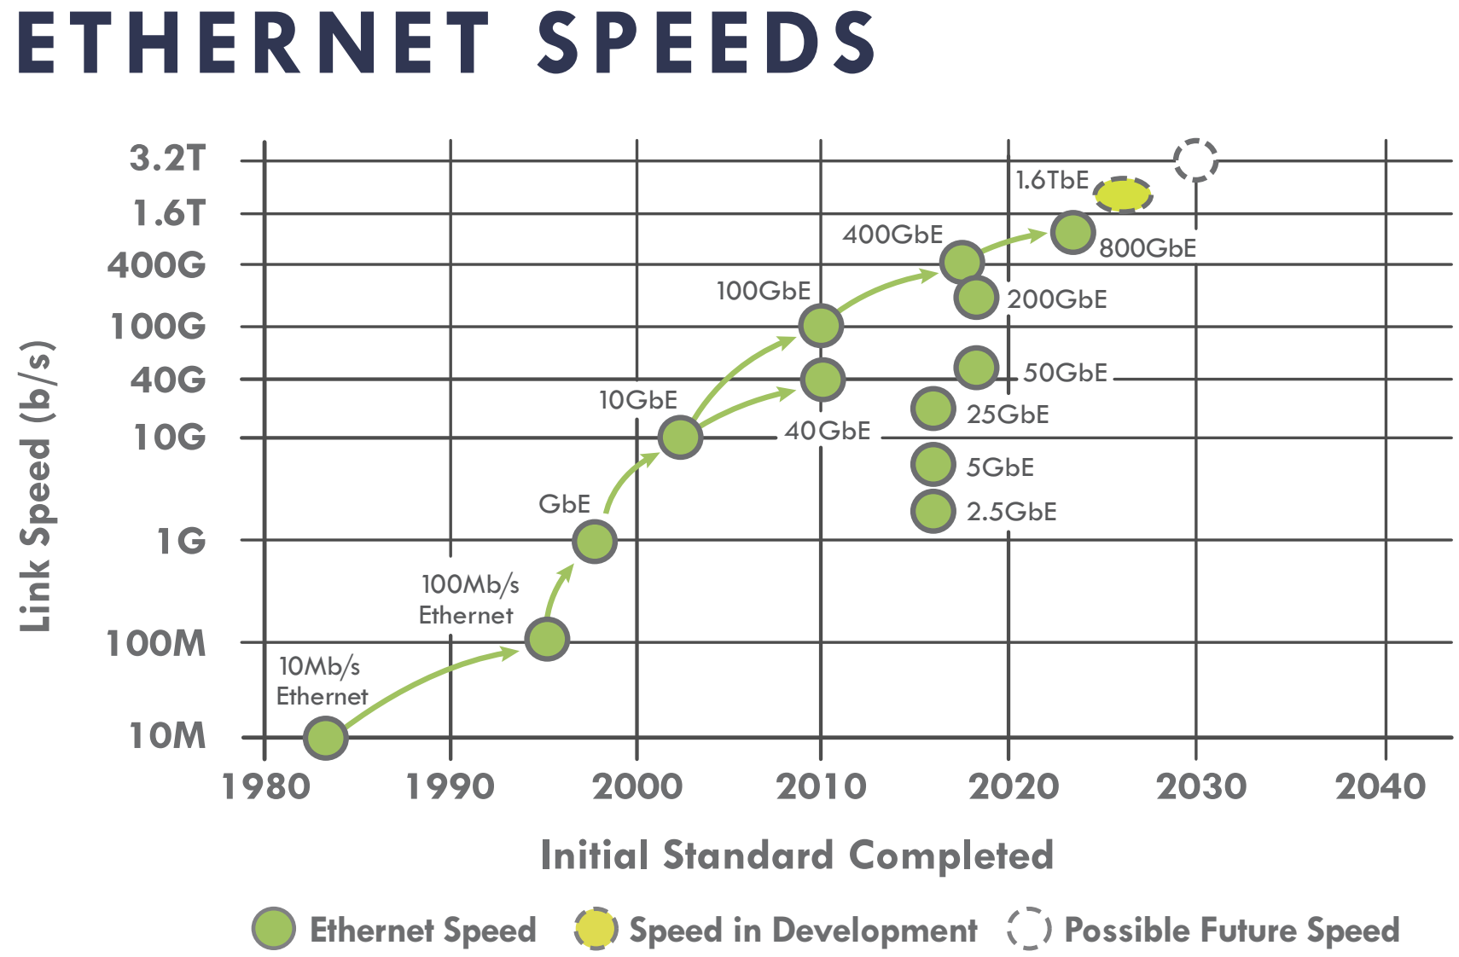
Network bandwidths grow much slower
~3-year doubling rate
Sources:
[1] https://ethernetalliance.org/technology/ethernet-roadmap/
Network is a bottleneck in distributed training.
Background
Compression Cost
Homomorphism
High Accuracy
Evaluation
Notes:
Moreover, the network bandwidth has a EVEN SLOWER growth rate and doubles roughly every three years in the past decades. So, (click) we expect to see more GPU workers synchronizing over relatively slow networks, making networks the bottleneck of distributed training.

Slide 5


Synchronization in data parallel training
Gradients
Parameter Server
Aggregated Gradients
Copy of Model
Copy of Model
Copy of Model
Copy of Model
Background
Compression Cost
Homomorphism
High Accuracy
Evaluation
Notes:
Indeed, in present training, inter-machine synchronization cost is already high. Let’s take the widely adopted Parameter Server architecture in data parallel training as an example. Each worker trains its copy of model with a dataset partition, and periodically sends local gradients to the PS for aggregation.
(Note: PS architecture is on the return as it offers a centralized view of how workers are progressing. And offers more flexibility in troubled workers / stragglers handling.)

Slide 6

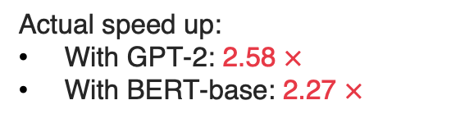

The synchronization cost is already high
BytePS, four A100 GPUs, weak scaling, Stanford Sentiment Treebank (SST2)
Increase the number of workers from one to four.
Ideal speed up: 4 $×$
Actual speed up:
With GPT-2: 2.58 $×$
With BERT-base: 2.27 $×$
100Gbps network
Background
Compression Cost
Homomorphism
High Accuracy
Evaluation
Notes:
In our microbenchmark experiment, we train GPT-2 and BERT-base with worker machines that each has one A100 GPU and measure the epoch time.
(click) Idealy, when we increase the number of workers to four, we should see a 4 times reduction in epoch time.
However, Even with a bandwidth as high as 100 Gbps and with BytePS, the SOTA PS architecture, the actual speedup is less than 2.6x mainly due to the inter-machine communication.
This is the case with just four workers. Previous studies have shown that the scaling efficiency is only going to get worse, as we increase the number of participating workers.

Slide 7
Potential solution: gradient compression
Send compressed gradients to reduce the number of bits transmitted.
Previous works integrated gradient compression into training systems.
BytePS-Compress
HiPress [SOSP’ 21]
Espresso [EuroSys’ 23]
Require decompression and re-compression at every synchronization step.
Background
Compression Cost
Homomorphism
High Accuracy
Evaluation
Notes:
We want to lower the communication overhead. A good way to do this is by sending less data.
So, instead of sending the original gradients, we send a compressed version to reduce the number of bits transmitted.
(click) Previous works have successfully integrated gradient compression into distributed training systems.
(click) But an issue is that they all leverage compression schemes that require decompression, and potentially recompression, at every synchronization step

Slide 8
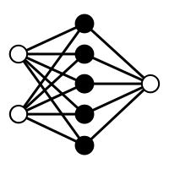
Issue: de- and re-compression at every synchronization step
Compressed Gradients
Worker 1
Gradients
① Compress
PS
Model
Worker N
Gradients
① Compress
Model
Background
Compression Cost
Homomorphism
High Accuracy
Evaluation
Notes:
For example, in the context of parameter server, workers first send compressed gradients

Slide 9
Issue: de- and re-compression at every synchronization step
Compressed Gradients
Worker 1
Gradients
① Compress
PS
② Decompress
Model
③ Sum
Worker N
Gradients
① Compress
④ Compress
Model
Background
Compression Cost
Homomorphism
High Accuracy
Evaluation
Notes:
The PS decompresses the gradients, sums them up, and then potentially compresses the sum again to reduce the data volume sent back to workers.

Slide 10
Issue: de- and re-compression at every synchronization step
Compressed Gradients
Worker 1
Gradients
① Compress
PS
② Decompress
⑤ Decompress
Global Updates
Model
Reduced Data Volume
③ Sum
Worker N
Gradients
① Compress
④ Compress
⑤ Decompress
Global Updates
Model
Compressed Gradients Sum
Background
Compression Cost
Homomorphism
High Accuracy
Evaluation
Notes:
Finally, the workers receive the compressed aggregation result, decompress, and update the local model
(click) Although we reduced the volume of data sent around and lower the network time
(click) we also brought out additional operations on the PS side.

Slide 11



Compression saving diluted by high computational cost
Microbenchmark:
A vector of 1M coordinates, BytePSCompress-TopK10%
Compressed Gradients
PS
Decompress
Reduced Data Volume
$Δ\text{Network} \text{Time}$ (%)
$Δ\text{PS} \text{Time}$(%)
$Δ\text{Total} \text{Time}$ (%)
Sum
-52.4%
+23.5%
-28.9%
Compress
Compressed Gradients Sum
Background
Compression Cost
Homomorphism
High Accuracy
Evaluation
Notes:
And these operations can lead to surprisingly high computational costs. In our microbenchmark, we communicate a vector of 1million coordinates among four workers, and we employ the PS of the BytePSCompress system with TopK10% compression,
the reduced network transmission time equals 52.4% of the previous synchronization time. But the compression introduces additional overhead at the PS equals 23.5% if the previous synchronization time,
(click) driving the total saving to just 28.9%.
We want to enjoy the saving of network time, while not paying for this high computational cost.

Slide 12

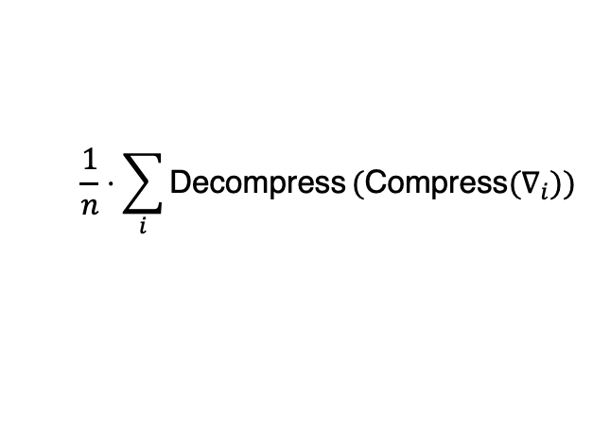
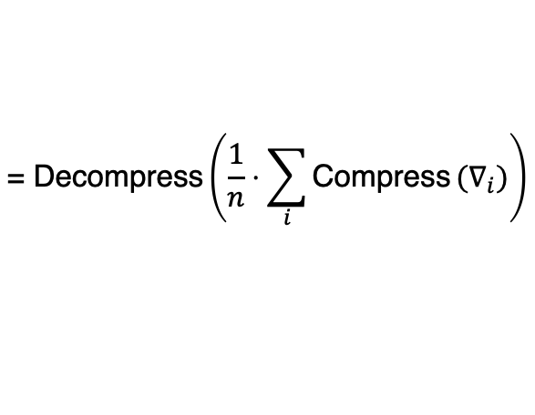

Key idea: Tensor Homomorphic Compression (THC)
Removing decompression on PS requires homomorphic compression:
$$\frac{1}{n}⋅\sum_{i}{\text{Decompress}}(\text{Compress}(∇_{i}))$$
$$\text{= }\text{Decompress}\left(\frac{1}{n}⋅\sum_{i}{\text{Compress}}{(∇}_{i})\right)$$
$n$: number of workers
$∇_{i}$: worker $i$ gradient
Compressed Values
PS
Decompress
Decompressed Values
Sum
Compress
Compressed Values
Background
Compression Cost
Homomorphism
High Accuracy
Evaluation
Notes:
Our goal is to design a compression scheme that enables direct aggregation (pause) of compressed data, and thus eliminate the decompression and re-compression on PS
This goal requires what we formally define as the homomorphic compression property:
that decompressing each compressed value individually, and then taking the average, is equivalent to directly decompressing, the average of the compressed values.
(click) This property gets rid of…, and only requires ONE decompression at the WORKER side
(click)And as the values remain in the compressed format, … To the best of knowledge, THC is the first gradient compression scheme that formally declared to be homomorphic.

Slide 13
Designing a homomorphic quantization scheme
Worker A
Quantization schemes:
Convert floats into quantized values taking fewer bits.
-1.2
……
1.0
0
1
7
Worker B
0.4
……
0
1
7
1.2
Background
Compression Cost
Homomorphism
High Accuracy
Evaluation
Notes:
Now moving on to designing the THC algorithm, we consider quantization schemes that turn floats into integer quantized values, that take fewer bits to represent. For example, we want to use 3 bits per value.
(click) then we can create 8 integer values on all workers, and each value covers a range of floats.

Slide 14
Worker-specific quantization is not homomorphic
0.8
Worker A
Quantization schemes:
Same quantized value might cover different ranges.
We can’t sum up quantized values directly.
-1.2
……
1.0
0
1
7
1.12
Worker B
0.4
……
0
1
7
1.2
Requires PS to scale the quantized values based on the per-worker range.
Background
Compression Cost
Homomorphism
High Accuracy
Evaluation
Notes:
The problem with most existing quantization comes down to the fact that workers have varying value ranges. So, each quantized value might cover different ranges on different workers, and as shown in this example, values that get turned into the same integer "7" can differ a lot. Therefore, it doesn’t make sense to sum up the quantized values.
(click) In practice, people will send information of the local range together with the quantized values to the PS; and on the PS side, the quantized values are first scaled based on the per-worker range before summation.

Slide 15
Achieve homomorphism by aligning worker ranges
-1.2
1.2
Worker A
global min
global max
Aligned Range
Aligned Range
Worker B
-1.2
1.2
Background
Compression Cost
Homomorphism
High Accuracy
Evaluation
Notes:
With THC, we want to convert floats into integer values that are directly summable. And this requires all workers to quantize over the same range. A straightforward approach to do this is by aligning the worker ranges through a preliminary round of min and max values communication

Slide 16
Quantization with global range is homomorphic
-1.2
1.2
Worker A
……
……
0
6
7
Number of quantized values: 8
Worker B
-1.2
1.2
Background
Compression Cost
Homomorphism
High Accuracy
Evaluation
Notes:
With the aligned range,
(click) when we specify the number of quantized values we want,
(click) we can create evenly distributed quantized values that cover the EXACT SAME ranges for all workers. Now these quantized values can be directly summed up.

Slide 17
Quantization with global range is homomorphic
0.8
-1.2
1.2
Worker A
Quantize
……
……
0
6
7
Server
6+7=13
Quantize
Worker B
-1.2
1.12
1.2
Background
Compression Cost
Homomorphism
High Accuracy
Evaluation
Notes:
Recall our previous example. (click) These two values that were both quantized into 7, are now get quantized into 6 and 7 respectively. (click) The PS will directly sum up these two quantized values, and then return the sum to the workers.
(The worker can then estimate the average of the original values by taking the average of the quantized sum, multiplying it with the bin width, and adding the global min.)

Slide 18
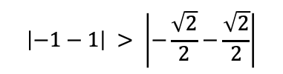
Optimizations for accuracy improvement
Shrink the quantization range through Randomized Hadamard Transform (RHT)
Intuition: “squeeze” values together before quantization to reduce the difference between min and max values.
-1
0
1
-1
0
1
$$\left|−1−1\right| > \left|−\frac{\sqrt{2}}{2}−\frac{\sqrt{2}}{2}\right|$$
Background
Compression Cost
Homomorphism
High Accuracy
Evaluation
Notes:
Key quantity that determines the error of a quantization scheme is its range
Now we know that any quantization with global range can be homomorphic. What make THC special is that we also make additional optimizations to reduce the compression error.
For example, we rotate the gradients with an intuition of reducing the expected difference between the min and max coordinates.

Slide 19
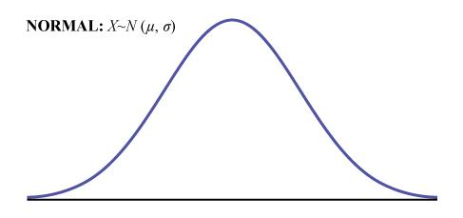
Optimizations for accuracy improvement
Shrink the quantization range through RHT
  Makes coordinates approach a normal distribution
  Happens in parallel with global range alignment
Non-uniform quantization
  Enables more fine-grained quantized values
  Convert non-uniform indices to uniform quantized values with a lookup table built offline
-1
0
1
-1
0
1
0
1
2
3
4
5
6
7
Background
Compression Cost
Homomorphism
High Accuracy
Evaluation
Notes:
To put it formally, RHT makes the coordinates values approach a normal distribution. The with extreme values clamping, we can bound the min and max we will quantize over and effectively reduce the quantization range.
(click) Now, with the coordinates normally distributed, we also adopt non-uniform quantization to enable more fine-grained quantized values, and map indices that take fewer bits to a subset of these values.
(click) We convert non-uniform indices back to directly summable uniform values, with an optimal lookup table built offline.
Due to the interest of time, I won’t get into the details of these optimizations and how to perform them efficiently, I am happy to elaborate offline.

Slide 20

THC workflow
Quantized Values/Indices
int
…
int
PS
Worker $i$
Lookup (non-uniform THC only)
Gradients
Compress
int
…
int
Quantized Values
Global Updates
Decompress
Model
Sum
Aggregated Quantized Values
int
…
int
Background
Compression Cost
Homomorphism
High Accuracy
Evaluation
Notes:
To put it all together, workers train the model with their local data and get the gradients. The gradients are transformed and then compressed using THC. We either send the quantized values or send lookup table indices when we enable non-uniform quantization. If we send table indices, these indices will be converted into quantized values through a simple lookup process. The quantized values are directly summed up at the PS. PS broadcasts this sum to the workers. The workers decompress, update their local model, and continue training.

Slide 21


Easy In-Network Aggregation (INA) integration
Can be offloaded to programmable devices
PS
No complex (de)compress operations.
Lookup (non-uniform THC only)
int
…
int
Integer operations only.
Quantized Values
Sum
Background
Compression Cost
Homomorphism
High Accuracy
Evaluation
Notes:
Notice that now there are only integer operations on the PS,
(click) making it easy to offload the PS to programmable device, and gain further speedup with In-Network Aggregation

Slide 22


THC prototype uses INA with Programmable Switches
Gradients
Aggregated Gradients
Switch
Programmable Switch
Remove traffic between the switch and PS.
Background
Compression Cost
Homomorphism
High Accuracy
Evaluation
Notes:
In our system prototype, we take INA with programmable switches as an example.
Previously we have CPU cores running the PS process. (click) Now, we replace this server with the programmable switch connecting to all workers, (click) and remove the traffic between the switch and PS.

Slide 23
Evaluation setup
Models: VGG16; RoBERTa-base, GPT-2
Baselines: Horovod without compression, DGC10%, TopK10%. All using RDMA.
Horovod: SOTA AllReduce (bandwidth optimal in homogenous settings [1]) framework.
DGC10% and TopK10%: communicate top 10% of coordinates by magnitude.
Testbed Setup:
100 Gbps
A100
A100
A100
Tofino 2
A100
[1] Pitch Patarasuk and Xin Yuan. Bandwidth Optimal All-reduce Algorithms for Clusters of Workstations. Journal of Parallel and Distributed Computing, 2009.
Background
Compression Cost
Homomorphism
High Accuracy
Evaluation
Notes:
For evaluation, we use the SOTA all-reduce architecture Horovod as the no-compression baseline. To compare with existing compression schemes, we choose DGC and TopK that communicate the top10% coordinates by magnitude
(click) Our local testbed has four workers, each with one A100 GPU
(click) one Tofino2 programmable switch that can also function as the parameter server
(click) all connected by 100Gbps network
The most important metric for training jobs is time-to-accuracy. Here we will highlight the time-to-accuracy results of training VGG16 with the ImageNet dataset.
RDMA and DPDK can provide similar latency characteristics for short messages, while RDMA outperforms DPDK as the message size grows.
RoBERTa stands for “Robustly Optimized BERT pre-training Approach”. In many ways this is a better version of the BERT model. The key points of difference are as follows:
a. Dynamic Masking: BERT uses static masking i.e. the same part of the sentence is masked in each Epoch. In contrast, RoBERTa uses dynamic masking, wherein for different Epochs different part of the sentences are masked. This makes the model more robust.
b. Remove NSP Task: It was observed that the NSP task is not very useful for pre-training the BERT model.
c. More data Points: RoBERTa was also trained on other datasets like CC-News (Common Crawl-News), Open WebText etc. The total size of these datasets is around 160 GB.
d. Large Batch size: To improve on the speed and performance of the model, RoBERTa used a batch size of 8,000 with 300,000 steps. In comparison, BERT uses a batch size of 256 with 1 million steps.
The Stanford Sentiment Treebank is a corpus with fully labeled parse trees that allows for a complete analysis of the compositional effects of sentiment in language. The corpus is based on the dataset introduced by Pang and Lee (2005) and consists of 11,855 single sentences extracted from movie reviews. It was parsed with the Stanford parser and includes a total of 215,154 unique phrases from those parse trees, each annotated by 3 human judges.
Binary classification experiments on full sentences (negative or somewhat negative vs somewhat positive or positive with neutral sentences discarded) refer to the dataset as SST-2 or SST binary.

Slide 24
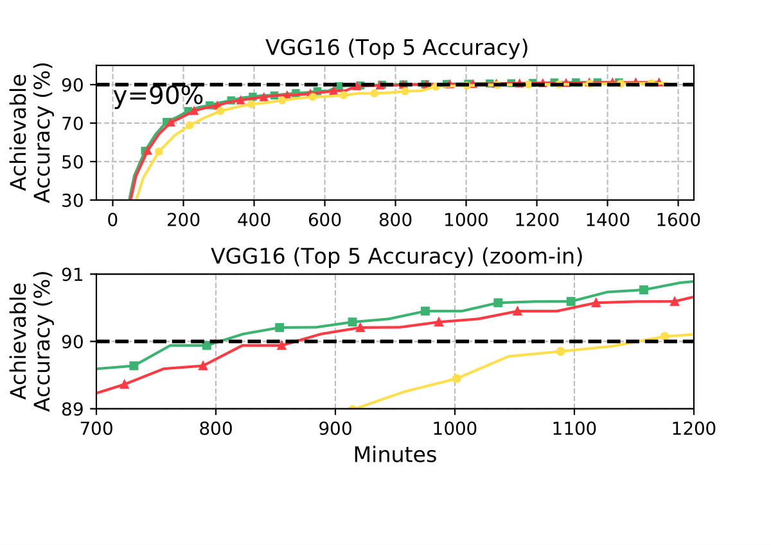

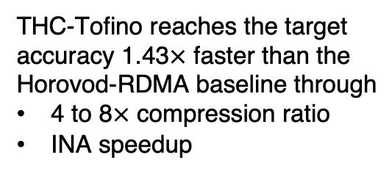
Evaluation: Time-to-Accuracy
THC-Tofino reaches the target accuracy 1.43$×$ faster than the Horovod-RDMA baseline through
4 to 8$×$ compression ratio
INA speedup
1. 43$×$
Background
Compression Cost
Homomorphism
High Accuracy
Evaluation
Notes:
We consider reaching a target accuracy that is very close to the final accuracy of an uncompressed baseline, and we quantify time savings to reach this accuracy.
The y-axis is attainable training accuracy, the x-axis is training time. The green curve is THC with Tofino2 switch as the PS, the red curve is THC with PS running on CPU cores, and the yellow curve is the no-compression Horovod baseline.
(click) THC-Tofino reaches the target accuracy 1.43 times faster than the Horovod baseline. Thanks to the 4-to-8 times compression ratio used by our system prototype, and the In-Network-Aggregation speedup

Slide 25
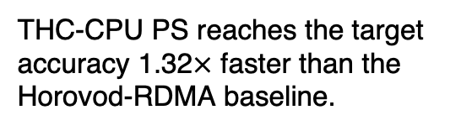

Evaluation: Time-to-Accuracy
THC-CPU PS reaches the target accuracy 1.32$×$ faster than the Horovod-RDMA baseline.
1. 32$×$
Background
Compression Cost
Homomorphism
High Accuracy
Evaluation
Notes:
And THC with CPU PS gives a 1.32x Time-to-accuracy improvement over the no compression baseline

Slide 26

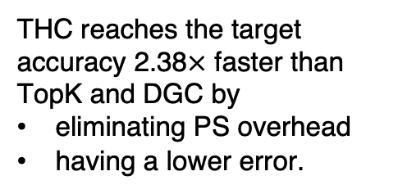
Evaluation: Time-to-Accuracy
THC reaches the target accuracy 2.38$×$ faster than TopK and DGC by
eliminating PS overhead
having a lower error.
2.38$×$
Background
Compression Cost
Homomorphism
High Accuracy
Evaluation
Notes:
Now we add in the curves for DGC and TOPK
(click) THC reaches the target accuracy 2.38x faster than by eliminating the PS compression overhead and by having a lower compression error (because of avoiding introducing more error through recompression, and thanks to the accuracy-related optimizations we make)
NOTE: it only takes baseline ~26 epochs to reach 90%, THC takes ~27-28 epochs, but DGC requires ~40 epochs to do so.

Slide 27
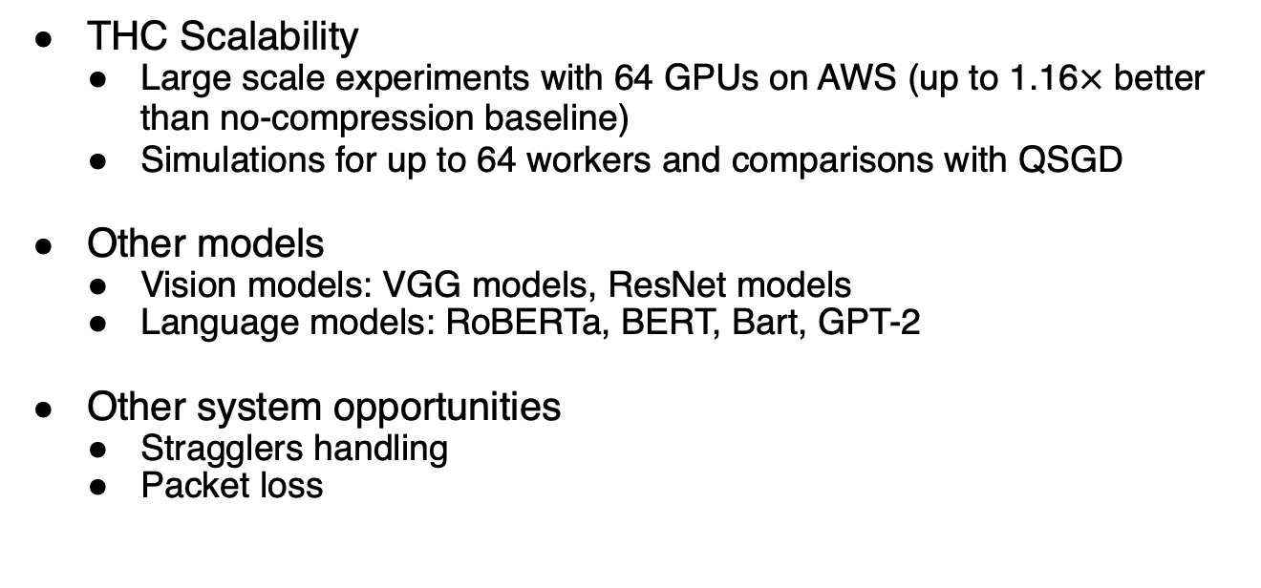
Additional results in paper
THC Scalability
  Large scale experiments with 64 GPUs on AWS (up to 1.16$×$ better than no-compression baseline)
  Simulations for up to 64 workers and comparisons with QSGD
Other models
  Vision models: VGG models, ResNet models
  Language models: RoBERTa, BERT, Bart, GPT-2
Other system opportunities
  Stragglers handling
  Packet loss
Background
Compression Cost
Homomorphism
High Accuracy
Evaluation
Notes:
We have additional results including large scale experiments on AWS with 64 GPUs, comparison with existing quantization schemes under different training scale, and training results with other representative vision and language models.
THC also tolerates minor data loss, enabling us to explore system opportunities in addressing stragglers and packet loss; For more details, please refer to our paper.

Slide 28
Conclusion
Networks take an increasingly large portion of distributed training time.
Tensor Homomorphic Compression (THC) is a novel scheme that enables direct aggregation on compressed data.
THC offers up to 1.47x time-to-accuracy speedup, is scalable, and supports in-network aggregation.
THC is integrated into BytePS and accessible at https://github.com/SophiaLi06/BytePS_THC.git
Background
Compression Cost
Homomorphism
High Accuracy
Evaluation
Notes:
In conclusion...

Slide 29
Future works
Theory
System
THC is a starting point of homomorphic compression schemes
Optimizing THC for AllReduce.
Integrating THC into hybrid parallelism.
Scale out THC.
Background
Compression Cost
Homomorphism
High Accuracy
Evaluation
Notes:
For future works, we would like to integrate THC into other training paradigms such as hybrid parallelism.
Since not all the current THC optimizations are all-reduce friendly. We would like to investigate more on incorporating homomorphic compression into all-reduce architectures.
Finally, We consider THC as a starting point. We believe there are more opportunities in codesigning theories and systems. This codesign encourages us to fully leverage the systems opportunities and consider the constraints and overheads.

Slide 30
Thank you for listening!
Q&A

