Slide 1


Decouple and Decompose:
Scaling Resource Allocation with DeDe
Zhiying Xu¹ Minlan Yu¹ Francis Yan²
¹ ²
July 8, 2025
Notes:
Hi, I‘m Zhiying.
Today I‘m going to talk about DeDe,
which scales resource allocation
through the idea of “decouple and decompose”.
I did this work during my PhD at Harvard,
together with my advisor Minlan, and Francis from UIUC

Slide 2






Networked systems are large and diverse
Cluster w/ 1000s of computing resources
Wide area network w/ 100s of network links
GPUs
A100, H100, B200
CPUs
Xeon, EPYC
How to efficiently share these resources?
800 Gbps
600 Gbps
200 Gbps
others
FPGA, ASIC
500 Gbps
Notes:
Nowadays, networked systems are getting significantly large and diverse.
(click) For example,
clusters now have thousands of computing resources of different types
to share among tenants
(click) including all sorts of GPUs, CPUs, and other computing resources.
(click) Another example is wide-area networks with hundreds of network links,
to carry network flow across datacenters all over the world.
(click) each link has different bandwidth capacities.
(click) With so many diverse resources, how do we efficiently share them?

Slide 3





Resource allocation in networked systems
Allocates diverse resources to dynamic demands
Modeled as linear programming, mixed-integer programming, etc.
demands (e.g. jobs)
objective & constraints
resource
allocator
scalability crisis:
hours required due to
scale & diversity
resources (e.g. GPUs)
Notes:
(click) Systems rely on resource allocation to meet dynamic user demands,
such as allocating GPUs to computing jobs
(click) This kind of allocation is often modeled as an optimization problem,
such as linear programming or mixed-integer programming
(click) Given an optimization objective and constraints
a resource allocator needs to figure out how to assign resources to demands.
(click) However, as systems get larger and more diverse,
it could take hours to find an optimal allocation,
making it hard to meet service requirements at scale.

Slide 4


Addressing the scalability crisis
optimization solvers
e.g. Gurobi
goal
allocation quality
heuristics
approx algorithm
ML-based
domain-specific or
workload-dependent
computational speed
Notes:
To address the scalability crisis,
current methods trade off between computational speed and allocation quality.
(click) Optimization solvers like Gurobi can find the best solution,
but they can be too slow at a large scale.
(click) To speed things up,
people have tried heuristics, approximation algorithms, and ML-based methods,
But these usually give suboptimal results.
(click) Besides, these approaches are often domain-specific, or workload-dependent.
(click) Therefore, our goal is to build a general-purpose resource allocation framework,
that is both fast and high-quality.

Slide 5
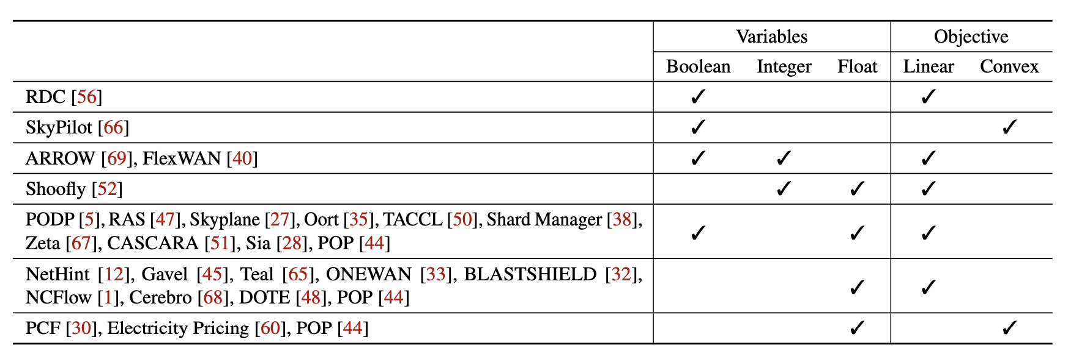
Common separable structure in resource allocation
Notes:
To this end,
(click) we surveyed dozens of real-world resource allocation problems in recent literature.
And we find that they all share a common separable structure.
Now let me explain what I mean by separable,
using a small example of cluster scheduling.

Slide 6
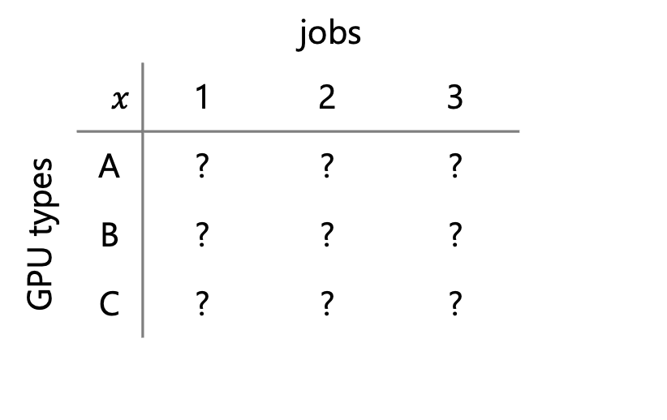

Common separable structure in resource allocation
max total throughput Σ tput · $x$
  objective: sum of utility
  per demand/resource
 |  | jobs
$$x$$ |  | 1 | 2 | 3
GPU types | A | ? | ? | ? | Σ_{A} ≤ 1.0
 | B | ? | ? | ? | Σ_{B} ≤ 0.5
 | C | ? | ? | ? | Σ_{C} ≤ 1.2
 |  | Σ₁ ≤ 1 | Σ₂ ≤ 1 | Σ₃ ≤ 1
separable structure separable problems in parallel
Σ_{A} ≤ 1.0
Σ_{B} ≤ 0.5
Σ_{C} ≤ 1.2
per-resource constraints:
within capacity
separable
structure
  per-demand constraints:
  no over-allocation
Σ₁ ≤ 1 | Σ₂ ≤ 1 | Σ₃ ≤ 1
Notes:
In this example,
every hour, we need to decide how to allocate 3 ML jobs on 3 types of GPUs,
such as A100, H100, and V100.
Each job can split its runtime across different GPU types.
We use x to represent the fraction of the hour a job runs on a GPU.
(click) Naturally, we have per-demand constraints on each column of x,
where the sum of runtime for each job can not exceed 1 hour.
(click) On the other hand, for each GPU type,
the total GPU hours requested by all jobs must stay within the capacity of that GPU type.
These per-resource constraints apply to each row of x.
(click) Since each GPU has different specs, a job can achieve different throughput on each type.
and the objective is to maximize the total throughput across all jobs
(click) This is what we mean by a separable structure,
constraints are specified for each resource and each demand.
The objective is also a sum of utilities from allocations
(click) This separable structure we identified naturally leads to the next question:
can we divide a large resource allocation problem into smaller problems that run in parallel?

Slide 7
Challenge: interdependent resource and demand constraints
max total throughput Σ tput · $x$
 |  | jobs
$$x$$ |  | 1 | 2 | 3
GPU types | A | ? | ? | ? | Σ_{A} ≤ 1.0
 | B | ? | ? | ? | Σ_{B} ≤ 0.5
 | C | ? | ? | ? | Σ_{C} ≤ 1.2
 |  | Σ₁ ≤ 1 | Σ₂ ≤ 1 | Σ₃ ≤ 1
Constraints are entangled
One allocation affects all others
↑
↓ | ↓
Σ_{A} ≤ 1.0
Σ_{B} ≤ 0.5
Σ_{C} ≤ 1.2
↓
↓
↑ | ···
··· | ···
Σ₁ ≤ 1 | Σ₂ ≤ 1 | Σ₃ ≤ 1
Notes:
However, we cannot just separate the problem directly.
The challenge is, resource and demand constraints are interdependent,
(click) These constraints are entangled across rows and columns,
(click) so one allocation affects all the others.
(click) for example, if we assign more GPU A to job 1,
(click) Then the other jobs have to receive less from GPU A,
(click) these changes then propagate, further impacting other allocations.
--4:45--

Slide 8

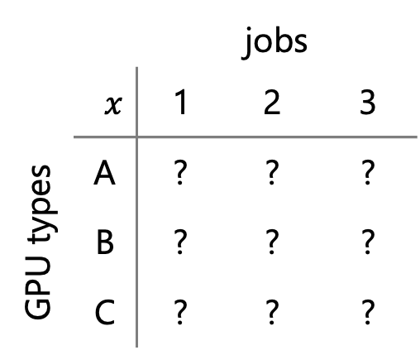
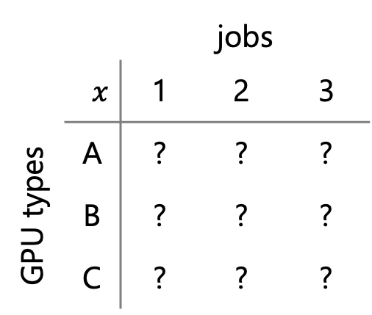






How to decouple interdependent constraints?
maximize
subject to
additional
constraint
Σ tput · $x$
✘
per-resource constraints on $x$, per-demand constraints on
$x$
$z$
, $x=z$
mathematically equivalent
 |  | jobs
$$x$$ |  | 1 | 2 | 3
GPU types | A | ? | ? | ?
 | B | ? | ? | ?
 | C | ? | ? | ?
 |  | jobs
$$x$$ |  | 1 | 2 | 3
GPU types | A | ? | ? | ?
 | B | ? | ? | ?
 | C | ? | ? | ?
 |  | jobs
$$z$$ |  | 1 | 2 | 3
GPU types | A | ? | ? | ?
 | B | ? | ? | ?
 | C | ? | ? | ?
decouple
$$=$$
Notes:
To tackle this challenge, we need to decouple the interdependent constraints.
Now let's look at the optimization form of the previous example
We start with an allocation matrix x, where the goal is to maximize total throughput
with per-resource constraints on the rows, and per-demand constraints on the columns.
(click) To decouple the constraints, we introduce a copy of the matrix, called z,
and move the demand constraints onto z.
(click) We also add one more constraint to keep x = z,
(click) so the transformed problem is still mathematically equivalent to the original.
(click) Now, the resource constraints stay on the rows of x,
(click) while the demand constraints are on the columns of z.

Slide 9







Reformulated problem fits ADMM
maximize
subject to
$f\left(x\right)+g\left(z\right)$
$Ax+Bz=c$
Σ tput · $x$
per-resource constraints on $x$, per-demand constraints on $z$, $x=z$
ADMM Algorithm:
Step 1: incorporate constraints into objective
$$L_{ρ}\left(x, z, y\right)=−f\left(x\right)−g\left(z\right)+y^{T}\left(Ax+Bz −c\right)+ \frac{ρ}{2}∥Ax+Bz −c∥_{2}^{2}$$
augmented Lagrangian
Lagrange multiplier
penalty
Step 2: optimize $x$ and $z$ alternatively
$x^{(k+1)}$ := argmin $L_{ρ}\left(x,z^{(k)}, y^{(k)}\right)$
$z^{(k+1)}$ := argmin $L_{ρ}\left(x^{(k+1)},z, y^{(k)}\right)$
$$x$$
$$z$$
update $y^{(k)}→$ $y^{(k+1)}$
Notes:
with this setup of x and z,
(click) the reformulated problem naturally fits the required form of ADMM as presented here,
ADMM is short for Alternating direction method of multipliers,
Which is a classical constrained optimization algorithm
(click) In the example, the total throughput can be viewed as f(x) + g(z)
and the constraints are all linear constraints on x and z.
(click) ADMM algorithm solves such problem in 2 steps
At step 1, it incorporates constraints into the objective,
so the problem becomes unconstrained
(click) This step introduces a Lagrange multiplier term,
as well as a quadratic penalty term from constraint violation,
this gives us a so-called augmented Lagrangian.
(click) At step 2, ADMM optimizes x and z in the augmented Lagrangian alternatively
(click) It starts by optimizing x while keeping the other variables fixed.
(click) Then it optimizes z, using the previous result.
(click) After that, ADMM updates the Lagrange multiplier,
and then starts the next round.

Slide 10
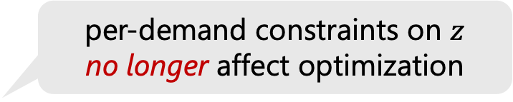
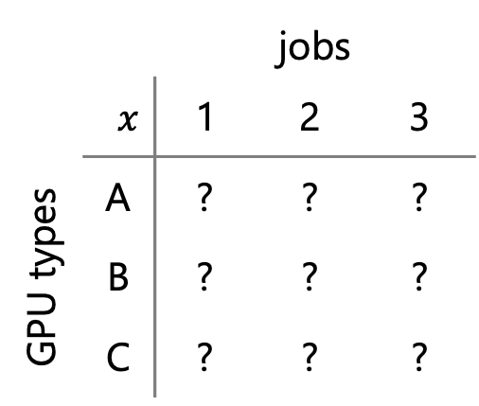
Constraints are decoupled in alternating optimization
 |  | jobs
$$x$$ |  | 1 | 2 | 3
GPU types | A | ? | ? | ?
 | B | ? | ? | ?
 | C | ? | ? | ?
per-demand constraints on $z$
no longer affect optimization
fixed
$x^{(k+1)}$ := argmin $L_{ρ}\left(x,z^{(k)}, y^{(k)}\right)$
$z^{(k+1)}$ := argmin $L_{ρ}\left(x^{(k+1)},z, y^{(k)}\right)$
$$x$$
$$z$$
update $y^{(k)}→$ $y^{(k+1)}$
Notes:
Since the algorithm alternates between optimizing x and z,
(click) let’s take a closer look at the optimization of x first.
and the optimization of z follows a similar process
(click) When optimizing x, the value of z is fixed.
(click) this means all the demand constraints on z no longer affect the optimization
(click) we can also see this in the allocation matrix x,
where per-demand constraints have disappeared.
(click) So overall, the constraints have been decoupled during ADMM’s alternating optimization

Slide 11



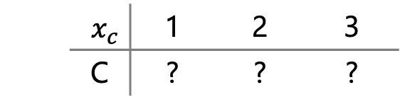
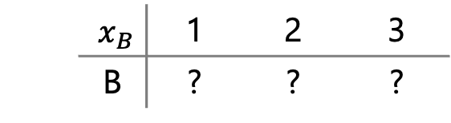
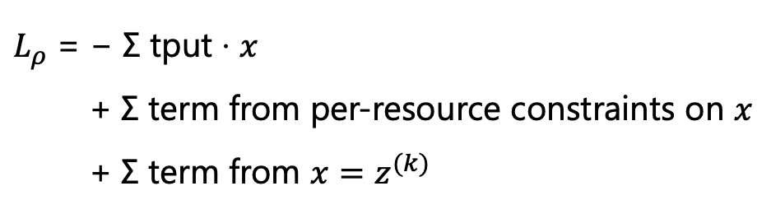


How to decompose for massive parallelism?
$L_{ρ}$ = − Σ tput · $x$
+ Σ term from per-resource constraints on $x$
+ Σ term from $x=z^{(k)}$
separable objective
separable constraints
separable
separable additional constraints
 |  | jobs
$$x$$ |  | 1 | 2 | 3
GPU types | A | ? | ? | ?
 | B | ? | ? | ?
 | C | ? | ? | ?
$$x_{A}$$ |  | 1 | 2 | 3
 | A | ? | ? | ?
decompose
$$x_{B}$$ |  | 1 | 2 | 3
 | B | ? | ? | ?
per-resource allocations
in parallel
$$x_{c}$$ |  | 1 | 2 | 3
 | C | ? | ? | ?
$x^{(k+1)}$ := argmin $L_{ρ}\left(x,z^{(k)}, y^{(k)}\right)$
$$x$$
optimizing a large $x$ is still slow
Notes:
now we have decoupled the constraints
(click) however, optimizing the large x is still slow
(click) so the question becomes,
how to decompose the large x into smaller pieces to solve in parallel?
(click) After we take a closer look at the augmented Lagrangian,
we find something helpful
(click) first, the objective is separable,
the total throughput is the sum of throughput from each GPU type
(click) the term from resource constraints is also separable,
as it is per-resource based, defined for each GPU.
(click) even the term from x equals to z turns out to be separable
as we can rewrite this as each row of x equals to its corresponding row of z.
(click) Since all these terms are separable,
(click) we can now decompose the large x into per-resource allocations,
With one row for each problem
And because these problems are independent, we can solve them in parallel.
a similar decomposition also applies when optimizing z.

Slide 12


DeDe design summary
per-resource allocations in parallel
demands
…
decouple &
decompose
per-demand allocations in parallel
resources
…
Notes:
To wrap up the design, (click) DeDe decouples and decomposes the problem.
(click) separating resource allocation problem into per-resource allocations
(click) and per-demand allocations in parallel
(click) These two allocations are performed alternately across iterations.
--9:15--

Slide 13


Implementation of DeDe
high-level
performance
enhancements
underway
easy-to-use API aligned with cvxpy syntax
low-level
powerful problem compilation inherited from cvxpy
real, efficient parallelism built with ray
highly optimized
used in eval
Notes:
With the DeDe design, our next step is implementing DeDe for real use.
(click) DeDe builds on convex-py, which is a Python-based modeling language for convex optimization,
DeDe leverages its powerful problem compilation.
(click) DeDe also achieves its real, efficient parallelism with ray library
(click) This low-level framework is highly optimized, and used in all our evaluation.
(click) At the same time, we build an easy-to-use API aligned with convex-py syntax
(click) The performance enhancements of this high-level API are underway.
In order to support more complex problem formulations.

Slide 14
DeDe‘s high-level API
pip install dede
import dede as dd
# Create allocation variables.
x = dd.Variable((N, M), nonneg=True)
# Create the constraints.
resource_constrs = [x[i,:].sum() <= 1 for i in range(N)]
demand_constrs = [x[:,j].sum() <= 1 for j in range(M)]
# Create an objective.
obj = dd.Maximize(x.sum())
# Construct and solve the problem.
prob = dd.Problem(obj, resource_constrs, demand_constrs)
prob.solve(num_cpus=64)
aligned with cvxpy syntax
specify:
resource & demand constraints
# of CPU cores
Notes:
We implement DeDe as a Python library at high level
which can be easily installed through pip install dede
Here’s a quick example to show how it works:
(click) First, we import DeDe
(click) Then, we create a non-negative allocation variable for n resources and m demands
(click) Next, we define constraints—for example,
We require allocations on each resource and each demand to stay below 1.
(click) We also specify an objective—say, maximizing total allocation.
(click) Once we have the objective and constraints,
we construct the problem and call solve to get the result.
(click) As mentioned, our interface is largely aligned with convex-py syntax.
(click) One difference is that we have to specify resource and demand constraints separately.
And since the solving process is in parallel, we may also specify how many CPU cores to use
if we don’t, it’ll use all available cores by default.
This is our high-level API. On the other hand, the low-level API gives users more control
to manually specify the augmented Lagrangian in each per-resource and per-demand problem.
but we are not showing it here

Slide 15


Evaluating DeDe in cluster scheduling
Gavel simulator [OSDI 2020] w/ real throughput data
Objective: maximizing proportional fairness
Baseline: Exact sol. based on a popular solver
2K jobs
DeDe
16K CPUs & GPUs
Notes:
we evaluate several popular resource allocation problems,
here we focus on cluster scheduling problem as we saw earlier in the example
(click) To do this, we use the Gavel scheduling simulator, along with real throughput data.
(click) In our simulation, DeDe allocates 2 thousand jobs across 16 thousand CPU & GPUs
(click) The goal is to maximize proportional fairness in resource allocation
(click) As a baseline, we compare against the exact solution computed by a popular solver,
which models the problem as convex programming,
this is more difficult than the previous example, which involves only linear programming

Slide 16
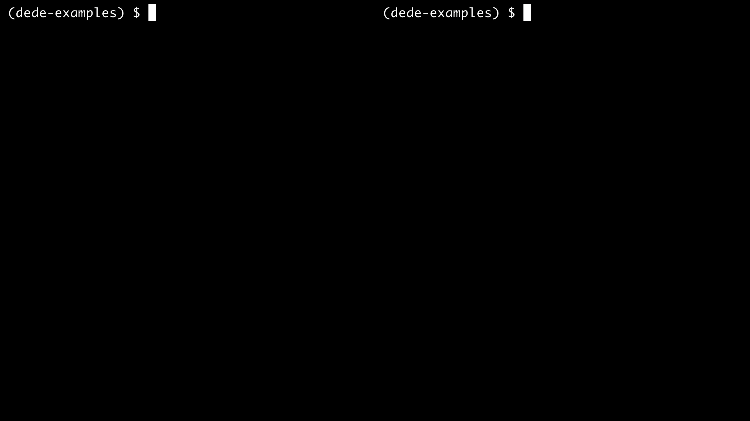
DeDe (playback speed = 5000)
Exact Sol. (playback speed = 5000)
Notes:
Here is a demo that compares DeDe's runtime with the exact solution.
dede is on the left and the exact solution on the right
We can clearly see dede runs much faster.
In scheduling round 1, dede is 65 times faster
In round 2, it's 61 times faster
And In round 3, it's 66 times faster

Slide 17
DeDe is faster, better in cluster scheduling
DeDe achieves 1.1 normalized proportional fairness with 5 minutes
Exact sol.: 0.1 less fairness; 60× slower
POP (simulation): 0.17 less fairness; 2× slower
DeDe* (simulation): 2× faster
Notes:
now we look at some statistics and the solution quality,
In this figure, x axis is the computation time in seconds,
and y axis is normalized proportional fairness, which represents the allocation quality
(click) we see that DeDe achieves a fairness score of 1.1 in just 5 minutes.
(click) in comparison, the exact solution is 60 times slower than dede.
meanwhile, the objective it achieves is surprisingly worse than DeDe’s.
This is because the solver fails to reach optimality due to the large problem size.
(click) We also compare DeDe against POP from SOSP 21,
which randomly splits the problem into concurrent subproblems.
But POP runs in simulation, without actually using multiple processes .
That means it avoids lots of system overhead.
Compared to DeDe, POP achieves lower fairness and is twice slower.
(click) For a fair comparison, we also implemented a variant of DeDe,
called DeDe star, based on similar simulated parallelism as POP.
Without real system overhead like cache thrashing,
DeDe-Star runs twice faster than the regular DeDe.

Slide 18




DeDe is faster, better in other resource allocation problems
traffic engineering
load balancing
3M traffic demands
2K data shards
8.5K network links
256 data servers
DeDe is
80-188× faster, up to 10% better than Exact sol.
2-76× faster, 5-14% better than POP (simulation)
Notes:
Apart from cluster scheduling,
DeDe is also faster and better in other resource allocation problems.
we showcase two additional examples
(click) One is traffic engineering,
which allocates 3 million traffic demands to over 8 thousand network links
The goal is to achieve high network utilization
(click) the other is load balancing,
Which allocates 2 thousand data shards on over 200 data servers
to balance query loads in a distributed store
(click) In both examples, DeDe is over 80 times faster,
with up to 10% better allocation quality compared to the exact solution
(click) DeDe also outperforms POP, both in speed and quality.

Slide 19

demands
pip install dede
resources
Decouple and Decompose:
Scaling Resource Allocation with DeDe
per-resource allocations
…
per-demand allocations
…
Notes:
In summary, (click) DeDe scales resource allocation
by decoupling and decomposing the problem —
(click) turning it into alternating per-resource and per-demand allocations,
without compromising the solution quality
DeDe is open-source on GitHub
and can also be easily installed with pip install dede.
If you have a resource allocation problem of large scale, DeDe is likely to help accelerate it.
Right now, we recommend using the low-level API if you'd like to give it a try,
but we’re actively improving the performance for the high-level API.
Thank you for your attention and I am happy to take questions!

