Slide 1


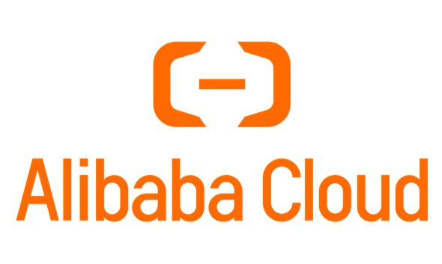
TrainMover: An Interruption-Resilient Runtime for ML Training
Chon Lam Lao¹², Jiaqi Gao², Jiamin Cao², Zhipeng Zhang², Pengcheng Zhang², Jiangfei Duan², Zhilong Zheng², Yu Guan², Yichi Xu², Yong Li², Zhengping Qian², Aditya Akella³, Minlan Yu¹, Ennan Zhai², Dennis Cai², and Jingren Zhou²
¹ Harvard University ² Alibaba Group ³ The University of Texas at Austin
Notes:
What is the scenario, delicate? Shared?
The data should be remove

Slide 2
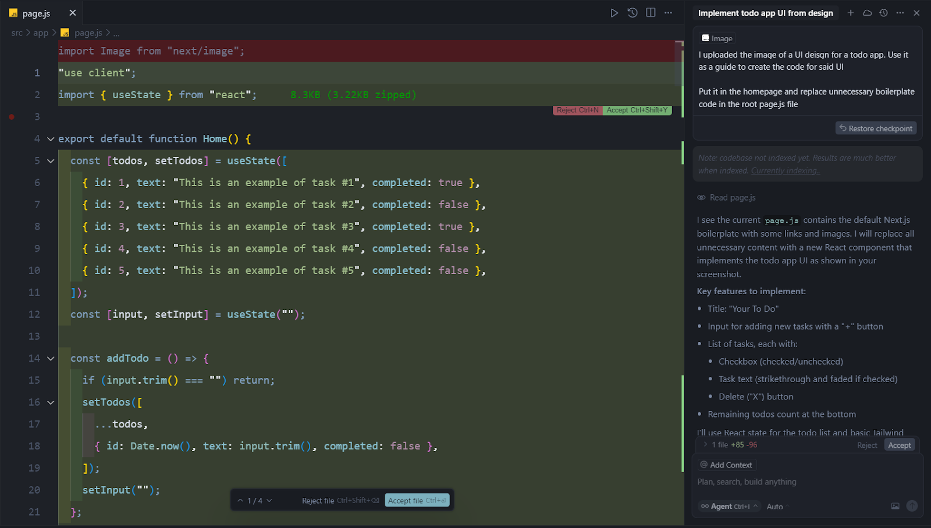

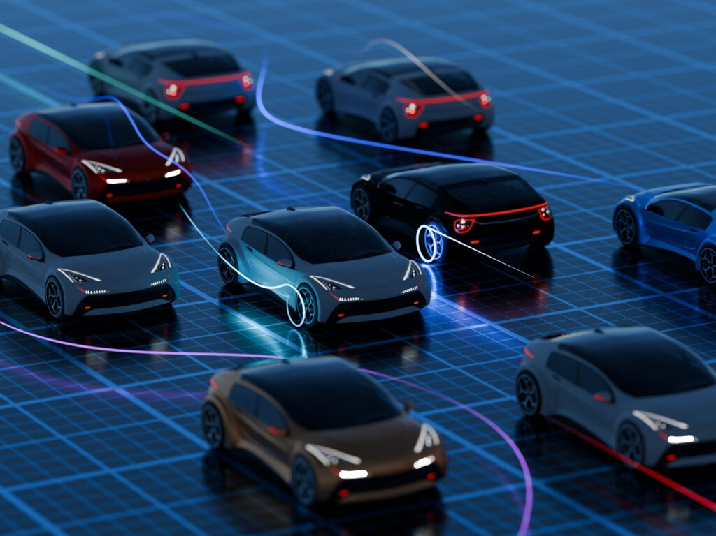

ML applications are keep evolving
Chatbot
AI Programming
AI Object recognition
AI Self-driving

Slide 3
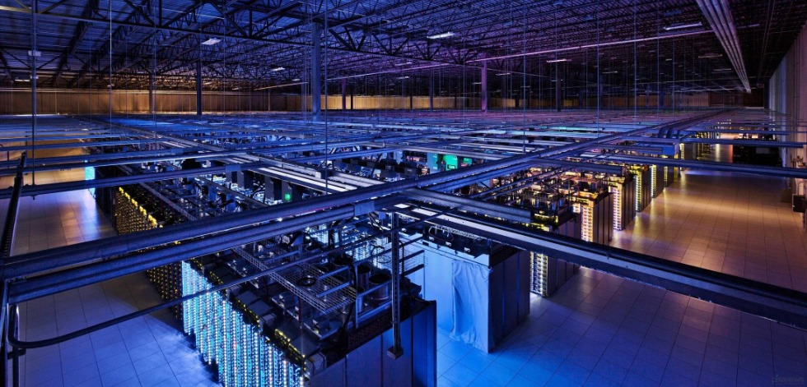
The scale of the training is now over 100K!
Meta [1] and xAI [2] are building 100K+ training cluster
[1] Collective Communication for 100k+ GPUs, Arxiv 2026
[2] xAI. xai’s colossus supercomputer cluster. https://x. ai/colossus/, 2024. Accessed 2024.

Slide 4




But the GPU Training are still tightly coupled and tailored…

Slide 5
But the GPU Training are still tightly coupled and tailored…
DP
TP
TP
TP
TP
TP
TP
DP
PP
PP
PP
PP
PP
PP
PP
PP
PP
PP
PP
PP
DP
TP
TP
TP
TP
TP
TP
PP
PP
PP
PP
PP
PP
PP
PP
PP
PP
PP
PP
DP

Slide 6

But the GPU Training are still tightly coupled and tailored…
Backup/Development Pool
(Google[3], Meta[4], Bytedance[5], Alibaba[6])
[3] Gemini: A family of highly capable multimodal models, 2025
[4] The llama 3 herd of models, 2024
[5] Robust llm training infrastructure at bytedance, SOSP 2025
[6] Alibaba HPN: A data center network for large language model training, SIGCOMM 2025

Slide 7

But the GPU Training are still tightly coupled and tailored…
Backup/Development Pool

Slide 8
At large scale, maintaining good cluster health becomes challenging
Hardware Failures
Software contentions
Management Events
Resource load balancing
…
Many Interruptions!

Slide 9
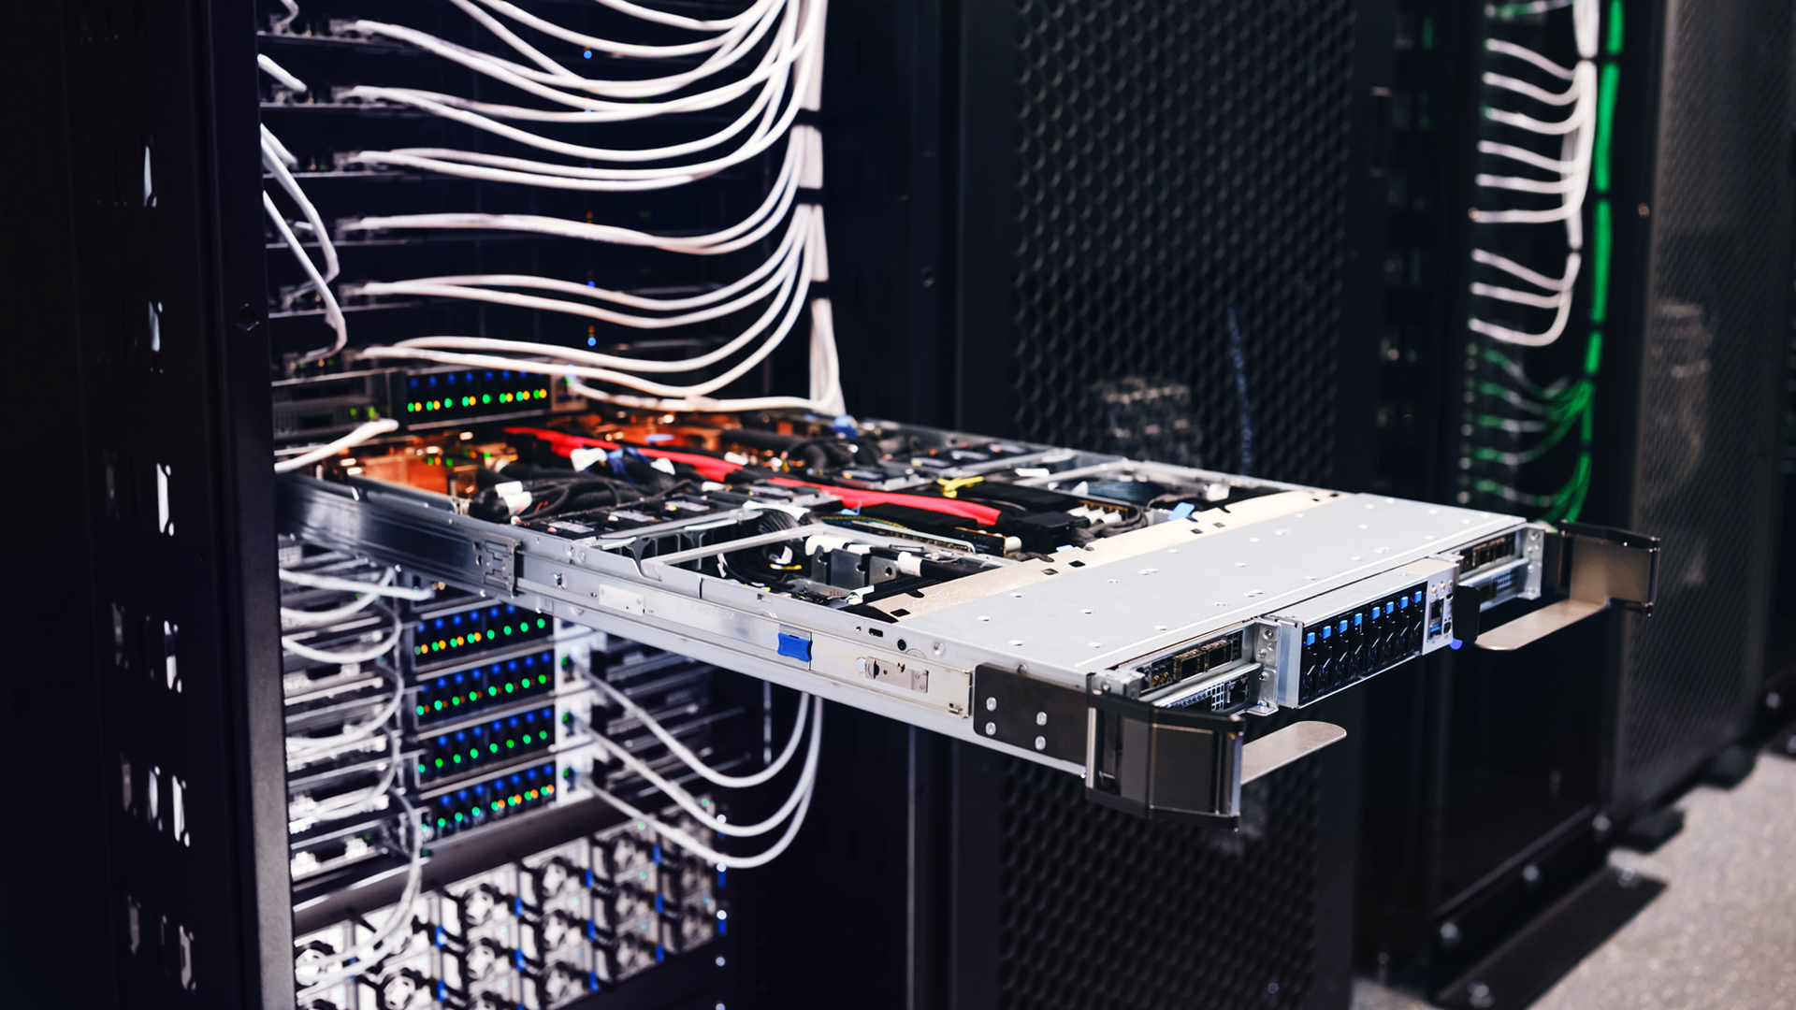
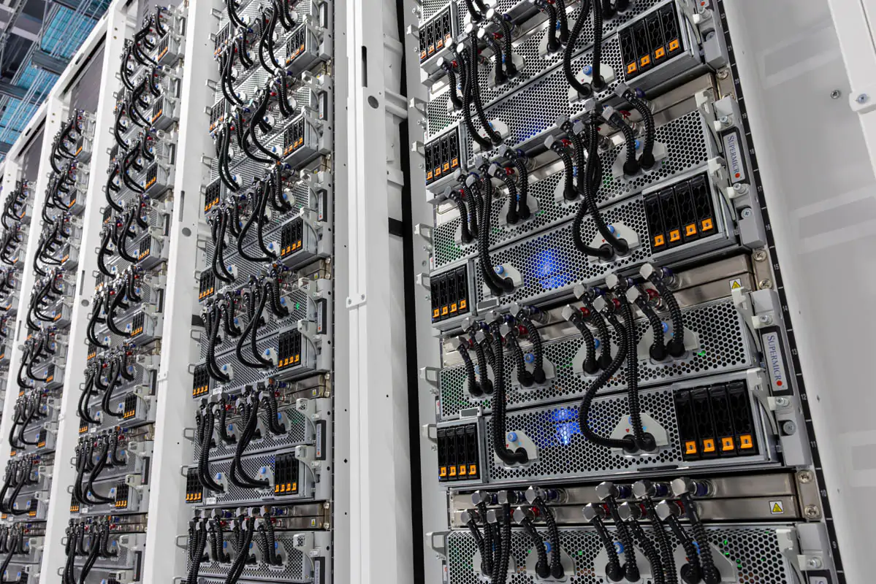


At large scale, maintaining good cluster health becomes challenging
Hardware failures
GPU Overheats
GPU Power Spike
Aegis[7] reports that GPU servers have orders of magnitude higher failure rates than
general cloud computing scenarios.
Meta [8] reports that the mean time to failure (MTTF) drops to under one hour (failures happen every hour) at the 100K+ GPU scale.

Slide 10
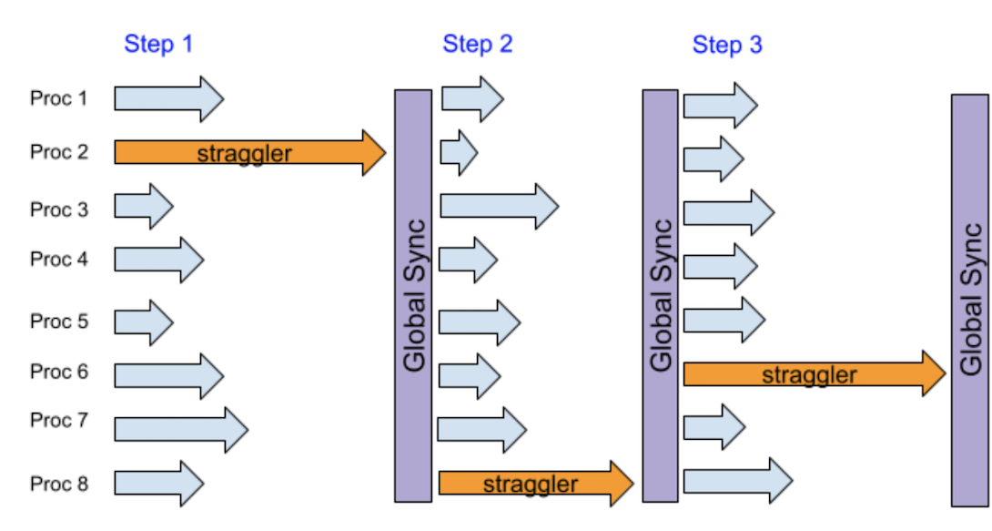
At large scale, maintaining good cluster health becomes challenging
Software contentions
Performance Straggler
Alibaba[9] reported nearly 60% of their large-scale
training jobs experience slowness in production.
Falcon[10] shows that software contentions caused by background tasks and network anomalies can easily affect LLM training frameworks, delaying the job completion time by 34.59% on average.

Slide 11
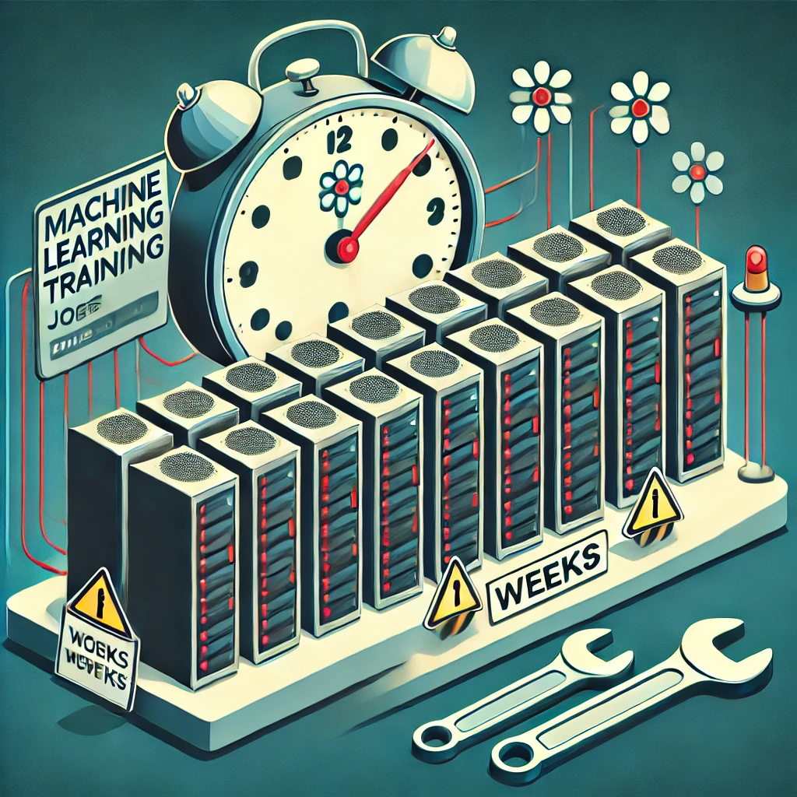
At large scale, maintaining good cluster health becomes challenging
Management Events
Urgent Security Upgrade
Routine Maintenance that requires reboot

Slide 12

At large scale, maintaining good cluster health becomes challenging
Load balancing
GPU and resource fragmentation
Power consumption skewness
Rack A
Rack B
Rack C
Rack A
Rack B
Rack C

Slide 13
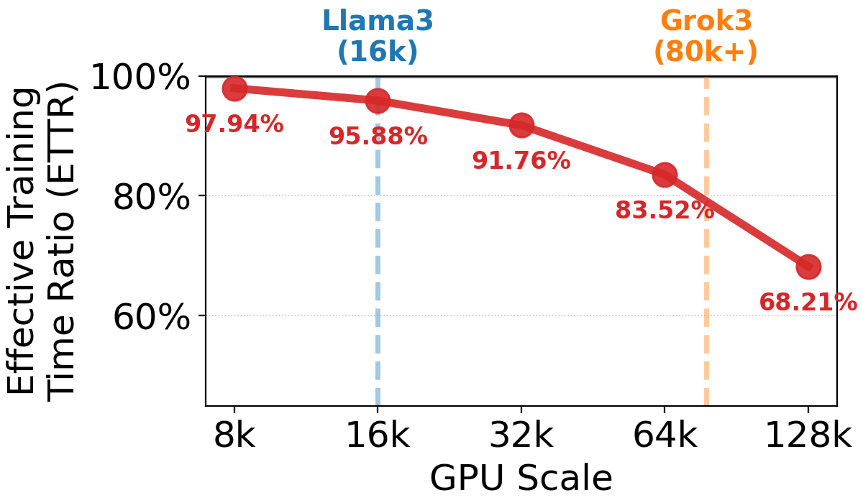
These interruptions affects the training significantly!
Interruption handling is the training performance bottleneck!

Slide 14
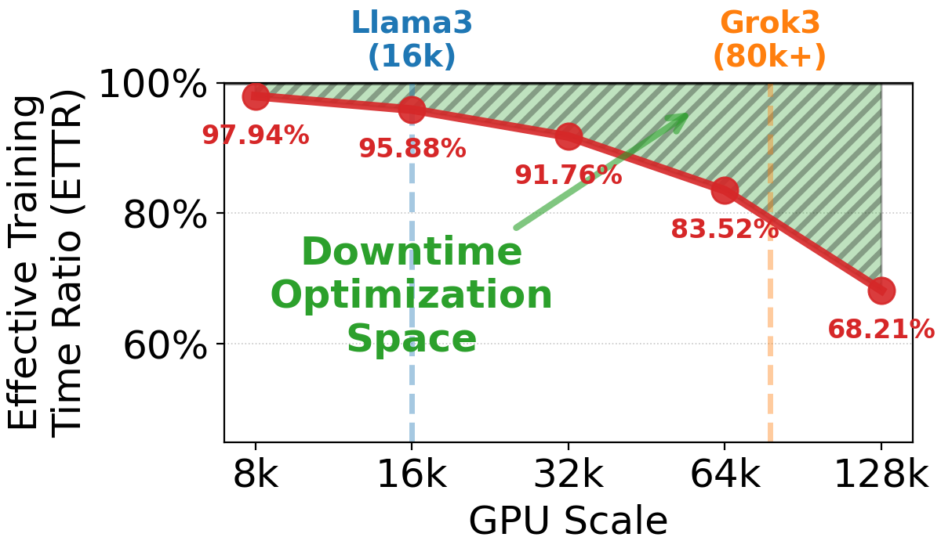
These interruptions affects the training significantly!
Interruption handling is the training performance bottleneck!

Slide 15
Current Practices?
- Full Restart
- Runtime Reconfiguration

Slide 16
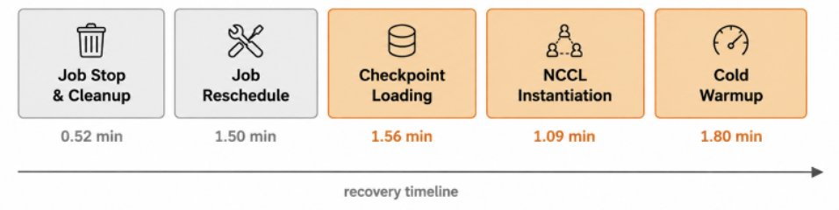
Current Practice: Full Restart
Need a long restart time
  e.g., 8192-GPU-job takes 6.47 minutes on average
  At 100K scale, failure happens every hour (Meta)
0.52 min
1.50 min
Varuna (EuroSys 22’), Horovod,
Torch Distributed…

Slide 17

Existing Practice 1 – Full Restart
Training
- Need a long restart time.
(e.g., 8192-GPU-job takes 6 minutes setup)
Stop
(Infra)
Reschedule
(Infra)
Reinitialize
(Worker)
Training
Varuna (EuroSys 22’), Horovod,
Torch Distributed…

Slide 18

Existing Practice 2 – Runtime Reconfiguration
Shrink (-1)
still long restart time
(e.g., the initialization time takes 4.45 mins)
Requires the change of training strategy (e.g., PP degree), change delicate setting, change user semantic
Stop
(Infra)
Reschedule
(Infra)
Reinitialize
(Worker)
Grow (+1)
Recycle (SOSP 24’), Oobleck (SOSP 23’), Parcae (NSDI 24’)..
Notes:
Remove the limited covertage and redundancy
- Limited coverage – primarily for unexpected failures, overlooks other data center events(e.g., straggler, maintenance, rebalancing)
- Relies on redundancy (e.g., DP group) to recover, which is no long hold nowadays

Slide 19
Existing Practice 1 – Full Restart
Training
- Need a long restart time.
(e.g., 8192-GPU-job takes 6 minutes setup)
Training
Varuna (EuroSys 22’), Horovod,
Torch Distributed…
0.52 min
1.50 min

Slide 20
Existing Practice 2 – Runtime Reconfiguration
Shrink (-1)
still long restart time
(e.g., the initialization time takes 4.45 mins)
Requires the change of training strategy (e.g., PP degree), change delicate setting, change user semantic
Grow (+1)
Recycle (SOSP 24’), Oobleck (SOSP 23’), Parcae (NSDI 24’)..
0.52 min
1.50 min
Notes:
Remove the limited covertage and redundancy
- Limited coverage – primarily for unexpected failures, overlooks other data center events(e.g., straggler, maintenance, rebalancing)
- Relies on redundancy (e.g., DP group) to recover, which is no long hold nowadays

Slide 21
Whether full restart or runtime reconfiguration, everyone must wait for the initialization of the new joiner; this delay is unavoidable.
Notes:
Figure 1 is too many information
Figure 1
Megatron
Reconfiguration
Tellall differentecet overheads

Slide 22
We have only one goal:
Minimize Job initialization downtime
during interruption handling
TrainMover
Minimize Job initialization downtime during interruption handling
Notes:
Figure 1 is too many information
Figure 1
Megatron
Reconfiguration
Tellall differentecet overheads

Slide 23
TrainMover: An Interruption-Resilient Runtime for ML Training
Make intelligent use of standby/low-priority/preemptable machines.
We prepare the initializations before the interruptions happen
Notes:
Color with stages only
Key insight only

Slide 24
TrainMover: An Interruption-Resilient Runtime for ML Training
Make intelligent use of standby/low-priority/preemptable machines.
We prepare the initializations before the interruptions happen
Training Timeline
Fully Restart or
Runtime reconfiguration
Stop
Restart
Interruption Happens!
Notes:
Color with stages only
Key insight only

Slide 25
TrainMover: An Interruption-Resilient Runtime for ML Training
Make intelligent use of standby/low-priority/preemptable machines.
We prepare the initializations before the interruptions happen
Preparation Phase
Switching Phase
TrainMover
Standby Machine
1. Communication CCL Preparation &
2. Training Context Initialization
Training Timeline
Fully Restart or
Runtime reconfiguration
Stop
Restart
Interruption Happens!
Notes:
Color with stages only
Key insight only

Slide 26
TrainMover: An Interruption-Resilient Runtime for ML Training
Make intelligent use of standby/low-priority/preemptable machines.
We prepare the initializations before the interruptions happen
Preparation Phase
Switching Phase
Interruption Happens!
TrainMover
Standby Machine
1. Communication CCL Preparation &
2. Training Context Initialization
Training Timeline
Fully Restart or
Runtime reconfiguration
Stop
Restart
Interruption Happens!
Notes:
Color with stages only
Key insight only

Slide 27
TrainMover: An Interruption-Resilient Runtime for ML Training
Make intelligent use of standby/low-priority/preemptable machines.
We prepare the initializations before the interruptions happen
Preparation Phase
Switching Phase
Interruption Happens!
TrainMover
Standby Machine
1. Communication CCL Preparation &
2. Training Context Initialization
Training Timeline
Minimized Downtime
Fully Restart or
Runtime reconfiguration
Stop
Restart
Interruption Happens!
Notes:
Color with stages only
Key insight only

Slide 28
TrainMover: An Interruption-Resilient Runtime for ML Training
Make intelligent use of standby/low-priority/preemptable machines.
We prepare the initializations before the interruptions happen
Preparation Phase
Switching Phase
Interruption Happens!
TrainMover
Standby Machine
1. Communication CCL Preparation &
2. Training Context Initialization
Training Timeline
Minimized Downtime
Fully Restart or
Runtime reconfiguration
Stop
Restart
Interruption Happens!
Notes:
Color with stages only
Key insight only

Slide 29
(1)
Preparation
Phase
(2)
Machine 0
Machine 1
Machine 0
Machine 1
Standby
Machine
Prepare
Standby
Machine
Machine 2
Machine 3
Machine 2
Machine 3
Exchange
Switching
Phase
(3)
(4)
Machine 0
Machine 1
Standby
Machine
Machine 0
Machine 4
Machine 2
Machine 3
Machine 2
Machine 3

Slide 30
Challenges
Prepare Computation Initialization
Prepare Communication Initialization
Standby machine must recover any role
- Initialization is implicit and tightly coupled.
- Communication groups assume static membership.
- We do not know which machine fails ahead of time.
§ Communication-free sandboxed warmup
§ Two-phase delta-based NCCL setup
§ General standby design
Notes:
No need to talk about the cata
Framework

Slide 31
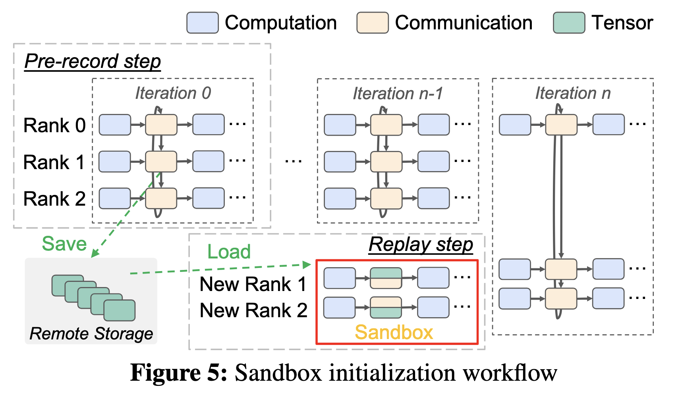
Prepare Computation Initialization
Challenge: Initialization is implicit and tightly coupled
Solution: Sandboxed shadow iterations
  Pre-record the output tensors of all collective calls from a training iteration
  Backup machine runs shadow iteration in sandbox to trigger initialization and replays recorded tensors
Notes:
pulls the initial state from the checkpoint,

Slide 32
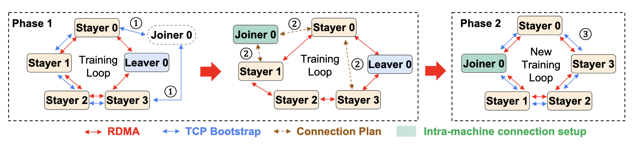
Prepare Communication Initialization
Challenge: Communication groups assume static membership
Solution: Two-phase delta-based Collective Comm setup
  Run intra-machine connection setup beforehand
  At switchover, only update the delta connections

Slide 33
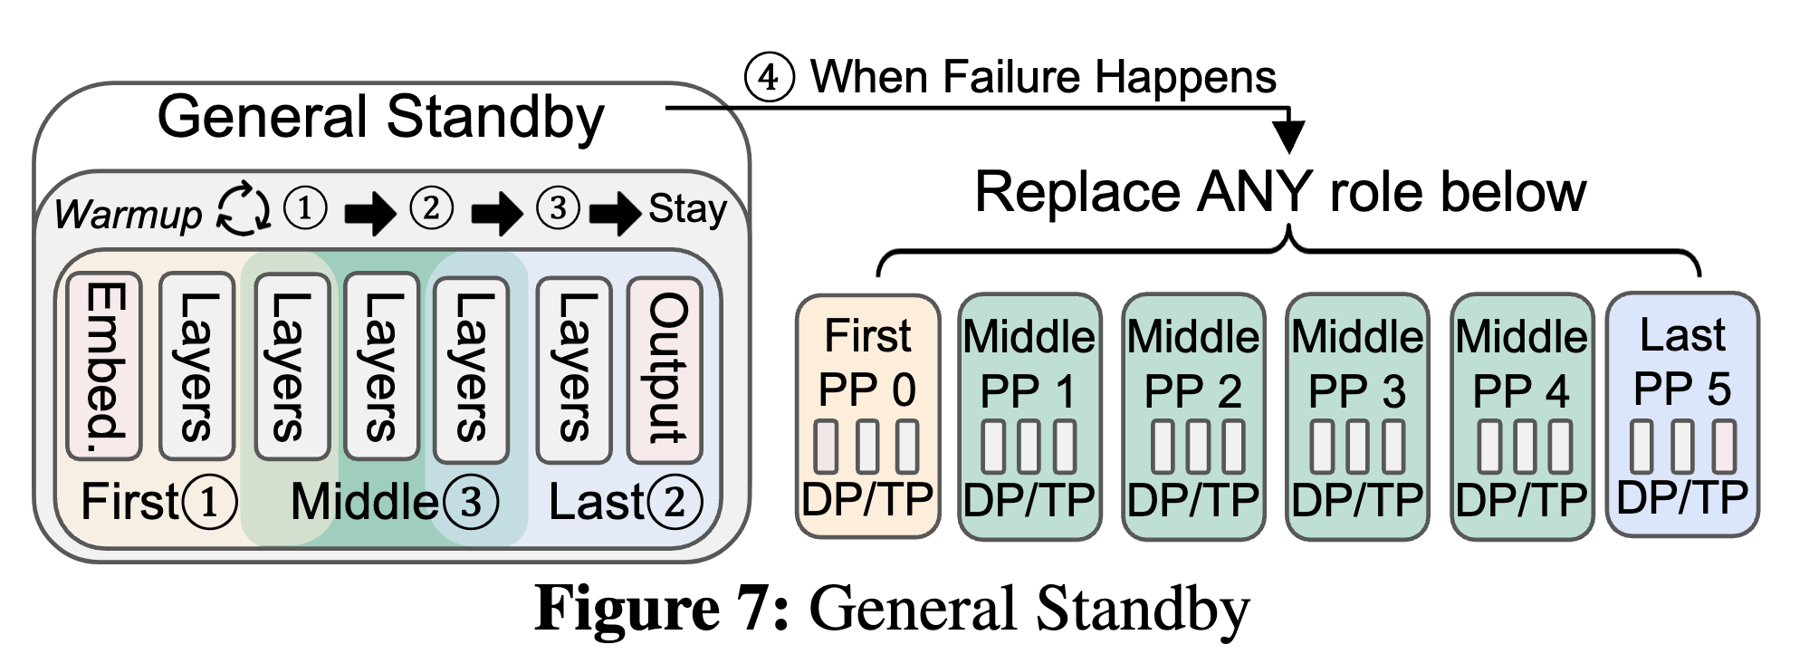
Standby machine must recover any role
Challenge: Do not know which machine fails ahead of time
Solution: general Standby design leveraging ML symmetry
  DP, TP, EP: Every GPU compiles the same kernels and has the same memory layout
  Preparing one role is therefore general enough to be used for all hosts
  PP has 3 roles: first stage, middle stage, and last stage
  We run 3 iterations to ensure all roles are executed and warmed
Notes:
DP, TP, EP: Every GPU compiles the same kernels and has the same memory layout. (EP: tokens are dynamically routed to different experts, but memory can be pre-allocated uniformly by MegatronLM — layout stays consistent.)

Slide 34
Challenges
Prepare Computation Initialization
Prepare Communication Initialization
Standby machine must recover any role
- Initialization is implicit and tightly coupled.
- Communication groups assume static membership.
- We do not know which machine fails ahead of time.
§ Communication-free sandboxed warmup
§ Two-phase delta-based NCCL setup
§ General standby design
Notes:
No need to talk about the cata
Framework

Slide 35
Communication-free Sandbox Initialization
(for computation)

Slide 36
Initialization is prolonged and complex!
  The initializations usually includes…
    Computational Graph Compilation…
    Model Parameters and Optimizer Initialization…
    CUDA Initialization Overhead…
    JIT Compilation Optimizations…
    Runtime Hooking…
    Other Caching Behaviors…
Prolonged
  a single interruption triggers about 2-3 minutes of warm-up before reaching stable performance.

Slide 37
Initialization is prolonged and complex!
Complex
  Initialization spans many layers and libraries in the training stack
  Different frameworks (Megatron-LM / DeepSpeed / NeMo) have different initialization behaviors.
  Initialization is intertwined with communication, requiring the interaction with other machines (e.g., barrier/send/receive)
It is not practical to dig out initialization and run it beforehand!

Slide 38
Our Solution
Running a shadow actual iteration in a communication-free sandbox to trigger initialization!

Slide 39
Communication-free Sandboxing
– Run the actual shadow iteration!
Workflow:
Pre-record Phase:
(deliciated machines record)
  - At the very beginning, we pre-record the vaild communication result tensors from the actual
  training iteration
Preparation phase – Sandbox wawrmup:
(standby machine prepare)
  - The backup machine (new joiner) is then sandboxed and replays the results to finish the iteration in the preparation phase

Slide 40
Communication-free Sandboxing
– Run the actual shadow iteration!
Benefits:
1. Run the shadow iteration in sandbox before joiner (backup machine) joins the main training loop
(minimal downtime)
2. The joiner do not need other existing training hosts to assist on the sandbox procedure
(scalable)

Slide 41
Challenges
Prepare Computation Initialization
Prepare Communication Initialization
Standby machine must recover any role
- Initialization is implicit and tightly coupled.
- Communication groups assume static membership.
- We do not know which machine fails ahead of time.
§ Communication-free sandboxed warmup
§ Two-phase delta-based NCCL setup
§ General standby design
Notes:
No need to talk about the cata
Framework

Slide 42
Two-phase delta-based NCCL setup

Slide 43
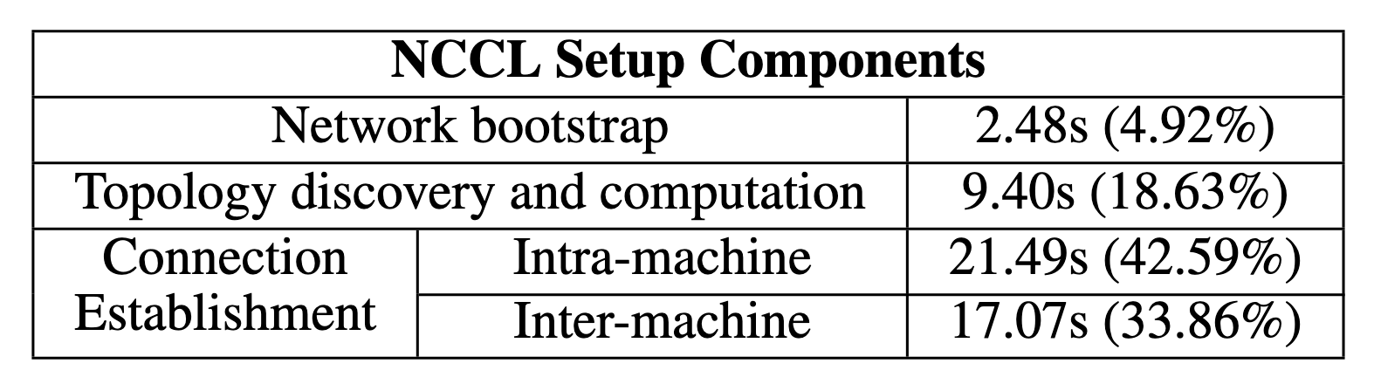
CCL Setup is Slow and Static
Slow…
Static…
tightly coupled to hardware (e.g., NVLink, GPU Direct RDMA)
Compute static optimized connectivity topology at the beginning
NCCL Problem Also observed by ByteCheckpoint [1],
MegaScale [2], ByteScale [3]
Notes:
Background
Refer to 4.1

Slide 44
Two-phase delta-based NCCL setup
We provide a two-stage CCL setup API for the applications
Solution and benefits:
Splitting NCCL setup to two phase: overlap most of the setup (e.g., intra-connection setup) beforehand in preparation phase
(minimal downtime)
Only change the connections delta (QP-level) in switching phase
(scalable)
Workflow:
Notes:
What we want to achieve
Minimize the downtime
The delta

Slide 45
TrainMover: An Interruption-Resilient Runtime for ML Training
Make intelligent use of standby/low-priority/preemptable machines.
We prepare the initializations before the interruptions happen
Preparation Phase
Switching Phase
TrainMover
Standby Machine
1. Communication CCL Preparation &
2. Training Context Initialization
Training Timeline
Stop & Reschedule
Restart
Fully Restart or
Runtime reconfiguration
Notes:
Color with stages only
Key insight only

Slide 46
Challenges
Prepare Computation Initialization
Prepare Communication Initialization
Standby machine must recover any role
- Initialization is implicit and tightly coupled.
- Communication groups assume static membership.
- We do not know which machine fails ahead of time.
§ Communication-free sandboxed warmup
§ Two-phase delta-based NCCL setup
§ General standby design
Notes:
No need to talk about the cata
Framework

Slide 47
TrainMover handles two kinds of interruptions
(1) live/expected events
(e.g., maintenance, straggler replacement, load balancing)
(2) unexpected events
(e.g., failure)
§ Delta NCCL
And § sandbox
Notify
Recover
§ Delta NCCL
And § sandbox
Machine 0
Machine 1
Standby
Machine
Machine 0
Machine 1
Standby
Machine
And § general standby
Machine 2
Machine 3
Machine 2
Machine 3
Knowing the leaving rank before it happens
Not Knowing the leaving rank before it happens
Notes:
No need to talk about the cata
Framework

Slide 48
General Standby design
We leverage the fact that the LLM is symmetric
Every GPU compiles the same kernels and has the same memory layout (TP, DP). Preparing one role is therefore general enough to be used for all hosts.
The only exception is PP, PP has 3 roles: first stage, middle stage, and last stage
We run 3 iteration to ensure all roles are executed and warmed.
Then the standby machine is ready for recover to any role.

Slide 49
Challenges
Prepare Computation Initialization
Prepare Communication Initialization
Standby machine must recover any role
- Initialization is implicit and tightly coupled.
- Communication groups assume static membership.
- We do not know which machine fails ahead of time.
§ Communication-free sandboxed warmup
§ Two-phase delta-based NCCL setup
§ General standby design
Notes:
No need to talk about the cata
Framework

Slide 50
Experiment Results

Slide 51
Experiment Settings
1024 GPUs
Various TP/DP/PP pararllelisms
Various size (175B, 960B, 2.56T, 5.12T models)
Handle expected and unexpected failures

Slide 52
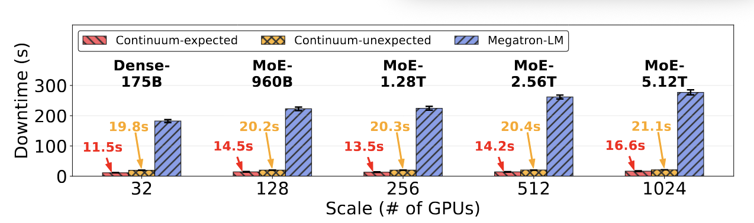
Expected and unexpected failures
TrainMover
TrainMover
Both expected and unexpected failure handling are less than 25 seconds
Notes:
After this
Have bullets, word to say
Bulet baseline

Slide 53
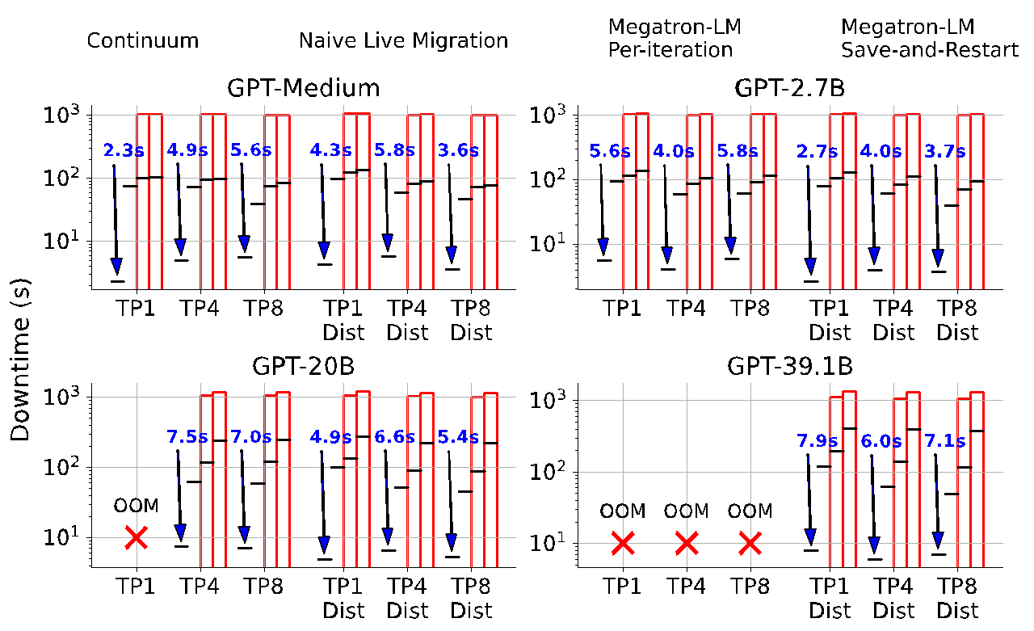
Expected event handling
TrainMover

Slide 54
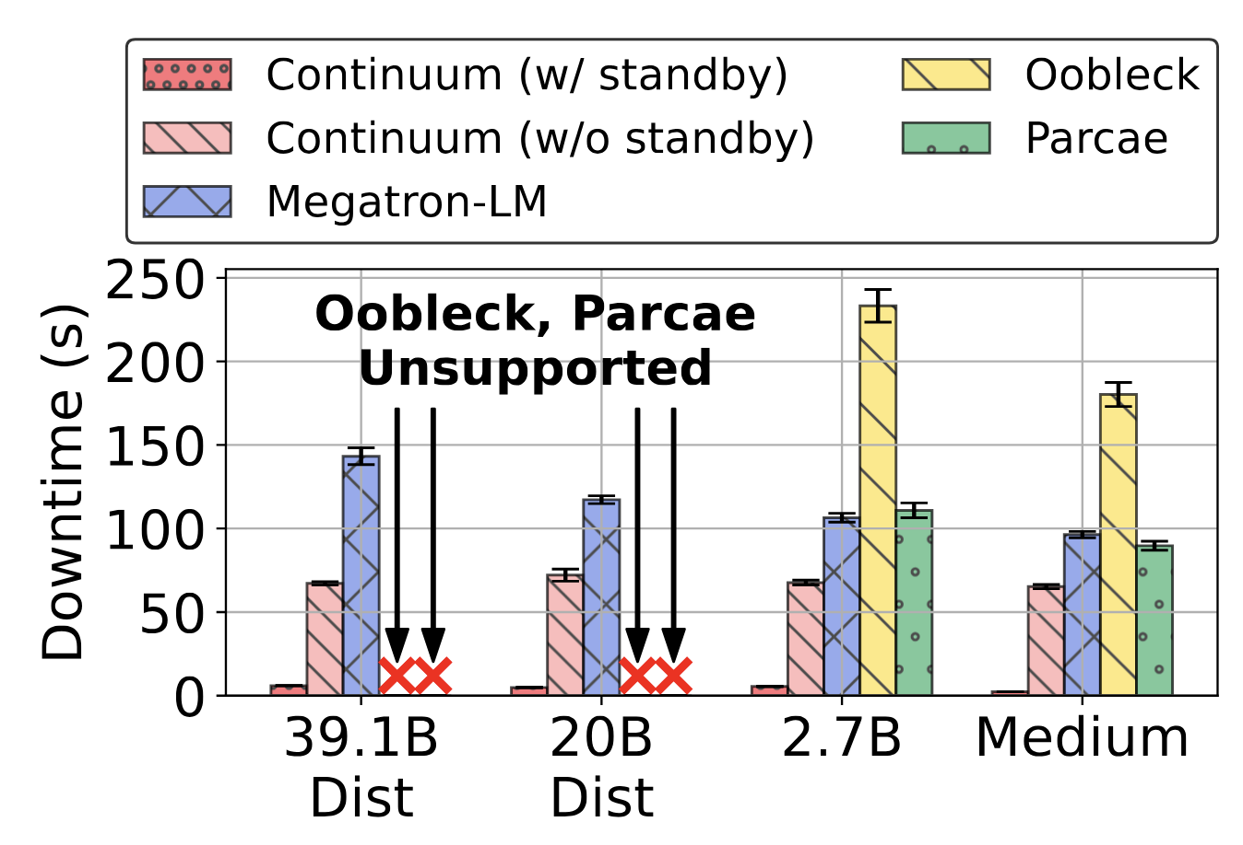
Unexpected Failure handling
TrainMover
TrainMover
Both expected and unexpected failure handling are less than 25 seconds

Slide 55
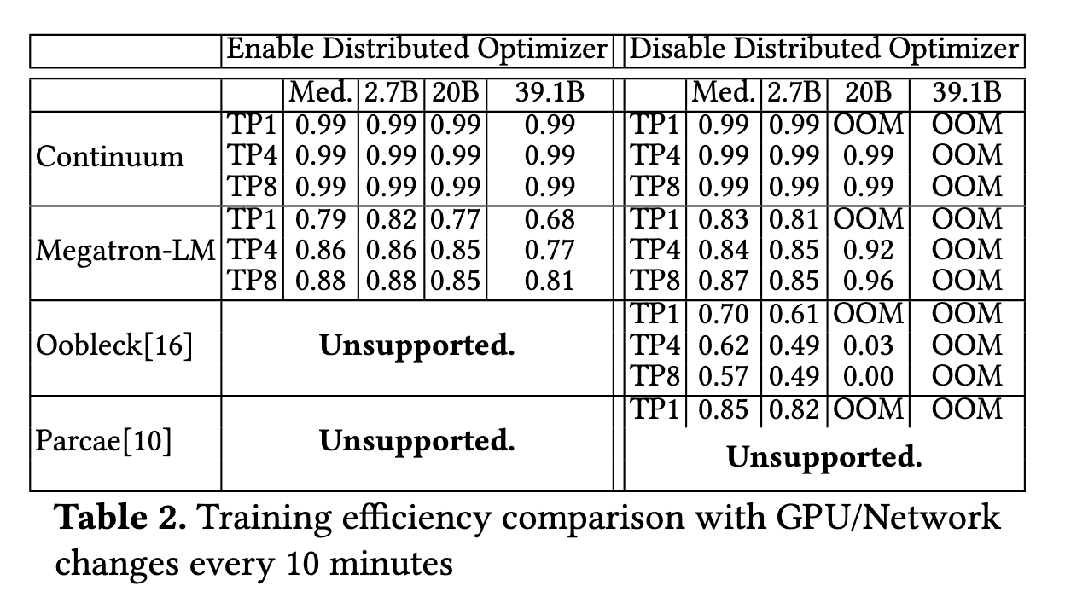
Use case – Rebalancing / Maintenance
TrainMover
We achieve 99% ETTR, while Oobleck and Parcae achieve less than 70% ETTR in the every-10-minute load balancing case.

Slide 56
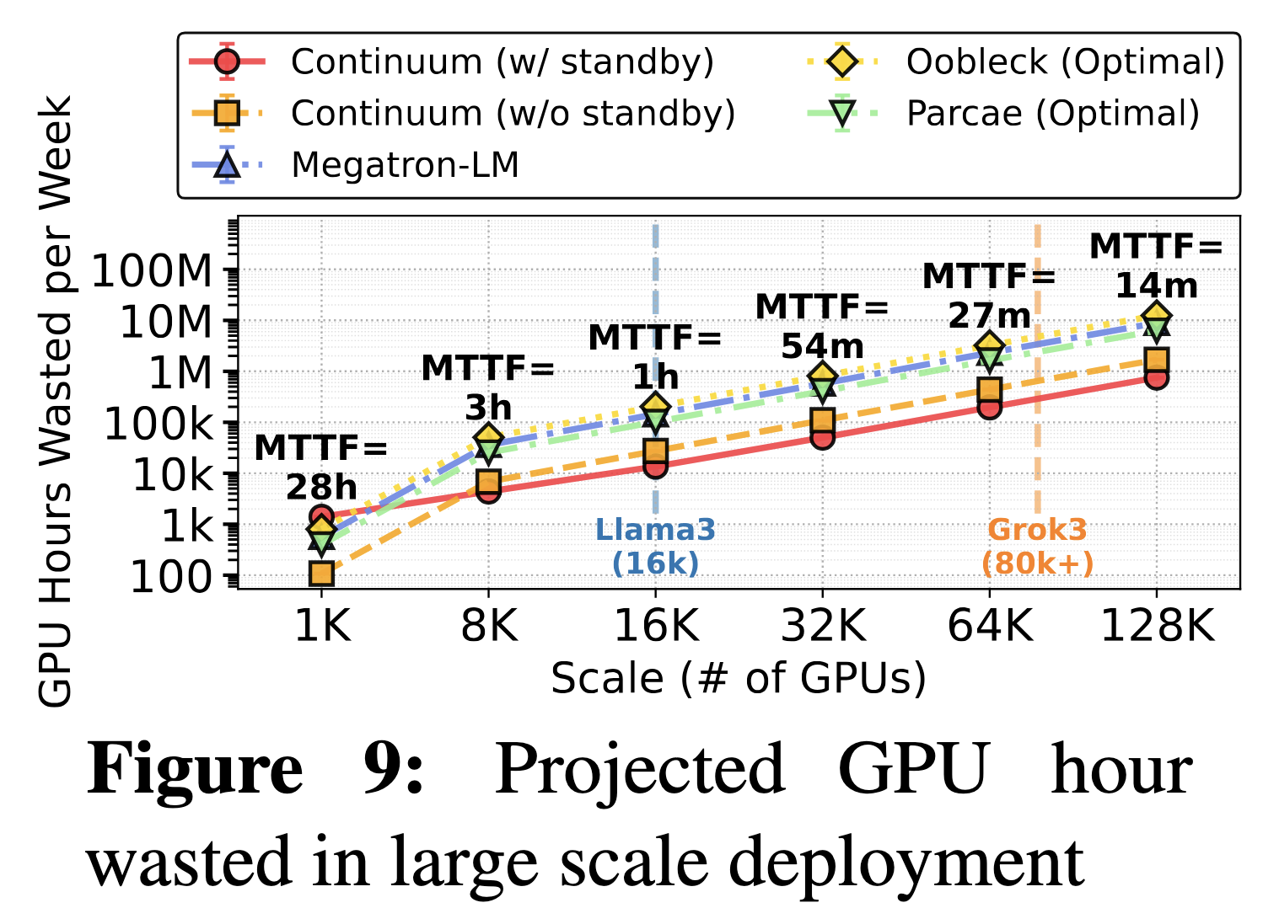
Projection – To over 100K scale
TrainMover
TrainMover

Slide 57
Takeaways
Interruptions including various data center events and failures happens frequently, resulting in an average of 1 failure per hour at 100K+ GPU scale.
Performance has shifted. Simply scaling GPUs yields marginal returns, whereas leveraging a standby machine can dramatically reduce downtime.
We present TrainMover, a resilient runtime that leverages the sandboxed iteration initialization, two-stage delta CCL setup, and general standby designs to handle such events.
TrainMover achieves 20~30 second migration downtime with zero memory overhead in a 1024 GPU testbed.

Slide 58
Conclusion and QA
TrainMover prototype is open-sourced at https://github.com/alibaba/TrainMover
We welcome collaboration—feel free to drop us an email! ☺

Slide 59
QA &
Looking for collaboration ☺

Slide 60
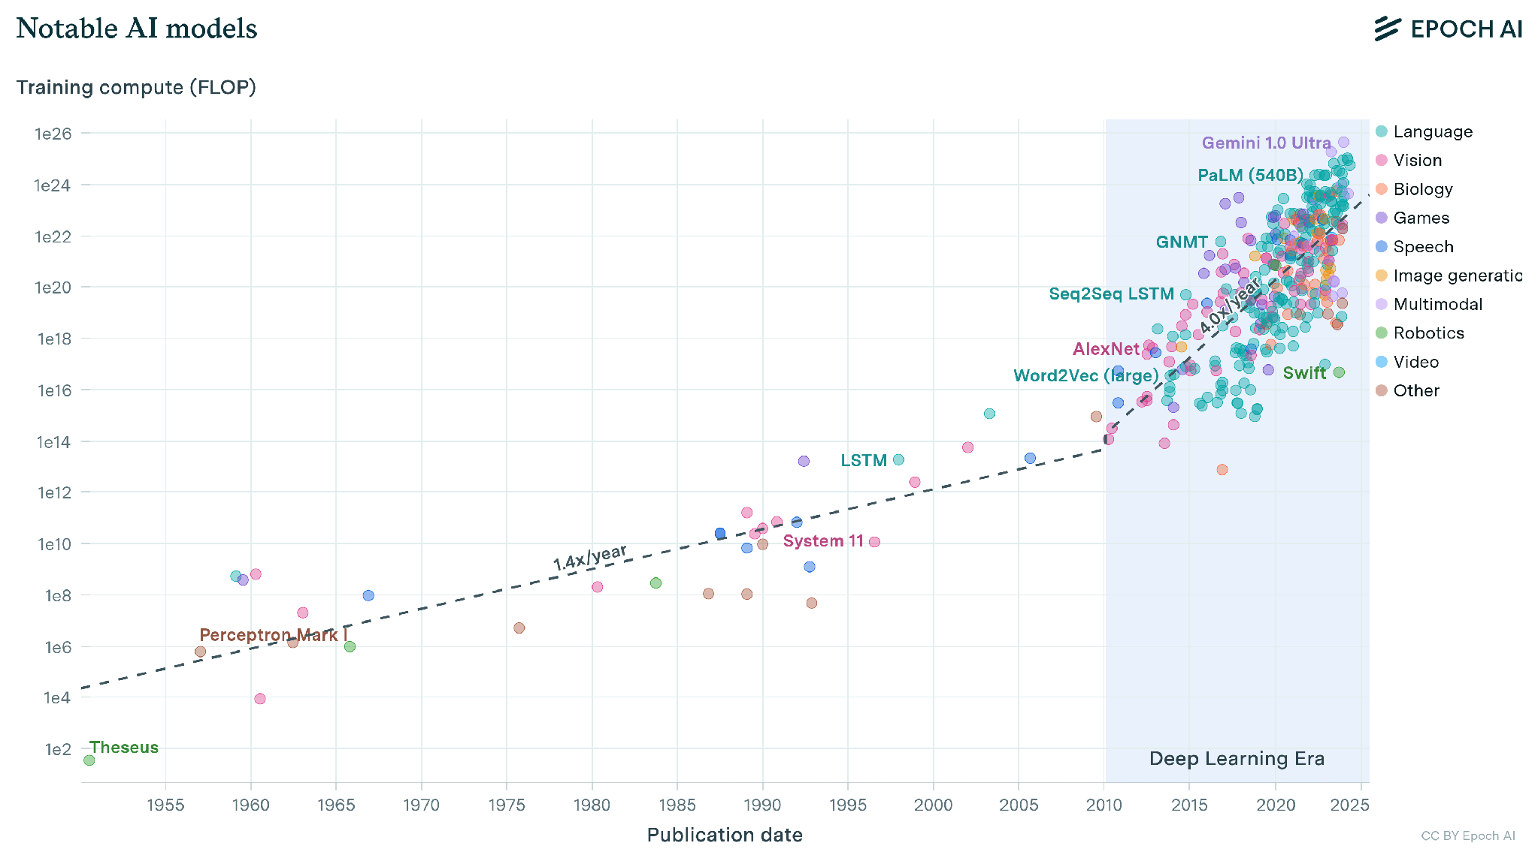
The scale of the model keeps increasing

Slide 61
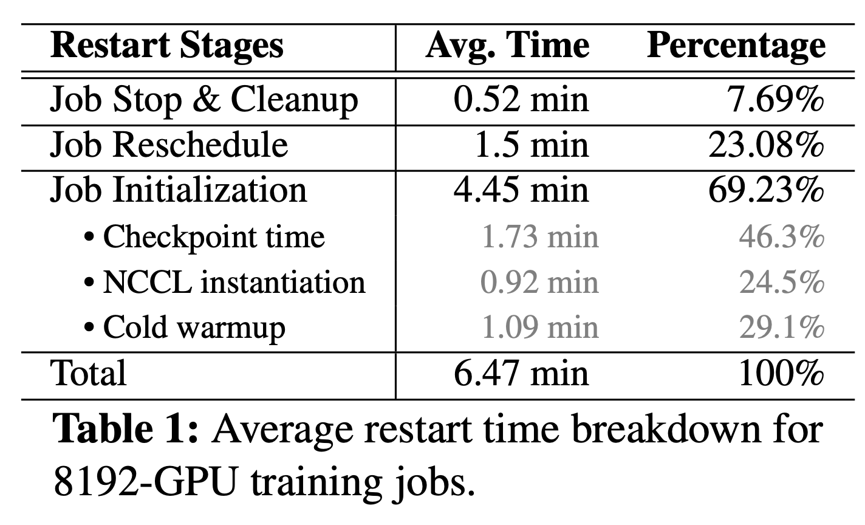
Existing Practice 2 – Runtime Reconfiguration
+ No full restart, no intra overhead!
Less (but still long) restart time
(e.g., the initialization time takes 4.45 mins)
Requires the change of training strategy (e.g., PP degree), change delicate setting, change user semantic
Stop
(Infra)
Reschedule
(Infra)
Reinitialize
(Worker)
Slipstream (SOSP 24’), Oobleck (SOSP 23’), Parcae (NSDI 24’), Bamboo (NSDI 23’)...
Notes:
Remove the limited covertage and redundancy
- Limited coverage – primarily for unexpected failures, overlooks other data center events(e.g., straggler, maintenance, rebalancing)
- Relies on redundancy (e.g., DP group) to recover, which is no long hold nowadays

Slide 62
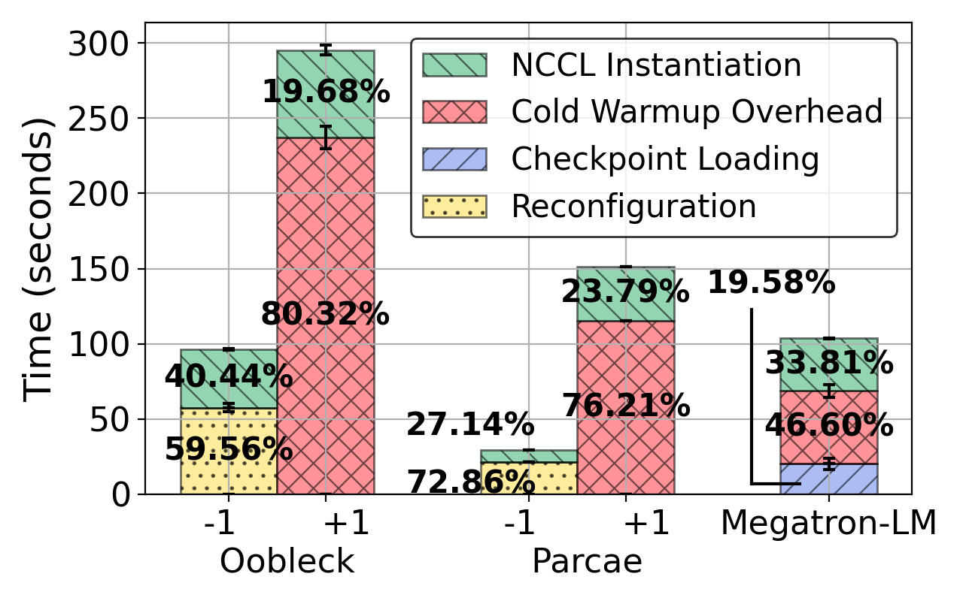
Job initialization overheads?
Checkpoint Systems (Megatron-LM)
Reconfiguration Systems (Oobleck, Parcae)
Notes:
Figure 1 is too many information
Figure 1
Megatron
Reconfiguration
Tellall differentecet overheads

Slide 63
Whether using stop–reschedule–initialize or runtime reconfiguration, everyone must wait for the new joiner to finish initialization (+1).
Notes:
Figure 1 is too many information
Figure 1
Megatron
Reconfiguration
Tellall differentecet overheads

Slide 64
We have only one goal:
Minimize Job downtime during interruption handling
Notes:
Figure 1 is too many information
Figure 1
Megatron
Reconfiguration
Tellall differentecet overheads

Slide 65
TrainMover: An Interruption-Resilient Runtime for ML Training
Minimize Job downtime during interruption handling
Notes:
What is the scenario, delicate? Shared?
The data should be remove

Slide 66

TrainMover: An Interruption-Resilient Runtime for ML Training
Make intelligent use of standby/low-priority/preemptable machines.
TrainMover

Slide 67
TrainMover: An Interruption-Resilient Runtime for ML Training
Make intelligent use of standby/low-priority/preemptable machines.
TrainMover
Restart or runtime reconfiguration
We prepare the initializations before the interruptions happen
Notes:
Color with stages only
Key insight only

Slide 68
TrainMover
Solution Designs:
1. Communication-free Sandbox Initialization
2. Two-phase, Delta-based NCCL setup

Slide 69
Challenge: Prolonged and complex Computation Initialization
Prolonged
  a single interruption triggers about 150 seconds of warm-up before reaching stable performance.
Complex
  Initialization spans many layers
  Different frameworks (Megatron-LM / DeepSpeed / NeMo) have different initialization behaviors.
  Initialization is intertwined with communication, requiring the interaction with other machines (e.g., barrier/send/receive)

Slide 70
Communication-free Sandbox Initialization

Slide 71
Our Solution
Running a shadow actual iteration in a communication-free sandbox!
We pre-record communication results beforehand;
The new joiner (backup machine) is sandboxed and replays them to finish the iteration in the preparation phase

Slide 72
Dig out all initialization and run it beforehand?
It is not practical to dig out all initialization and run it beforehand!
  Different frameworks (Megatron-LM / DeepSpeed / NeMo) have different initialization behaviors.
  Initialization is implicated
A practical way --- Run an actual shadow iteration in the new joiner before the new joiner joins!

Slide 73
Challenges on running shadow iteration:
Running a shadow actual iteration requires the interaction with other machines (e.g., barrier/send/receive)
Running a shadow actual iteration requires valid states

Slide 74
TrainMover
Solution Designs:
1. Communication-free Sandbox Initialization
2. Two-phase, Delta-based NCCL setup

Slide 75
TrainMover handles two kinds of interruptions
(1) live/expected events
(e.g., maintenance, straggler replacement, load balancing)
(2) unexpected events
(e.g., failure)
§ Delta NCCL
And § sandbox
Notify
Recover
§ Delta NCCL
And § sandbox
Machine 0
Machine 1
Standby
Machine
Machine 0
Machine 1
Standby
Machine
And § general standby
Machine 2
Machine 3
Machine 2
Machine 3
Knowing the leaving rank before it happens
Not Knowing the leaving rank before it happens
Notes:
No need to talk about the cata
Framework

Slide 76
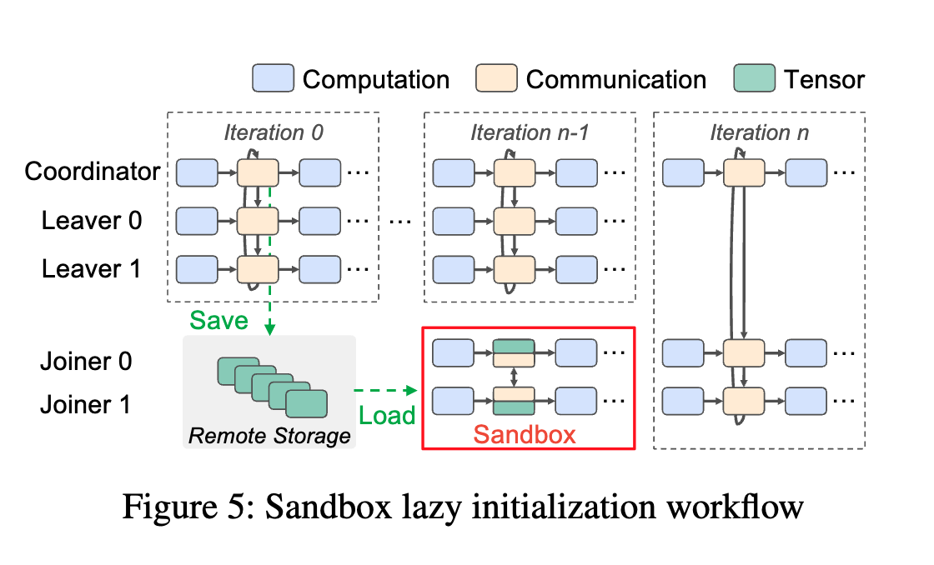
Sandboxing Warmup – Run the actual iteration!
During the sandbox running, we intercept all NCCL calls that sending out to others, and directly response by the tensors that we recorded previously.

Slide 77
Cluster health is challenging
Network Failures
Incast, strom
Some points are unreachable,
Timeout configuration is not
Proper set
Network Slowdown
Communication Timeout
GPU Power Spike
Aegis reports that GPU servers have orders of magnitude higher failure rates than
general cloud computing scenarios.

Slide 78
— What's the difference?
 | Offline Checkpointing | Reconfiguration System | Our system
Restart Required? | Restart entire Job with all machines | Wait for new machine to warm up and join | No Restart/Wait required
User-level Changes? | Start from the last checkpoint | Adjust PP/TP/PP or batch size to fit memory constraints | No User Awareness

Slide 79
Cluster health is challenging
Maintenance
Incast, strom
Some points are unreachable,
Timeout configuration is not
Proper set
Urgent Security Upgrade
Communication Timeout
GPU Power Spike
Aegis reports that GPU servers have orders of magnitude higher failure rates than
general cloud computing scenarios.

Slide 80
Training Resilience becomes critical for maintaining the training health
Move training machines to re-load balancing…
Avoid computational and power skewness…
replace training straggler...
Swap machine out to upgrade machines offline…
Handling Failures…

Slide 81


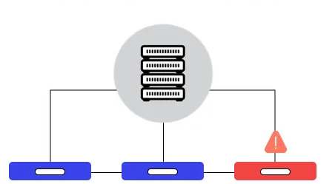
What is the existing solutions for such data center events?
Offline Checkpointing
(Pause-and-restart)
Varuna (EuroSys 22’), Horovod,
Torch Distributed…
+ Easy to deploy and manage
- Need a long restart time, even worse for high frequent.
(e.g., 32-GPU-job takes 500s setup)
Online Training Scheme Change
(Run-with-remaining-machines)
Slipstream (SOSP 24’),
Oobleck (SOSP 23’),
Parcae (NSDI 24’),
Bamboo (NSDI 23’)...
+ Less (but still long) restart (reconfiguration) time
(e.g., 32-GPU-job takes 100s setup)
- complex training and network, change user semantic, not possible in practice due to complexity and memory overhead
These works are design for failure, not suitable for proactive maintenance or data center events (e.g., replace straggler hosts)
A better yet simple solution? — Live migration

Slide 82
Goals
1. Can we achieve uninterrupted (sub-iter downtime) and zero GPU memory overhead during migration?
2. Can we achieve a migration that leaves user semantics untouched and removes fault tolerance responsibilities from the development?

Slide 83
What are the initialization overheads
Checkpoint Systems (Megatron-LM)
Reconfiguration Systems (Oobleck, Parcae)
Notes:
Figure 1 is too many information
Figure 1
Megatron
Reconfiguration
Tellall differentecet overheads

Slide 84
Existing Solutions 2 – Runtime Reconfiguration
+ No full restart, no intra overhead!
Training
Opaque – Requires the change of training strategy (e.g., PP degree), change delicate setting, change user semantic
Less (but still long) restart time
(e.g., the initialization time takes 4.45 mins)
Stop
(Infra)
Reschedule
(Infra)
Reinitialize
(Worker)
Training
Slipstream (SOSP 24’), Oobleck (SOSP 23’), Parcae (NSDI 24’), Bamboo (NSDI 23’)...
Notes:
Remove the limited covertage and redundancy
- Limited coverage – primarily for unexpected failures, overlooks other data center events(e.g., straggler, maintenance, rebalancing)
- Relies on redundancy (e.g., DP group) to recover, which is no long hold nowadays

Slide 85
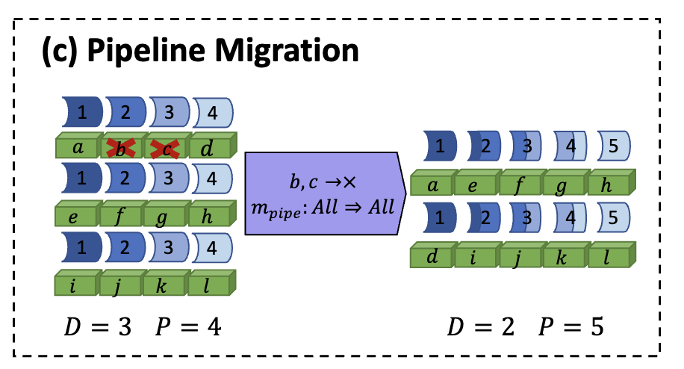
Existing Solutions 2 – Runtime Reconfiguration
Parcae as an example
+ No full restart, no intra overhead!
Less (but still long) restart time
(e.g., the initialization time takes 4.45 mins)
Opaque – Requires the change of training strategy (e.g., PP degree), change delicate setting, change user semantic
Stop
(Infra)
Reschedule
(Infra)
Reinitialize
(Worker)
Slipstream (SOSP 24’), Oobleck (SOSP 23’), Parcae (NSDI 24’), Bamboo (NSDI 23’)...
Notes:
Remove the limited covertage and redundancy
- Limited coverage – primarily for unexpected failures, overlooks other data center events(e.g., straggler, maintenance, rebalancing)
- Relies on redundancy (e.g., DP group) to recover, which is no long hold nowadays

Slide 86
Existing Solutions 2 – Reconfiguration Systems
- Complex – Requires the change of training strategy, change delicate setting, change user semantic
- Different coverage – primarily for failures, overlooks other data center events(e.g., straggler, maintenance, rebalancing)
- Less (but still long) restart (reconfiguration) time because the bottleneck is the new incoming machine
(e.g., 32-GPU-job takes 100s setup)
Parcae as an example
Slipstream (SOSP 24’), Oobleck (SOSP 23’), Parcae (NSDI 24’), Bamboo (NSDI 23’)...
Notes:
Remove the limited covertage and redundancy
- Limited coverage – primarily for unexpected failures, overlooks other data center events(e.g., straggler, maintenance, rebalancing)
- Relies on redundancy (e.g., DP group) to recover, which is no long hold nowadays

Slide 87
— What's the difference?
 | Stop- Reschedule-Reinitialize | Reconfiguration System | Our system
Restart Time | High | Middle
Complexity | Low | High

Slide 88
Existing solutions:
(1) High Overhead
(2) are not designed for handling such data center events
Offline Checkpointing
(Pause-and-restart)
Varuna (EuroSys 22’), Horovod,
Torch Distributed…
- Need a long restart time, even worse for high frequent.
(e.g., 32-GPU-job takes 500s setup)
Reconfiguration Systems
(Run-with-remaining-machines)
Slipstream (SOSP 24’),
Oobleck (SOSP 23’),
Parcae (NSDI 24’),
Bamboo (NSDI 23’)...
- Less (but still long) restart (reconfiguration) time because the bottleneck is new machine issue
(e.g., 32-GPU-job takes 100s setup)
- Complex – Requires the change of training strategy, change delicate setting, change user semantic
- Limited coverage – primarily for failures, overlooks other data center events(e.g., straggler, maintenance, rebalancing)

Slide 89
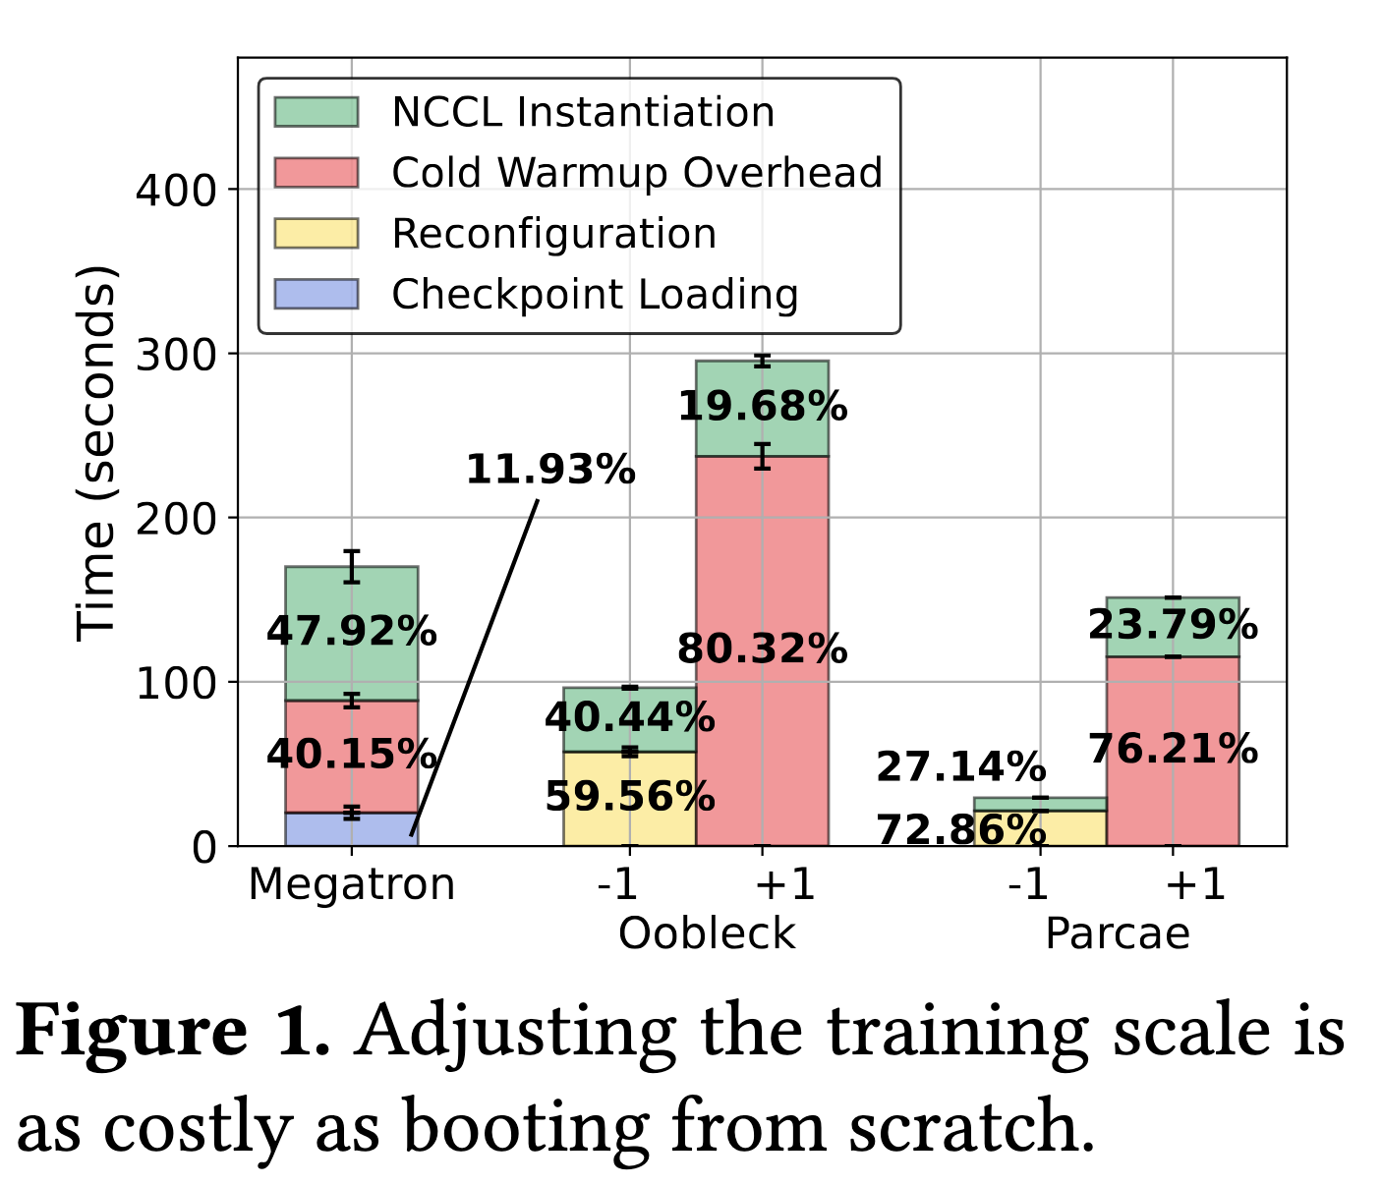
Can we design a better system for handing such interruptions/events?
Leverage standby/preemptable machines to prepare and overlap the critical path
How standby machine can help effectively?

Slide 90
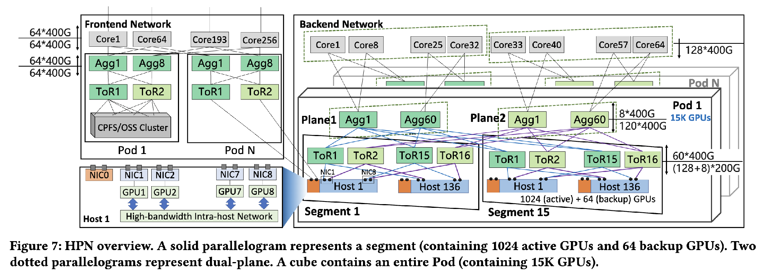
Standby Machines / Preemptable Machines
Cloud has a preemptable machines (spot instance)
Jobs that runs with low-priority can be preemptable

Slide 91
Can we design a better system for handing such interruptions/events?
Leverage standby/preemptable machines to prepare and overlap the critical path
How standby machine can help?

Slide 92
TrainMover
Handling live interruptions
  Operator sends migration signal a head of time
  Brings preemptable machine to the table and warmup as joiner
  After joiner finish their warmup, swap it in
(2) Handling failure interruptions
  speculatively warmup
  Interruption happens unexpectedly
  Downtime is small due to the handling of live interruptions if the warmup hits.
Notes:
No need to talk about the cata
Framework

Slide 93
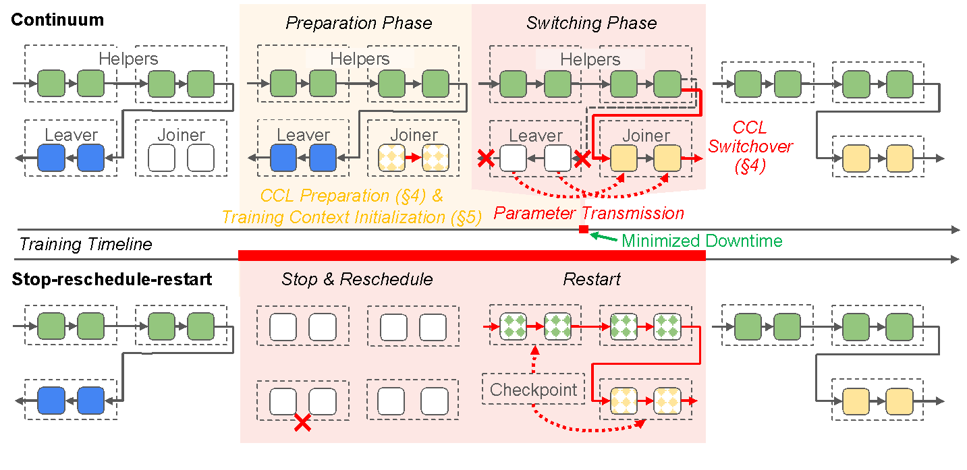
TrainMover --- Design Principles
P1: The system should achieve minimal transit downtime and zero GPU memory overhead to existing training nodes during migration.
P2: The impact of interruptions should not scale with the training size
Notes:
Princople is better than questions
Give some hints when talk about upfront

Slide 94
TrainMover

