Slide 1
The Need for End-to-End Evaluation of Cloud Availability
Zi Hu^{1,2}, Liang Zhu^{1,2}, Calvin Ardi^{1,2},
Ethan Katz-Bassett¹, Harsha Madhyastha³, John Heidemann^{1,2}, Minlan Yu¹,
1. USC 2. ISI 3. UCR

Slide 2
Cloud usage is big and growing
But is cloud always available?

Slide 3
Need to understand cloud availability
Users care
Many applications in the cloud: Facebook, Gmail, Dropbox, etc.
Businesses care
Data/Apps on cloud needs to be always available
Providers care
5-minute outage costs Google half million in revenue[1]
only a few providers, but real competition
[1] http://venturebeat.com/2013/08/16/3-minute-outage-costs-google-545000-in-revenue/

Slide 4
Prior work relies on ICMP probes
Amogh Dhamdhere, et al, CoNEXT, 2007.
Netdiagnoser: Troubleshooting Network Unreachabilities Using End-to-End Probes and Routing Data.
Zheng Zhang, et al, SIGCOMM, 2008.
iSPY: Detecting IP Prefix Hijacking on My Own.
Ethan Katz-Bassett, et al, NSDI 2008.
Studying Black Holes in the Internet with Hubble.
Lin Quan, et al, SIGCOMM 2013.
Trinocular: Understanding Internet Reliability through Adaptive Probing.
…
But can we trust ICMP?

Slide 5
Cloud needs end-to-end measurement
Customers
The cloud
ICMP tests only this part
HTTP tests the whole path
Front end
Back end
ICMP
broken here
Storage
HTTP
Gateway
Plus ICMP filtering, rate limiting ….
cloud is much more complicated: load balancers, RAID … All must work

Slide 6
Our contributions
Show importance of retries
Compare ways to measure cloud availability
Network vs. app-level (ICMP vs. HTTP)
Show end-to-end measurements are necessary
ICMP can over- and under-estimate

Slide 7
Methodology
Probing Method
(2 probing methods:
ICMP vs. HTTP)
Target
(2 types of targets: VMs and storage
3 vendors for storage: Amazon, MS, Google)
HTTP: fetch a 1KB file
(end to end)
VM:
8 Amazon EC2
rounds of 10/11 minutes each
Additional 2/8 retries upon a failure
Storage:
7 Amazon S3
2 Google Storage 7 Microsoft Azure
ICMP: ping hostname
(network-level)
ISI&UW: only for validation

Slide 8
Our contributions
Show importance of retries
Compare ways to measure cloud availability
Network vs. app-level (ICMP vs. HTTP)
Show end-to-end measurements are necessary
ICMP can over- and under-estimate

Slide 9
Why retries?
Packet loss could mess up the result:
random packet loss (could be as high as 1%)
cloud outages are rare (<<1%)
Unfair to compare HTTP with ICMP w/o retry
HTTP, TCP has kernel retries
ICMP, nothing

Slide 10
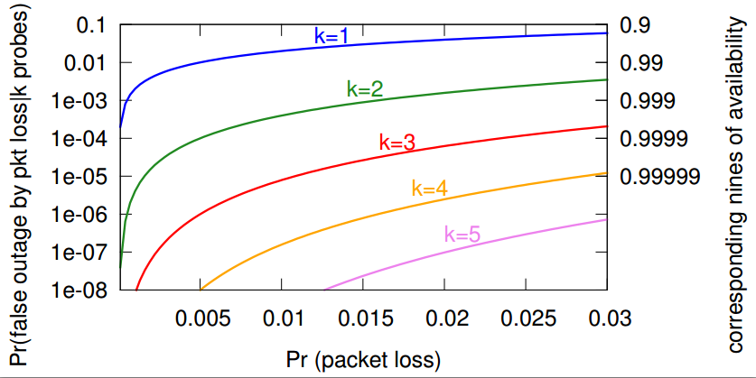
The case for retries
k: number of tries
p: packet loss rate
Outage: all k tries fail.
With k=1 try and p=1% loss rate, 1% probability of false positive
cloud availability
Need retries to eliminate the noise of packet loss
Notes:
Light Green is unreadable.

Slide 11
Our contributions
Show importance of retries
Compare ways to measure cloud availability
Network vs. app-level (ICMP vs. HTTP)
Show end-to-end measurements are necessary
ICMP can over- and under-estimate

Slide 12
Comparing network and app-Level probing
Method agreement (>97% of the time)
No outage/ Provider outage, e.g. power outage
…
Method disagreement (<3%, but still large compared to rare cloud outage rates)
Outage inside cloud
ICMP filtering/rate limiting
…
Customers
The cloud
ICMP tests only this part
HTTP tests the whole path
Front end
Back end
ICMP
HTTP
Storage
Gateway

Slide 13
Showing the underlying data
each column of data shows one round
24-hour boundaries
Color represents the percentage of failed probes.
Light color => probe succeed.
Medium colors => some tries fail.
Dark color => all tries fail
dark blue diamond => ICMP outage
dark red square => HTTP outage
White => control node fail.
each pair of rows shows ICMP and HTTP observations from one VP:
blue top is ICMP
lower red is HTTP

Slide 14
Agreement between ICMP and HTTP
Power outage at
Amazon EC2 (Singapore)
confirmed by operators
No outage/provider outage: ICMP and HTTP report consistent result
Notes:
Case study of agreement

Slide 15
Disagreement between ICMP and HTTP (case 1)
Three VPs report an ICMP-only outage
ICMP: down; HTTP: up
Amazon EC2 (N. California)
tcpdump shows ICMP probes reach the VM
=> filtering happens on the return path
ICMP overestimates outages
Notes:
Case study of disagreement

Slide 16
Disagreement between ICMP and HTTP (case 2)
All VPs report a
HTTP-only outage
at Amazon S3 (Tokyo)
ICMP: up;
HTTP: down
confirmed by operators
ICMP underestimates outages
Notes:
Case study of disagreement

Slide 17
Conclusion
We have shown
Retries are needed to eliminate noise
ICMP is suspect
can over- /under- estimate cloud availability.
We should use end-to-end probes
Interested in our project?
Visit https://ant.isi.edu/availability

