Slide 1

Intent-Driven Network Management with Multi-Agent LLMs:
The Confucius Framework
SIGCOMM 2025
Ying Zhang
With Zhaodong Wang, Samuel Lin, Guanqing Yan, Soudeh Ghorbani, Minlan Yu, Jiawei Zhou, Nathan Hu, Lopa Baruah, Sam Peters, Srikanth Kamath, Jerry Yang
Notes:
Welcome everyone. Today, I’ll be presenting “Intent-Driven Network Management with Multi-Agent LLMs: The Confucius Framework.” This work is a collaboration between Meta and several academic partners

Slide 2
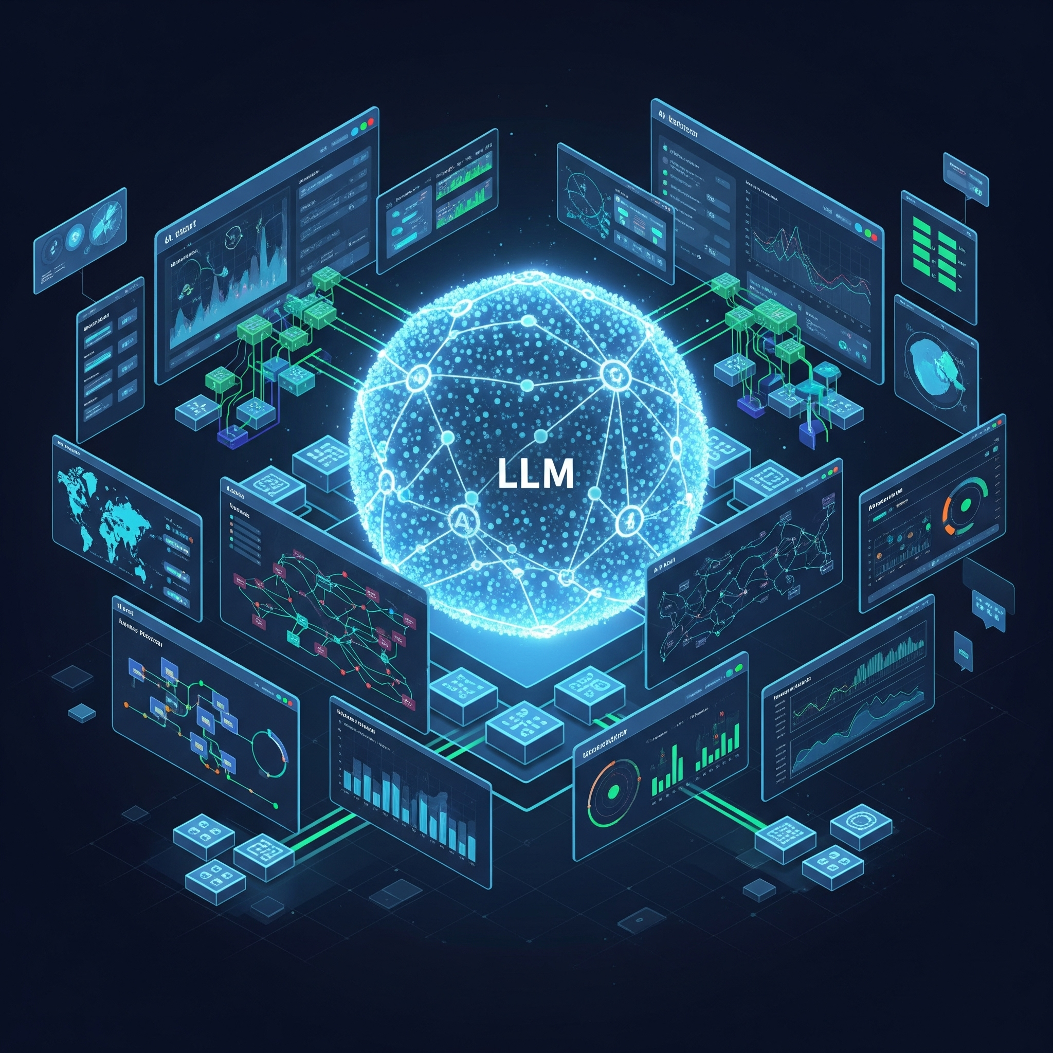
LLM for Network: The True Intent-Driven Management
Network Scale & Complexity
  Exponentially growing network infrastructure
  Increasing device types and configurations
  Complex interdependencies
Limitations of Traditional Software
  Rule-based systems don't scale well
  Hard to maintain with evolving network needs
  Cannot handle unstructured data effectively
  Limited ability to learn from experience
Need for Intelligent Automation
  Handle complex pattern recognition
  Process natural language inputs
  Learn and improve from operational data
Notes:
Modern networks are growing exponentially in both scale and complexity.
We’re seeing more device types, more configurations, and increasingly complex interdependencies.
Traditional, rule-based network management software can’t keep up: it’s hard to maintain, doesn’t scale, and can’t process unstructured data or learn from experience.
This motivates the need for intelligent automation—systems that can recognize complex patterns, process natural language, and learn from operational data.
Large Language Models (LLMs) are uniquely positioned to address these challenges.

Slide 3
Motivating Example: Capacity What-if Analysis
Capacity Planning
Task: Where to add new network capacity?
Gather Current Topology
Production steady-state topology
Production real-time topology
Including capacity added in the next 30 days?
Forecast Demand
50th percentile forecast
90th percentile forecast
Daily basis
Hourly basis
Challenges: Involves complex, multi-step tasks
Generate Future Topology
Existing fiber
only
Turn on more channels
Include upcoming fiber deployments
Run failure simulations
Single-fiber cut
Multi-fiber cut
Shortest-path
Max-flow
Analyze Results
Node availability
Demand
Link capacity
Latency
Notes:
- Let’s look at a real-world example: “Where should we add new network capacity?”
- Capacity planning is a multi-step process:
1. Gather current topology (steady-state, real-time, and planned changes).
2. Forecast demand (using different percentiles and time granularities).
3. Generate future topology, considering new fiber deployments.
4. Run failure simulations (single/multi-fiber cuts, max-flow, shortest-path).
5. Analyze results.
- Each step is complex and interdependent, requiring orchestration of multiple tools and data sources.
The diagram outlines a process that begins with three parallel inputs at the top:
"Production steady-state topology"
"Production real-time topology"
"Including capacity added in the next 30 days?"
These are the three scenarios of the "Gather Current Topology" step.
Parallel to this, on the right side of the diagram, there are various choices related to how to generate demand, including:
"50th percentile forecast"
"90th percentile forecast"
"Daily basis"
"Hourly basis"
Another set of inputs related to fiber supply, including:
"Existing fiber only"
"Turn on more channels"
"Include upcoming fiber deployments"
These feed into the "Generate Future Topology" step.
After these initial gathering and generation steps, the process moves through:
"Run failure simulations", which takes input from "Single-fiber cut", "Multi-fiber cut", "Max-flow", "Shortest-path", and "Node availability".
"Analyze Results".
This example highlights the main challenge: "Involves complex, multi-step tasks."

Slide 4
Motivating Example: Performance Diagnosis
Task: Diagnose a service performance issue
Failure incident detected
Failed requests for IG-Training service between 7-8pm on 12/31/2024
Isolate the domain of the issue
Group hosts by region
Group hosts by prefix
Group hosts by pod/cluster
NO
Not a network problem
Check network metrics
Is there anomalous spike
in TCP retransmissions?
YES
Active probing
Is there high latency
in the same time window
and regions?
Is there high packet loss
in the same time window
and regions?
NO
Application-
layer error
Challenges: Large search space, manually create complex workflows
YES
Topology analysis
Identify LSP paths that carry the traffic
Network change logs
Examine network change logs
associated with routers along the
paths
Examine controller alerts
Possible root cause identified
Notes:
- Another example: diagnosing a service performance issue, such as failed IG-Training requests.
- The process involves:
- Grouping affected hosts (by region, prefix, pod/cluster).
- Examining network change logs and controller alerts.
- Checking for anomalies in TCP retransmissions, packet loss, and latency.
- Isolating the domain of the issue and identifying root causes.
- The challenge: the search space is huge, and workflows are complex and often manually constructed.
The diagram outlines a decision-tree like process:
Initial Detection: A failure incident is detected.
Initial Isolation (Parallel Paths):
"Group hosts by region"
"Group hosts by prefix"
"Group hosts by pod/cluster"
Examine Logs/Alerts (Parallel Paths):
"Examine network change logs associated with routers along the paths"
"Examine controller alerts"
These steps lead to a "Possible root cause identified."
Network Problem Check (Decision Point 1):
"Is there anomalous spike in TCP retransmissions?"
If "NO," it's "Not a network problem."
If "YES," proceed to "Isolate the domain of the issue."
Domain Isolation and Metric Checks (Parallel Paths from "Isolate the domain of the issue"):
"Check network metrics"
"Active probing"
"Topology analysis"
"Network change logs"
These checks lead to further decision points:
"Is there high packet loss in the same time window and regions?"
If "NO," it's an "Application-layer error."
If "YES," proceed to "Identify LSP paths that carry the traffic."
"Is there high latency in the same time window and regions?"
If "NO," it's an "Application-layer error."
If "YES," proceed to "Identify LSP paths that carry the traffic."

Slide 5
Challenges and Key Insights
Multi-Step Complex Tasks
Leverage Structured Workflows for Planning
Lots of Network Management Tools
Connect Tools with Domain Specific Language
Large Search Space
Domain-specific RAG for Memory Management
High Safety Requirements
Built-in Validation and Human Input
Notes:
Network management involves complex, multi-step tasks.
MOPs and runbooks are predefined workflows for network tasks, available in structured format [51]. To have LLMs learn from these workflow
Numerous specialized tools exist for network management.
Network engineers use advanced tools that require structured data; their expertise is in choosing the right tool and formatting commands.
The Confucius agent is designed to work with multiple domain-specific tools, converting natural language into outputs that comply with each tool’s requirements.
Modern networks present a large search space for tasks.
In a multi-agent LLM setup, each agent handles a specific subtask. Confucius coordinates these agents by providing memory functions:
Short-term memory: Users can control how much session memory is retained.
Long-term memory: Uses Retrieval-Augmented Generation (RAG) to manage large amounts of context.
High safety requirements demand extreme reliability in network operations.
Confucius ensures task correctness by integrating with validation frameworks, such as dry-run and configuration validation systems.
All outputs are validated before being shown to users, and human approval is required for sensitive tasks.
The Collector primitive is used to gather structured user input, supporting human oversight and interaction.

Slide 6
Confucius Framework
Programming Framework
  Simply application development
  Primitives and Abstraction
  Chat Interface
Design Principles
  Separate Reasoning from Factual Knowledge
  Leverage Existing Network Management Systems
  Carefully Engineered Prompts
  Iterative Improvement
Notes:
- Confucius is a multi-agent LLM framework designed for network management.
- It provides:
- **Primitives and Abstractions:** Modular building blocks for common network tasks.
- **Chat Interface:** Natural language interaction for users.
Separate Reasoning from Factual Knowledge: We leverage LLMs
for reasoning tasks, which they are well-suited for, while we rely
on existing runbooks, tools, and databases for retrieving factual
information.
•Leverage Existing Expertise: We utilize established tools and
expert knowledge in network management, similar to existing
approaches for incorporating domain knowledge [3].
•Orchestrate with Carefully Engineered Prompts: Inspired by
“cognitive architectures” [1], we decompose management tasks
into individual components and use carefully engineered prompts
to guide LLM reasoning. This allows us to maintain control over
the reasoning process.
•Prioritize Iterative Improvement: We prioritize basic implementa-
tion to develop a functional system quickly and refine iteratively
over time.
•Not Depend on Fine-tuning: We design our approach to work
effectively with foundation models that do not require fine-tuning
as a prerequisite. This allows us to leverage the latest advances
in LLMs while minimizing the dependency on costly and time-
consuming fine-tuning.

Slide 7
Multi-Agent Architecture
Human
Interface
Confucius Agent
Planning
(Workflows)
Tooling
(DSLs)
Memory
(RAG)
Runbooks
MOPs
Time series
Graphs
Data models
Network logs
Topology database
Notes:
- The architecture consists of:
- **Human Interface:** Users interact via chat or UI.
- **Confucius Agent:** Orchestrates planning, memory, and tool usage.
- **Planning:** Uses workflows and runbooks to decompose tasks.
- **Tooling:** Connects to network tools via DSLs (topology graphs, time series, data models).
- **Memory:** Manages both short-term and long-term context using RAG.
- Each agent specializes in a subtask, and Confucius coordinates their actions for end-to-end automation.
In network management, complex
tasks must be decomposed into multiple interconnected subtasks,
each requiring different specialized tools and domain knowledge. A
naive solution uses a single LLM to handle an entire task from start
to finish, but this falls short with sufficiently complex tasks, leading
to excessive prompts and unreliable performance. By adopting a
multi-agent framework, Confucius decomposes complex workflows
into distinct subtasks that can be tackled by multiple specialized
agents. Figure 3 shows the LLM agent interacting with four parts:
planning, memory, tools, and human.
Leverage Existing MOPs and Workflows for Planning: MOPs
and runbooks are predefined workflows for network tasks, available
in structured format [51]. To have LLMs learn from these workflows,
we must overcome three challenges: 1) bridge the gap between
structural language (e.g., Python or DSL) and natural language; 2)
incorporate deep domain knowledge, such as BGP routing priorities;
3) manage numerous workflows.
Structured Data to Connect with Tools: Network engineers
rely on sophisticated tools that operate with structured data. Ex-
pertise lies in selecting the right tool and formatting commands
to achieve desired actions. We design Confucius agent to interact
with multiple domain-specific tools using a set of primitives that
convert natural language inputs into DSL-compliant outputs.
Domain-Specific Retrievals for Long-Term and Short-Term
Memory: In a multi-agent LLM framework, each agent focuses
on a specific subtask. To coordinate agents, Confucius provides
memory functionality that tracks interactions with humans and
tools. It offers short-term memory management, where users can
control the level of memory for each session. For long-term memory,
Confucius leverages RAG to handle large volumes of context.

Slide 8



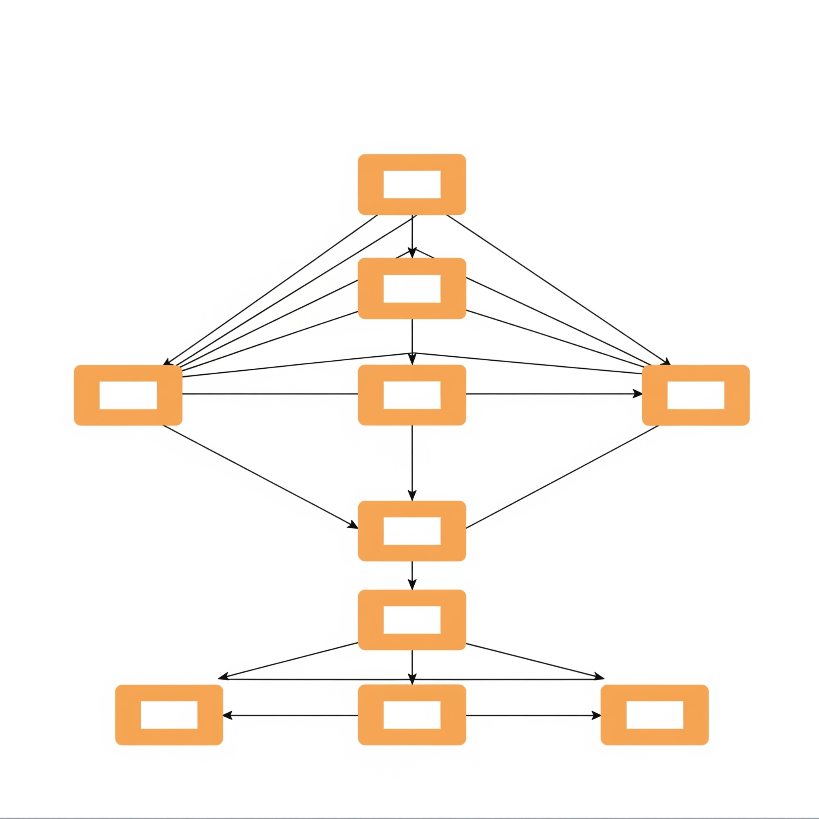
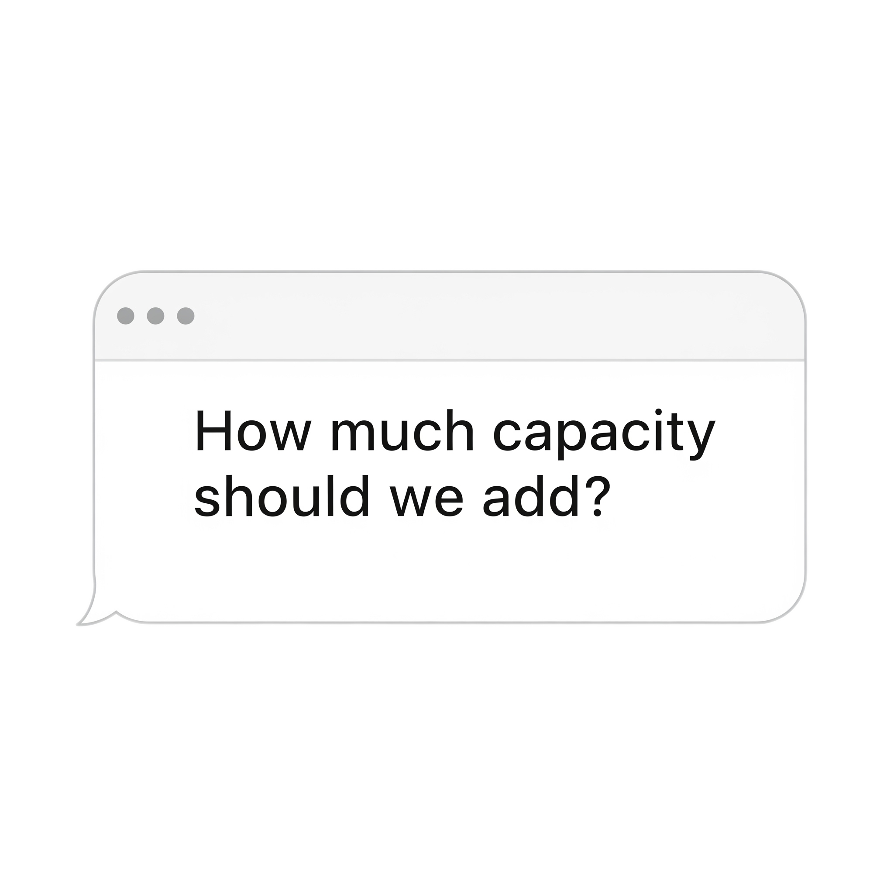
Planning: Workflows
ifconfig eth1 …
Workflow
Building blocks
./run_config.sh …
Step 1
ConfigDevice
Step 2.1
CommandDevice
Step 2.2
…
…
…
Meta’s Workflow systems (Occam EuroSys’24)
    Method of procedure (MOP)
Notes:
Historically, companies like Meta have relied on MOPs (step-by-step procedures in natural languages for network management tasks
However, their ambiguity and loose documentation made execution challenging. To address this,
Meta developed a workflow system that codifies and breaks
down MOPs into smaller, modular building blocks (BBs), facilitating
better modularity and code reuse.
BBs are flexible scripts or configlets written in various programming languages or as binaries.
We design a prompt
engineering method to teach LLMs workflows.
DAG Representation: We represent the planning logic of net-
work tasks as a directed acyclic graph (DAG), implemented using
a Python-based DSL. Each node in the DAG represents a subtask,
which is the same as a building block. The output of each node
is parsed by the LLM and used as input for subsequent nodes. In-
dependent subtasks can be executed in parallel
- Confucius leverages Meta’s workflow systems (like Occam) to codify MOPs into reusable building blocks.
- Tasks are represented as Directed Acyclic Graphs (DAGs), where each node is a subtask.
- The system can suggest existing workflows and building blocks using RAG-based retrieval.
- This modular approach enables parallel execution and easy reuse.

Slide 9
Planning: Workflows
Human request:
“Consider the fiber supply in H2,
scale the demand by 1.5 and 0.8,
find out the optimal way to add capacity, generate an A/B testing report.”
Base Topology
Desired Topology Modifications
Patched Topology
Topology Modifier
Patched Topology
Scale demand by 1.5x
Scale demand by 0.8x
Scaled Topology
Scaled Topology
Topology Optimizer
Topology Optimizer
Failure Analysis
Cost Analysis
Report Visualization
Notes:
illustrates an example
DAG for capacity what-if analysis. A user-defined scenario, which
involves modifying network topology, scaling demand, and eval-
uating outcomes under multiple conditions, is broken down into
discrete, composable subtasks. Each operation is encapsulated as a
node in a DAG to enable modular execution and clear data flow.
In our production environment,
we face challenges with workflow and BB discovery. With hundreds
of workflows and thousands of BBs, it is difficult for engineers to
identify the right ones for specific tasks. To address this, we have
developed a RAG-based approach to efficiently search and recom-
mend workflows and BBs.

Slide 10
Connect Tools with Three Key Domain-Specific Languages
tm.add(
what="l3_nodes",
add="""
name="<name>",
l1_node_name="<l1_node_name>",
is_hose_entity=True,
lat=<lat>,
lon=<lon>,
node_role=NodeRole.DC,
...
"""
)
Network Topology Graph (NAPT, SIGCOMM’21):
Example: “I want to add a new hose L3 node.”
Time Series Network Data (ODS, VLDB’15):
Example: “Calculate the avg CPU utilization for SW1 over the last 10 minutes, then take the P95.”
"key": {
"values": ["FBNet:device.cpu_util"]
},
"query": {
"time_range": "start = -600, end = 0",
"reduction": ["percentile(95)"],
"transformation": ["avg(10m)", "formula(+ $1 5)"],
...
},
"entity": {
"values": ["fbnet_device(DEVICE_NAME=sw01)"]
}
Network Data Model (Robotron, SIGCOMM’15):
Example: “Create a BGP session with AT&T using peer 10.0.0.1, reachable via interface eth0/1 on Switch1.”
NetworkDeviceV4Prefix
NetworkSwitch
id = •
prefix = 10.0.0.1/24
ipv4 = •
ipv6 = •
mgmt_ipv4 = •
mgmt_ipv6 = •
desired_interfaces = •
BgpPeer
NetworkDeviceV6Prefix
id = •
name = •
as_no = •
…
BgpV4Session
Interface
bgp_peer = •
desired_interface = •
name = eth0/1
interfaceaddressv4prefixes = •
interfaceaddressv6prefixes = •
Notes:
- Confucius supports three foundational DSLs:
1. **Network Topology Graph (TML):** For topology modifications and planning.
2. **Time Series Network Data (ODS):** For monitoring and analysis.
3. **Network Data Model (Robotron):** For configuration and device management.
- Primitives like Translator, Selector, and Collector convert natural language into structured queries for these DSLs.
- This enables seamless integration with existing network management tools.
To integrate with existing network management tools, we have to
translate natural language into structural data (DSLs) that these
tools can process
we
have identified three widely used DSL classes in network manage-
ment. Supporting these three DSLs enables easier onboarding of a
large number of tools.
Network Graph. The network topology graph is a fundamental
element in various applications, such as capacity planning, risk
analysis, routing, and traffic engineering. We represent the topology
using a Thrift-defined graph, which includes regions, layer-1 nodes,
layer-3 nodes, layer-1 optical edges, layer-3 IP edges, and flows.
One insight is that the naming conventions of nodes are crucial
for understanding the topology.
Time Series Network Data. Time series network data is a fun-
damental construct in network management, with applications
ranging from traffic analysis and network health monitoring to
anomaly detection. At Meta, time series data is stored in a key-
value store known as ODS (Operations Data Store) [41]. The basic
unit of data is an entity, which can represent any object under mea-
surement, such as interface loss or CPU utilization. The data for
each entity consists of a series of <time, value> snapshots, as shown
in Figure 7(b). For LLMs to become familiar with time series data,
we embed the prompts with specific domain knowledge. In other
words, we explicitly instruct the LLMs how to handle this type of
data; this includes methods for aggregating time series data, such
as calculating the average or 90th percentile, as well as conventions
for generating mathematical formulas to manipulate this data.
Network Data Model. It is common practice to store network
management data in a structured model
At Meta, the Robotron data
model [46] is a fundamental component of nearly all management
tools. Figure 7(c) illustrates an example of how to translate the in-
tent of creating a BGP session to a set of network objects modeled.
We find that Robotron is a powerful DSL that connects LLMs with
a variety of existing network management tools. It captures high-
level network design intent as relational data objects, which are
then translated into low-level, vendor-specific device configurations
and network operations.

Slide 11








Tools: Primitives
Primitives that define DSL translation logic and collect additional information needed.
Plain
Text
Translator
Structured Data
Query
Collector
Structured Data
Query
List of Options
Selector
Matched
Option
Notes:
- Primitives define how to translate and collect information for each DSL.
- **Collector:** Gathers and clarifies user intent.
- **Translator:** Converts intent into structured queries or commands.
- **Selector:** Chooses relevant options from large datasets.
- These primitives can be chained together (as “Analects”) to handle complex queries, ensuring accuracy and reducing ambiguity.
To facilitate translation, Con-
fucius introduces three primitives that systematically define the
translation logic and collect additional information needed to com-
plete the translation.
Translator converts natural language into structured output
(e.g., command lines or configurations), allowing users to focus on
writing examples without worrying about formatting and parsing.
Collector gathers and processes data from various sources, in-
cluding the user, to clarify intent and identify relevant entities. This
primitive is designed based on the observation that natural lan-
guage often contains ambiguity. It can also ask follow-up questions
to refine the user’s instructions.
Selector uses customizable logic (e.g., language models or simi-
larity search methods) to select a subset of relevant options based
on the user’s query.

Slide 12
Tools: Chaining Primitives Together
Entity Intent
Translator
Entity
Key Intent
Translator
Key
User I/O
Collector
Translator
Transform Intent
Translator
Transform
ODS Query
Reduction Intent
Translator
Reduction
Human: What is the average CPU utilization of ToR switches in data center X?
Collector: Do you want any transformations? …
Time Range Intent
Translator
Time Range
ODS Query:
"key": {
"values": ["FBNet:device.cpu_util"]
},
"query": {
"time_range": "start = -3600, end = 0",
"reduction": ["percentile(95)"],
"transformation": ["avg(10m)""],
...
},
"entity": {
"values": ["fbnet_device(DEVICE_NAME=rsw01)"]
}
Translator:
Entity: RSW1
Key: FBNet:device.cpu_util
Transform: avg(10min)
Reduction: percentile(95)
Time Range: last hour
Notes:
the ODS prompting example uses the
Translator to convert user queries into sub-questions, including
narrowing down relevant keys with the Selector, identifying spe-
cific entities in the query, providing built-in prompts for common
reduction operators (e.g. groupby, top, avg), converting time range
descriptions into start and end values, and applying complex func-
tions like smoothing or computing differences between samples

Slide 13
Memory Management
Short-Term Memory (same-session)
Long-Term Memory (RAG)
RAG Techniques:
  Naive RAG
  Hybrid RAG
  Query Transformations
Indexer
Summary Chunk 1
Embedding 1
Building Blocks
Source Code
Code Summarizer
Summary Chunk 2
Embedding 2
Wiki
Summary Chunk N
Embedding N
Vector Database
Retriever
Similarity Search
User Question
Building Block 1
Building Block 1
Building Block 2
LLM Selector
Building Block 2
Building Block 3
…
Building Block 10
Notes:
- **Short-Term Memory:** Maintains session context for coherent multi-turn interactions.
- **Long-Term Memory (RAG):** Uses retrieval-augmented generation to access large knowledge bases (workflows, models, documentation).
- **RAG Techniques:** Includes naive RAG, hybrid RAG (coarse-to-fine filtering), and query transformations for better retrieval accuracy.
- This memory system enables Confucius to provide context-aware, accurate responses.
Short-term memory stores the context
for one user across different Analects. For instance, if a user asked
for the total egress of region A and then asked about region B,
the context from the first question should be efficiently reused
for the second query.
To support context sharing across Analects,
we develop a dedicated memory manager component that uses
a tree of messages as the abstraction for memory.
Each Analect
has its own memory manager, which maintains a private list of
messages and pointers to parent memories, session memories, and
other relevant contexts.
This hierarchical structure allows Analects
to access and manage messages from their parents, grandparents,
entries, and sessions, providing a comprehensive understanding
of the conversation history.
We find that many network management use cases
require external indexing to improve the efficiency of LLM queries.
For instance, with hundreds of thousands of network data models,
many sharing similarities, it is challenging to differentiate between
them without domain-specific knowledge. To address this com-
plexity, we developed a novel RAG approach specifically designed
for network data models. Our method involves pre-computing an
embedding store by grouping similar models together and feeding
each model to the LLM one at a time.
Naive RAG: It builds a vector store for various data sources and
performs similarity searches. Suitable for small datasets.
•Hybrid RAG: We use a two-stage filtering approach to retrieve
relevant information: first fetch similarity search results and
rank them by relevance, then we apply additional filters such as
staleness, rating, and usage frequency.
Query Transformations: We use LLMs to refine user queries, gen-
erating more accurate and relevant search results. This involves
two steps: refining questions based on user input and employing
collector mode to gather additional context through conversa-
tions with users.
The system
architecture consists of two main components: the Indexer and the
Retriever. The Indexer utilizes LLMs to analyze each workflow and
BB, extracting key information to compute semantic embeddings,
which are then stored in a database. The Retriever operates in two
stages: a coarse-grained similarity search to select around 10 candi-
date workflows/BBs, followed by a fine-grained selection to refine
the options to fewer than three.

Slide 14
Programming Framework Implementation
User Questions
Dispatching Analect
Entry
Confucius
Applications
FBNet ODS Helper
CLI Generator
Drainer CLI Helper
Capacity Delivery
TML Generator
…
Validation
Simulators
Network Tool DSLs
Time Series Data
Topology Graph
Network Data Model
…
Verification
Primitives
Translator
Selector
Evaluator
Ensemble
…
Dry Runs
State Validators
Basic Operators
Parser
Tracer
IO
Retriever
…
…
Programming Abstract Class
Analect
External Systems
LLM Models
FAISS
Laser KNN
Embedding
(InstructOR)
LangChain
NLTK
Notes:
- Confucius is implemented in Python, leveraging frameworks like LangChain and FAISS for LLM orchestration and retrieval.
- The core abstraction is the “Analect,” At its core, Confucius is built on Pydantic, a Python schema language for defining custom data structures. The core abstraction class is the Analect, which holds reusable logic and data for inputs, outputs, and runtime. Several basic operators are shared among all Analects. These operators implement basic functionalities, including a JSON Parser, a Tracer that automatically collects and logs
the execution trace in an internal database, and an I/O function that enables human-in-the-loop interaction.
Confucius Primitives: These are specialized Analects that implement one particular action. They can be applied across various use cases.
Analogous to SDN Apps, different teams have developed various LLM-based network management applications to address specific domains.
Confucius leverages several external systems to enhance its capabilities, including LangChain [13], MetaGen
API [23] for AI model access, FAISS [21] for efficient similarity
search, Instructor [45] for embedding, and NLTK [10] for natural
language processing.
- The system supports integration with external systems, validation tools, and benchmarking frameworks for continuous improvement.

Slide 15
Case Study: Performance Diagnosis
Scribe read has long tail latency. Is this network issue?
Invoke Tool Use: Scuba Engine
Human
SELECT
(SUBSTR(Sdc, 1, 3)) AS `src_dc`,
(SUBSTR(Ddc, 1, 3)) AS `dst_dc`,
AVG(`rtt_p99`, `weight`) / 1000 AS `rtt_p99_avg_ms` FROM `network_latency`
WHERE
`time` BETWEEN (NOW() - 86400) AND NOW()
AND ((`Ssiterole`) IN ('DC'))
AND ((`Dsiterole`) IN ('DC'))
GROUP BY `src_dc`,`dst_dc`
Thinking…
I will write a SQL query for the rtt_p99 column and calculate average RTT between DC pairs.
Confucius
Confucius
Confucius
src_dc dst_dc rtt_p99_avg_ms
0 DC2 DC2 0.542145
1 DC2 DC3 24.811065
... ... ... ...
1153 DC4 DC4 0.146312
[1154 rows x 3 columns]
Tool:
Scuba Engine
Notes:
- Example: Diagnosing long-tail latency in Scribe read operations.
- Confucius automates:
- Data retrieval (e.g., querying Scuba logs).
- Data analysis (e.g., generating heatmaps with Python).
- Pattern recognition (e.g., identifying high-latency datacenter pairs).
- The system guides users through each step, reducing manual effort and improving diagnostic accuracy.

Slide 16
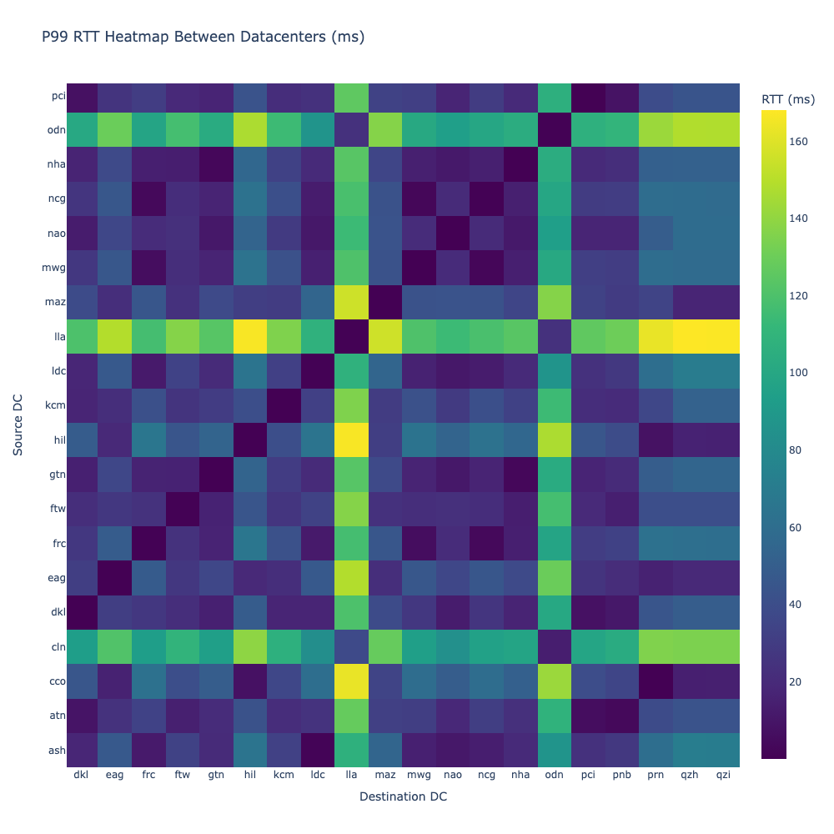
Thinking…
Let's create a visualization to better understand the RTT patterns between datacenters using a heatmap. I need to write a Python script.
P99 RTT Heatmap Between Datacenters (ms)
We observe these highest latency pairs: (1) DC1 ↔ DC5: ~168ms, (2) DC1 ↔ DC6: ~167ms, (3) DC1 ↔ DC7: ~167ms
DC1 appears in most of the highest latency connections. Most high-latency pairs show RTTs ~165ms.
Confucius
Confucius
Source DC
Tool: Python Compiler
Invoke Tool Use: Python Compiler
Confucius
# Pivot the dataframe to create a matrix suitable for heatmap
matrix_df = df.pivot(index='src_dc', columns='dst_dc', values='rtt_p99_avg_ms')
# Create heatmap
fig = go.Figure(data=go.Heatmap(
z=matrix_df.values,
x=matrix_df.columns,
y=matrix_df.index,
colorscale='Viridis',
colorbar=dict(title='RTT (ms)'),
))
fig.update_layout(
title='P99 RTT Heatmap Between Datacenters (ms)',
xaxis_title='Destination DC',
yaxis_title='Source DC',
width=1000,
height=1000,
)
fig.show()
Destination DC
Thinking…
Let's analyze the key patterns from the heatmap and find the datacenter pairs with highest and lowest RTTs for Scribe reads.
Human
Yes
Confucius
Confucius
Invoke Tool Use: Python Compiler
top_5_highest = df.nlargest(5, 'rtt_p99_avg_ms')[[src_dc, dst_dc, 'rtt_p99_avg_ms']]
print(top_5_highest.to_string(index=False))
src_dc dst_dc rtt_p99_avg_ms
DC1 DC5 168.057024
DC1 DC6 167.457915
DC1 DC7 166.755838
DC7 DC1 166.654504
DC1 DC8 162.874577
Tool: Python Compiler
Human

Slide 17
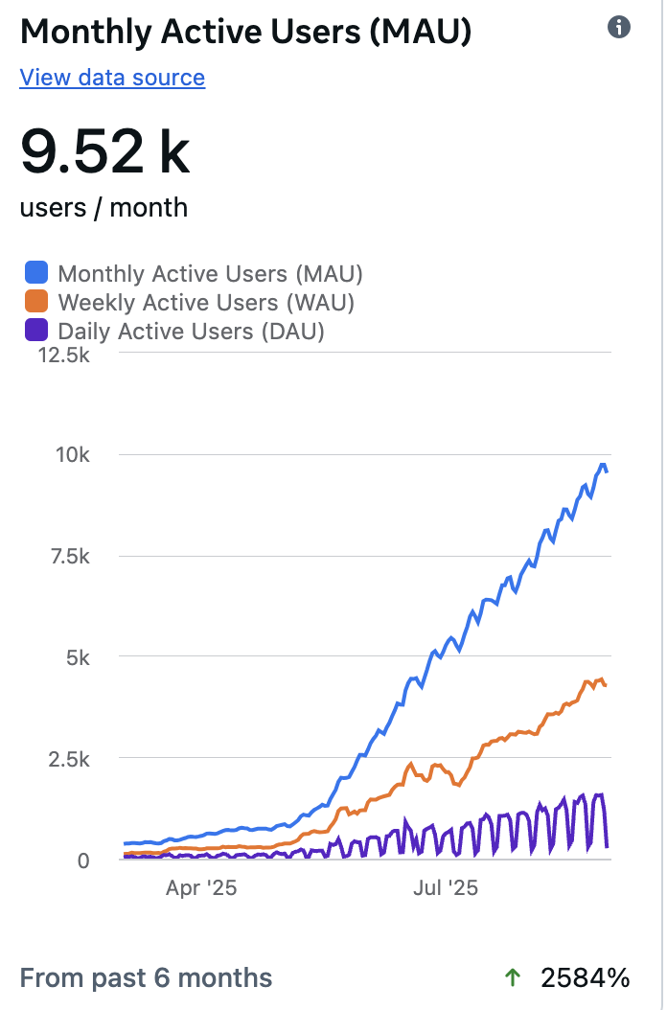
Usage Statistics
Adoption Till Submission
  Monthly Active Users: 1.63K
  Total Sessions: 241.38K
  Total Messages: 31.62M
  Use Cases Onboarded: 64
Since Submission
Notes:
- Confucius has been widely adopted at Meta:
Confucius has seen substantial growth and adoption over the past
year
The ease of development
design has enabled such rapid growth in both onboarded use cases
as well as the developer community.
- 4,160+ users, 241K+ sessions, 31M+ messages, 64 use cases onboarded.

Slide 18
Lessons Learned
What Worked Well
RAG Prompt Engineering: leveraging existing content to suggest and generate new items with user modifications
Integrate into Existing Management Pipelines: key to fast adoption
Limitations
Network troubleshooting has the most variants
Difficult to bring value to a domain expert
Hallucinations and fabricating response contradict with fail early principle
Notes:
- RAG prompt engineering and integration with existing pipelines drive adoption.
- Iterative, UI-driven workflows help users manage complex tasks.
- Limitations include challenges in troubleshooting, context propagation, and hallucination management.
We have
observed that many network applications share a common pattern:
leveraging existing content to suggest similar items and generate
new ones with user modifications. Some examples include writing
a new model based on existing models in the database, generating
device configurations by adapting existing vendor/device configura-
tions, and creating customized workflows by combining steps from
multiple existing workflows. Confucius’s embedding and retrieval
method enables straightforward integration with RAG prompt en-
gineering, often yielding satisfactory results.
Integration with Existing Management Tools for Quick Adoption.
An initial challenge was attracting consistent users to the app. Users
would try it out as a novelty but struggle to incorporate it into their
routine. We found that integration with existing automation sys-
tems and tools is key to broader adoption.
Importance of Iterative Processes in Networking Problems. We have
found that many network management tasks are complex, often
modeled as a workflow that invokes multiple tools. However, writ-
ing a workflow accurately requires deep domain knowledge of all
the tools involved. To address this challenge, Confucius’ design
includes an artifact that demonstrates intermediate steps in the UI,
allowing developers to work on the workflow step-by-step.
Limitations of LLMs in Network Troubleshooting. Among all ap-
plications, we observed that network troubleshooting problems
have the largest variants, and it is challenging to achieve perfor-
mance equivalent to that of a domain expert. In fact, experts are
also masters of basic models and commands, making it difficult
for LLMs to bring significant value as a copilot.
This is similar to
how ChatGPT can help a student with writing improvement but
may not be equally helpful to a professional writer.
Failure Scenarios. We explicitly highlight the issues that we have
observed with Confucius and LLMs in general. 1) Context prop-
agation can be lost in later parts of a session.
For instance, in a
troubleshooting scenario, a user might start by asking about packet
loss during a specific time period of the day. While Confucius fol-
lows a troubleshooting plan, the specific time constraint may not
consistently apply to all subsequent actions
Hallucination remains a sig-
nificant issue in networking applications. When LLMs cannot find
answers from the designated data sources, they tend to fabricate re-
sponses. This behavior contradicts the principle of failing early and
deterministically, which is fundamental in most computer systems.

Slide 19
Notes:
- Confucius demonstrates that multi-agent LLM frameworks can revolutionize network management.
- By decoupling reasoning from domain knowledge and leveraging modular primitives, Confucius enables intent-driven, reliable, and scalable automation.
- We hope this work inspires further research and innovation in intent-based network management.

Slide 20
Network Management in Production
Network Design
Network Operations
Monitoring and Diagnosis
Knowledge Sharing
Topology Design
Configuration Generation
Capacity What-if Analysis
Create Operations Workflows
Generate Migration Commands
Monitor Operations Status
Monitoring Network Health
Anomaly Detection
Maintaining Documentation
Onboarding New Engineers

Slide 21




Case Study: Capacity What-if Analysis
I want to do a set of capacity planning experiments with several supply and demand scenarios, then run optimizer NAPT
Confucius
I need additional information to run the first node “tml_topology_patch_supply”:
Input topology name
Input topology time frame
For the inputTopology, you can specify a single value, a range or list of values, a dependent output, or leave empty and fill out later.
Steps:
User describes an intent
Confucius uses Selector to suggest and pick tools
Confucius automates DAG creation
Confucius solicits missing information per-node
Confucius uses Translator to generate TML code snippet
Human
Please select which tools you want to use.
Confucius
Search…
tml_topology_patcher
Topology name is “netgram_cpor_
napt_2024_12_31” and time phase is 2024H2
napt_optimizer
Human
…
dc_risk_analysis_report_generator
I need additional information to run the second node “tml_topology_patch_demand”:
Input topology name
Input topology time frame
For the inputTopology, you can specify a single value, a range or list of values, a dependent output, or leave empty and fill out later.
Confirm
Confucius
Human
Yes
From your input, I've identified the following tasks and matched them to a suitable workload:
Patch several
supply scenarios
Using the output,
patch several
demand scenarios
Run napt
Please edit and
confirm the
following DAG.
The input to the second node depends on the output of the first node.
Human
…
Confucius
tml_topology_patch_supply
What would you like to do next?
Ok, here is a link to the code.
tml_topology_patch_demand
Confucius
Generate Code Snippet
Launch Experiment Directly From Confucius
napt_planning
Confirm
Human
Looks good

Slide 22
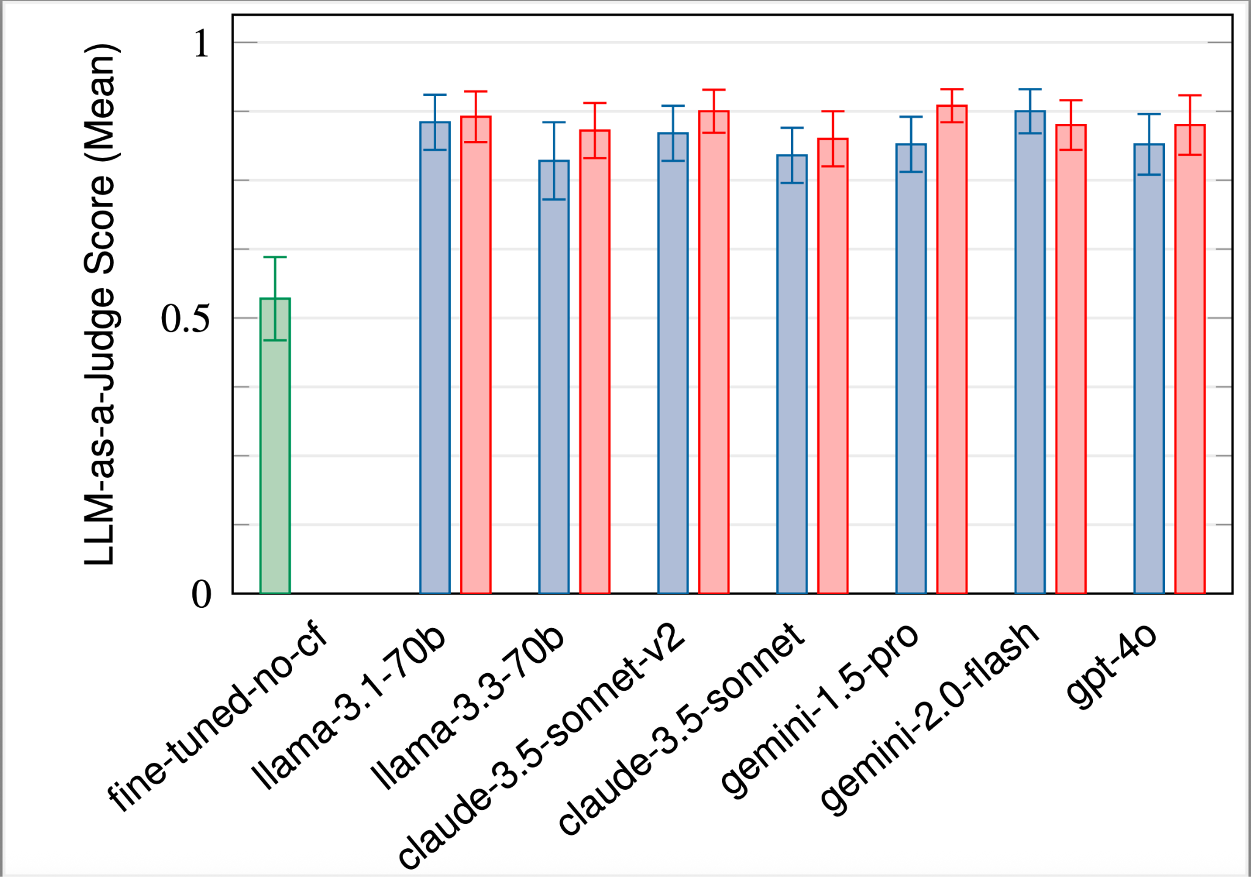
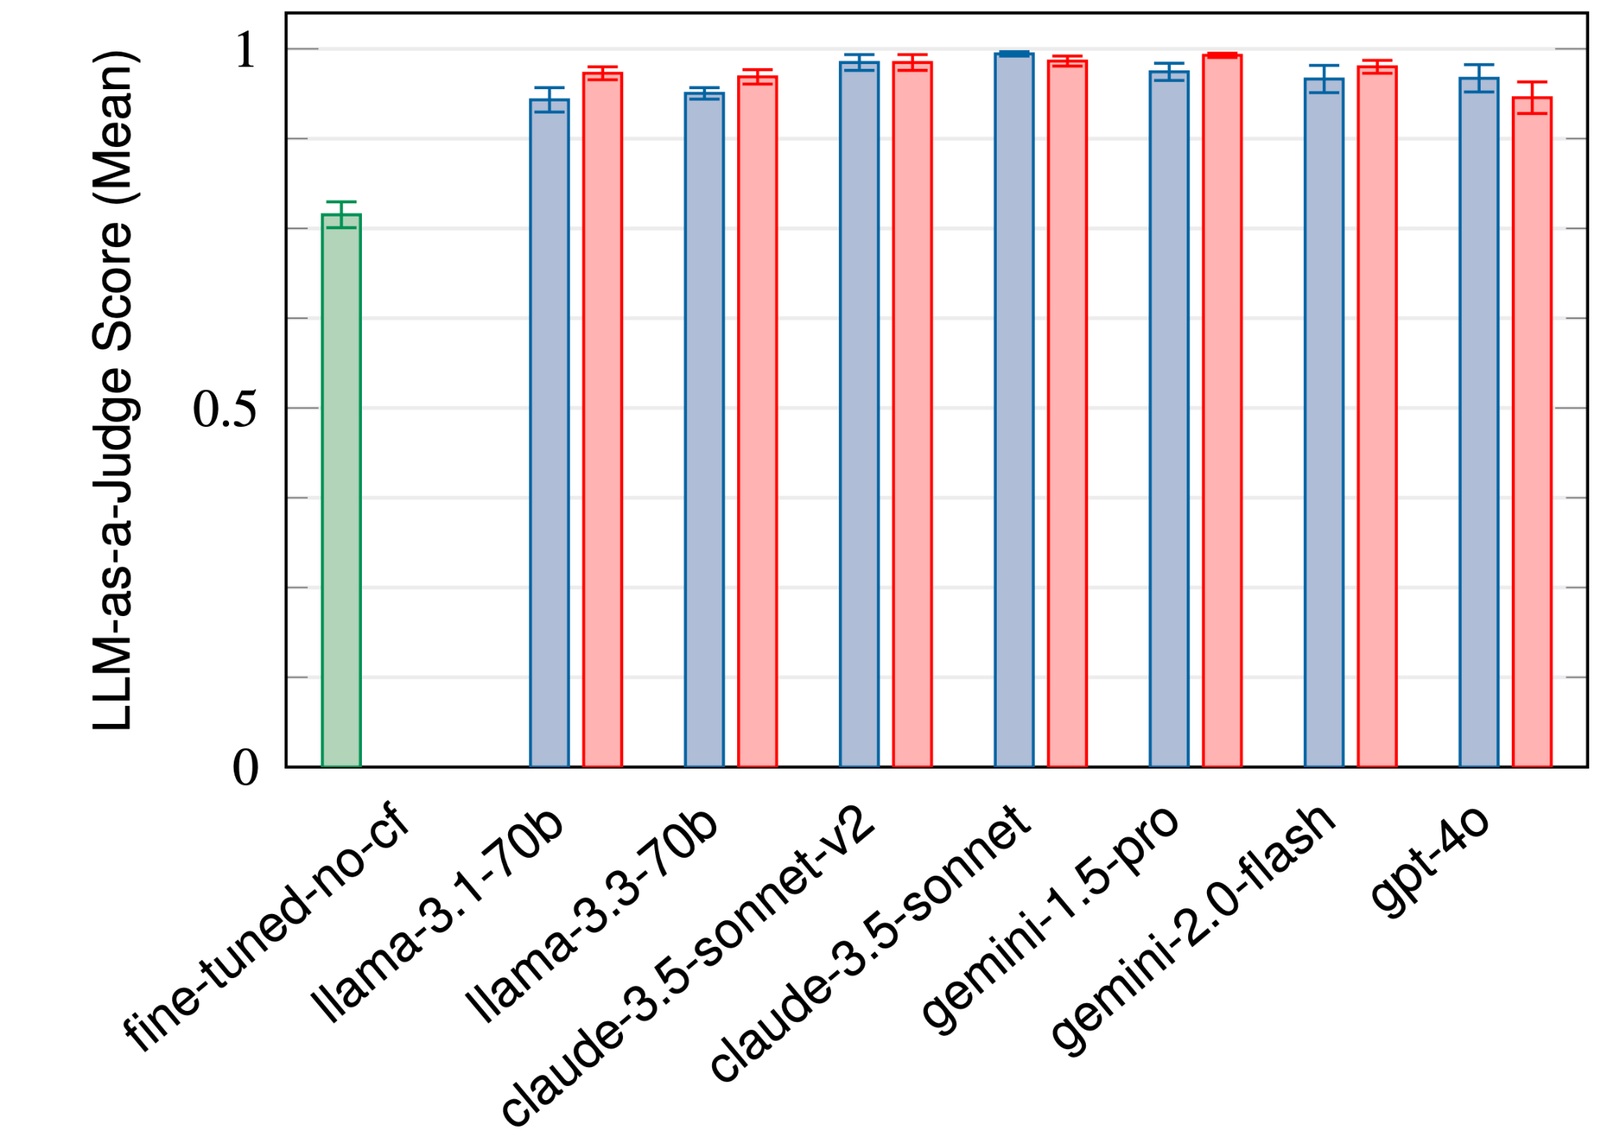
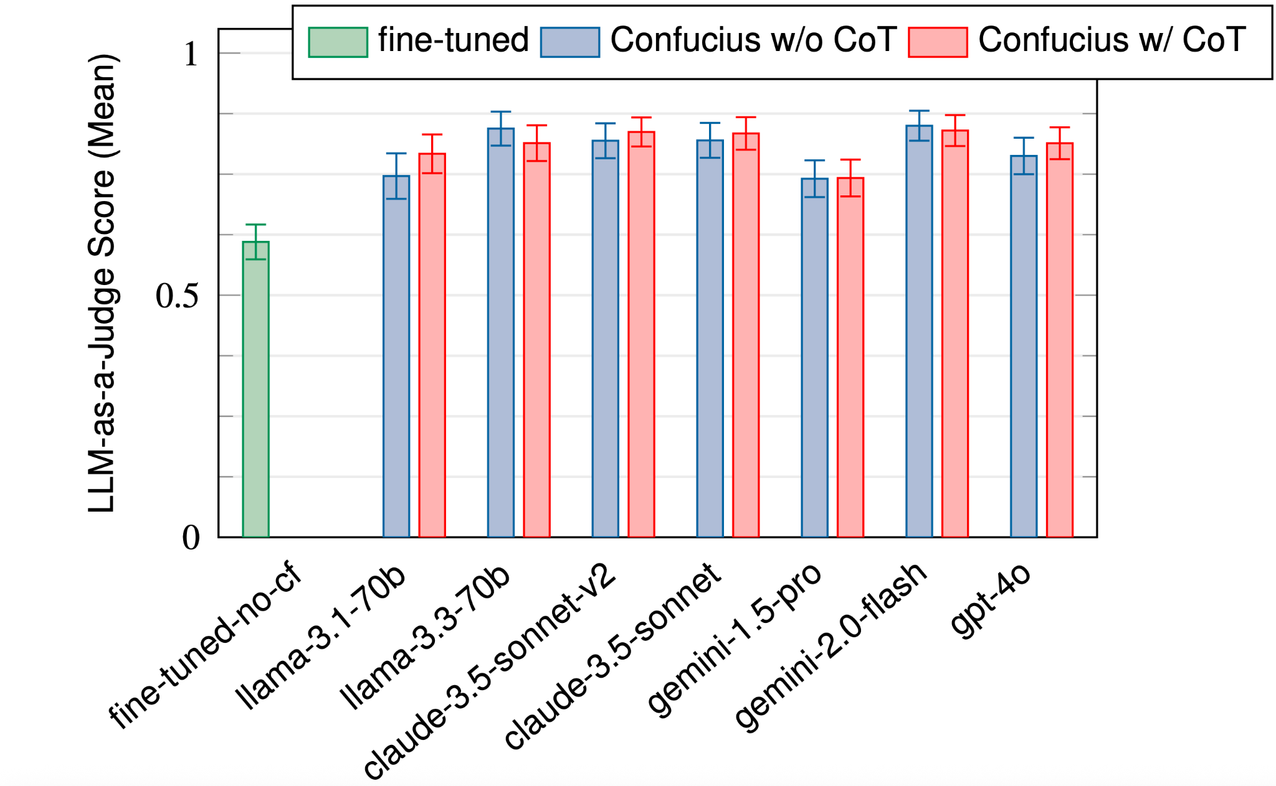
Evaluation: DSL Translation
We compare model fine-tuned on domain-specific knowledge vs. Confucius prompt engineering with foundation models.
We measure accuracy using LLM as a judge.
Confucius outperforms by 35% (TML), 22.4% (ODS transformations), 23% (ODS reductions)
Chain-of-thought (CoT) prompting improves accuracy by up to 9%
TML
ODS Transformation
ODS Reduction

Slide 23
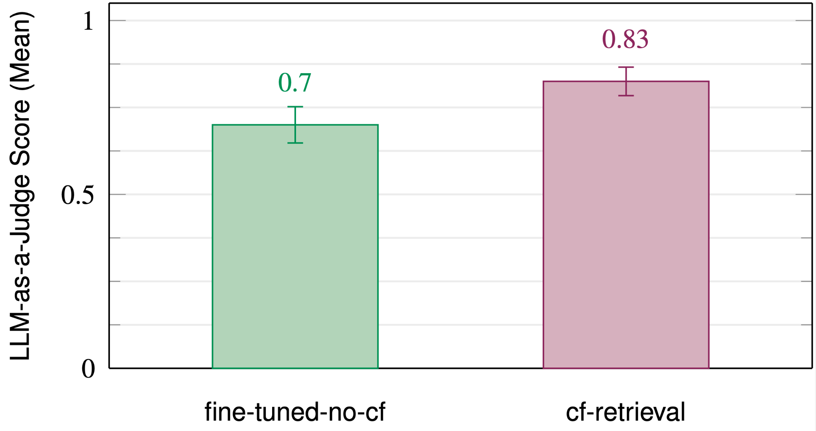
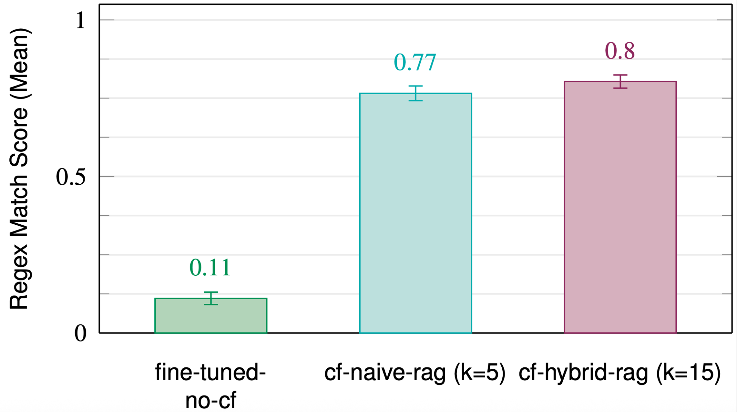
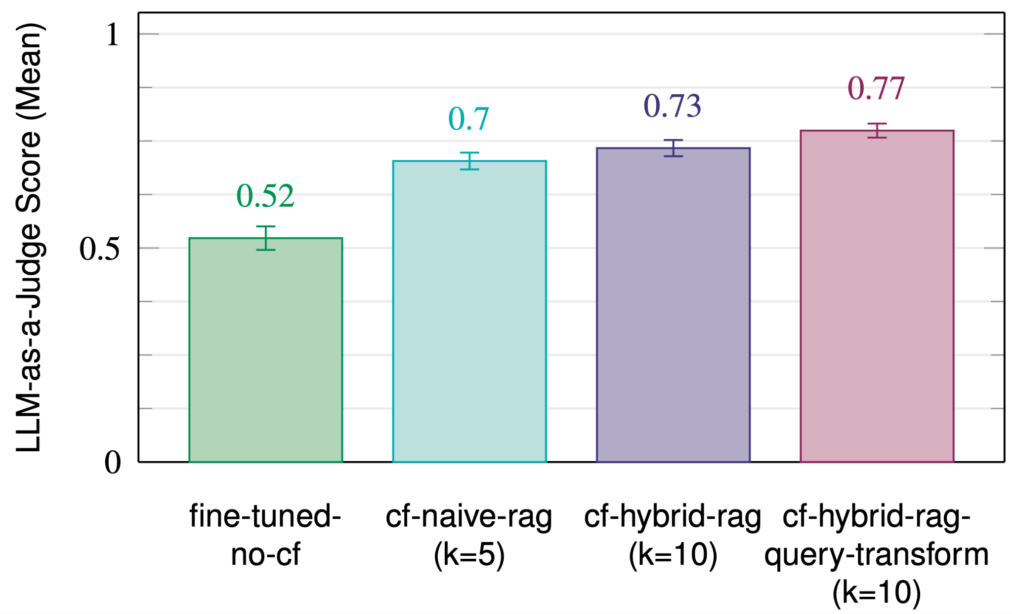
Evaluation: RAG
We compare model fine-tuned on domain-specific knowledge vs. Confucius prompt engineering on Llama 3.1 with RAG.
RAG improves performance across all retrieval use cases.
Hybrid RAG (retrieve >k, then use LLM to filter for best-k) improves performance by 2-3%
Query transformation (rewrite query into keywords) improves performance by 4% on Wiki
Robotron
Netgram
Wiki Q&A

