Slide 1





HACK: Homomorphic Acceleration via Compression of the Key-Value Cache for Disaggregated LLM Inference
Zeyu Zhang, Haiying Shen, Shay Vargaftik, Ran Ben Basat,
Michael Mitzenmacher, Minlan Yu

Slide 2
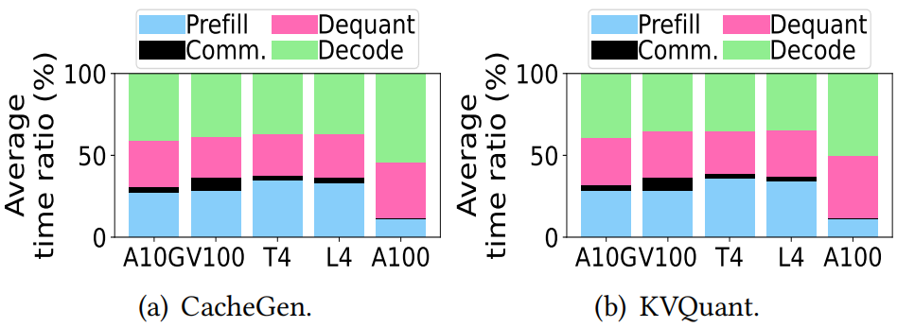
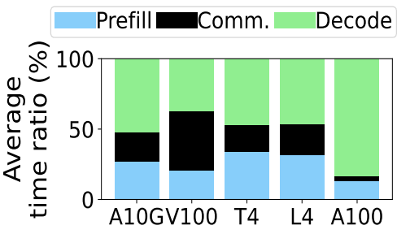
HACK: Homomorphic Acceleration via Compression of the Key-Value Cache for Disaggregated LLM Inference
Motivation
Cost saving by using cheap GPUs for prefill and high-end GPUs for decode.
Overhead: KV transmission, computation, and memory demand.
Existing quantization methods require costly dequantization.
Overhead in disaggregated LLM inference.
Model: Llama-3.1 70B
Dataset: Cocktail for information retrieval
Overhead in existing LLM quantization methods.
Model: Llama-3.1 70B
Dataset: Cocktail for information retrieval

Slide 3
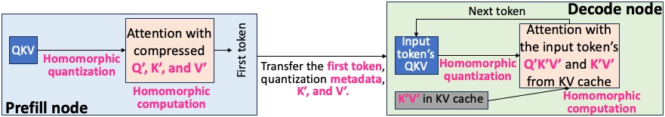
HACK: Homomorphic Acceleration via Compression of the Key-Value Cache for Disaggregated LLM Inference
Key Idea
Enables direct computation on quantized KV without dequantization.
Uses INT2 asymmetric quantization for KV to minimize KV transmission overhead.
Accelerates both prefill and decode using quantized matrix multiplication.
Reduces KV communication, memory demand, and overall JCT.
The architecture of HACK

Slide 4
HACK: Homomorphic Acceleration via Compression of the Key-Value Cache for Disaggregated LLM Inference
Quantization Details & Optimizations
Homomorphic Quantization Core:
Quantize A, B → perform C' = A' × B’
Approximate C from C' using low-cost linear adjustment
Optimization:
Store partial sums to avoid per-iteration recomputation
Hybrid FP16 + INT2: last V block in FP16 avoids costly requantization
Overhead limited to ~2.7% GPU memory

Slide 5
HACK: Homomorphic Acceleration via Compression of the Key-Value Cache for Disaggregated LLM Inference
Key Results
Setup:
vLLM + FlashAttention-2 backend
Models: Llama-3.1 70B, Mistral 7B, Phi-3 14B, Falcon 180B
Datasets: IMDb, Cocktail, arXiv, HumanEval, GSM8K
AWS GPUs: A10G, V100, T4, L4, A100
Results:
Up to 70.9% JCT reduction over disaggregated baseline without quantization.
Up to 52.3% JCT reduction over quantization methods (CacheGen & KVQuant).

