Slide 1
Scheduling Jobs Across Geo-distributed Datacenters
Chien-Chun Hung, Leana Golubchik, Minlan Yu
Department of Computer Science
University of Southern California
Notes:
Good afternoon, everyone.
My name is Chien-Chun Hung.
I am honored to be here and present our work: scheduling jobs across geo-distributed datacenters.
This is a collaboration work with my adviser Professor Leana Golubchik and Professor Minlan Yu.

Slide 2
Geo-distributed Jobs
Large-scale data-parallel jobs
Data too big for full replication
Data spread across geo-distributed datacenters
Conventional approach moves data for computation
Bandwidth cost⬆, completion time⬆, data access restrictions
Emerging trend moves computation for data
Bandwidth usage savings up to 250x [Vulimiri-NSDI’15]
Query completion time 3-19x [Pu-SIGCOMM’15]
Notes:
Nowadays large-scale data-parallel jobs have become the essential workloads for many important applications.
A job is composed of many small tasks; each of them processes a portion of data and can run in parallel
Since data volume have grown significantly, it becomes inefficient to fully replicate all of them
Therefore data are are typically stored and spread across geo-distributed datacenters.
As the data required by the jobs are stored in different sites, there are 2 approaches for jobs to process the data
conventional approach moves data for the computation by aggregating all the required data and do the computation at one site
Such centralized approach has several disadvantages
It incurs significant bandwidth usages because the data to be transferred are huge
Besides, the completion time for each job increases due to the significant delay in data transfer
Finally, there could also be the data sovereignty issues which restricts some data to be accessed only in certain regions.
Recently, an emerging trend is to move computation for the data by distributing the tasks to where their data are stored, and aggregates only the results after the computation is done locally.
Recent works have shown the bandwidth usage saving could be up to 250x as aggregating the results is more efficient than aggregating the input.
Also, the query completion time speeds up by 3 to 19 times mainly due to meeting data locality.
(Since only the results are aggregated, data sovereignty is also met.)
(NSDI’15) 250x bandwidth savings
(CoNext’12) reduce 90th-percentile completion time by a factor of 3
(SIGCOMM’15) 3-19x query speed-up, 15-64% reduction in bandwidth cost

Slide 3
Job Scheduling
Job scheduling is critical for distributed job execution
Global scheduler: compute job order
Datacenter scheduler: schedule tasks, report progress
Global Scheduler
Progress
Progress
Job order
Datacenter Scheduler
Datacenter Scheduler
Notes:
While distributed job executions show significant advantages, how to schedule the jobs becomes the critical problem in terms of the performance.
In the system, usually each datacenter has a local scheduler, and beyond the datacenters there is a global scheduler that coordinates all datacenters.
Global scheduler would compute the job order that will be passed to each datacenter to follow.
The datacenter scheduler would schedule the tasks based on the job order given by the global scheduler, and report the progress to the global scheduler to keep its information up-to-date.

Slide 4
Challenges in Job Scheduling
Shortest Remaining Processing Time (SRPT) for reducing average job completion time
Greedily schedule the smallest job
Sub-optimal due to lack of coordination across datacenters
Scheduling distributed jobs is NP-hard [Garg-FSTTCS’07]
Design 2 job scheduling heuristics for reducing average job completion time
Notes:
Speaking of job scheduling performance, the classical shortest remaining processing time (SRPT) is well known for reducing the average job completion time.
By greedily scheduling the smallest job to run, it achieves optimal scheduling result in single-server-single-queue settings.
However, SRPT does not achieve optimal scheduling result in distributed job execution setting due to the lack of coordination across the datacenters.
This is mainly because finishing part of the tasks quickly at one datacenter does not necessarily guarantee fast completion for the entire job as the job may have bottleneck at other datacenters.
In fact, previous works show scheduling for such distributed job execution setting is NP-hard.
Our goal is not to find the optimal solutions, but instead to develop 2 heuristics for reducing the average job completion time,
While each of them will have different characteristics and limitations.

Slide 5
Motivating Example
Job ID | #tasks in DC1 | #tasks in DC2 | #tasks in DC3 | Total #tasks
A | 1 | 10 | 1 | 12
B | 3 | 8 | 0 | 11
C | 7 | 0 | 6 | 13
A: 10
A: 10
C: 7
A: 1
B: 3
B: 8
C: 6
B: 8
A: 1
C: 7
C: 6
A: 1
B: 3
A: 1
DC 1
DC 2
DC 3
DC 1
DC 2
DC 3
SRPT
B→ A→ C: 12.3
Optimal C→B→A: 11.7
Notes:
Before we present the details of the solutions, let’s first look at a motivating example.
In this simple example, there are 3 jobs in the system A, B and C.
Each of them has different number of tasks across the datacenters.
For example, job A has 1 task at DC1&3, and 10 tasks at DC2, and has 12 tasks in total.
Let’s first look at how SRPT would schedule these jobs.
(going through the example)
Finally the job order computed by SRPT is B,A and C, which gives us 12.3 as average completion time.
However the optimal scheduling is 11.7.
So, this motivating example confirms that SRPT does not achieve optimal scheduling in distributed job execution.
In understanding the performance gap, we first notice that we do not have to complete job A at DC1 and DC3 so quickly since it has bottleneck at DC2.
In fact, we can delay job A at DC1&3 safely without degrading A’s completion time, and yield the resources so that job C could finish earlier.

Slide 6
Reordering-based Approach
Design insights
Job has bottleneck
Tasks can be delayed until the bottleneck
Adjust the job order based on bottleneck
Job A’s bottleneck
A: 10
C: 7
B: 8
C: 6
A: 1
B: 3
A: 1
DC 1
DC 2
DC 3
Notes:
This observation leads us to the first heuristic design, which is the Reordering-based approach.
The insights behind designing Reordering is that each job has its bottleneck across the datacenters,
And part of its tasks can be delayed until hitting the bottleneck without degrading its completion time.
These insights correspond to the observation in the previous example that we can safely delay job A at DC1&3 as it has bottleneck at DC2.
Therefore, the design spirit of Reordering is to adjust job order based on the bottleneck.

Slide 7
Reordering Algorithm
Iteratively select “delay-able” job
Identify the last set job at the most-loaded datacenter.
Delay the tasks won’t hurt its job completion time.
Continue until all jobs are selected.
Light-weight add-on; won’t degrade job’s completion
Conservative improvements
A: 1
A: 1
A: 1
A: 1
A: 1
A: 1
A: 10
A: 10
A: 10
A: 10
C: 7
A: 10
C: 6
C: 7
C: 6
SRPT
B → A → C
Average: 12.3
A: 1
B: 3
C: 7
C: 7
C: 7
B: 8
B: 8
B: 8
Reordering
B → C → A
Average: 12
B: 8
B: 8
A: 1
C: 6
C: 6
A: 1
C: 6
B: 3
B: 3
B: 3
B: 3
Optimal: 11.7
A: 1
DC 1
DC 1
DC 1
DC 2
DC 2
DC 2
DC 3
DC 3
DC 1
DC 2
DC 3
DC 1
DC 2
DC 3
DC 3
Notes:
Now let’s describe how Reordering actually works.
The main idea is, given the scheduling result computed by other solutions,
Reordering iteratively selects the jobs that can be delayed without hurting its completion time.
(present the algo by going through the animated example)
Finally the new order adjusted by Reordering is B, C and A, which gives us 12 as average completion time.
Reordering is a simple, light-weight add-on to any existing scheduling result; and it can be proved that it won’t hurt any job’s completion time.
However, as it only changes the job order if not hurting job completion time, its improvements are conservative, which still leaves room for improvements as Optimal is giving us 11.7 as average completion time.
We think about whether we can further improve the performance with more aggressive approach.

Slide 8
Workload-Aware Greedy Scheduling (SWAG)
Design insights:
Faster job first (SRPT)
Uneven #tasks at each datacenter
Uneven existing queue length at each datacenter
Bottleneck determines completion
Notes:
So, we propose the second heuristic, workload-aware greedy scheduling, abbreviated as SWAG,
which is a standalone scheduling solution that aims at further improving the performance.
Let’s first talk about the insights for designing the better scheduling solution.
From SRPT we learned that the faster the job can complete, the earlier it should get served so that it leads to less waiting time for the remaining jobs.
However, as we mentioned earlier, SRPT cannot address the fact that a job may have uneven size at each datacenter,
Besides, each datacenter may have different existing queue length
Therefore we should include all these 3 insights for designing the scheduling solution.
And actually, it is the bottleneck of the job that determines the completion time, not the job’s total size used by SRPT.

Slide 9
SWAG Algorithm
Greedily select the “fastest” job
Minimum addition to the current queue lengths
Minimum remaining tasks (tie-breaker)
Continue until all jobs are selected
More computationally intensive
More performance improvements
A: 10
SWAG
C → B → A
Average: 11.7
10; A: 12 tasks
10; B: 11 tasks
10
A: 1
8
A: 10
A: 10
B: 3
B: 3
7
A: 1
B: 8
B: 8
A: 1
B: 8
A: 1
C: 7
C: 7
C: 7
C: 7
Optimal
C → B → A
Average: 11.7
C: 6
C: 6
C: 6
C: 6
A: 1
B: 3
A: 1
DC 1
DC 2
DC 3
DC 1
DC 2
DC 1
DC 3
DC 2
DC 1
DC 1
DC 2
DC 3
DC 2
DC 3
DC 3
DC 1
DC 2
DC 3
Notes:
Now let’s talk about how SWAG actually works.
The main idea is that SWAG would greedily select the fastest job at each time.
Initially the system is empty, and we are selecting the first job to run.
(going through the example)
Finally the job order computed by SWAG is C, B and A, and it gives us 11.7 as average completion time.
We can see that SWAG is more computationally intensive than Reordering
Yet it provides more performance improvements.
In this example SWAG matches the optimal result.
Next I am going to show how much performance improvements these 2 heuristics offer.

Slide 10
Simulation Settings
Real job size information (Facebook, Google)
Poisson arrival process; 200 – 500 ms
Sensitivity experiments
System utilization: 40% - 80% (default: 70%)
Task distribution: Zipf distribution (default: 2)
Number of datacenters: 10 - 30 (default: 30)
Fairness across different job sizes
System overhead
Robustness to estimation accuracy
Notes:
We construct the simulation job traces based on real job size information from Facebook and Google.
We synthesize the job trace with Poisson arrival process, the inter-arrival time is between 200-500 ms.
We conduct various kinds of sensitivity experiments to understand the insights of performance improvements.

Slide 11
Performance Improvements Average job completion time normalized by FCFS
More improvements as utilization increases.
At 80%, Reordering improves SRPT by 30%, SWAG improves by 40%.
Improvements are up to 35% from Reordering; 50% from SWAG.
SWAG achieves performance within 5% of Optimal.
Average Completion time
30%
40%
System Utilization
Notes:
(Exponential job trace; Zipf=2)
Performance metric is average job completion time normalized by FCFS, which is the Y-axis in the figure.
X-axis is system utilization (from 40% to 80%)
The first observation is that as the system utilization increases, the performance of all scheduling solutions increase.
This is mainly because when the system is highly loaded, there are more concurrent jobs in the system, which creates more opportunities in manipulating the job order to gain improvements.
In addition, the improvements from SWAG and Reordering compared to SRTP also increase.
In this setting, at 80% utilization, Reordering improves SRPT by 30%, and SWAG improves by 40%.
We have also seen in other settings that the improvements from Reordering could be up to 35%, and improvements from SWAG could be up to 50%.
Finally SWAG is able to achieve the performance within 5% of the optimal.

Slide 12
Other Key Results
Sensitivity to task distribution
Most improvements in skewed settings
E.g., Zipf distribution with parameter 2
Similar performance in extreme scenarios
E.g., uniform (no-skew), single-DC
Fairness across different job classes
All solutions perform similarly for small jobs
SWAG and Reordering outperform for large jobs
Notes:
We conduct sensitivity experiments to task distribution.
The main takeaway is that the most significant improvements happen in skewed settings.
For example, the largest improvements happen with Zipf distribution of 2
The other thing is that all scheduling solutions perform similarly in the extreme scenarios.
We also conduct fairness experiment.
All solutions perform similarly for the small jobs,
While SWAG and Reordering significantly outperform for large jobs.
This is mainly because SWAG and Reordering is able to schedule the large job that can be finished earlier even before some small jobs.

Slide 13
Summary
The challenges of job scheduling
Shortcomings of SRPT-based approaches.
Two heuristics for reducing average job completion time
Reordering: light-weight, add-on, conservative improvements
SWAG: more performance improvements at reasonable cost
Simulation experiments show promising improvements
SWAG (50%), Reordering (35%)
More improvements in heavily-loaded and skewed settings
Notes:
In this presentation we first talk about the challenges of job scheduling for distributed job execution,
And give insights to why SRPT fails.
We propose 2 heuristics for reducing average job completion time.
Reordering is the light-weight add-on to any scheduling solution, which brings conservative improvements as it won’t hurt any job’s completion time.
SWAG is a standalone scheduling solution that provides more performance improvements at reasonable overhead.
Simulation experiments show promising improvements.
Improvements from SWAG could be up to 50%, while improvements from Reordering could be up to 35%.
And sensitivity experiments suggest that most improvements happen in heavily-loaded and skewed settings
With that I conclude my presentation.
Thank you!

Slide 14
Thank You!
Chien-Chun Hung
chienchun.hung@usc.edu
University of Southern California (USC)
Poster Presentation: August 28th, 1:30pm

Slide 15
Appendix

Slide 16
Robustness to Inaccurate Info
Stale info (job order) for local scheduler
Continue to schedule based on previous job order
Stale info (progress) for global scheduler
Compute job order based on stale info
Inaccurate estimation for task duration
Performance gains robust to error

Slide 17
Scheduling Decision Point, Scalability
Local scheduler computes upon available slot
Longest task from the first job
Global scheduler computes upon job arrival/departure
No significant difference from task completion
Less overhead; less than tens of ms

Slide 18
Job/Task Size
Job size is measured by number of tasks
Common approach in existing works
Task duration is estimated based on:
Data processing rate (from history record)
Data size
Performance gains robust to estimation error

Slide 19
SWAG vs. Reordering
Reordering
Light-weight add-on
Won’t degrade any job’s completion time
SWAG
Higher computational complexity
More improvements

Slide 20
SWAG vs. Optimal

Slide 21
Sensitivity to Task Distribution
The most improvements happen at partly-skewed scenarios.
The gains first increases then decreases.
All methods have similar performance in extreme scenarios.
Notes:
(80% system utilization, Exponential job trace)
We study how task distribution affects the performance gains.

Slide 22
Fairness Across Different Job Classes Slowdown: system time divided by service time
All methods have best slowdown for small job class.
SWAG and Reordering have better slowdowns for large job class.
Notes:
We are interested in how the performance improvements vary among different job classes.
Especially, how are some of the jobs sacrificed in order to reduce average job completion time.
We use slowdown as the metric for evaluating such fairness among different job classes.
Slowdown is defined as XXX, and we divide the jobs into small, medium and large classes according to their number of tasks.
All methods have the best slowdown for the small job class as the small jobs generally get served earlier across all methods.
Reordering and SWAG have better slowdown for large job class compared to SRPT.
Reordering can identify the scenarios that yield resources to the large jobs that are originally queued in the end.
SWAG is able to schedule some large jobs that can finish faster than other smaller jobs.

Slide 23
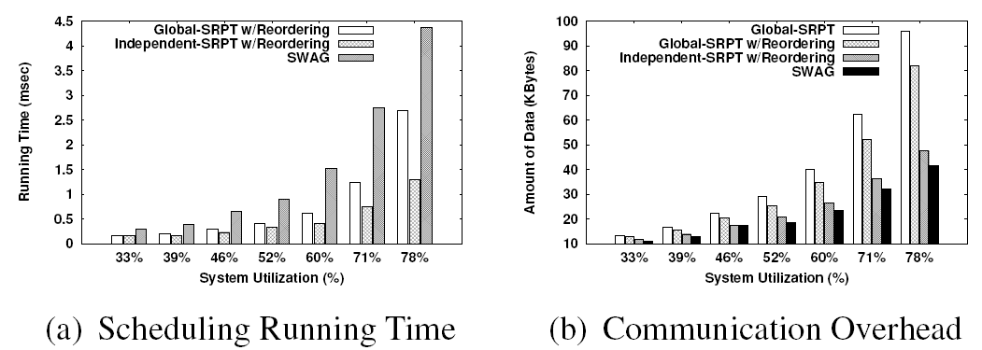
Overhead

Slide 24
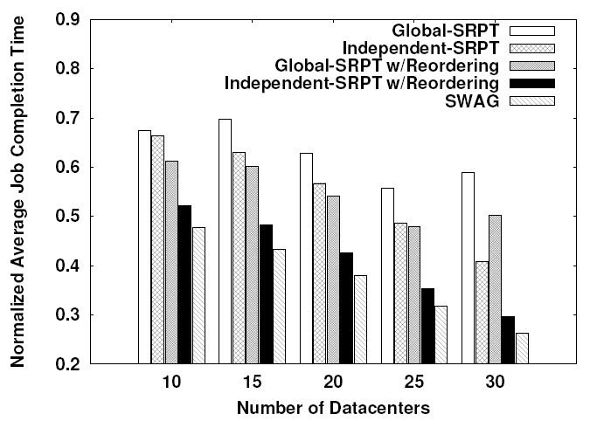
Sensitivity to #Datacenters

Slide 25
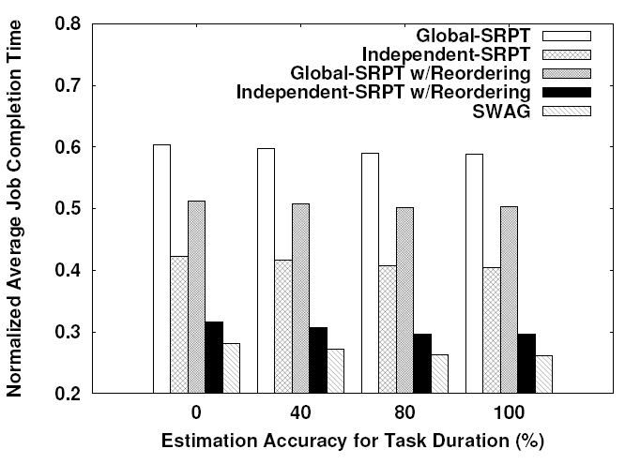
Sensitivity to Estimation Accuracy

Slide 26
System Architecture
Global scheduler
Collect system states from DCs.
Compute job orders.
Local scheduler
Schedule tasks based on job orders.
Report progress to controller.
Scheduling decision upon job arrivals and departures.
Notes:
(Add animation? One component at a time.)

Slide 27
Materials

Slide 28
A: 10
A: 10
C: 7
A: 1
B: 3
B: 8
C: 6
B: 8
A: 1
A: 1
C: 7
C: 6
B: 3
A: 1
DC 1
DC 2
DC 3
DC 1
DC 2
DC 3
A: 10
A: 10
A: 1
A: 1
C: 7
C: 7
B: 8
A: 1
B: 8
A: 1
C: 6
C: 6
B: 3
B: 3
DC 1
DC 2
DC 3
DC 1
DC 2
DC 3

Slide 29
A: 1
A: 10
A: 1
A: 10
C: 7
C: 7
B: 8
C: 6
B: 8
A: 1
C: 6
B: 3
B: 3
A: 1
DC 1
DC 2
DC 3
DC 1
DC 2
DC 3
A: 1
A: 10
A: 1
A: 1
A: 10
A: 1
C: 7
C: 6
C: 7
C: 6
B: 3
B: 8
B: 8
B: 3
DC 1
DC 2
DC 3
DC 1
DC 2
DC 3
Notes:
Reordering

Slide 30
10
8
A: 10
7
B: 8
C: 7
C: 6
A: 1
B: 3
A: 1
DC 1
DC 2
DC 3
DC 1
DC 2
DC 3
DC 1
DC 2
DC 3
10; A: 12 tasks
10; B: 11 tasks
A: 10
B: 3
A: 1
A: 1
B: 8
C: 7
C: 6
C: 7
C: 6
DC 1
DC 2
DC 3
DC 1
DC 2
DC 3
A: 10
A: 1
B: 3
B: 8
A: 1
C: 7
C: 6
DC 1
DC 2
DC 3
Notes:
SWAG

Slide 31
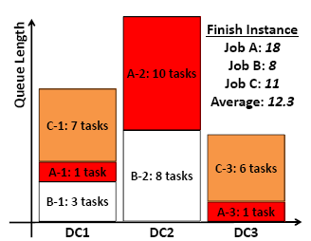
A: 10
A: 1
C: 7
B: 8
A: 1
C: 6
B: 3
DC 1
DC 2
DC 3
A: 10
A: 1
C: 7
B: 8
A: 1
C: 6
B: 3
DC 1
DC 2
DC 3

Slide 32
FCFS
B-2: 8 tasks
B-2: 8 tasks
C-1: 7 tasks
C-1: 7 tasks
A-2: 10 tasks
A-2: 10 tasks
C-3: 6 tasks
C-3: 6 tasks
B-1: 3 tasks
B-1: 3 tasks
A-3: 1 task
A-1: 1 task
A-3: 1 task
A-1: 1 task
DC 1
DC 2
DC 3
DC 1
DC 2
DC 3
FCFS: 13
Optimal
Global-SRPT
A-2: 10 tasks
A-2: 10 tasks
C-1: 7 tasks
A-1: 1 task
B-1: 3 tasks
B-2: 8 tasks
C-3: 6 tasks
B-2: 8 tasks
A-3: 1 task
C-1: 7 tasks
C-3: 6 tasks
A-1: 1 task
B-1: 3 tasks
A-3: 1 task
DC 1
DC 2
DC 3
DC 1
DC 2
DC 3
Notes:
(Materials for FCFS)

