Slide 1





Jaqen: A High-Performance Switch-Native Approach for Detecting and Mitigating Volumetric DDoS Attacks with Programmable Switches
Alan Zaoxing Liu
Joint work with Hun Namkung, Georgios Nikolaidis, Jeongkeun Lee, Changhoon Kim,
Xin Jin, Vladimir Braverman, Minlan Yu, Vyas Sekar
Notes:
Today I’m going to present our system jaqen on how we can build a high-performance ISP DDoS defense with emerging programmable network hardware.

Slide 2




DDoS attacks are getting worse
Increasing in volume
Increasing in diversity
Increasing in cost to defend the attacks
9/15/2020 Infosecurity
9/10/2020 U.S. CISA
9/16/2020 Neustar
9/3/2020 ZDNet
2
Notes:
Distributed denial of service attacks are on the rise now today. Despite of decades of efforts, we are facing increasing attack risks in terms of volumes, diversity and large capital and operation cost to defend them For example, recent news from infoSecurity, US cybersecurity and infrastructure security agency
So DDoS attacks are really getting worse regardless of the efforts of more than two decades.

Slide 3
Requirements for DDoS Defense
Performance:
handle large volumes with low latency
Flexibility:
handle diverse attack vectors
Cost-effectiveness:
handle attacks with low capital and operational costs
Notes:
In general, DDoS defense have the following three requirements. First of all, we expect the defense system can handle large volumes with low latency, especially not interrupting legitimate traffic. Second, the system needs to be flexible in order to handle many changing attacks. Third, DDoS systems need to optimize their capital and operational costs for the best cost-effective defense, especially for o perators and ISPs.

Slide 4




Current DDoS Solutions: Middleboxes
Hardware appliance
Attacker
Out-of-band
Detection
Inflexible, high cost
Slow or inaccurate
Server Clusters
Victims
low performance, high cost
E.g., 100 servers for 1000Gbps mitigation. [Security’15]
Can we do better?
Notes:
Given all these requirements in mind, existing ddos solutions rely on out-of-band detection, e.g., NetFlow or sFlow based sampling solutions and offline packet analysis for a slow or inaccurate detection. Once attacks are detected, we can some hardware appliances to mitigate the attacks, for example firewalls with certain mitigation rules. However, these hardware appliances are usually fixed-functioned and inflexible with a high buying cost. For example, Arbor network 100K for 10G volumetric attacks.
Alternatively, we can deploy server clusters to mitigate the attacks. These software appliances are flexible but with low performance. For example, a recent NFV-based defense system needs at least 100 commodity servers to handle 1000Gbps attacks. So my question, can we really conduct better DDoS defense in terms of performance, flexibility and cost?

Slide 5

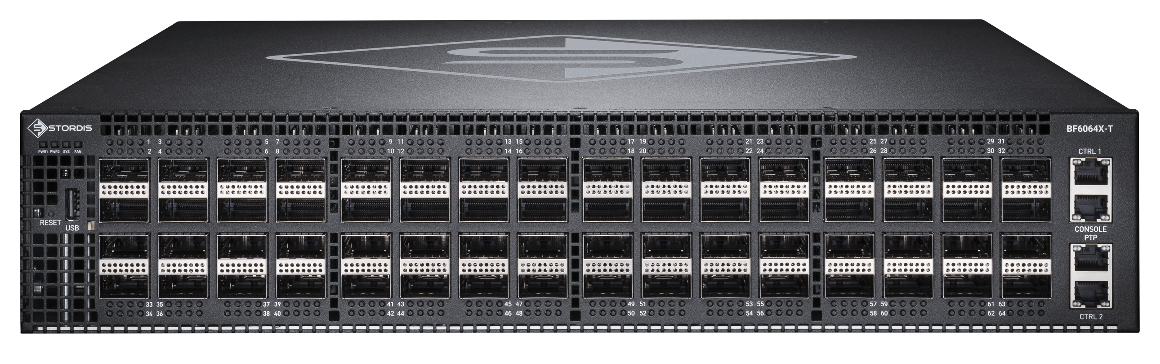
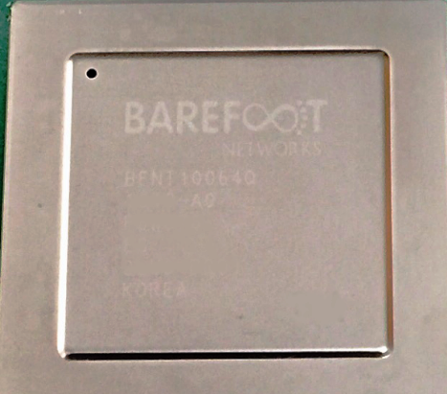
Trend: Network devices are more programmable
Increasing in-network programmability in ISP networks
Programmable Switch
Switch ASICs
High line-rate performance (e.g., Tbps)
High programmability using high-level language (e.g., P4)
Cost effective with similar cost as traditional switches
Notes:
So there are indeed new opportunities here based on the emerging trend. in the networking community/ With the increasing in-network programmability and new devices in the network, large-networks such asISP networks have the new capabilities now and for the foreseen future. For example, programmable switches

Slide 6
Current DDoS Solutions: Switches for Scrabbing
Scrubbing Center with programmable switches [Poseidon, NDSS’20]
Still need out-of-band detection.
Scrubbing approach adds large latency.
Unscalable mitigation functions (e.g., Server-like SYN Proxy )
Notes:
So, there are some recent efforts that tried to explore the potential of programmable switches for DDoS Defense. For example, Poseidon on NDSS’20. They added programmable switches into the scrubbing centers to improve the ddos defense.
However, their approach is not well suited for large-scale defense (ISP-scale) for several reasons.
They still require out-of-band detection which is slow
The scrubbing center requires extensive traffic rerouting that adds large latency.
They ported a few server-based mitigation functions directly to the switches, which have significant security implications. I will show an example in later.

Slide 7
Opportunity: Programmable ISP Networks for DDoS Defense
Internet Service Provider (ISP)
DDoS
Victims
Near the source or victim of the attacks
Provide defense-as-a-service to the clients
Notes:
To fight against the rising DDoS attacks, ISPs become a vantage point as they are usually near the source of the attack or the victim of the attacks for effective defense. And also ISPs have the incentives to provide the DDoS defense as a service to their clients for profit
So today im focusing on ISP-based defense.

Slide 8
Can we design ISP-based DDoS defense that fully leverages programmable switches?
Notes:
So our questions is simple to state:

Slide 9
Jaqen: Switch-Native DDoS Defense for ISP
ISP network as a defender
DDoS
Victims
Detection + Mitigation integrated “switch-native” solution.
Designed for ISP networks where there are a LOT of switches.
Notes:
To answer this question, our vision is a switch-native ddos defense system called Jaqen that turns an ISP network into a defender. No out-of-band detection, no scrubbing centers, no what’s so ever.
Jaqen integrates detection and mitigation completely in the programmable switches and designed for switch-native mitigation efforts towards volumetric attacks.

Slide 10

Jaqen’s Full Stack Design
Controller
DDoS
Victims
1.
Broad-Spectrum Detection
2.
Dynamic Resource Allocation
3.
Fast On-demand Mitigation
Notes:
In jaqen, we have three compoents

Slide 11
Broad-Spectrum and Always-On Detection
+
SYN
…
RST
Attack types
Attack volumes
Unidentified
Packet
Parser
+
…
+
+
DNS
…
NTP
+
Universal Sketches
Attack Signatures
e.g., elephant flows, distinct flows, heavy sources, entropy
A wide-spectrum detection of volumetric attacks.
Compact design with future-proof universal sketches.
Detection metric API: Query (proto, func, mode, freq)
Notes:
In the Detection components, our design leverage universal sketches to estimate a large range of statistics or even unforeseen functions for different flow identities.
In addition to the sketches, we add a few signature counters as a complement
Together, we can estimate various attacks and volumes.
For users, we provide

Slide 12
Fast On-Demand Mitigation
Detection results
Available resources
Quick resource allocation
(Optimization solver)
Mitigation Modules:
M1, M2, M3, …
Cannot afford preloading all possible mitigation modules.
Notes:
Once we have the detection results, along with the network-wide available resources

Slide 13
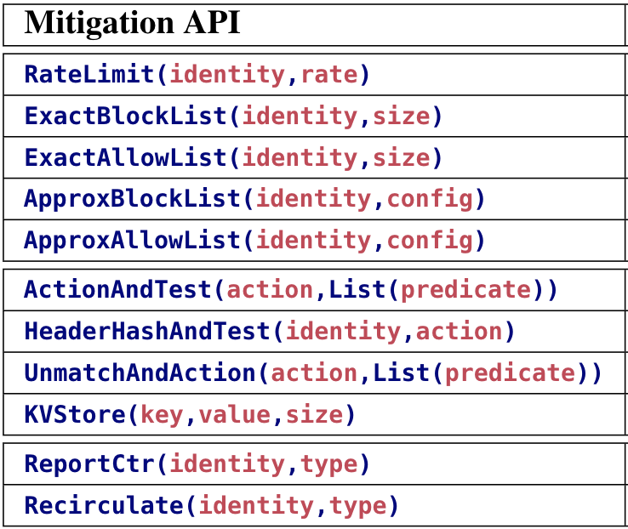
Switch-Optimized Mitigation Library
SYN Cookie/proxy [BSDC’02, RFC4987]
Block-List [WDFIA’07]
Allow-List [WDFIA’07]
ICMP block
DNS filter
…
Sketches
Bloom filters
Counting bloom filters
SYN Proxy with filters
Exact-match table
Rater limiter
…
Best-practice mitigation
Switch-optimized library
Mitigation API
Preserve O(10 Million) legitimate connections
with O(10 MB) on-switch memory.
Support mitigation strategies on 21 attacks.
Notes:
In designing mitigation modules, we explore a set of best-practice mitigation strategies, extract their workflow as a few key components and redesign each component with efficient probabilistic data structures. Finally, we provide API for each component to help construct mitigation strategies for current and possibly future attacks.

Slide 14
Switch-Native SYN Proxy
Client
Switch
Server
Client
SYN Proxy
Server
SYN
SYN Cookie & conn table
SYN
Cookie w/o states
Per-conn state!
Error SYN-ACK
w/ cookie
SYN-ACK
w/ cookie
Verify cookie +allowlist
RST
w/ cookie
Verify cookie
ACK w/ cookie+1
SYN
SYN
SYN-ACK
SYN-ACK
ACK
Seq. # adjustment
ACK
SYN Proxy [NDSS’20]
Jaqen SYN Proxy
Notes:
Implementing mitigation functions in switches require careful redesign.

Slide 15
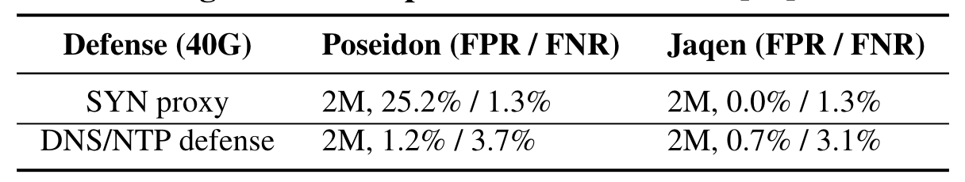
Evaluation – Single Attack
Comparison with Poseidon [NDSS’20].
Single Intel Tofino switch.
40Gbps attack traffic with 2M legitimate TCP connections.
Mitigation with probabilistic data structures is more scalable.

Slide 16
Evaluation – Dynamic Attacks
6 volumetric attacks (SYN, ICMP, UDP, DNS, NTP, Memcached)
380Gbps total volume, 3.2 Tbps Intel Tofino switch
High detection accuracy and high mitigation effectiveness

Slide 17
Conclusions
ISP DDoS defense compromises performance, flexibility and
cost-effectiveness.
Appealing programmable network devices (e.g., programmable switches)
  * High line-rate packet processing
  * Full packet programmability with low cost
      Jaqen: Switch-native DDoS defense for ISP networks
  * Broad-spectrum detection integrated with on-demand mitigation
  * Network-wide resource management
  * Switch-optimized library for best practice mitigation
Contact: Alan Liu
zaoxing@bu.edu
http://zaoxing.github.io/
17
Notes:
On the rise of DDoS attacks today, ISP is a good place to take care of the attacks. However, existing DDoS defense

Slide 18
Mitigation Strategy Example: SYN Flood
Filtering
Analysis
Update
Notes:
For example, using our API, we can construct a sophisticated mitigation strategy for SYN flood.

